Slide 1

URLs and Views
SoftUni Team
Technical Trainers
Software University
https://softuni.bg

Slide 2
Table of Contents
Creating a New Project
URLs in Django
Function-Based Views
Views Returning Errors
2

Slide 3
Have a Question?
sli.do
#python-web

Slide 4

Creating a Project
Review

Slide 5
Creating a Project in PyCharm
Start a new project
Set up a database
Create a new app called departments
Include the app in the project
Create an url.py file in the app
Include the app/url.py module in the project/url.py

Slide 6

URLs in Django
Design with No Framework Limitations

Slide 7
URL Configuration (1)
When an URL is entered by a user, it ensures that a certain result is achieved
softuni.bg/
Loads the starting page
softuni.bg/about
Loads the about page
softuni.bg/curriculum
Loads curriculum page

Slide 8
URL Configuration (2)
How it happens:
Django looks for the urlpatterns variable in the urls.py file
Runs through each URL pattern and stops at the first matching pattern
Calls the given view and passes an instance of the class HttpRequest
my-site.com/department
urlpatterns = [
path('department/', views.show_department),
]

Slide 9
Dynamic Path Segments (1)
To create more pages on a website, you can add additional paths and views
In this case, it is better to use dynamic path segments
urlpatterns = [
path('department/1/', views.show_department_with_id_one),
path('department/2/', views.show_department_with_id_two),
path('department/3/', views.show_department_with_id_three),
path('department/4/', views.show_department_with_id_four),
path('department/5/', views.show_department_with_id_five),
]

Slide 10
Dynamic Path Segments (2)
Set one dynamic URL pattern for all departments
Optionally, can include converter type (otherwise, it is converted to a string)
The value name is passed as an argument to the view
path('department/<department_name>/', views.show_department_by_name)
path('department/<int:department_id>/', views.show_department_by_id)
def show_department_by_id(request, department_id):
...

Slide 11
Default Path Converters
str – matches any non-empty string, excluding "/"
int – matches zero or any positive integer
slug – matches any slug string consisting of ASCII letters, numbers, hyphens, and underscores
path - matches any non-empty string, including "/"
Allows you to match a complete URL path
uuid – matches a formatted UUID

Slide 12
RegEx in URLs
Use re_path() instead of path()
Makes the matching limited
Each captured argument is sent to the view as a string
Using unnamed RegEx groups isn't recommended
When both styles are mixed, any unnamed groups are ignored and only named groups are passed to the view function
re_path(r'^archive/(?P<archive_year>[2005-2021])/$', views.show_archive)

Slide 13
Including URL modules
At any point, you can include urls.py modules
It chops off the part of the matched URL ("department/") and sends the remaining string to the included urls.py file for further processing
from django.urls import include, path
urlpatterns = [
...
path('department/', include('departments.urls')),
]

Slide 14
Including URLpatterns List
Or you can include URLpatterns lists
It removes redundancy from URL conf modules where a single pattern prefix is used repeatedly
urlpatterns = [
path('<page_name>-<page_id>/', include([
path('add/', views.add),
path('edit/', views.edit),
path('delete/', views.delete),
])),
]

Slide 15

Function-Based Views
Returning HttpResponse

Slide 16
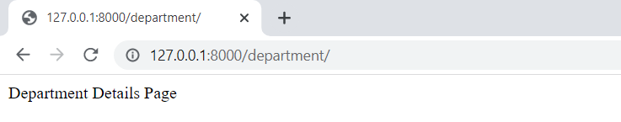
Views in Django (1)
The view holds the concrete logic to achieve the expected result when a certain URL is entered
from django.http import HttpResponse
def show_department(request):
return HttpResponse("Department Details Page")

Slide 17
Views in Django (2)
Each view receives
HttpRequest object as its first argument (typically named request)
*args - matches from no named groups in the URL pattern
**kwargs - matches from named parts in the URL pattern
Each view returns
HttpResponse object

Slide 18
Views in Django – Example (1)
departments/views.py
from django.http import HttpResponse
def show_department_by_id(request, department_id):
if department_id == 1:
department_name = "Developers"
elif department_id == 2:
department_name = "Trainers"
html = "<html><body><h1>" \
"Department Name: %s, Department ID: %s" \
"</h1></body></html>" \
% (department_name, department_id)
return HttpResponse(html)

Slide 19
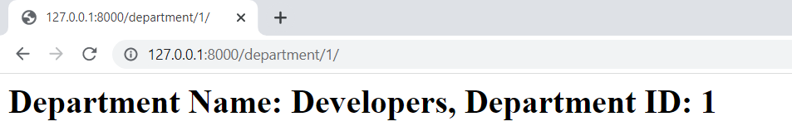
Views in Django – Example (2)
departments/urls.py
from django.urls import path
from . import views
urlpatterns = [
path('department/<int:department_id>/', views.show_department_by_id),
]

Slide 20
Django Shortcut Functions
Django shortcut functions are helper functions
They make developing with Django easier
Connect many different levels of the Model-View-Template paradigm
render()
redirect()
get_object_or_404()
get_list_or_404()

Slide 21
render() Function
Combines a template with a context dictionary
Returns an HttpResponse object with the rendered text
Required arguments
request - generating this response
template_name - a full name of a template to use
render(
request=request,
template_name='departments/department_by_id.html',
)

Slide 22
render() Context
context - optional argument (empty dictionary by default)
A dictionary of values to add to the template context
from django.shortcuts import render
def show_department_by_id(request, department_id):
...
context = {"department_name": "marketing",
"department_id": department_id}
return render(
request=request,
template_name='department/department-details.html',
context=context,
)

Slide 23
Context Example In a Template
The variable names are used by the context key names
department-details.html
<!DOCTYPE html>
<html lang="en">
<head>
<meta charset="UTF-8">
<title>Department Info</title>
</head>
<body>
<p>Department Name: {{ department_name }}</p>
<p>Department ID: {{ department_id }}</p>
</body>
</html>

Slide 24
redirect() Function
Use it to redirect the user to the appropriate URL
By passing a hardcoded URL to redirect to
By passing the name of a view and optionally some positional or keyword arguments
It returns an HTTP status code 302
redirect(some_view_name, *args, **kwargs)
redirect('/some/url/')

Slide 25
Redirecting Example
Directly inject the URL into the function
However, it is not dynamic, and it could lead to some issues
department/views.py
from django.shortcuts import render, redirect
def show_department_by_name(request, department_name):
# find the id of a department by its name
return redirect(
'http://127.0.0.1:8000/department/' + found_department_id
)
def show_department_by_id(request, department_id):...

Slide 26
Dynamic Redirecting Example (1)
First, add a name to the path in the urls.py module
department/urls.py
from django.urls import path
from . import views
urlpatterns = [
path(
'department/<int:department_id>/',
views.show_department_by_id,
name='department-by-id',
),
]

Slide 27
Dynamic Redirecting Example (2)
The redirect() function constructs a URL based on the name of the view and its parameters
department/views.py
from django.shortcuts import redirect
def show_department_by_name(request, department_name):
# find the id of a department by its name
return redirect('department-by-id', found_dep_id)
def show_department_by_id(request, department_id):
...

Slide 28

Views Returning Errors

Slide 29
Returning Errors
Instead of a normal HttpResponse object, a view can return an HTTP status code
Using HttpResponse subclasses
Passing an HTTP status code to the HttpResponse class
Raising Http404 exception

Slide 30
Using HttpResponse Subclasses
There are list of HttpResponse subclasses for several common HTTP status codes that can be returned to signify an error
from django.http import HttpResponse, HttpResponseNotFound
def employees_by_department_id(request, department_id):
if ...:
...
return HttpResponse(html)
else:
return HttpResponseNotFound('Department was not found')

Slide 31
Passing an HTTP Status Code
If there is no subclass for specific status code, you could create a return class for any status code
from django.http import HttpResponse
def show_department_by_id(request, department_id):
if ...:
...
return HttpResponse(html)
else:
return HttpResponse(status=501)

Slide 32
Raising Http404 Exception (1)
Unlike HttpResponseNotFound, it is an exception
It returns an application's standard error page and an HTTP 404 status code
from django.http import Http404
def show_department_by_id(request, department_id):
...
else:
raise Http404

Slide 33
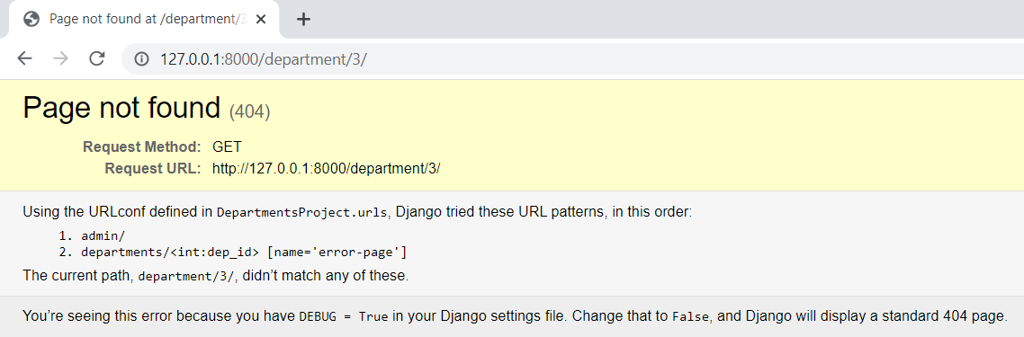
Raising Http404 Exception (2)
When DEBUG is True, the provided message to Http404 will appear in the standard 404 debug template

Slide 34
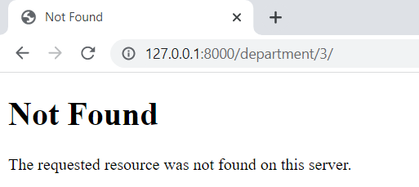
Raising Http404 Exception (3)
When DEBUG is set to False, Django provides a default 404 page for this exception

Slide 35
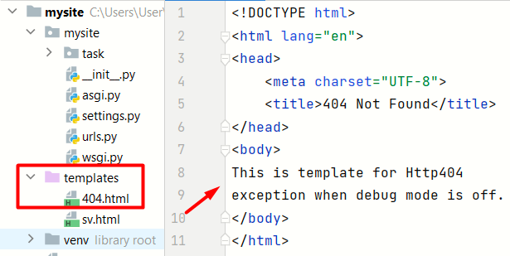
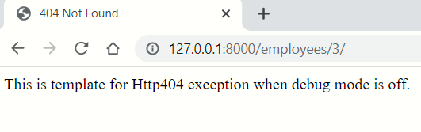
Raising Http404 Exception
To show a customized page, create a 404.html template
This template will be served when DEBUG is set to False

Slide 36

Demo
Live Exercise in Class

Slide 37

Summary
The views.py file contains the logic for when a given URL is reached
The urls.py file uses the views.py file to configure the URL's
It is strongly desirable to avoid hard-coding URL patterns

Slide 38
Questions?
Notes:
38

Slide 39













SoftUni Diamond Partners

Slide 40

Educational Partners

Slide 41
Trainings @ Software University (SoftUni)
Software University – High-Quality Education, Profession and Job for Software Developers
softuni.bg, softuni.org
Software University Foundation
softuni.foundation
Software University @ Facebook
facebook.com/SoftwareUniversity
Software University Forums
forum.softuni.bg
41
Notes:
41

Slide 42

License
This course (slides, examples, demos, exercises, homework, documents, videos, and other assets) is copyrighted content
Unauthorized copy, reproduction, or use is illegal
© SoftUni – https://softuni.org
© Software University – https://softuni.bg
Notes:
42

