Slide 1

Django Templates
SoftUni Team
Technical Trainers
Software University
https://softuni.bg

Slide 2
Table of Contents
Templates and Django Template Language
Custom Filters
Custom Tags
Template Inheritance
Static Files
2

Slide 3
Have a Question?
sli.do
#python-web

Slide 4

Templates and DTL
Generate HTML Dynamically

Slide 5
Django Template
It is a text document (usually a .html file) in which you use the Django template language
Django defines a standard API for loading and rendering templates:
Loading consists of finding the template and preprocessing it
Rendering means interpolating the template with context data and returning the resulting string

Slide 6
Django Template Language
It is Django's own template system
Use to express presentation, not program logic
The syntax involves four constructs
Variables
Filters
Tags
Comments

Slide 7
DTL Variables
Outputs a value from the view context (dict-like object)
Variables are surrounded by {{ and }}
The name of a variable:
Cannot have spaces or punctuation characters
May not have a dot in it
May not be a number
Variable attributes that begin with an underscore may not be accessed

Slide 8
Example: DTL Variables
Displaying an information for an employee
Example context
Employee names: {{ first_name }} {{ last_name }}
Department: {{ department }}
Email Adress: {{ email_address }}
context = {
"first_name": "John",
"last_name": "Smith",
"department": "Marketing",
"email_address": "john.smith@company.com"}

Slide 9
Specific DTL Syntax
Access dictionary values by using the dot notation
Call functions by using them like regular variables
Without the parenthesis
{{ some_dictionary.some_key }}
{{ some_function }}
{{ some_dictionary.items }}

Slide 10
Filters
Modifies variables for display
Use a pipe "|" to apply a filter to a variable
Filters can be "chained"
The output of one filter is applied to the next
Some filters take arguments
Use colon ":" to mark arguments
Django provides about sixty built-in template filters

Slide 11
Commonly Used Filters (1)
Display the first N chars of a string (string ends with "…")
Display the first N words of a string (string ends with "…")
Join list elements
Format a date according to the given format
{{ value|truncatechars:N }}
{{ value|truncatewords:N }}
{{ list|join:", " }}
Click here for more date format strings
{{ my_date|date:"Y-m-d" }}

Slide 12
Commonly Used Filters (2)
If a variable is false or empty, use given default
Otherwise, use the value of the variable
Returns the length of the value (string or list)
Formats a float value to the N^{th} decimal place
{{ value|default:"nothing" }}
{{ value|length }}
{{ value|floatformat:N }}
More built-in filters: https://docs.djangoproject.com/en/4.0/ref/templates/builtins/#built-in-filter-reference

Slide 13
Tags
A template tag is a function which returns a value to be displayed
Provide custom logic in the rendering process
Surrounded by {% and %}
Most tags accept arguments
Some tags require beginning and ending tags

Slide 14
if Tag (1)
Evaluates a variable, and if that variable is "true" (exists, not empty or not false)
Requires beginning and ending tags
{% if employees_list %}
Number of employees: {{ employees_list|length }}
{% elif selected_candidates %}
Number of candidates {{ selected_candidates|length }}
{% else %}
No employees or candidates!
{% endif %}

Slide 15
if Tag (2)
In it could be used "and", "or" or "not"
Use of both "and" and "or" clauses within the same tag is allowed, with "and" having higher precedence than "or"
Use of parentheses in the if-tag is invalid syntax
{% if employees_list and deparments or selected_candidates %}
...
{% endif %}

Slide 16
if Tag (3)
Use operators
"==", "!=", "<", ">", "<=", ">="
"in", "not in", "is", and "is not"
You can use filters in the if-expression
{% if employees_list|length > 10 %}
...
{% endif %}
More about Boolean operators: https://docs.djangoproject.com/en/4.1/ref/templates/builtins/#boolean-operators

Slide 17
for Tag
Sorry, no athletes in this list.
Requires beginning and ending tags
It can take an optional {% empty %} clause whose text is displayed if the given array is empty or could not be found
{% for employee in employees %}
<li>{{ employee.first_name }}</li>
{% empty %}
<li>No employees in this list.</li>
{% endfor %}

Slide 18
url Tag
Sorry, no athletes in this list.
Returns a URL, matching a given view and optional parameters
You can use the URL as variable
{% url 'show-department-by-id' department.id %}
{% url 'some-view' as var_name %}
{% if var_name %}
# use the URL
{% endif %}

Slide 19
csrf_token Tag
Cross-site Request Forgery protection
Used inside the <form> element
Cross-site request forgeries:
Type of malicious exploit
Unauthorized commands are performed on behalf of an authenticated users
More about Cross-site Request Forgery
19

Slide 20
Comments
Comments are surrounded by {# and #}
A multi-line comment can be written using a {% comment %} tag
{# this is a comment #}
{% comment %}
This is a
multi-line
comment
{% endcomment %}

Slide 21

Custom Filters

Slide 22
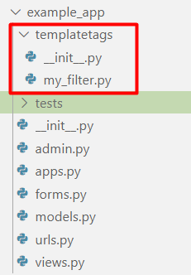
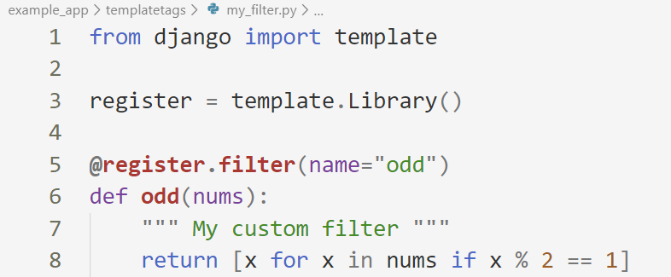
Create templatestags Folder
In your application create a templatetags module with your custom filter file
Write your own filter function

Slide 23
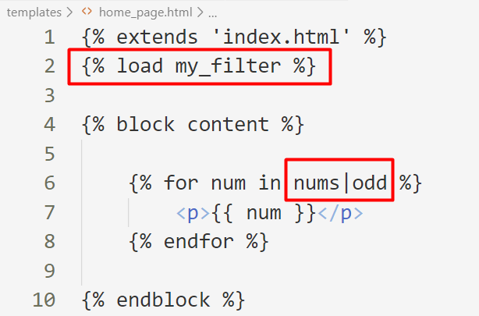
Use Your Custom Filter
Load the filter in your template and use it
Use the name of your file

Slide 24
Custom Tags
{% my_tag %}

Slide 25
Template Tags Helper Functions
Django provides us with helper functions that allow us to create custom template tags
simple_tag
Processes the data and returns a string
inclusion_tag
Processes the data and returns a rendered template

Slide 26
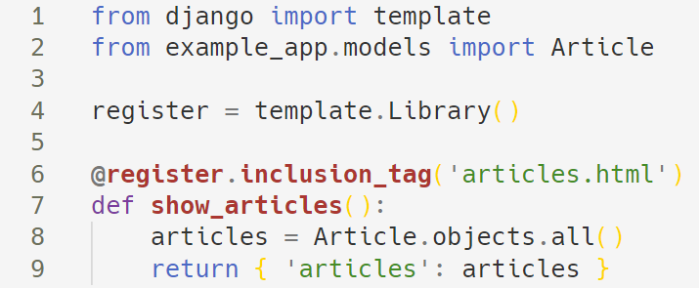
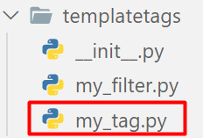
Creating Custom Template Tags
To create a custom template tag, we need again the created templatetags package
Here is an example of an inclusion custom tag

Slide 27
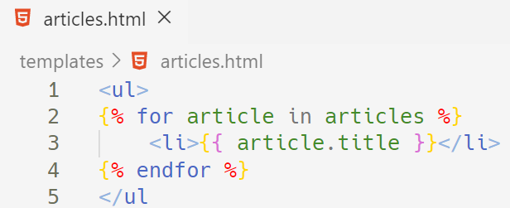
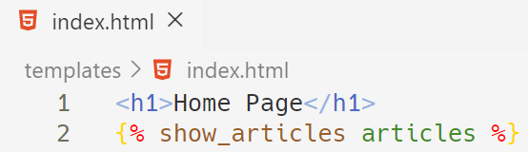
Using the Template Tag
Create the article.html' template and make a loop through the articles
After that, use your tag in your main template

Slide 28

Template Inheritance
block, endblock, extends

Slide 29
Template Inheritance
Template inheritance allows us to build a base skeleton template
The base template contains all the common elements and defines blocks that child templates can override
Typically, the header and the footer remain the same in the whole app
Using template inheritance, we can reuse the common parts of our app

Slide 30
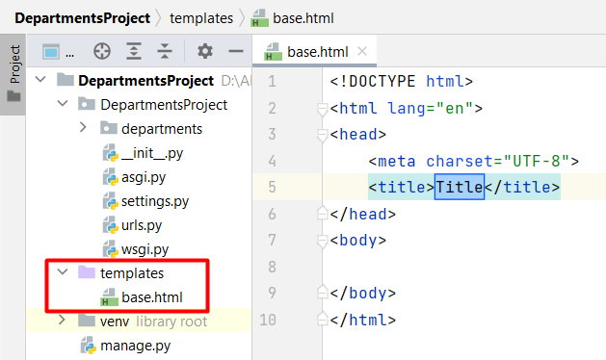
Example: Template Inheritance (1)
Create the base template in the project/template directory
The base template is typically called base.html

Slide 31
Example: Template Inheritance (2)
base.html
<!DOCTYPE html>
<html lang="en">
<head>
<meta charset="UTF-8">
<title>{% block title%}{% endblock %}</title>
</head>
<body>
{% block content%}
# default code if no content is passed in
{% endblock %}
</body>
</html>
You can have many blocks in one template
Each block should have its own unique name

Slide 32
Example: Template Inheritance (3)
index.html
Always use the extends tag in the "child" templates
{% extends "base.html" %}
{% block page_title %}
Home Page
{% endblock %}
{% block content %}
{% for dep in departments.items %}
<h2>{{ dep.title }}</h2>
<p>{{ dep.description }}</p>
{% endfor %}
{% endblock %}
"Home Page" will be injected in the page_title block in the base.html
The code will be injected into the content block in the base.html

Slide 33
Including Template Snippets
It is a way of including templates within another template
The template name can be:
A variable
A quoted string in single or double quotes
{% include template-name %}
{% include template_name %}
{% include "nav-bar.html" %}

Slide 34
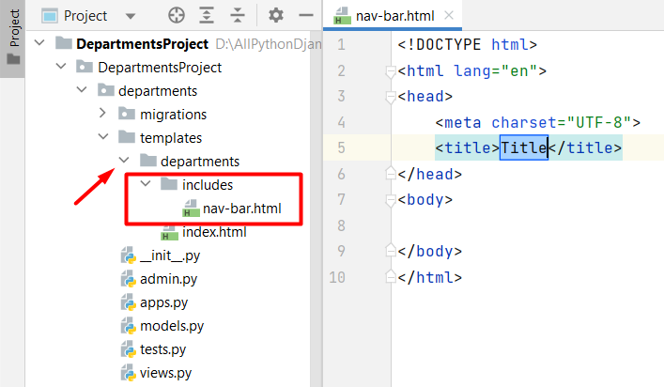
Example: Including Template Snippets (1)
Create a new directory in the app/templates/departments
Create a .html file called nav-bar

Slide 35
Example: Including Template Snippets (2)
Create the navigation bar logic, which can be reused in all templates where it is needed
If the code is used in all templates, it is better to put it in the base template
nav-bar.html
<header>
<nav>
{# some navigation bar logic #}
</nav>
</header>

Slide 36
Example: Including Template Snippets (2)
Include the template in the same HTML file, created above
index.html
{% extends "base.html" %}
{% block page_title %}Home Page{% endblock %}
{% block content %}
{% include "departments/includes/nav-bar.html" %}
{% for dep in departments.items %}
<h2>{{ dep.title }}</h2>
<p>{{ dep.description }}</p>
{% endfor %}
{% endblock %}

Slide 37
Include with Context
The included template nav-bar.html is rendered within the context of the template index.html that includes it
Also, an additional context can be passed to the template using keyword arguments
Or, the context can be rendered only with the variables provided, or even no variables at all
{% include template_name with user='user_name' %}
{% include template_name with user='user_name' only %}

Slide 38
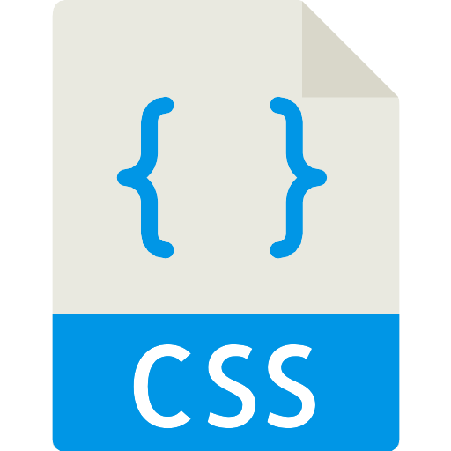
Static Files in Django
Managing Static Files

Slide 39
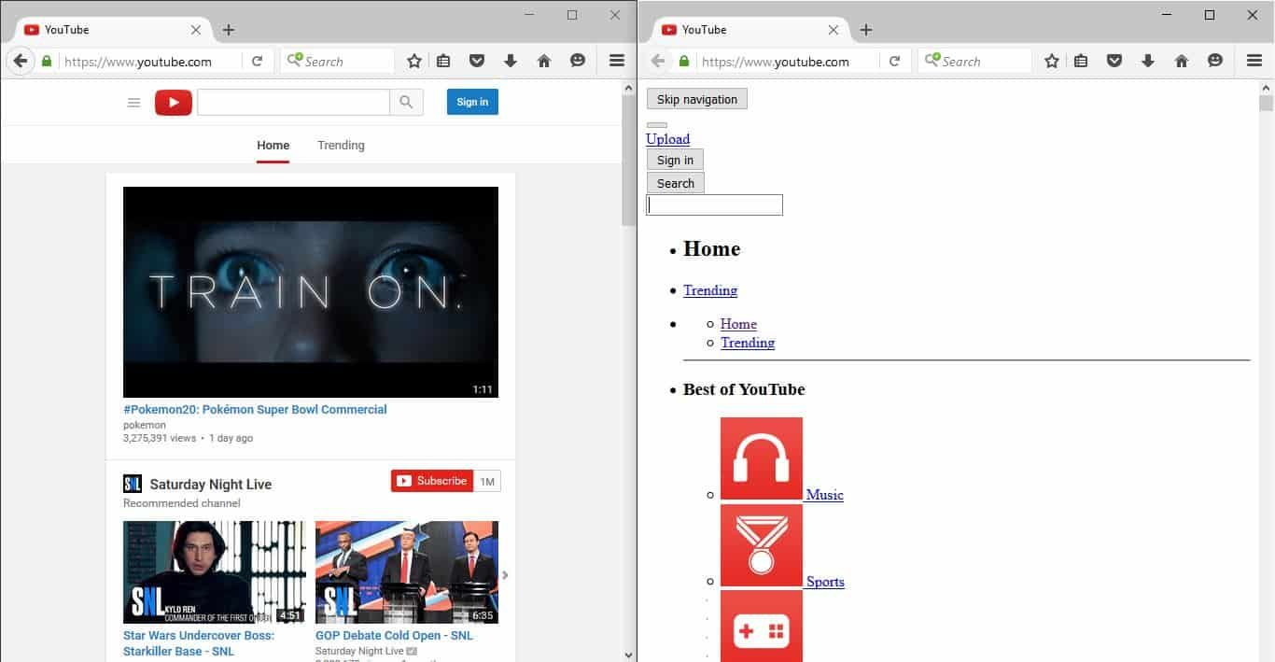
A Word About Static Files
Most of the times, your application would need to serve external files such as JavaScript, CSS, etc.
This type of files are called "static files"
Youtube with and without CSS

Slide 40
Configuring Static Files in Django
First, make sure that your application is in INSTALLED_APPS
Make sure you have STATIC_URL variable
Make sure you have STATICFILES_DIRS variable
STATIC_URL = '/static/'
STATICFILES_DIRS = [
os.path.join(BASE_DIR, 'static'),
]

Slide 41
Using Static Files
To include static files in the template, you will need to load it
To include the CSS file, set the style sheet href attribute
To include an image, set the src attribute
Path to the CSS file
{% load static %}
<link rel="stylesheet" href="{% static './css/style.css' %}"/>
Path to the image
{% load static %}
<img src="{% static './my_image.png' %}" alt="My image">

Slide 42

Bootstrap
CSS Framework
Developing Responsive
Mobile-first websitesa
Booststrap 4 website
42

Slide 43

Demo
Live Exercises in Class

Slide 44

Summary
Templates are used to generate HTML dynamically
Filters allow us to modify variables before displaying them in the browser
Template tags are functions that returns a value to be displayed
Template inheritance allows us to build a base skeleton template

Slide 45
Questions?
Notes:
45

Slide 46













SoftUni Diamond Partners

Slide 47

Educational Partners

Slide 48
Trainings @ Software University (SoftUni)
Software University – High-Quality Education, Profession and Job for Software Developers
softuni.bg, softuni.org
Software University Foundation
softuni.foundation
Software University @ Facebook
facebook.com/SoftwareUniversity
Software University Forums
forum.softuni.bg
48
Notes:
48

Slide 49

License
This course (slides, examples, demos, exercises, homework, documents, videos, and other assets) is copyrighted content
Unauthorized copy, reproduction, or use is illegal
© SoftUni – https://softuni.org
© Software University – https://softuni.bg
Notes:
49

