Slide 1


Models in Django - Part 1
SoftUni Team
Technical Trainers
Software University
https://softuni.bg

Slide 2
Table of Contents
Understanding Models
Models
Fields
Field Types
Models Migration
Model Field Options
Relationships in Django Models
Django Admin Site
2

Slide 3
Have a Question?
sli.do
#python-web

Slide 4

Understanding Models

Slide 5
Models Benefits
Work with database data using Python code
Don't have to write low-level SQL queries
Focus on the data and the business logic
Django automatically creates the needed queries and executes them

Slide 6
Model vs SQL Query
Creating model Employee in the app employees
It will create a database table like the following
class Employee(models.Model):
first_name = models.CharField(max_length=30)
last_name = models.CharField(max_length=40)
CREATE TABLE employees_employee (
"id" BIGINT NOT NULL PRIMARY KEY,
"first_name" VARCHAR(30) NOT NULL,
"last_name" VARCHAR(40) NOT NULL
);
id is added automatically

Slide 7
Fields
The most important and only required part of a model
Field name should not conflict with reserved words
Field name cannot have more than one underscore in a row and cannot end with an underscore
Each field is an instance of an appropriate Field class
class Employee(models.Model):
first_name = models.CharField(max_length=30)
last_name = models.CharField(max_length=40)

Slide 8
Field Types
They determine the column type in a database table (e.g., INTEGER, VARCHAR, TEXT)
Django has dozens of built-in field types
Technically, they are defined in django.db.models.fields
For convenience they're imported into django.db.models
Standard convention
from django.db import models
class Employee(models.Model):
first_name = models.CharField(max_length=30)
last_name = models.CharField(max_length=40)

Slide 9
String Field Types
CharField
Appropriate for small- to large-sized strings
Has one required argument - max_length
TextField
Appropriate for large texts
When specifying max length, it won't be enforced at the model or database level

Slide 10
Numeric Field Types
IntegerField
Stores integers
PositiveIntegerField
Stores integers that could be either positive or zero
FloatField
Stores floating-point numbers
DecimalField
Stores fixed-precision decimal numbers
Two required arguments - max_digits and decimal_place

Slide 11
Date/Time Field Types
DateField - stores a date
TimeField - stores a time
DateTimeField - stores a date and a time
They have two extra field arguments (not required):
auto_now
Sets the field to now every time the object is saved
auto_now_add
Sets the field to now when the object is first created

Slide 12
More Useful Field Types
BooleanField
Stores Booleans - either True or False
URLField
CharField for URLs
max_length is 200 by default
EmailField
CharField that checks if the value is a valid email address
max_length is 254 by default
More Field Types: https://docs.djangoproject.com/en/4.1/ref/models/fields/#field-types

Slide 13
Example: Model
class Employee(models.Model):
first_name = models.CharField(max_length=30)
last_name = models.CharField(max_length=40)
email_address = models.EmailField()
works_full_time = models.BooleanField()
job_level = models.CharField(max_length=20)
photo = models.URLField()
birth_date = models.DateField()

Slide 14

Models Migration

Slide 15
Migrations
Use to add changes made to the models into the database
Django creates migrations for you
Just write the appropriate terminal commands
You can use many database systems with Django
However, PostgreSQL is the most capable of all in terms of schema support

Slide 16
Migration Commands
Creating new migrations
Package up the changes into migration files
Applying the created migrations to the database
Use after the migration files are created
python manage.py makemigrations
python manage.py migrate

Slide 17
Migration Files
Python files, written in a declarative style
It is possible to write them manually if needed
from django.db import migrations, models
class Migration(migrations.Migration):
initial = True
dependencies = []
operations = [migrations.CreateModel(
name='Employee',
fields=[('id', models.BigAutoField(auto_created=True, primary_key=True, serialize=False, verbose_name='ID')),
('first_name', models.CharField(max_length=30)),
...])]

Slide 18
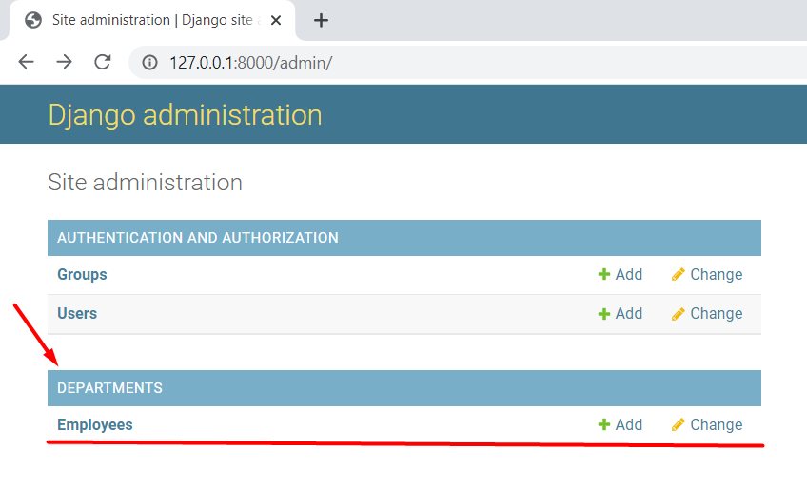
Access the Models
Use the Django Admin site to manage the models

Slide 19
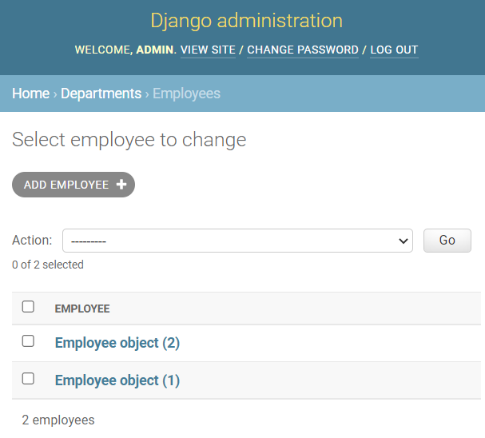
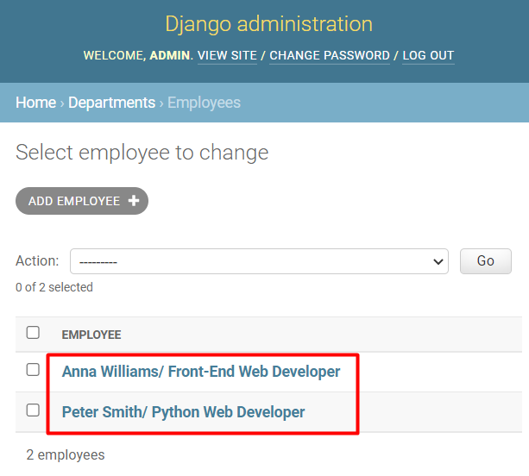
Display the Model Objects
Use __str__() to return a human-readable representation
In the admin site, in the console, or into a template

Slide 20
Reversing Migrations
To reverse concrete migration, pass the app name and the number of the previous migration
To reverse all migrations applied, use the app name and the name zero
Note: If a migration contains any irreversible operations, attempting to reverse it will raise IrreversibleError
python manage.py migrate employees 002
python manage.py migrate employees zero

Slide 21
Model Field Options

Slide 22
Field Options
Common SQL constraints written with python code
Available to all field types
All of them are optional
Note: they are NOT field-specific arguments
class Employee(models.Model):
...
email_address = models.EmailField(unique=True)
field option

Slide 23
Default vs Unique
default
A default value or a default callable object for the field
unique
False by default
If True, this field must be unique through the table
class Employee(models.Model):
...
works_full_time = models.BooleanField(default=True)
job_level = models.CharField(max_length=30, default='Junior')
business_account = models.CharField(max_length=30, unique=True)

Slide 24
Null vs Blank
null - database-related
False by default. If True, empty values will be stored as NULL
Use for non-string fields such as integers, Booleans, and dates
blank - validation-related
False by default. If True, the field is allowed to be blank
class Employee(models.Model):
...
second_email_address = models.EmailField(blank=True)
photo = models.URLField(default='default-picture-url', blank=True)
birth_date = models.DateField(null=True, blank=True)

Slide 25
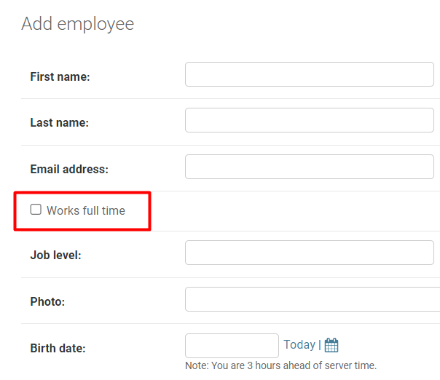
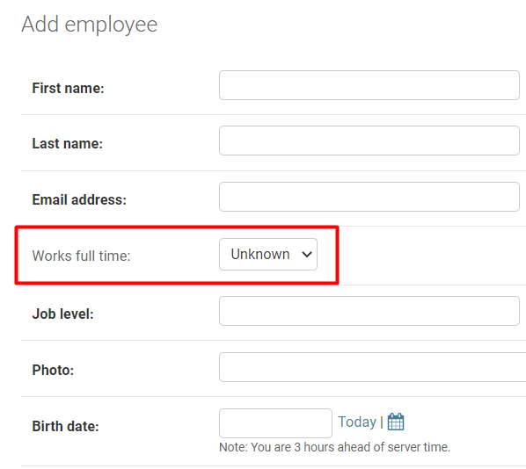
Blank|Null BooleanField
If BooleanField is set to allow empty values, it changes from a checkbox to a select box

Slide 26
Primary Key Option
primary_key
If True, the field becomes the primary key for the model
Used to override the default primary-key behavior
The primary key field is read-only
Note: If you change the value of the primary key on an existing object and then save it, a new object will be created alongside the old one

Slide 27
Choices Option (1)
choices
Use a sequence consisting of iterables of exactly two items to create choices
A new migration is automatically created each time the list of choices changes
MONTHS = [
('Jan', 'January'),
('Feb', 'February'),
('Mar', 'March'),
...
]
value to be set on the model
human-readable name

Slide 28
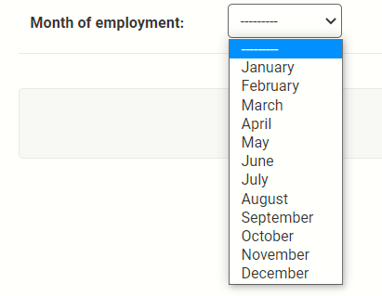
Choices Option (2)
It appears as a select box with the created choices instead of a standard text field
class Employee(models.Model):
...
month_of_employment = \
models.CharField(
max_length=3,
choices=MONTHS)

Slide 29
Verbose Name Option
verbose_name
Most field types take it as an optional first positional argument
If it isn't given, Django automatically creates it using the field's attribute name, converting underscores to spaces
class Employee(models.Model):
first_name = models.CharField(
"First Name", max_length=30)
last_name = models.CharField(
"Family Name", max_length=40)
email_address = models.EmailField(
unique=True)
"First Name"
"Family Name"
"Email address"

Slide 30
Editable Option
editable
True by default
If False, it modifies the field so:
It is not able to be filled/ edited
It disappears from all forms
Used to hide some fields such as encrypted code, verifications, etc.
class Employee(models.Model):
...
email_address = models.EmailField(editable=False)

Slide 31

Relationships in Django Models
Relating Tables to Each Other

Slide 32
Many-to-One Relationship
ForeignKey
Requires two positional arguments
The class to which the model is related
Required on_delete option
class Department(models.Model):...
class Employee(models.Model):
...
department = models.ForeignKey(to=Department,
on_delete=models.CASCADE)

Slide 33
On Delete Option
You can reproduce the behavior of the SQL constraint ON DELETE using Python code
class Employee(models.Model):
...
manager = models.ForeignKey(to=Manager,
on_delete=models.SET_NULL,
null=True)
department = models.ForeignKey(to=Department,
on_delete=models.RESTRICT)
More about on_delete: https://docs.djangoproject.com/en/4.1/ref/models/fields/#django.db.models.ForeignKey.on_delete

Slide 34
Many-to-Many Relationship
ManyToManyField
Requires one positional argument
the class to which the model is related
Doesn't matter which model has the field, but it should be only put in one of the models
class Project(models.Model):...
class Employee(models.Model):
...
department = models.ManyToManyField(Project)

Slide 35
Through Option
When creating many-to-many relationship, Django automatically creates an intermediary join table
To manually specify the table, use the through option
It creates a Django intermediary model that represents it
Note: Most used when associating extra data with a many-to-many relationship

Slide 36
Example: Through Option
class Employee(models.Model):...
class Project(models.Model):
...
project_appointment = models.ManyToManyField(
Employee, through='ProjectAppointment'
)
class ProjectAppointment(models.Model):
employee = models.ForeignKey(Employee, on_delete=models.CASCADE)
project = models.ForeignKey(Project, on_delete=models.CASCADE)
start_date = models.DateField()
role = models.CharField(max_length=30)

Slide 37
One-to-One Relationship
OneToOneField
Requires two positional argument
the class to which the model is related
on_delete option
Note: Most useful on the primary key of an object when that object "extends" another object in some way
class Address(models.Model):...
class BusinessBuilding(models.Model):
address = models.OneToOneField(
Address, on_delete=models.CASCADE, primary_key=True)
...

Slide 38
Lazy Relationship
When resolving circular dependencies between two models
When creating a relation with instances of the same model
class Manager(models.Model):
...
team = models.ManyToManyField('Employee')
class Employee(models.Model):
...
team_colleagues = models.ManyToManyField('self')
team_leader = models.ForeingKey('Manager', ...)

Slide 39

Custom Django Admin Site

Slide 40
Custom Django Admin Site
Use the ModelAdmin class
It represents the model in the admin site
Use its options to customize the admin interface
from django.contrib import admin
from departmentsapp.models import Employee
@admin.register(Employee)
class EmployeeAdmin(admin.ModelAdmin):
pass
Add custom options here

Slide 41
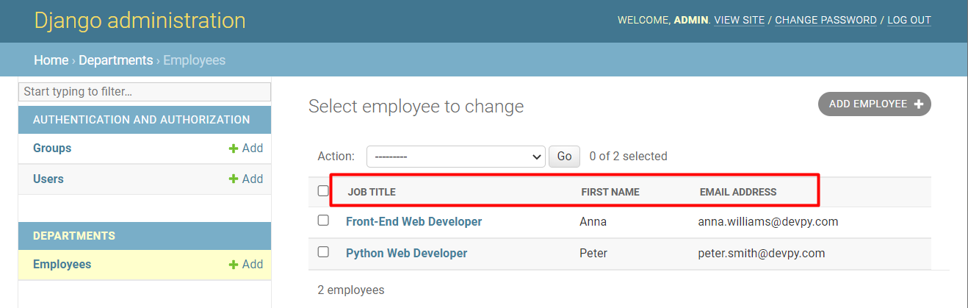
ModelAdmin Options (1)
Display the model fields
class EmployeeAdmin(admin.ModelAdmin):
list_display = ['job_title', 'first_name', 'email_address']

Slide 42
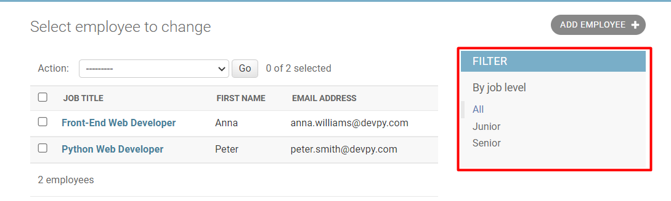
ModelAdmin Options (2)
Add filters to the models
class EmployeeAdmin(admin.ModelAdmin):
list_filter = ['job_level']

Slide 43
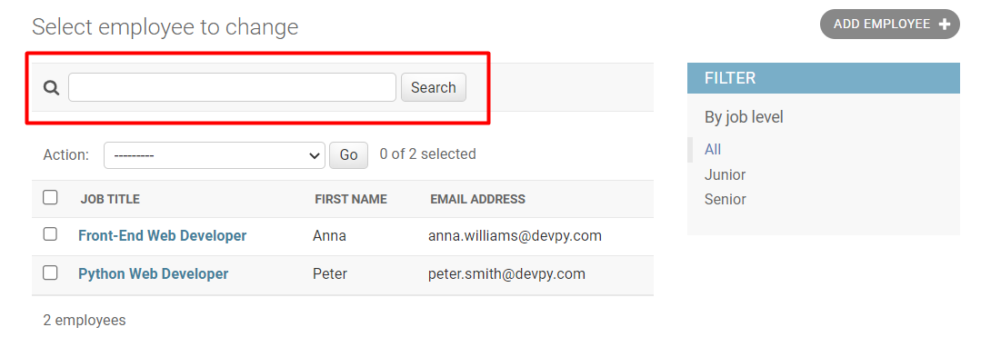
ModelAdmin Options (3)
Add search box with field names that will be searched
class EmployeeAdmin(admin.ModelAdmin):
search_fields = ['email_address']

Slide 44
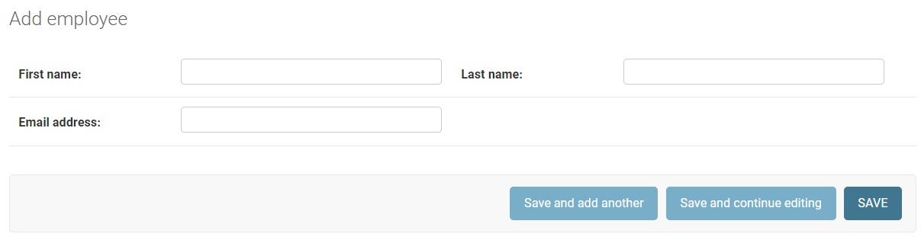
ModelAdmin Options (4)
Make layout changes on "add" and "change" pages
class EmployeeAdmin(admin.ModelAdmin):
fields = [('first_name', 'last_name'), 'email_address']

Slide 45
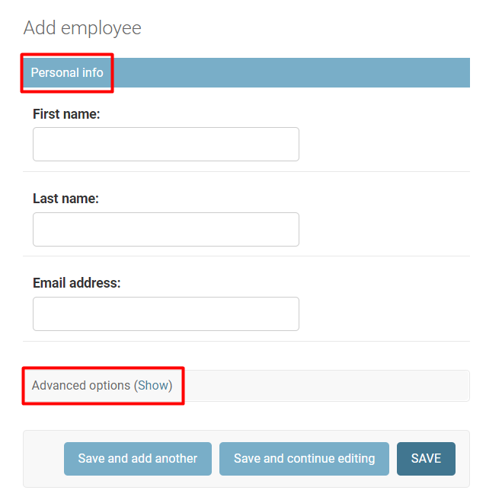
ModelAdmin Options (5)
Control the layout of "add" and "change" pages
fieldsets = (
('Personal info',
{'fields': (...)}),
('Advanced options',
{'classes': ('collapse',),
'fields': (...),}),
)
More ModelAdmin Options: https://docs.djangoproject.com/en/4.1/ref/contrib/admin/#modeladmin-options

Slide 46

Live Demo
Live Exercises in Class

Slide 47

Summary
Models allow us to work with data using Python code
Django automatically generates a database-abstraction API
We could specify DB column constraints using model field options
We can create relations between tables using Django models

Slide 48
Questions?
Notes:
48

Slide 49













SoftUni Diamond Partners

Slide 50

Educational Partners

Slide 51
Trainings @ Software University (SoftUni)
Software University – High-Quality Education, Profession and Job for Software Developers
softuni.bg, softuni.org
Software University Foundation
softuni.foundation
Software University @ Facebook
facebook.com/SoftwareUniversity
Software University Forums
forum.softuni.bg
51
Notes:
51

Slide 52

License
This course (slides, examples, demos, exercises, homework, documents, videos, and other assets) is copyrighted content
Unauthorized copy, reproduction, or use is illegal
© SoftUni – https://softuni.org
© Software University – https://softuni.bg
Notes:
52

