Slide 1
SUPPLIED
Team POLIBUCME:
ALEXANDRA-IRINA BULĂCEANU
BOGDAN GUȘULEAC
IOAN SAVU
ALEXANDRU-IULIAN MUNTEANU
RADU-ȘTEFAN MINEA

Slide 2
TOPIC - Daily life: Resource Management
CONTEXT
In such a peculiar period dominated by chaos, fear and incertitude most of the population was ruled by panic and started acting irrationally. Especially when it comes to consumer behaviour, a noticeable incapacity of proper management of food resources could be easily identified
One of humanity’s greatest fears is to remain without nourishment resources and basic products that are necessary for daily activities
The COVID-19 caused bulk buying, due to fears of shortages. Fortunately, the global food chain has survived [1]
[1] https://www.bbc.com/worklife/article/20200401-covid-19-why-we-wont-run-out-of-food-during-coronavirus

Slide 3
TOPIC - Daily life: Resource Management
PROBLEM
In times of crisis, people rush irrationally to the stores
More than ever, it is crucially to realize that you need to be well-balanced both with the quantities you buy and your finances that might suffer some reduction
However, consumer behavior is almost always characterized by excess or irrational buying, regardless of context., which raises further problems:
Poor budget management
Resource waste

Slide 4
THE CONCEPT
OUR MISSION
SUPPLIED is a fin-tech application specialized in financial forecasts, planning
and budget administration
SOCIAL IMPACT
We make sure that each and every user gets to know how to manage its shopping habits in order to maximize their satisfaction without wasting indispensable resources for others and making savings.
Based on a set of factors and criteria such as frequency, prices, utility we generate ideal shopping lists to meet the user’s needs and budget. We forecast what the client might have to buy in the next period of time (days, weeks, months).

Slide 5
INNOVATION
EXISTING PRODUCTS
Consist of replacement services for traditional banks and minimal financial management
User input usually gets categorized - “food”, “clothes” etc.
Budget reports specify amounts paid, divided by categories
SUPPLIED
Comprehensive financial reports (FINANCIAL PLANNING)
Predictions of what you could buy next (FORECASTS)
Suggestions of what you could take out of your shopping lists as to meet your budget targets (BUDGET MANAGEMENT)

Slide 6
TARGET + REACH
PRODUCT TYPE
B2C
TARGET CUSTOMER:
Tech-savvy, financial-aware
Our comprehensive and easy to understand budget report make the app suitable to all users who wish to improve their buying experience

Slide 7
TECHNICAL ARCHITECTURE
BACKEND
Python: used for the backend code
We used the following helper libraries: numpy, requests, smtplib, BeautifulSoup(bs4), time
MongoDB: used for the database
FRONTEND
HTML, CSS, Javascript, Bootstrap 4
Each navigation page has its own .html file
MIDWARE
The bond between backend and frontend is realized through – Flask

Slide 8
ALREADY DEVELOPED FUNCTIONALITIES
BUDGET FORECAST
Our budget administration is based on the user’s evolution of behavior as a customer
This works by determining a function of type f (t) = the price of the object at time (t)
This function is built on the data taken from the shopping lists, being a polynomial having the degree and the coefficients determined by the previous prices

Slide 9
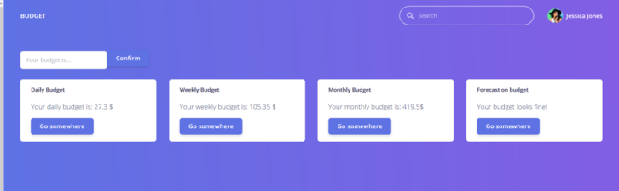
BUDGET FORECAST

Slide 10
ALREADY DEVELOPED FUNCTIONALITIES
RECOMMENDATION ENGINE
If the budget is exceeded then we offer suggestions about the products
that could be removed from the shopping lists
We take into consideration a utility that could be:
Set manually by the user, be set as default for some products or as extremely important for a list of products such as water and medical
articles
We also consider the frequency with which a product is bought and the unitary cost of it
The user has the possibility to choose if that product is deleted or not in the end, so we introduce a “Tinder for Products” concept offering a new dimension to the level of customization that the customer can achieve

Slide 11
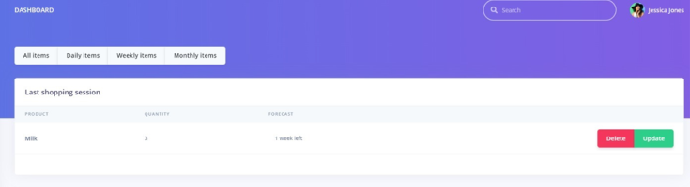
RECOMMENDATION ENGINE

Slide 12
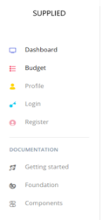
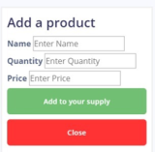
ADDING PRODUCT + MENU BAR

Slide 13
ALREADY DEVELOPED FUNCTIONALITIES
COMMUNICATION WITH DATABASE
We have client database from which we can forecast the products to be
bought
Classification - products by categories
Creating shopping lists for - day, week, month
WEB SCRAPER
Suggesting what is the store with the lowest price for a searched product
Sending automatically a personalized e-mail to the user when we find that
product
We used BeautifulSoup for being able to search everything that we need through Python automation

Slide 14
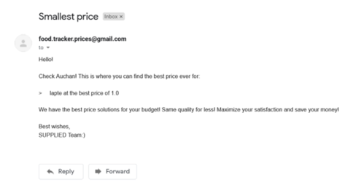
OPTIMAL PRICE RECOMMENDATIONS

Slide 15
FUTURE FUNCTIONALITIES
Receipt reading
Instead of having the user manually introduce his shopping items, we would use Machine Learning algorithms to scan receipts => automatically adding/updating items
Product voice search
Through e-mail will be sent the direct link to that sought product with the smallest price and the stock of it, so that you don’t go to the store for no reason
Smallest price e-mail recommendation
The stores will also be selected by taking into consideration the distance from the user’s home
Payments at shops through the app

Slide 16

PERSONAL PROGRESS DURING HACKATHON
TECHNICAL
Practiced putting Maths to good use in Programming (through the formulas used in determining recommendations, budget forecasts etc.)
Learned or furthered knowledge in the programming languages/technologies used (Bootstrap, Flask, MongoDB)
NON-TECHNICAL
Embraced the challenge of competing in a hackathon from home
Improved effective Communication skills in order too coordinate larger teams
Improved Task & Project Management skills
Innovated amidst the pressure of working against a deadline
Thank you, !

Slide 17
OUR MANTRA
SUPPLIED
Your personal assistant that makes product buying predictions for you
~ WITH SUPPLIED – FINANCE ADMINISTRATION WILL NEVER BE THE SAME ~
~ MAKE YOUR LIFE EASIER AND LEARN TO CHERISH THE RESOURCES THAT YOU HAVE ~

