Slide 1

Socialdata analysis 2020
Vehicle crashes in New York

Slide 2
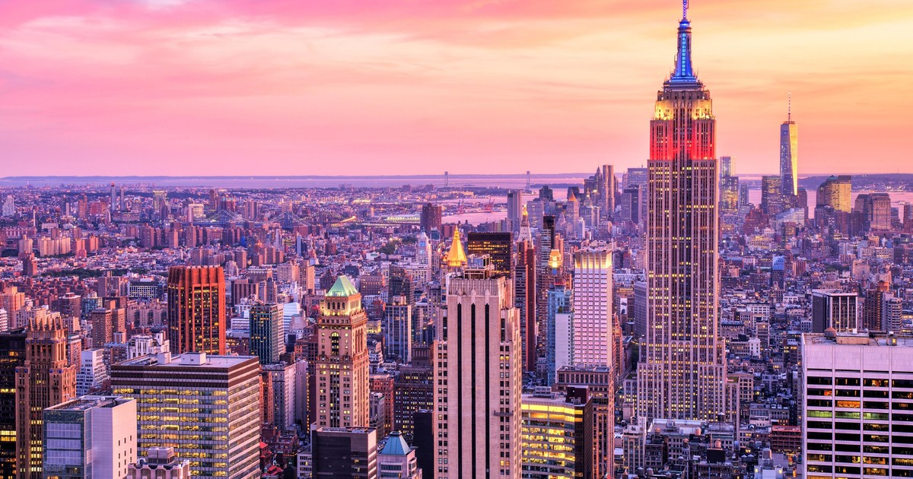
Project overview
Central idea:
Combine 3 motor vehicle crash data sets
Persons, vehicles and the crash itself
Investigate, visualize and predict using ML how car crashes in NYC are affected by a number of variables
Age and gender of the driver
Location in NYC and time of day
Car type, age and model

Slide 3
Visualizations
Distributions of different car types/models and their associated accidents plotted in an interactive Bokeh plot
Spatial distribution of fatal car crashes across NYC plotted in Folium(heatmaps with time)/Bokeh with Google Maps
Are some Boroughs in NYC more inclined to fatal crashes (dense trafic in downtown, more reckless driving in suburbs, etc.)
Machine learning classifier to predict number of fatalities, gender of the driver etc. Or classify between pedestrians or cyclists.
Displayed in a gif across the hours of the day?

Slide 4
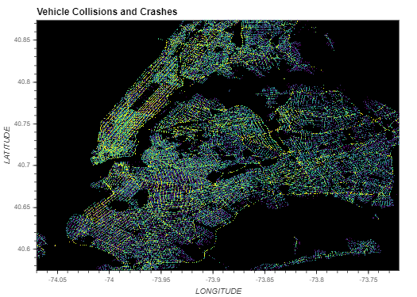

Slide 5
Genre of the visualizations
Magazine style
Text and plots of the interesting data viz.
Great for guiding the reader through such a large data set, and telling the story we want to tell.

Slide 6
Implementation plan
Preliminary data analysis
Cleaning the data
Select the interesting variables for analysis
Creating the data visualizations and ML models
Combine the analysis and visualization with a webpage
The webpage planned for now, is a Jupyter Notebook displayed in nbviewer.

Slide 7
Preliminary data-analysis
Size of data sets:
Crashes:
361 MB, 1.67M rows, 29 columns
Vehicles:
551 MB, 3.35M rows, 25 columns
Persons:
624MB, 3.91M Rows, 21 columns
Large amount of NaNs
Remove unnecessary features.
Enrich by API.
https://data.cityofnewyork.us/Public-Safety/Motor-Vehicle-Collisions-Crashes/h9gi-nx95?fbclid=IwAR12fO_6_G4RuJacBXncVcQhNdLenksmEr_IrHcSGPD94PZU6w5anQjO5jo
https://data.cityofnewyork.us/Public-Safety/Motor-Vehicle-Collisions-Vehicles/bm4k-52h4?f
bclid=IwAR1MOwivYAiW2RaG1_IUxfG64CKrxXBKJMBZNGawWfYBGKSHx0PMGXRajWI
https://data.cityofnewyork.us/Public-Safety/Motor-Vehicle-Collisions-Person/f55k-p6yu?fbclid=IwAR3qHC60qvaCDcOJY6kb84otDnps9o4yvMMDP-17DrbPcSB3C2dQzdt9LMY

Slide 8
Data distribution
Mean, variance, outliers of the given data (plot histograms of interesting continuous variables)

