Slide 1
Human–Algorithm Collaboration in Exoplanet Detection:
A Planet Hunters TESS Citizen Science Project
Mathew Zhou
(2500011162 周子涵)

Slide 2
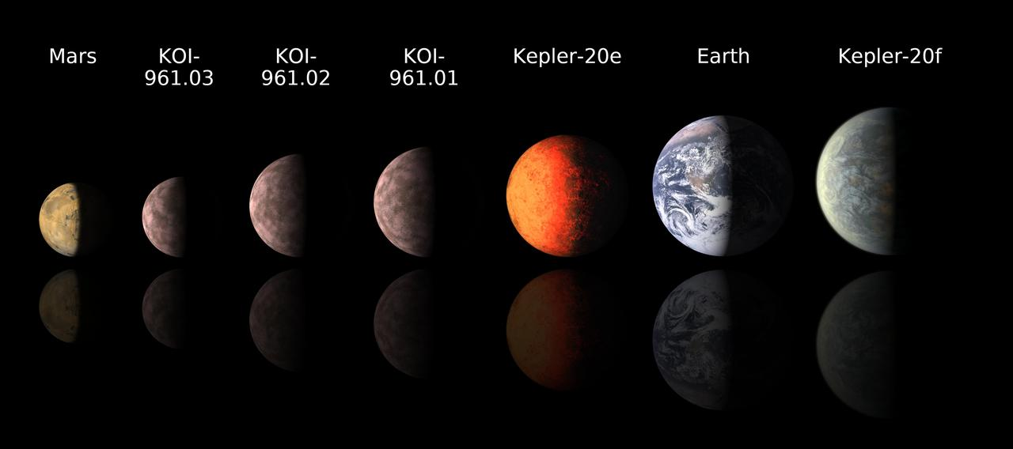
Human–Algorithm Collaboration in Exoplanet Detection:
A Planet Hunters TESS Citizen Science Project
Mathew Zhou

Slide 3
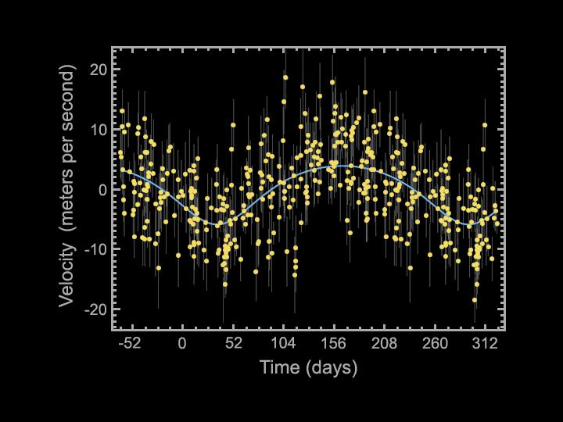
Mathew Zhou

Slide 4
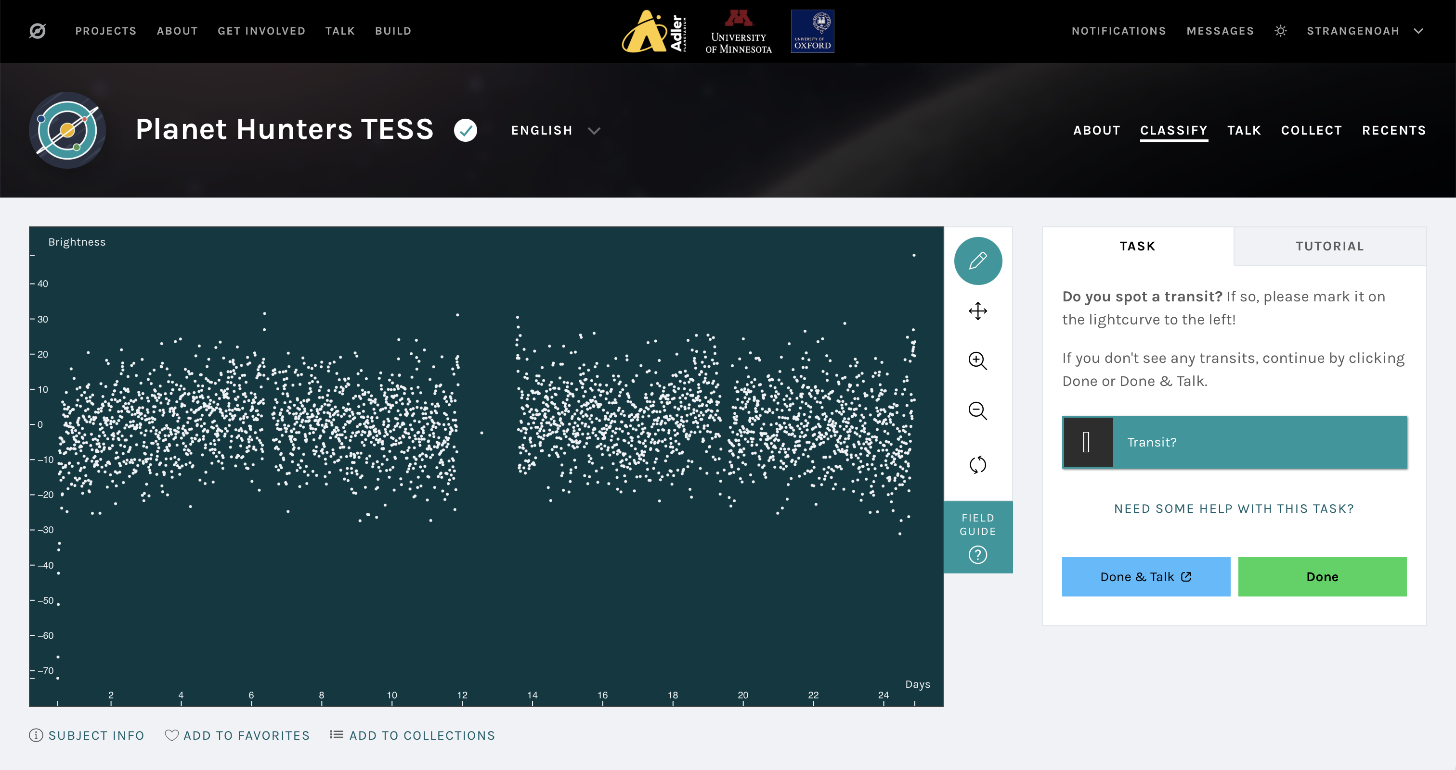
Human–Algorithm Collaboration in Exoplanet Detection:
A Planet Hunters TESS Citizen Science Project
Mathew Zhou

Slide 5
Sigma clipping
Detrending
BLS period search
Phase folding
Transit visulization

Slide 6
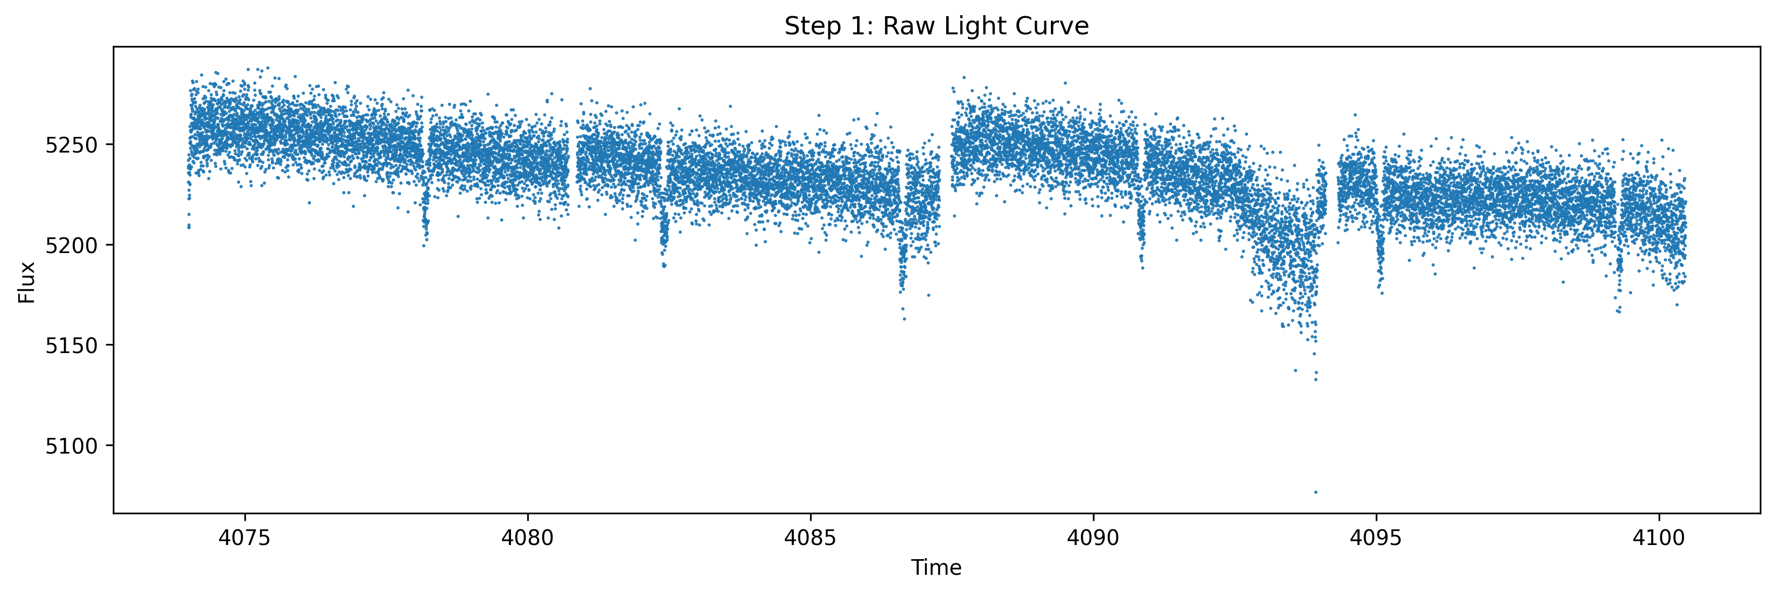
sigma clipping
detrending
BLS period search
Phase folding
transit visulization

Slide 7
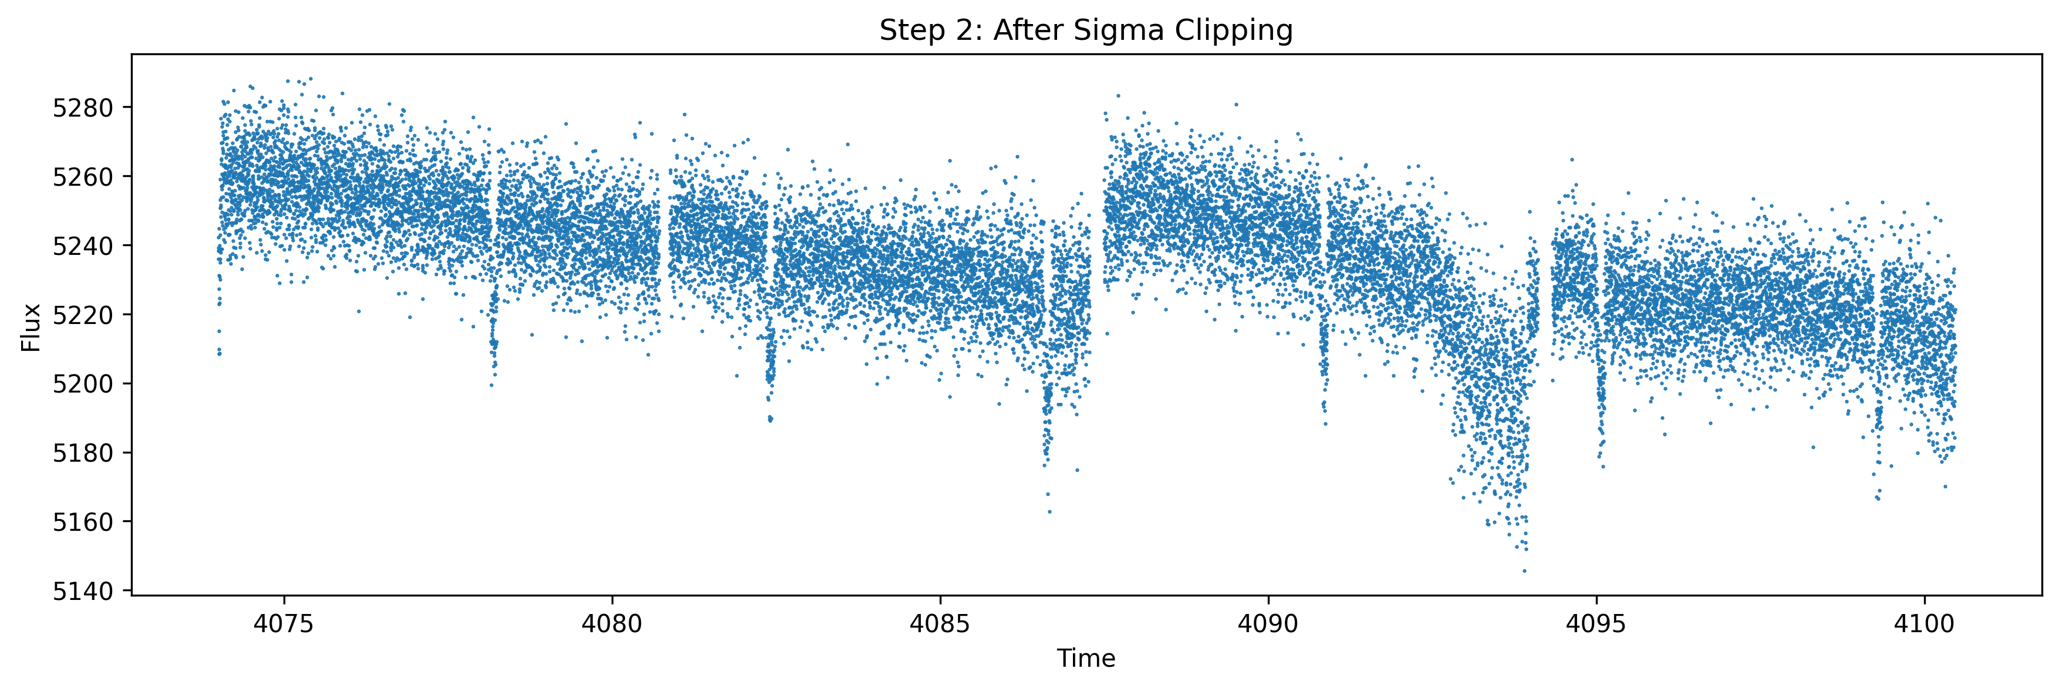
sigma clipping
detrending
BLS period search
Phase folding
transit visulization

Slide 8
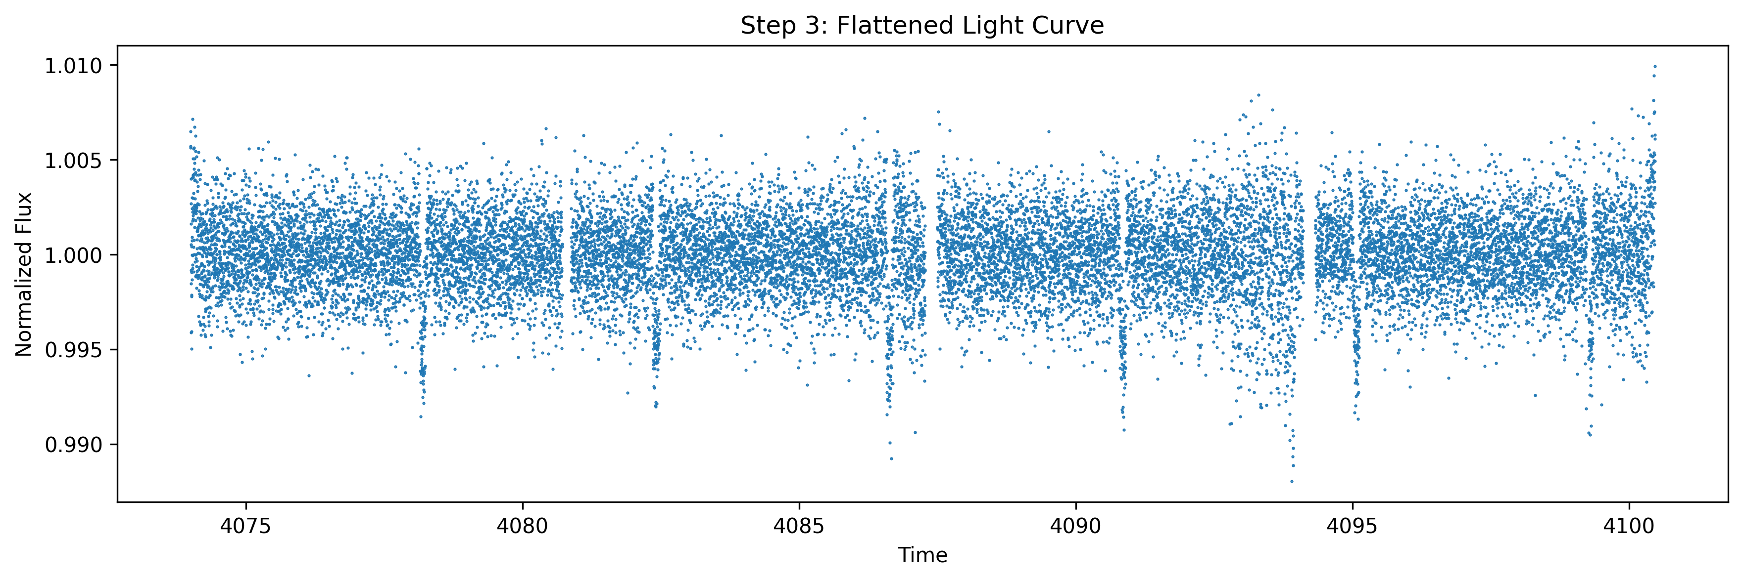
sigma clipping
detrending
BLS period search
Phase folding
transit visulization

Slide 9
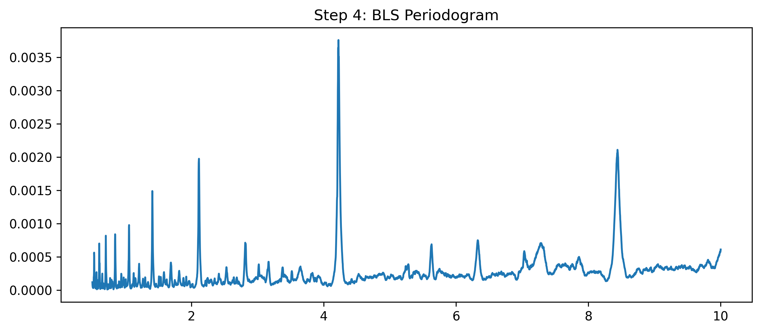
sigma clipping
detrending
BLS period search
Phase folding
transit visulization

Slide 10
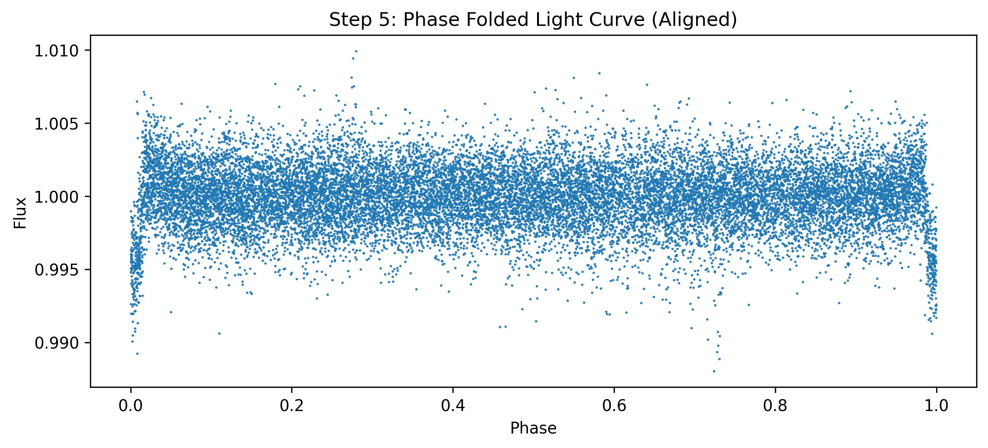
sigma clipping
detrending
BLS period search
Phase folding
transit visulization

Slide 11
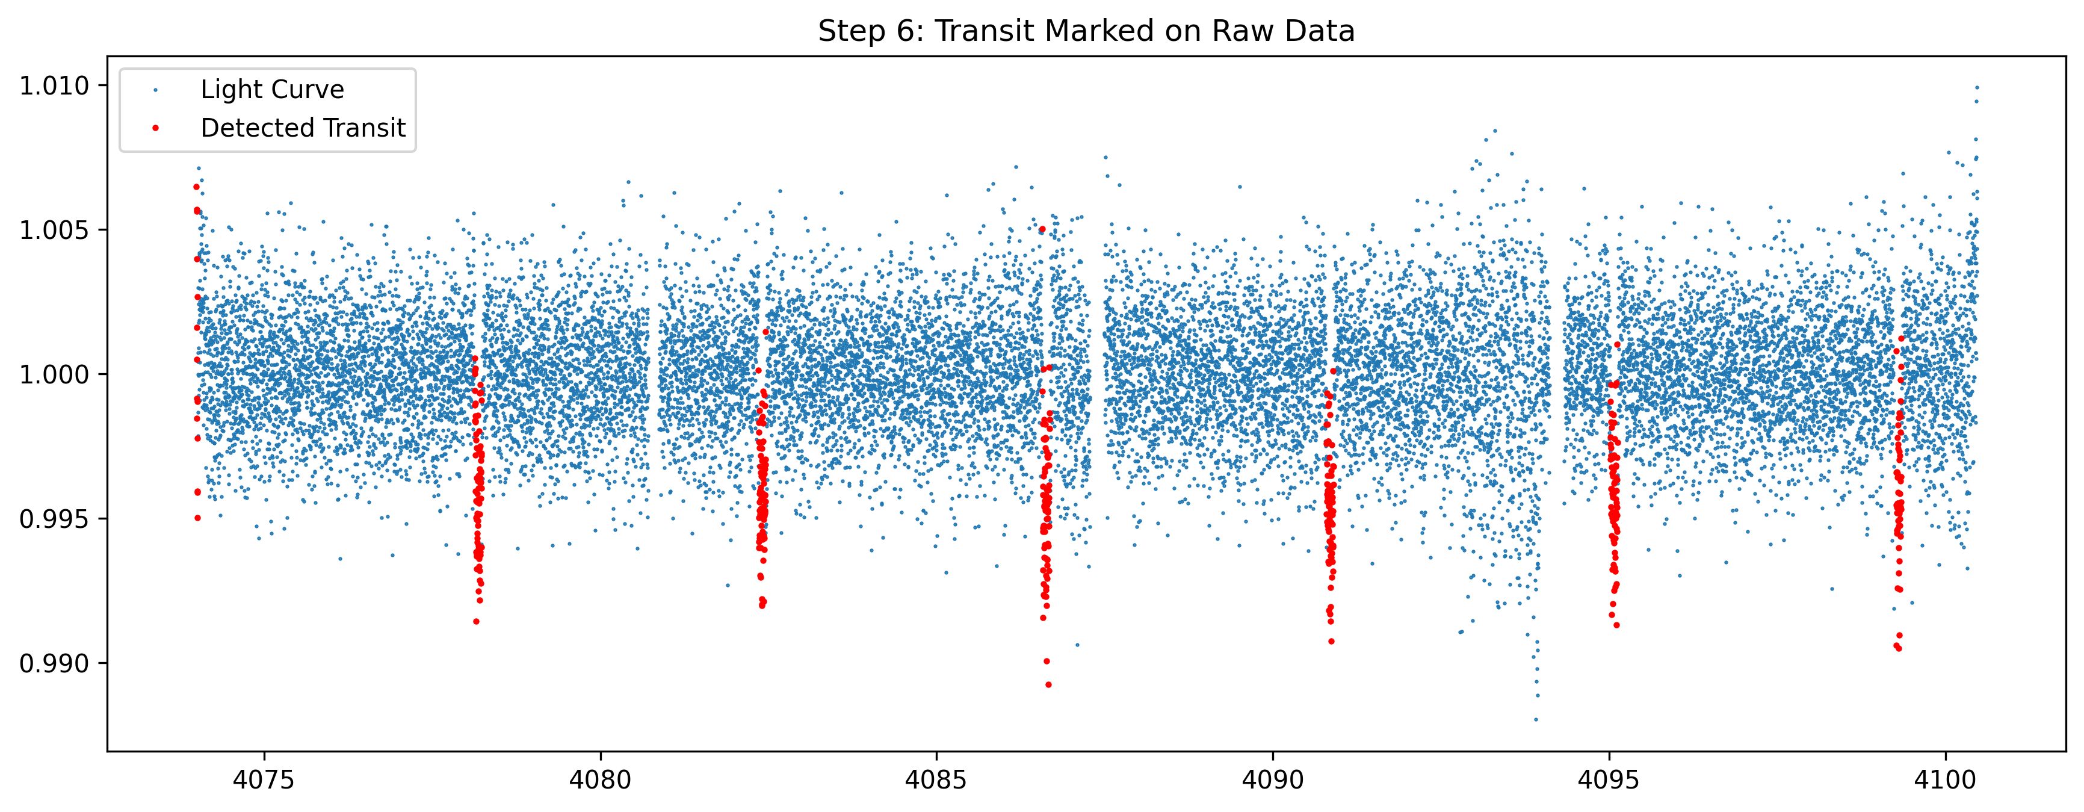
sigma clipping
detrending
BLS period search
Phase folding
transit visulization

Slide 12
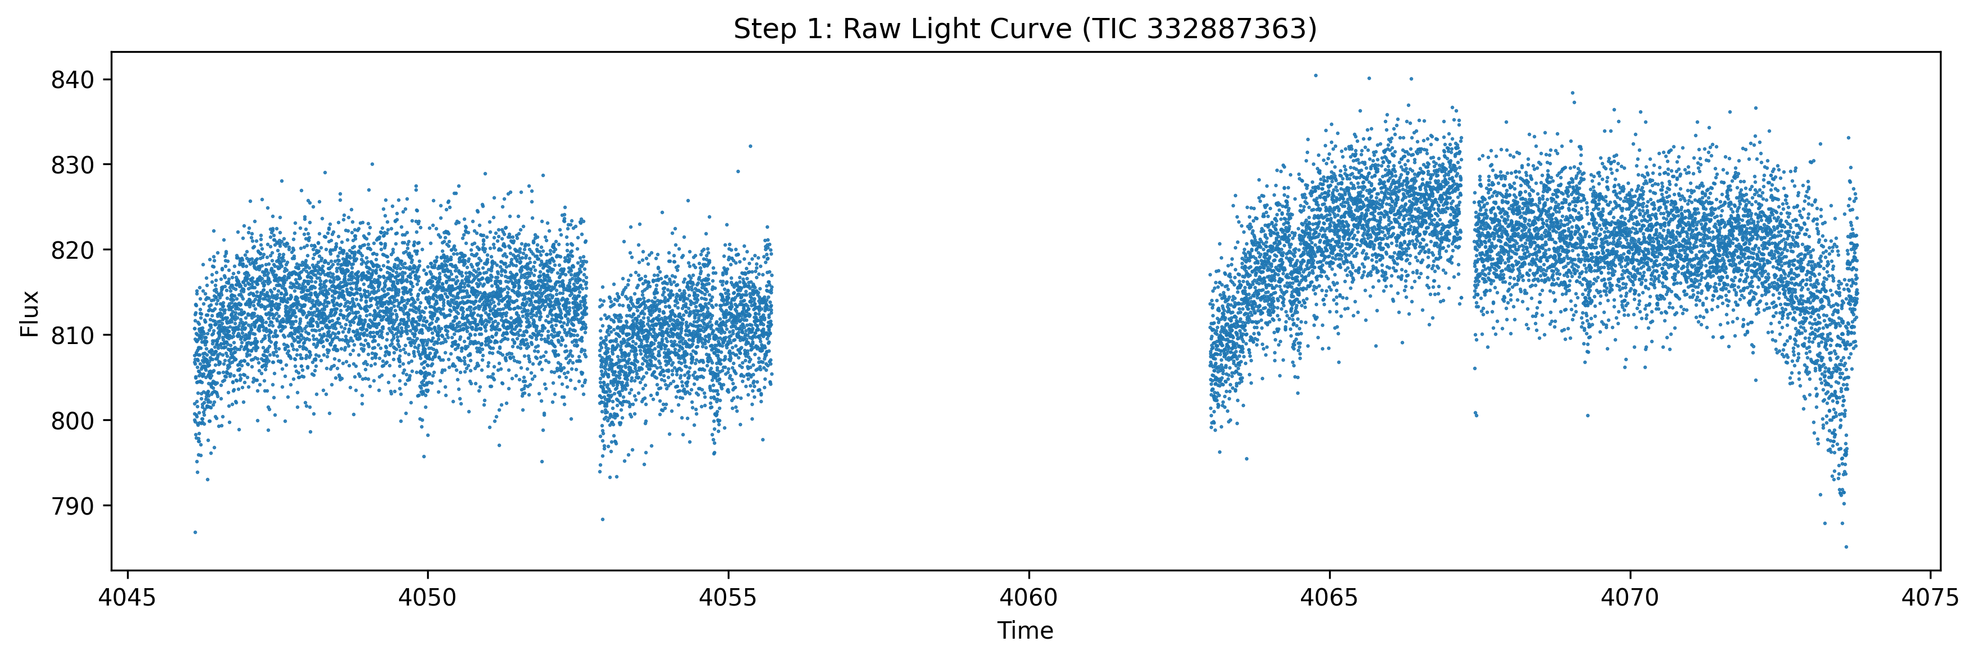
sigma clipping
detrending
BLS period search
Phase folding
transit visulization

Slide 13
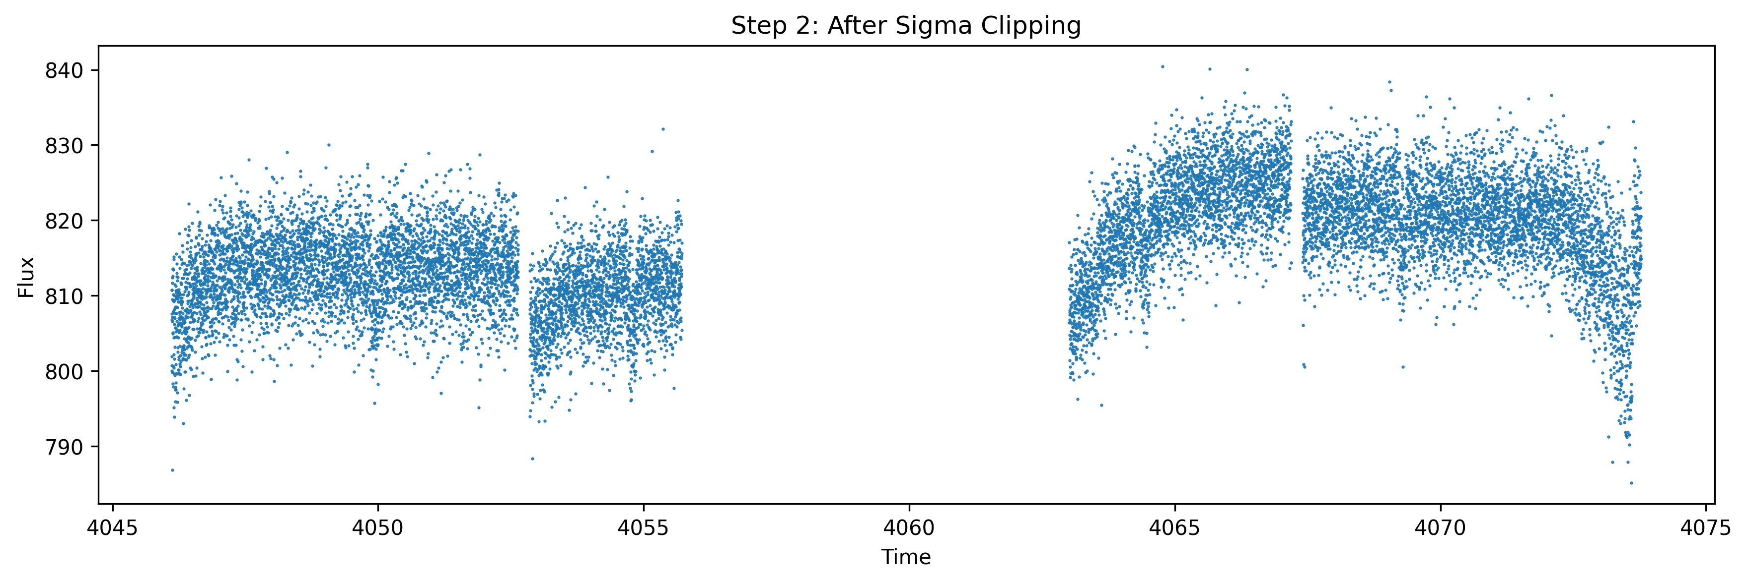
sigma clipping
detrending
BLS period search
Phase folding
transit visulization

Slide 14
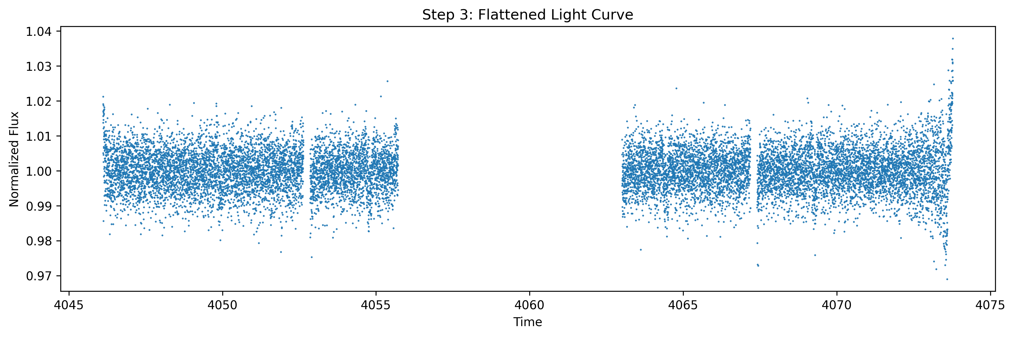
sigma clipping
detrending
BLS period search
Phase folding
transit visulization

Slide 15
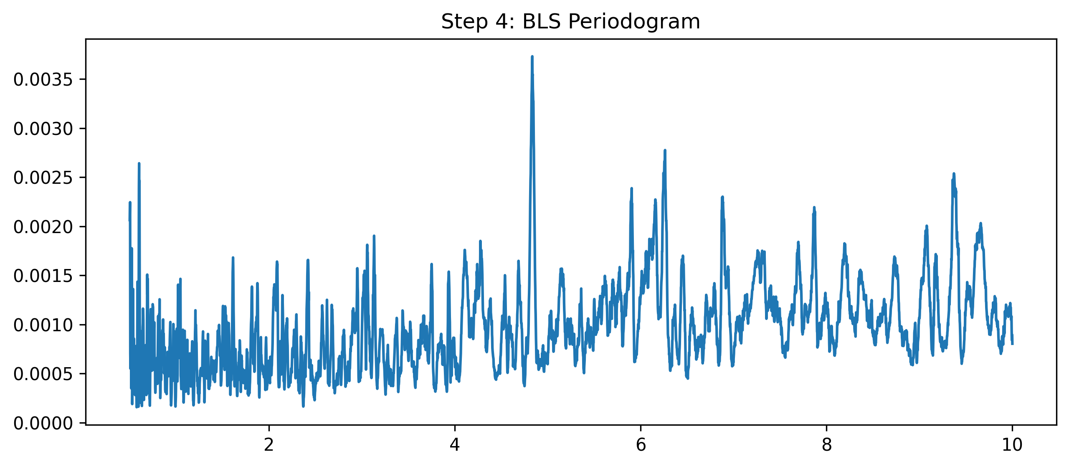
sigma clipping
detrending
BLS period search
Phase folding
transit visulization

Slide 16
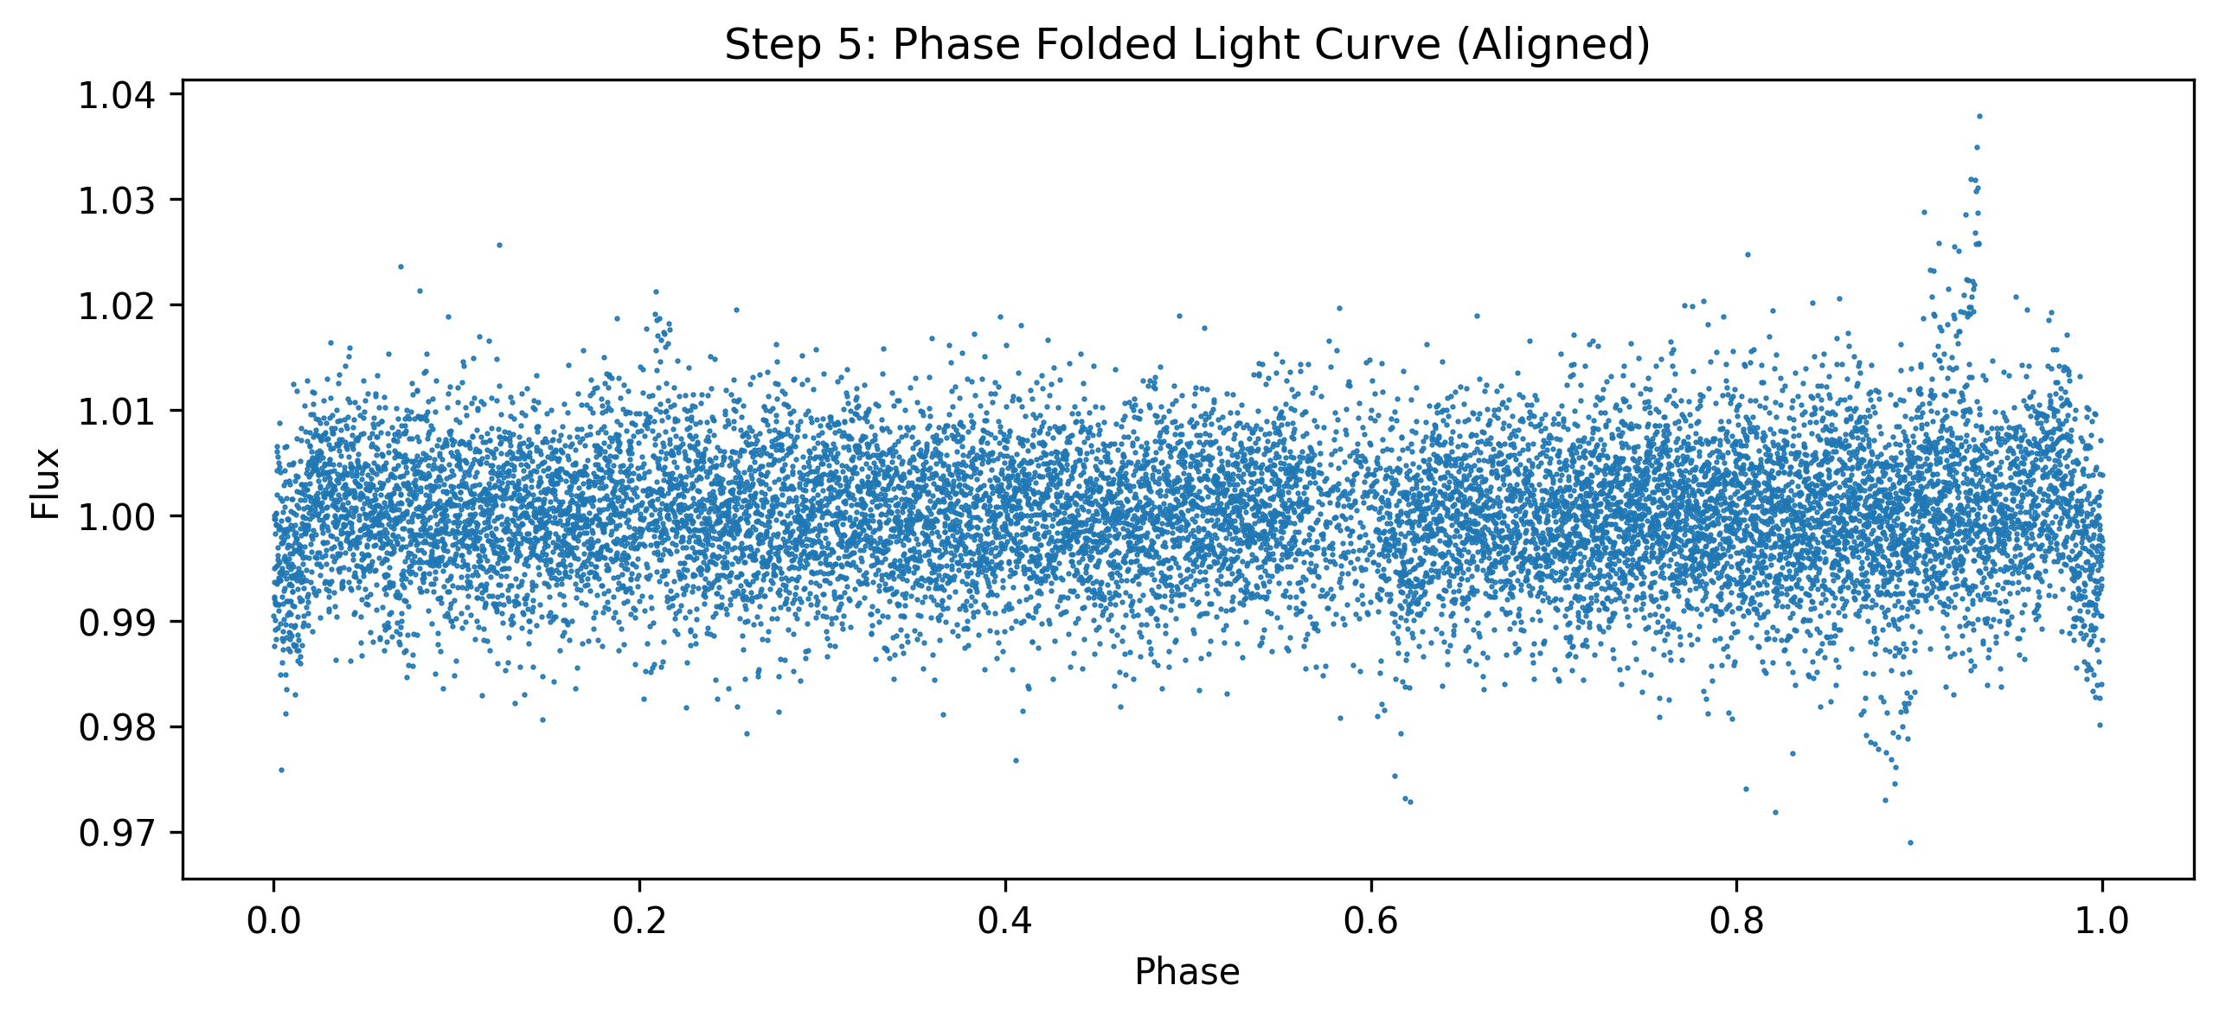
sigma clipping
detrending
BLS period search
Phase folding
transit visulization

Slide 17
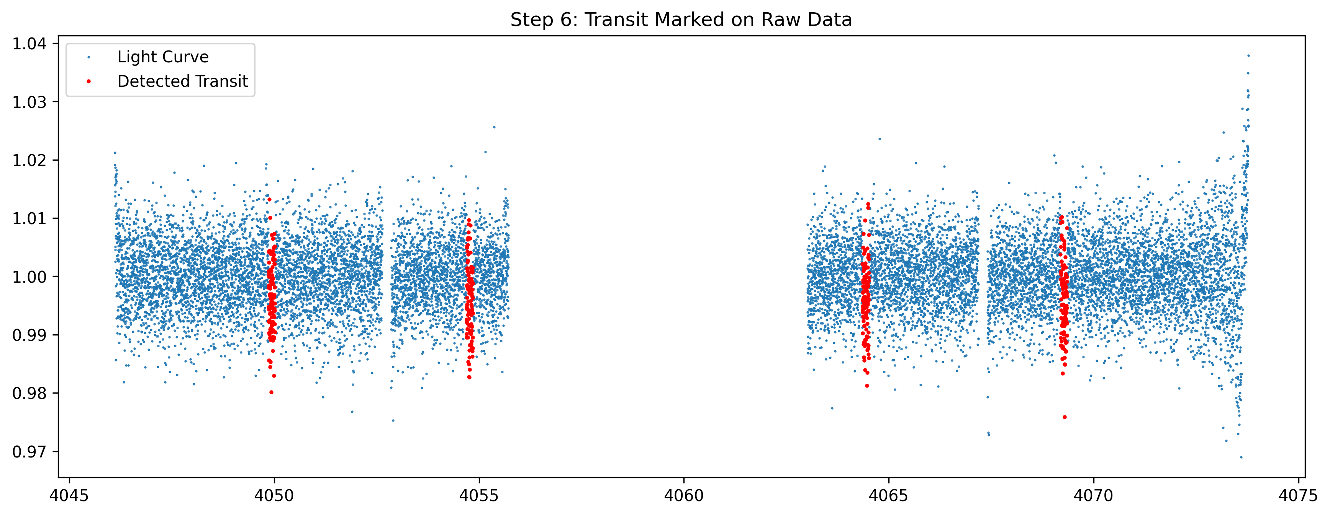

Slide 18
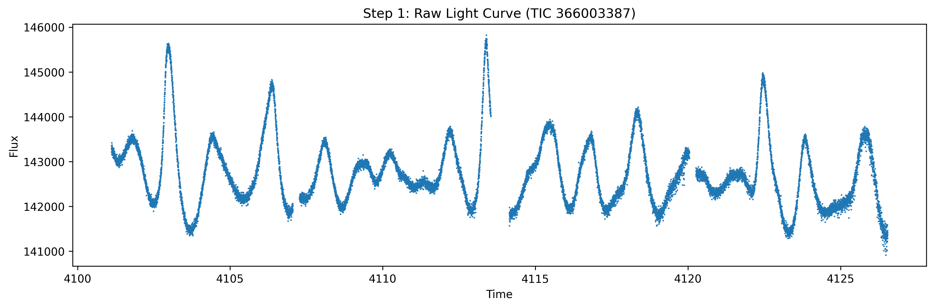

Slide 19
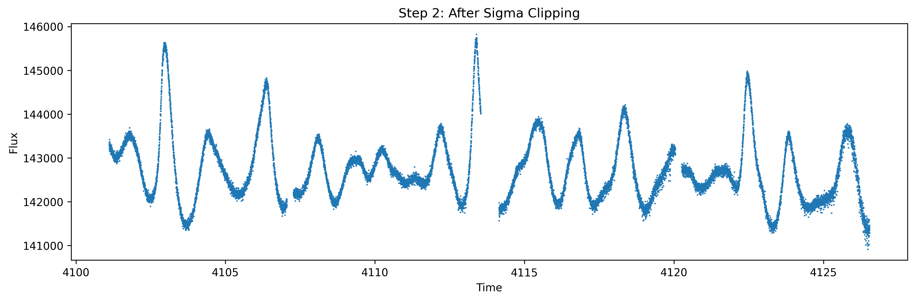

Slide 20
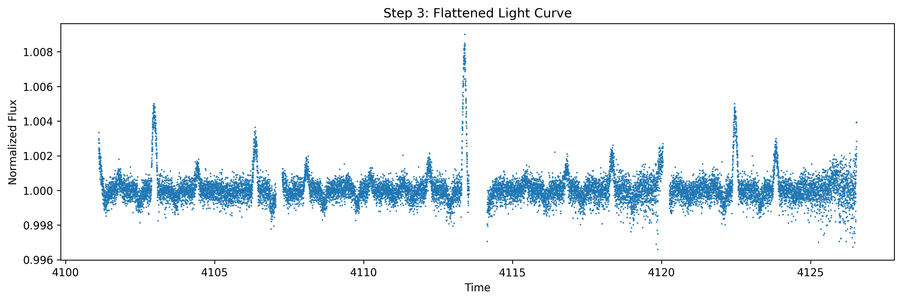

Slide 21
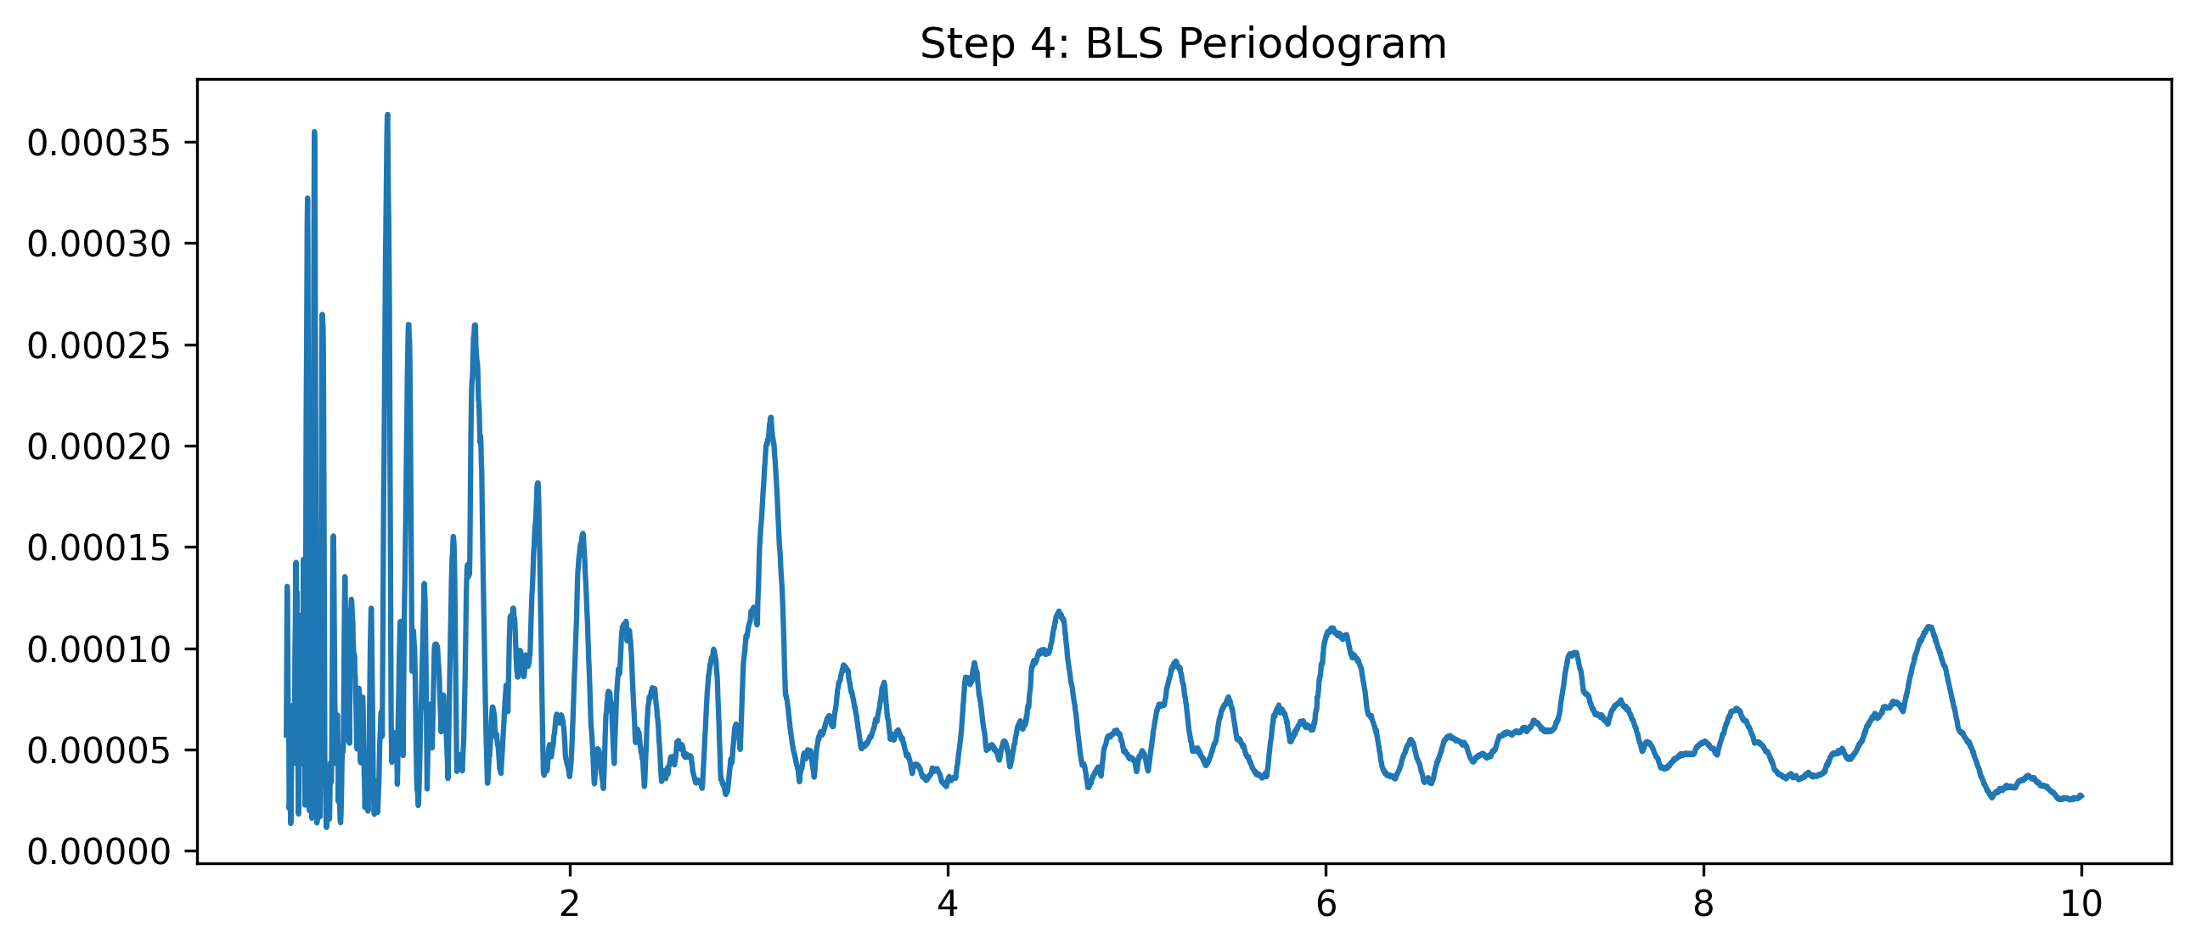

Slide 22
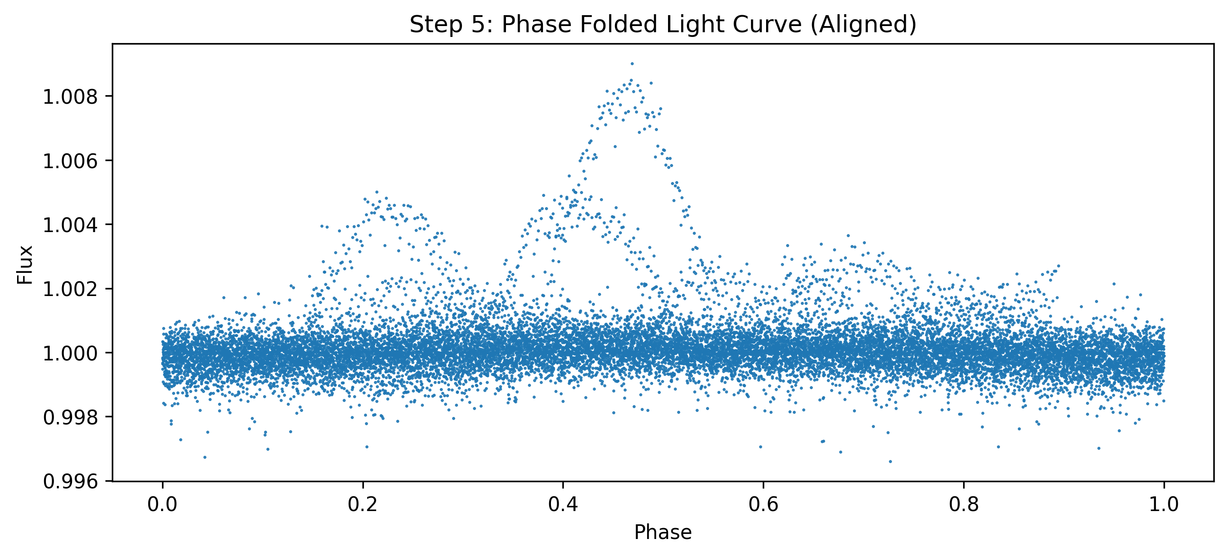

Slide 23
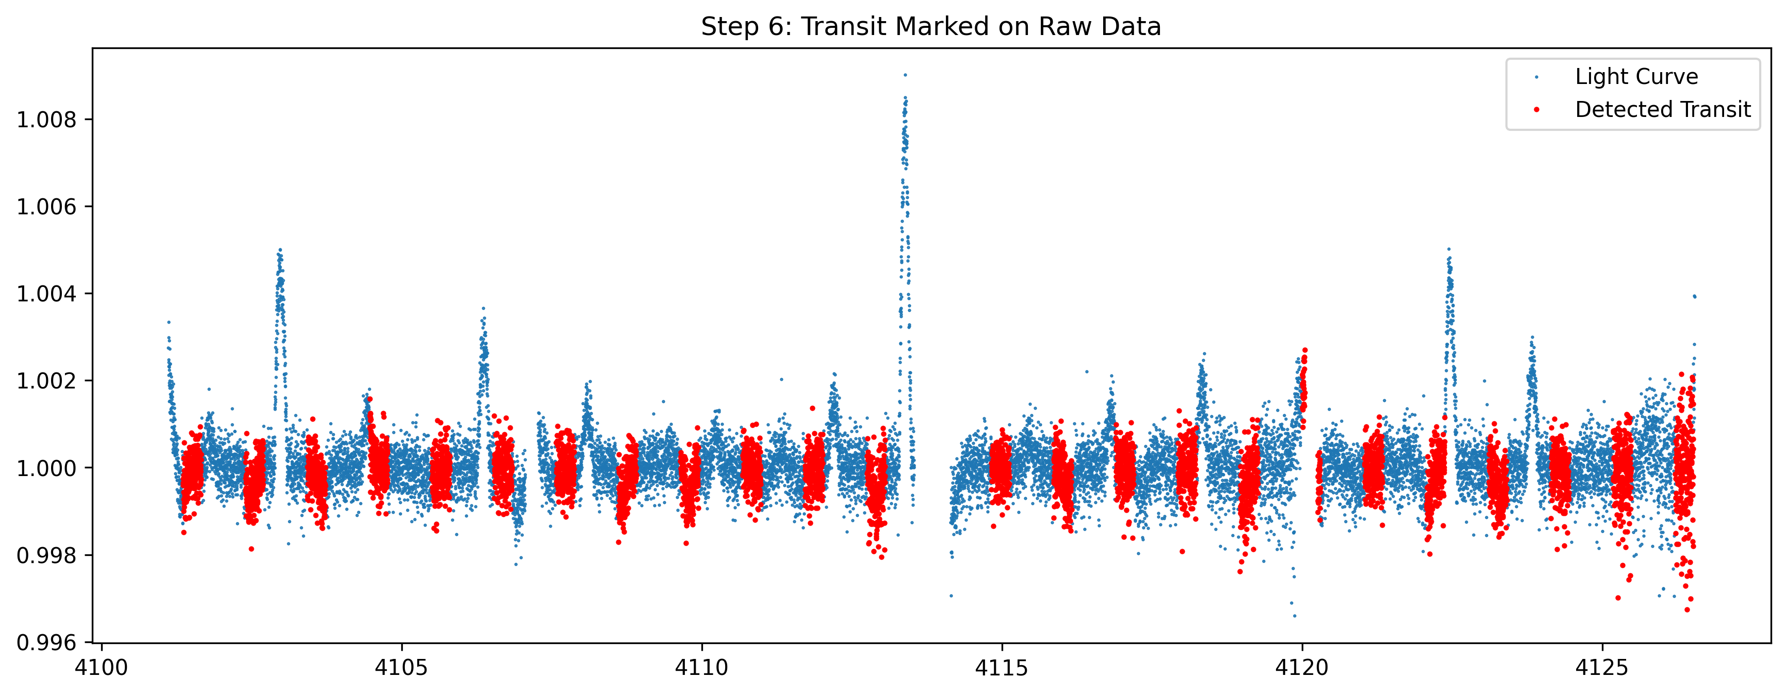

Slide 24
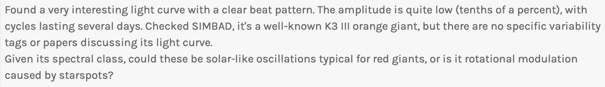

Slide 25
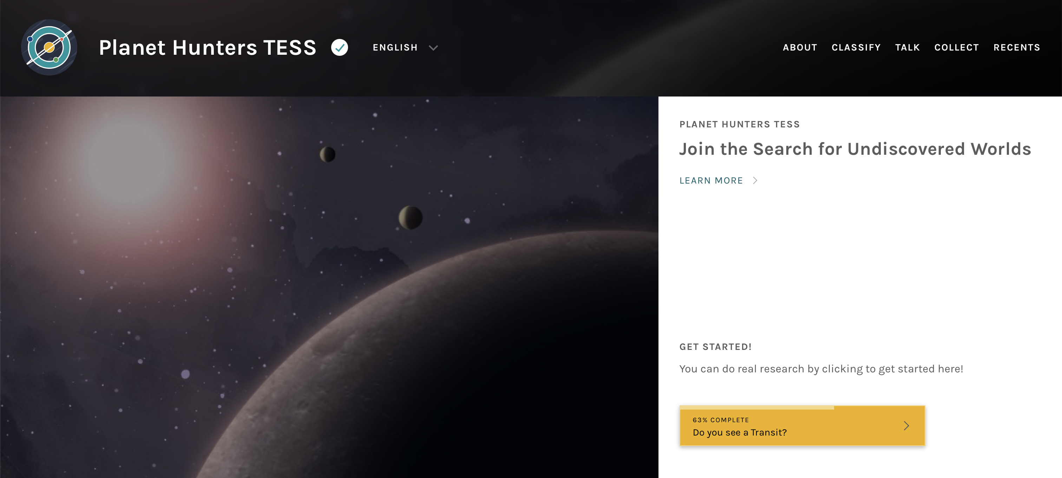

Slide 26
Thank you!

