Slide 1
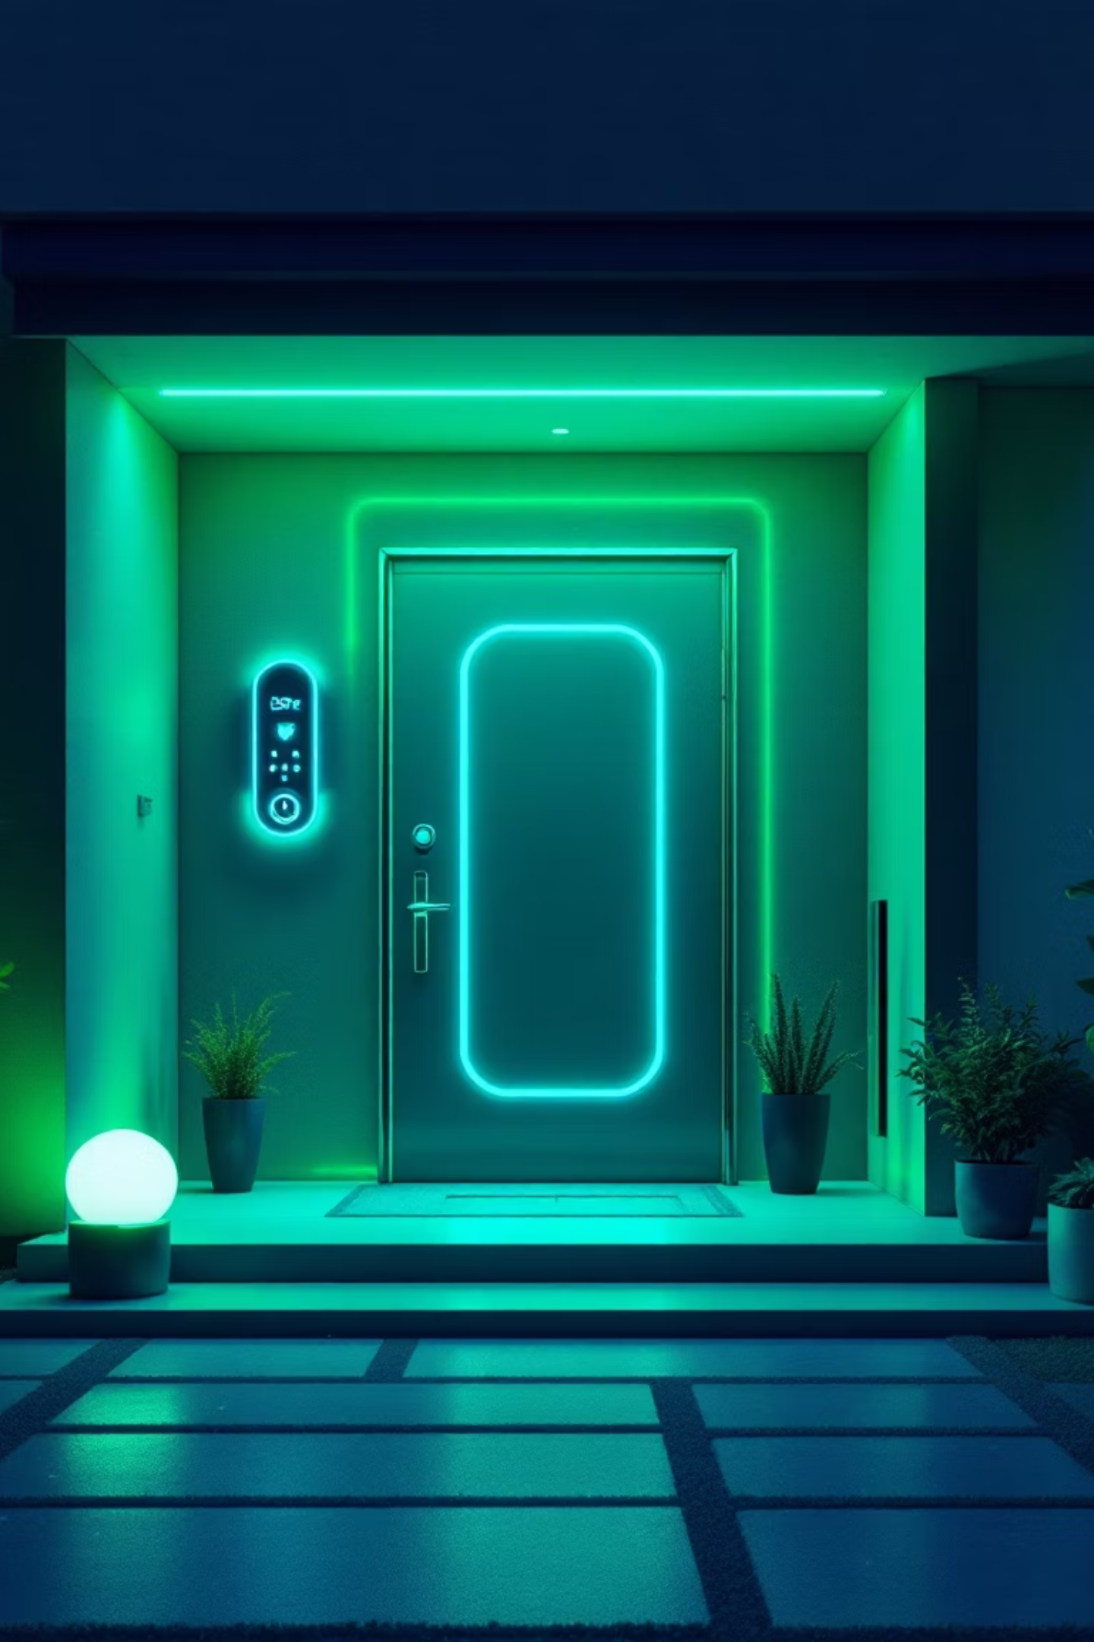
AI-Powered Door Security System
👥 Group Members
Muhammad Abdullah — 23-ARID-479
Ahmed Malik — 23-ARID-542
Muhammad Tayyab — 23-ARID-570
Zeeshan Abbas — 23-ARID-615
📌 Project OverviewThis presentation outlines our innovative AI-powered door security system, designed to enhance safety through real-time threat detection and automated responses.

Slide 2

Problem and Objectives
Problem: Traditional Security Limitations
Current systems often lack real-time threat analysis. They struggle with immediate identification of unknown individuals or dangerous objects, creating security vulnerabilities.
Objective: Enhance Door Security
Our goal is to create a robust, intelligent system. It will provide automated threat detection and rapid response for improved safety.
Solution: Real-time AI Detection
We built a system that uses AI for instant face and weapon recognition. This allows for proactive security measures.

Slide 3
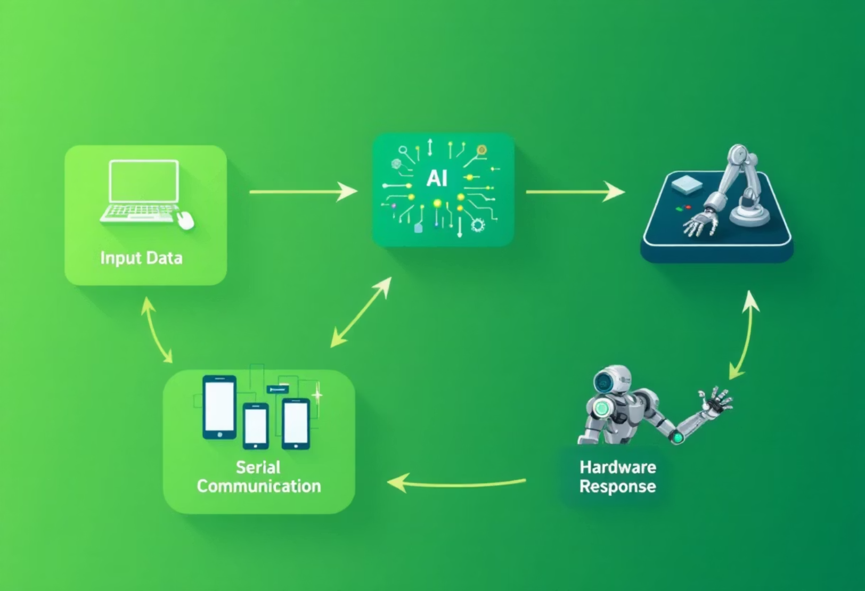
System Overview
Integrated Detection and Response
The system integrates AI for real-time analysis. It uses a camera for visual input. Detected threats trigger immediate hardware actions.
PySerial facilitates communication between software and hardware. Arduino UNO manages the physical security components. This creates a cohesive security loop.

Slide 4






Hardware Components
Host PC or Raspberry Pi
USB Camera or Built-in Camera
Runs the Python AI application. Processes video streams for detection.
Captures real-time video feed. Essential for face and weapon detection.
Arduino UNO / ESP8266
Red/Green LEDs
Receives commands from PC. Controls LEDs, buzzer, and other peripherals. Enables wireless communication for ESP8266.
Visual indicators for security status. Red for alert, green for clear.
Buzzer
Ultrasonic Sensor
Audible alarm for security breaches. Provides immediate alert notification.
Measures distance for known face verification. Ensures proper proximity for access.

Slide 5
Software Stack
1
Python 3.13
1
YOLOv8
Core programming language for AI application. Provides robust libraries.
Real-time object detection model. Used for detecting faces and weapons in video frames with high accuracy and speed.
2
OpenCV
2
PySerial
Computer vision library. Handles image and video processing tasks. Essential for real-time analysis.
Python serial communication library. Facilitates data exchange with Arduino.
3
Face Recognition
3
Arduino IDE
A powerful Python library used for detecting and recognizing human faces in images or video using deep learning. Built on top of dlib’s facial recognition features.
Programming environment for Arduino sketches. Uploads code to the microcontroller.

Slide 6
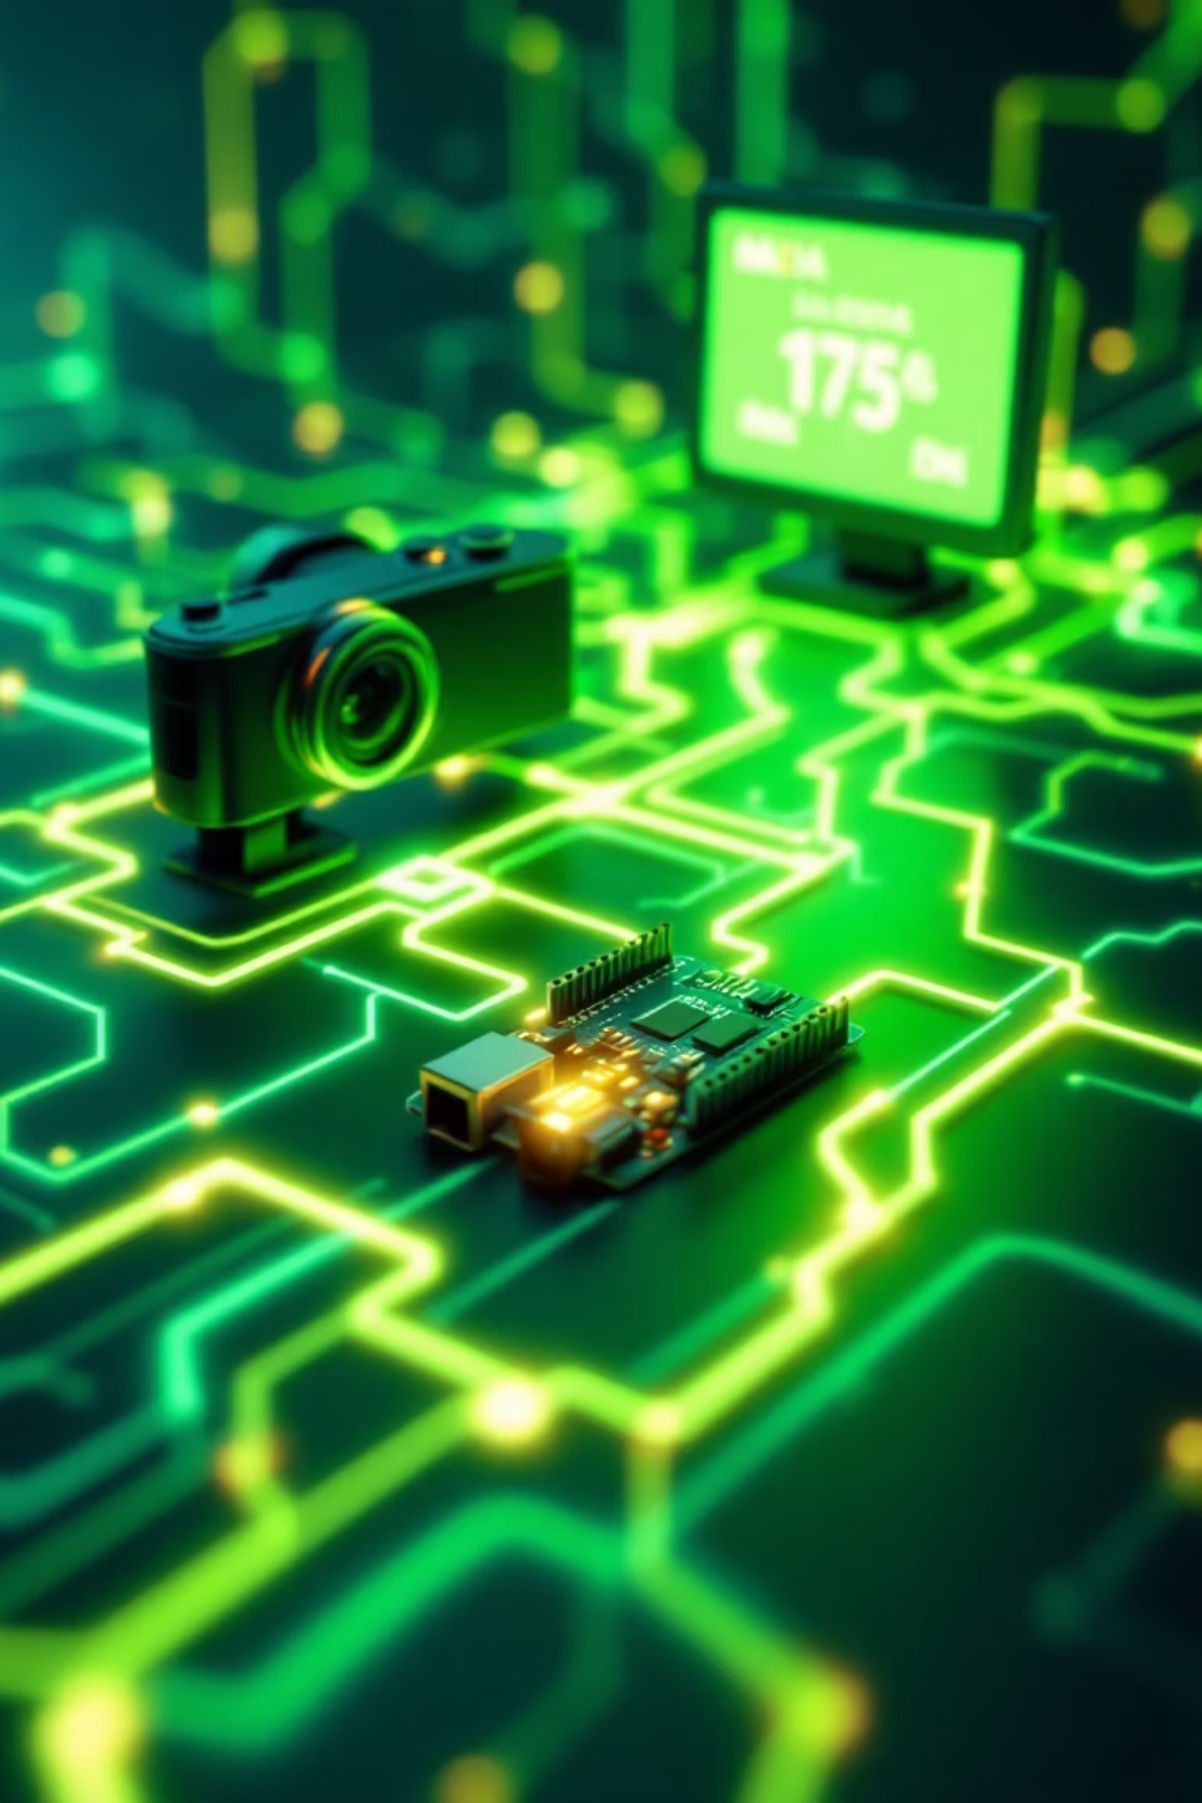




Communication Flow
Camera Captures Video
Camera continuously feeds video to the host System. This is the initial input.
AI Application Processes
Python script with OpenCV analyzes video frames. Detects faces and identifies weapons.
Decision and Label Sent
Based on detection, a security status label is generated. Sent to Arduino UNO via PySerial (or ESP8266 via WiFi).
Arduino Triggers Hardware
Arduino receives label and activates corresponding LEDs. Buzzer sounds if a threat is detected.

Slide 7
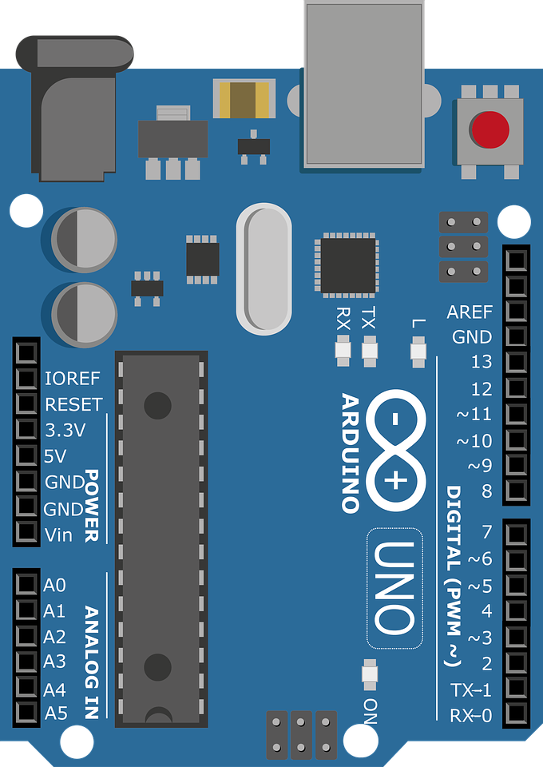
Sample Arduino Code Snippet
// Pin Configuration
#define trigPin 9 // Trigger pin of ultrasonic
#define echoPin 10 // Echo pin of ultrasonic
#define redLedPin 2 // Red LED pin (PD2)
#define greenLedPin 3 // Green LED pin (PD3)
#define buzzerPin 4 // Buzzer pin (PD4)
void setup() {
Serial.begin(9600); // Start serial communication
pinMode(trigPin, OUTPUT);
pinMode(echoPin, INPUT);
pinMode(redLedPin, OUTPUT);
pinMode(greenLedPin, OUTPUT);
pinMode(buzzerPin, OUTPUT);
// Turn everything OFF
PORTD &= ~((1 << PD2) | (1 << PD3) | (1 << PD4)); // Direct port write
Serial.println("✅ Arduino Ready. Waiting for Python input...");
}
This snippet illustrates how Arduino processes commands. It activates security features based on received signals. This code ensures immediate and appropriate hardware responses.

Slide 8
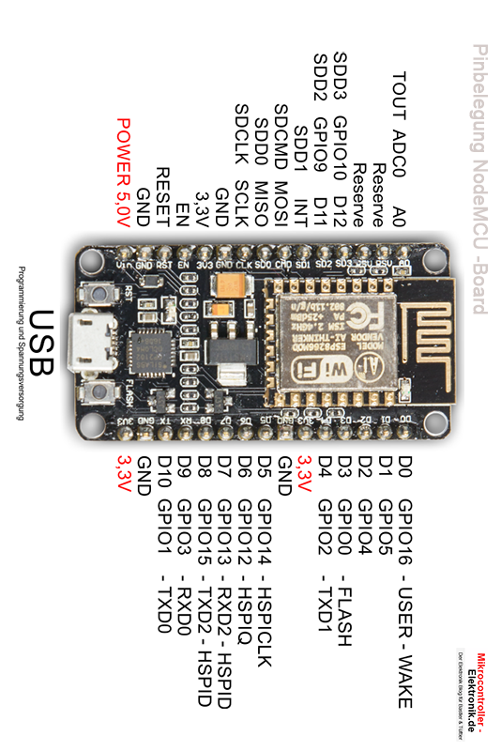
Sample Arduino Code Snippet
void loop() {
checkDistanceForGreenLED(); // Handle distance sensor logic
checkForPythonLabel(); // Handle serial communication with Python
delay(200); // Delay is okay here
}
void checkDistanceForGreenLED() {
int distance = measureDistance();
if (distance != -1) {
Serial.print("📏 Distance: ");
Serial.print(distance);
Serial.println(" cm");
if (distance >= 20 && distance <= 70) {
// Turn ON green LED (PD3)
asm volatile("sbi %[port], %[pin]" :: [port] "I" (_SFR_IO_ADDR(PORTD)), [pin] "I" (3));
} else {
// Turn OFF green LED
asm volatile("cbi %[port], %[pin]" :: [port] "I" (_SFR_IO_ADDR(PORTD)), [pin] "I" (3));
}
This snippet illustrates how Arduino processes commands. It activates security features based on received signals. This code ensures immediate and appropriate hardware responses.

Slide 9
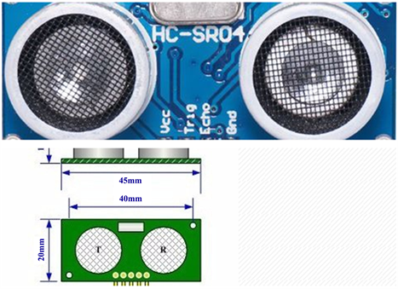
Sample Arduino Code Snippet
} else {
Serial.println("⚠️ Distance read failed (no echo received)");
// Turn OFF green LED
asm volatile("cbi %[port], %[pin]" :: [port] "I" (_SFR_IO_ADDR(PORTD)), [pin] "I" (3));
}
}
void checkForPythonLabel() {
if (Serial.available()) {
String received = Serial.readStringUntil('\n');
received.trim();
Serial.print("📥 Received from Python: ");
Serial.println(received);
if (received.indexOf("unknown") >= 0 ||
received.indexOf("guns") >= 0 ||
received.indexOf("knife") >= 0) {
triggerAlert(); // 🚨 Alert if label matches
}
}
}
This snippet illustrates how Arduino processes commands. It activates security features based on received signals. This code ensures immediate and appropriate hardware responses.

Slide 10
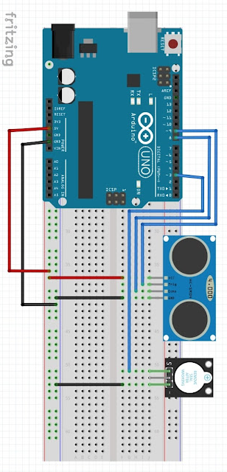
Sample Arduino Code Snippet
void triggerAlert() {
for (int i = 0; i < 5; i++) {
// Turn ON red LED (PD2) and Buzzer (PD4)
asm volatile("sbi %[port], %[pin]" :: [port] "I" (_SFR_IO_ADDR(PORTD)), [pin] "I" (2));
asm volatile("sbi %[port], %[pin]" :: [port] "I" (_SFR_IO_ADDR(PORTD)), [pin] "I" (4));
delay(200);
// Turn OFF both
asm volatile("cbi %[port], %[pin]" :: [port] "I" (_SFR_IO_ADDR(PORTD)), [pin] "I" (2));
asm volatile("cbi %[port], %[pin]" :: [port] "I" (_SFR_IO_ADDR(PORTD)), [pin] "I" (4));
delay(200);
}
}
This snippet illustrates how Arduino processes commands. It activates security features based on received signals. This code ensures immediate and appropriate hardware responses.

Slide 11
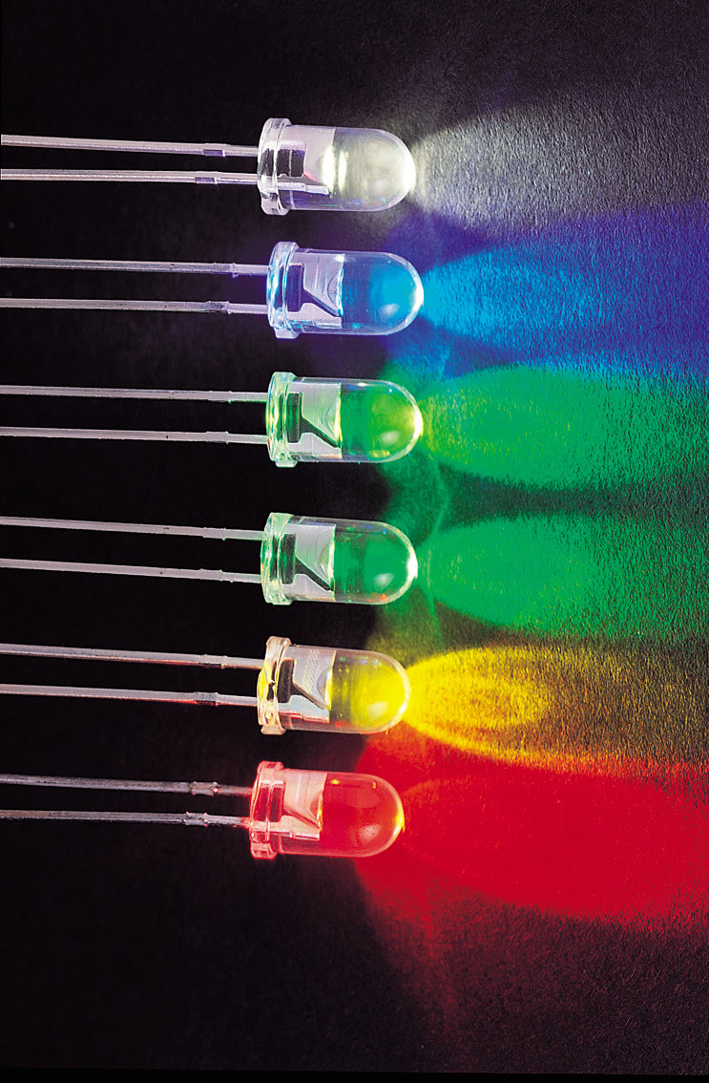
Sample Arduino Code Snippet
int measureDistance() {
// Clear previous pulse
digitalWrite(trigPin, LOW);
// Replace delayMicroseconds(2) with NOPs (about 2us = 32 cycles)
asm volatile (
"nop\n\t""nop\n\t""nop\n\t""nop\n\t"
"nop\n\t""nop\n\t""nop\n\t""nop\n\t"
"nop\n\t""nop\n\t""nop\n\t""nop\n\t"
"nop\n\t""nop\n\t""nop\n\t""nop\n\t"
"nop\n\t""nop\n\t""nop\n\t""nop\n\t"
"nop\n\t""nop\n\t""nop\n\t""nop\n\t"
"nop\n\t""nop\n\t""nop\n\t""nop\n\t"
"nop\n\t""nop\n\t""nop\n\t""nop\n\t"
);
This snippet illustrates how Arduino processes commands. It activates security features based on received signals. This code ensures immediate and appropriate hardware responses.

Slide 12

Sample Arduino Code Snippet
// Send 10us pulse to trigger
digitalWrite(trigPin, HIGH);
delayMicroseconds(10);
digitalWrite(trigPin, LOW);
// Listen for echo. Timeout after 30ms.
long duration = pulseIn(echoPin, HIGH, 30000);
if (duration == 0) return -1; // No echo received
int distance = duration * 0.0343 / 2;
return distance;
}
This snippet illustrates how Arduino processes commands. It activates security features based on received signals. This code ensures immediate and appropriate hardware responses.

Slide 13
Sample Arduino Code Snippet
🕒 Traditional Delay: delayMicroseconds(2);
High-level function
Internally uses timers or busy-wait loops
✅ Easy to use
❌ Overhead due to function calls
❌ Not cycle-exact on all platforms
❌ Can be optimized differently by compiler
digitalWrite(trigPin, LOW);
delayMicroseconds(2);
⚡ Assembly Delay: 32 × nop (precise delay)
nop = “No Operation” (1 cycle = 62.5ns on 16MHz)
32 nops = ~2 microseconds
✅ Direct CPU cycle control
✅ No function call
✅ Super accurate
asm volatile (
"nop\n\t""nop\n\t""nop\n\t"... // 32 times
);
🔁 Result: Assembly provides faster and more accurate microsecond timing for critical hardware tasks.
This snippet illustrates how Arduino processes commands. It activates security features based on received signals. This code ensures immediate and appropriate hardware responses.

Slide 14
Sample Arduino Code Snippet
🖐️ Traditional: digitalWrite(pin, HIGH/LOW);
High-level abstraction
✅ Easy to read
❌ Slow! (~50–100 CPU cycles)
❌ Goes through pin-mapping logic
digitalWrite(redLedPin, HIGH); // ~60+ cycles
⚙️ Assembly: sbi and cbi
sbi = Set Bit in I/O Register
cbi = Clear Bit in I/O Register
✅ Executes in just 2 CPU cycles
✅ Direct access to port registers
✅ Ultra-fast I/O control
// Turn ON PD2 (red LED)
asm volatile("sbi %[port], %[pin]" ::
[port] "I" (_SFR_IO_ADDR(PORTD)),
[pin] "I" (2));
🚀 Result: Assembly provides instant pin control with massive speed boost — perfect for real-time response systems
This snippet illustrates how Arduino processes commands. It activates security features based on received signals. This code ensures immediate and appropriate hardware responses.

Slide 15

Download Python Application
Integrated Detection and Response
🔗 Project Repository
GitHub Link: 👉 https://github.com/Stranger-S8/Strange-Projects
Requirements
Python 3.13
Arduino IDE
Arduino Uno
Required Python Libraries (in requirements.txt)

Slide 16

Results and Future Improvements
95%
200ms
⬆️
Detection Accuracy
Response Time
Future Enhancements
Hardware response time under 200 milliseconds, ensuring rapid action against threats.
Achieved 95% accuracy in real-time weapon and known/unknown face detection, proving the system's reliability.
Integrate cloud-based logging and notifications for remote monitoring. Implement advanced AI models for behavioral analysis.
Our system demonstrates high accuracy and quick response, significantly enhancing door security. Future plans include advanced analytics and broader smart home integration.

