Slide 1
Diagram Presentation PowerPoint
Presented by No Magic

Slide 2
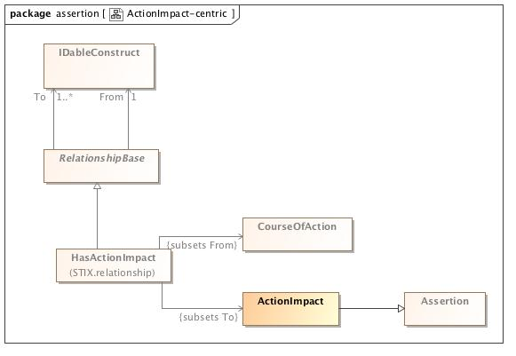
ActionImpact-centric

Slide 3
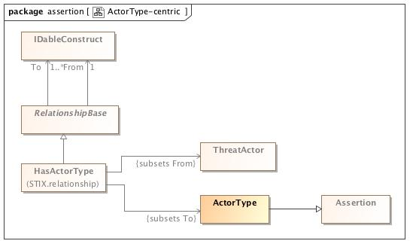
ActorType-centric

Slide 4
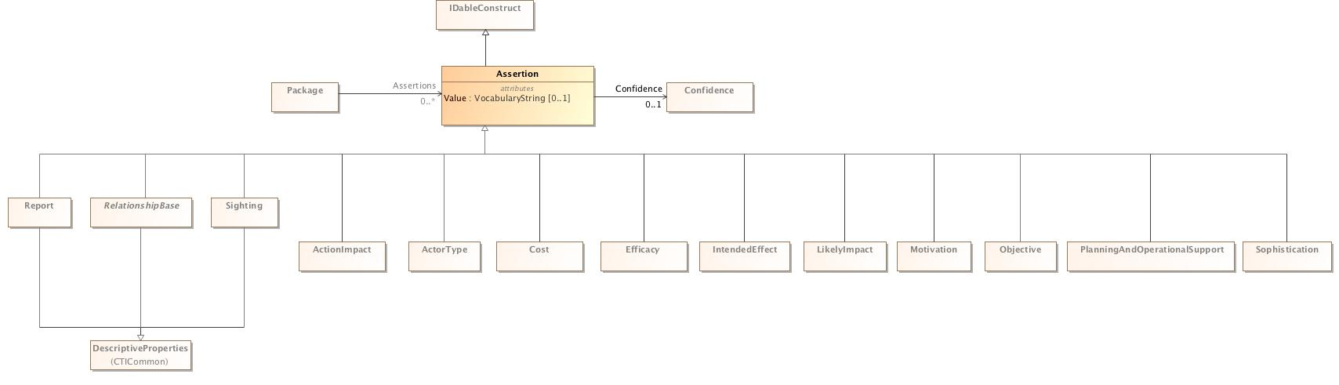
Assertion-centric

Slide 5
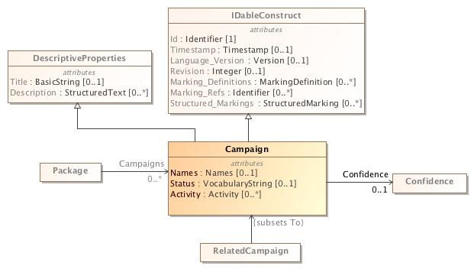
Campaign-centric

Slide 6
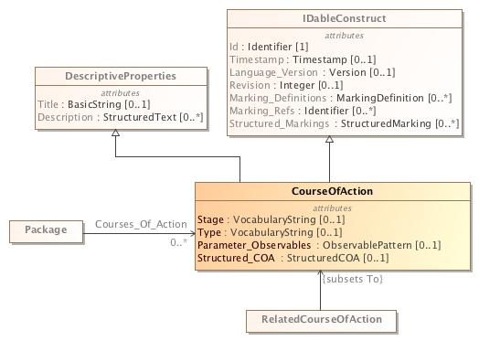
COA-centric

Slide 7
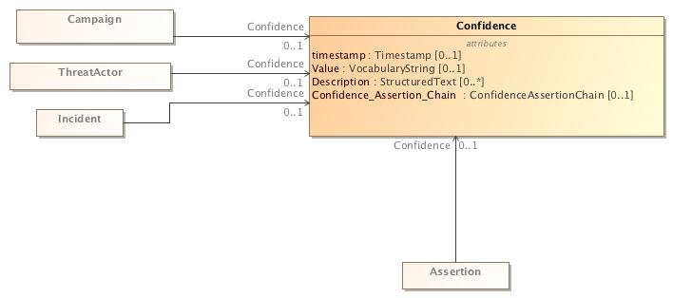
Confidence-centric

Slide 8
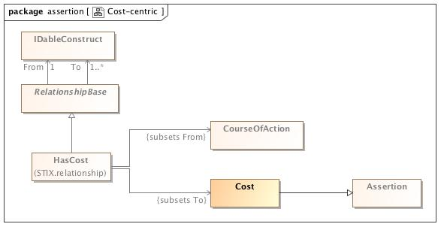
Cost-centric

Slide 9
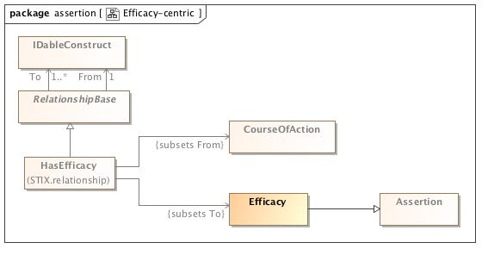
Efficacy-centric

Slide 10
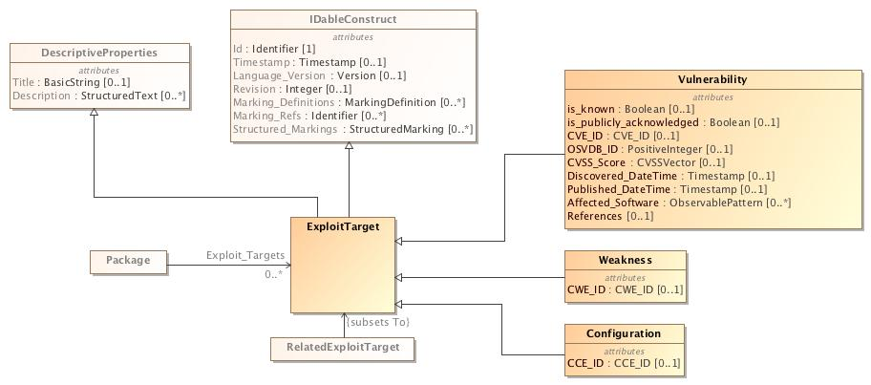
ET-centric

Slide 11
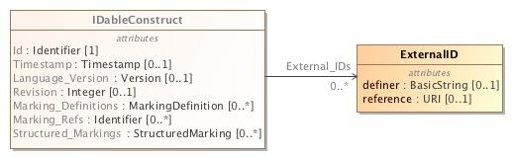
External_IDs

Slide 12
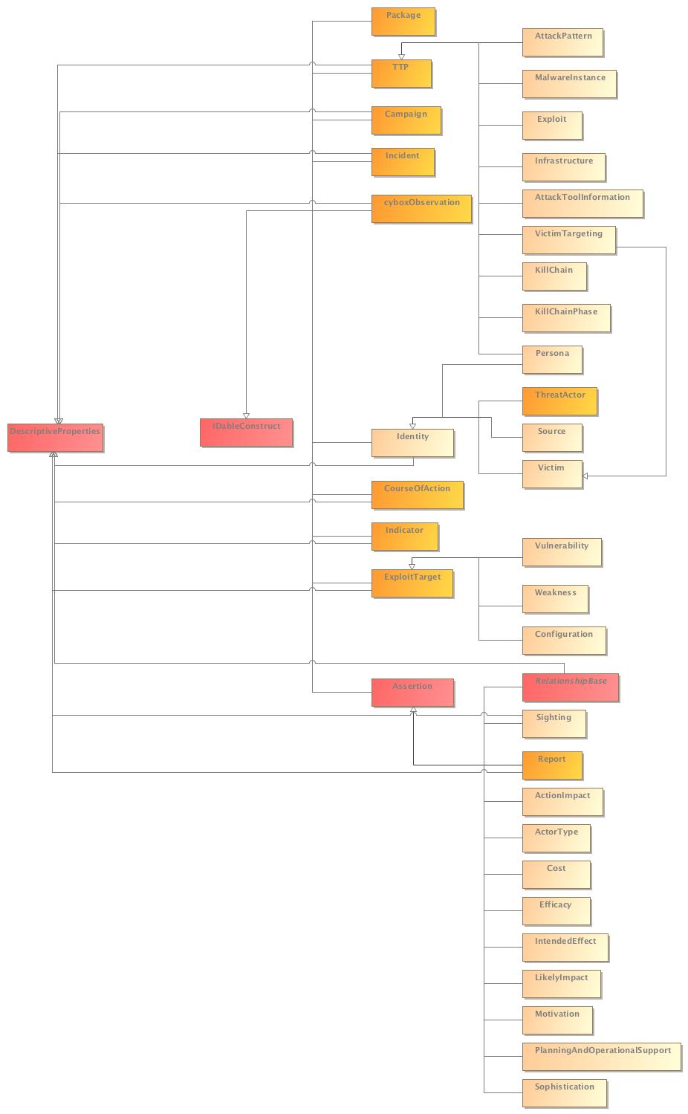
IDableConstruct-centric

Slide 13
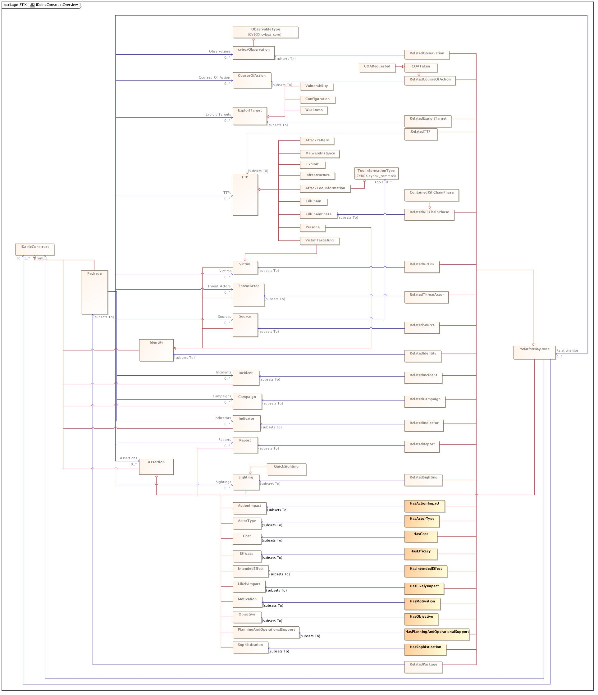
IDableConstructOverview

Slide 14
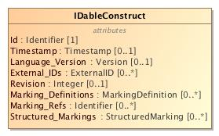
IDableConstructType

Slide 15
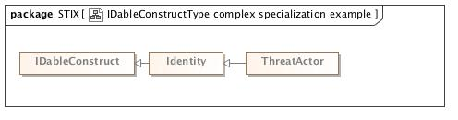
IDableConstructType complex specialization example

Slide 16
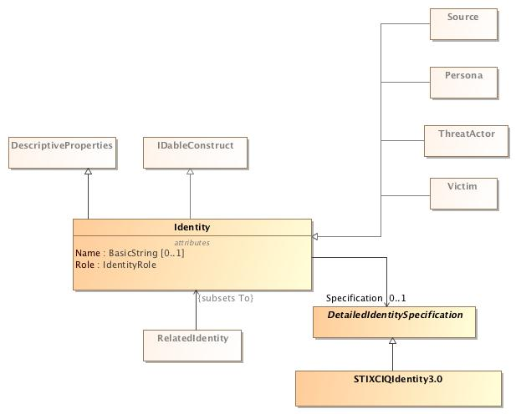
Identity-centric

Slide 17
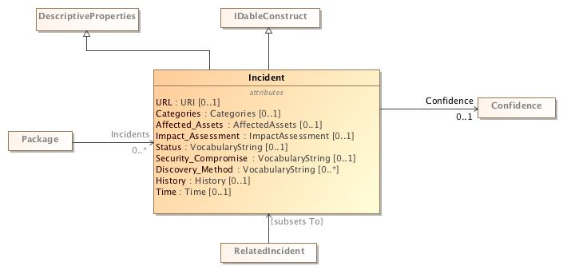
Incident-centric

Slide 18
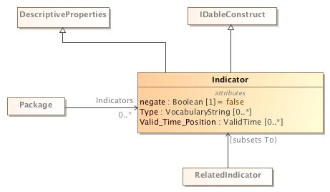
Indicator-centric

Slide 19
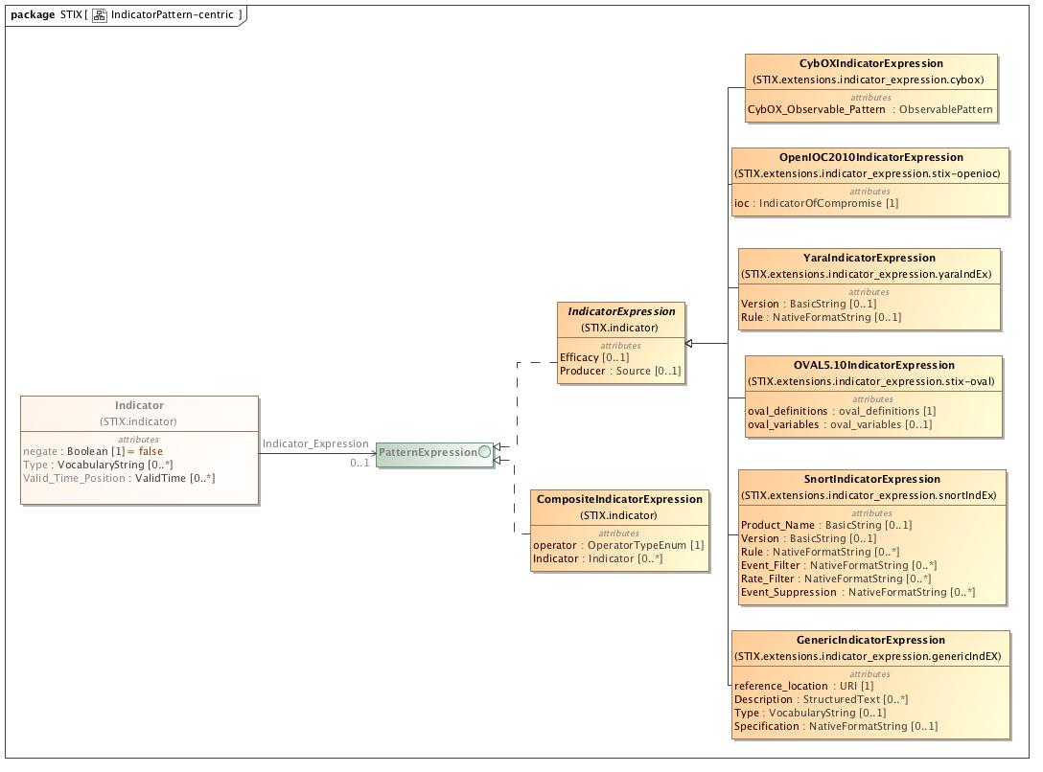
IndicatorPattern-centric

Slide 20
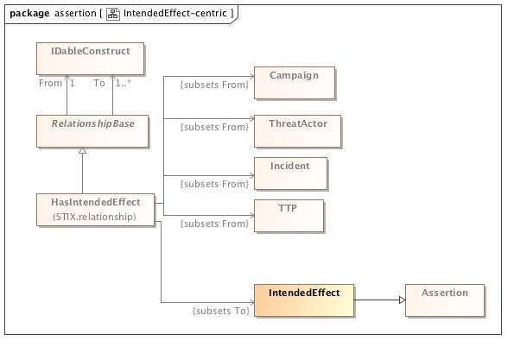
IntendedEffect-centric

Slide 21
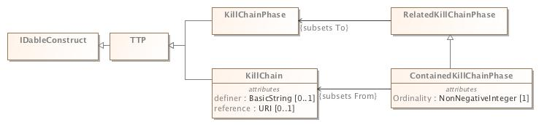
KillChain-centric

Slide 22
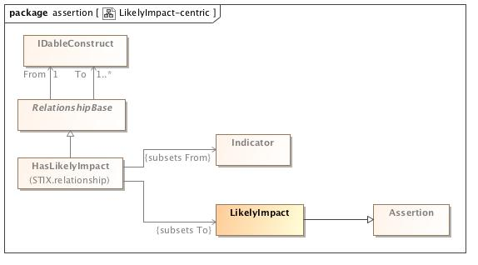
LikelyImpact-centric

Slide 23
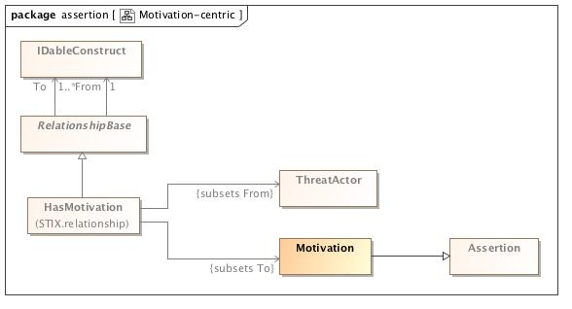
Motivation-centric

Slide 24
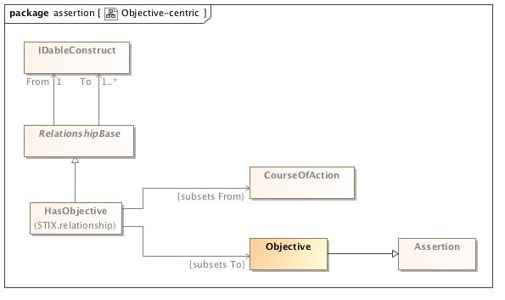
Objective-centric

Slide 25
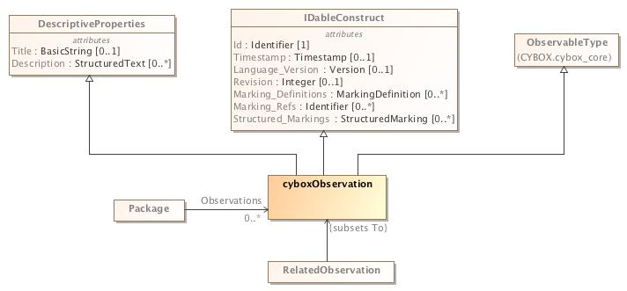
Observation-centric

Slide 26
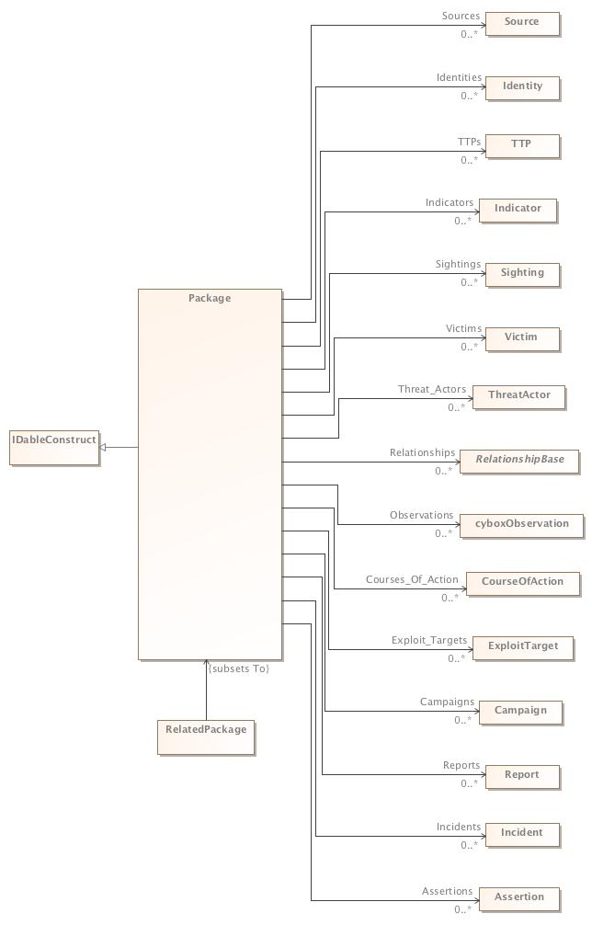
Package-centric

Slide 27
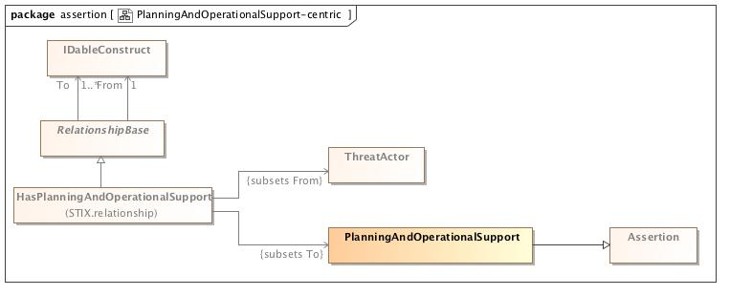
PlanningAndOperationalSupport-centric

Slide 28
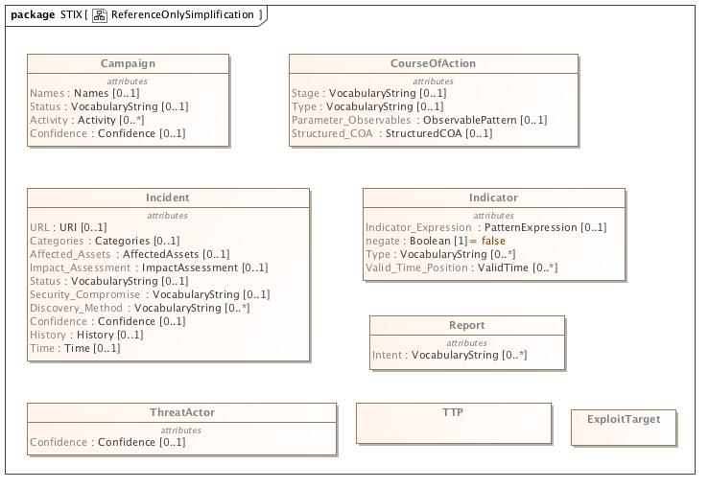
ReferenceOnlySimplification

Slide 29
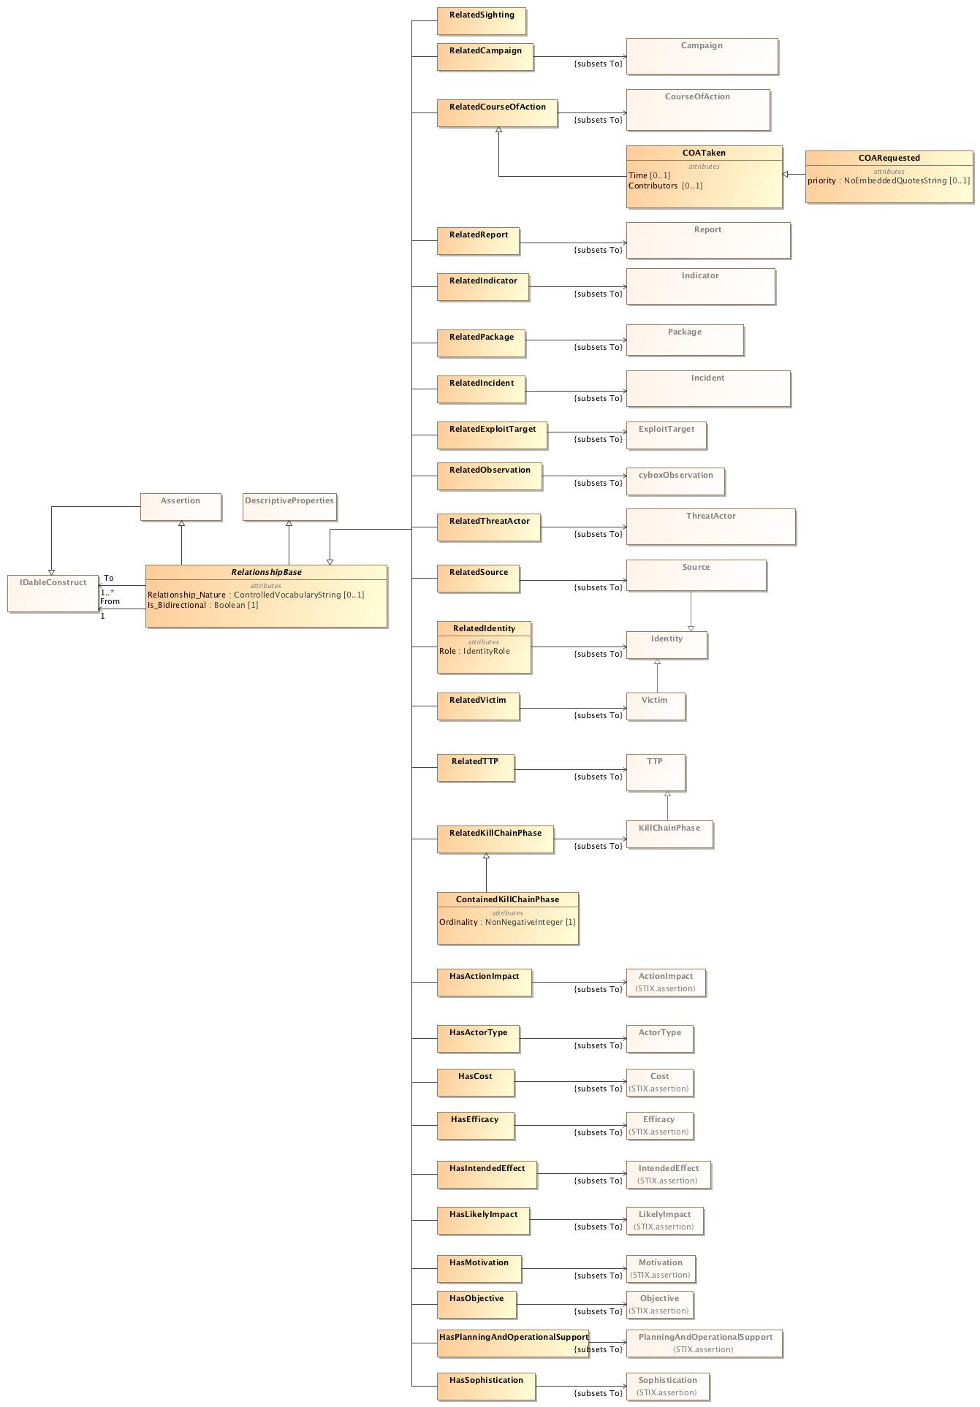
Relationship-centric

Slide 30
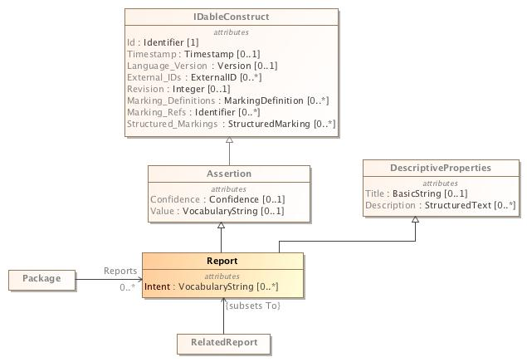
Report-centric

Slide 31
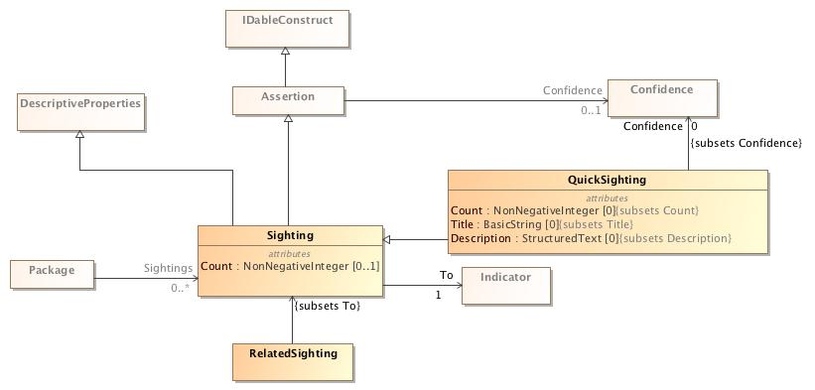
Sighting-centric

Slide 32
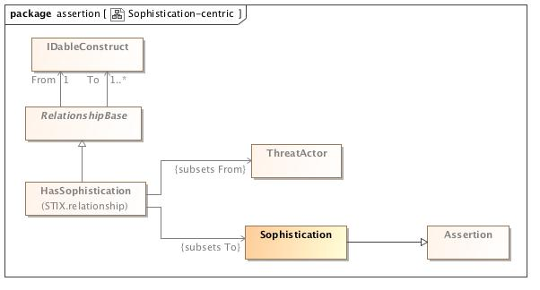
Sophistication-centric

Slide 33
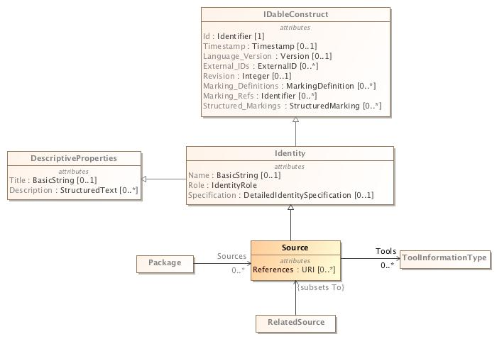
Source-centric

Slide 34
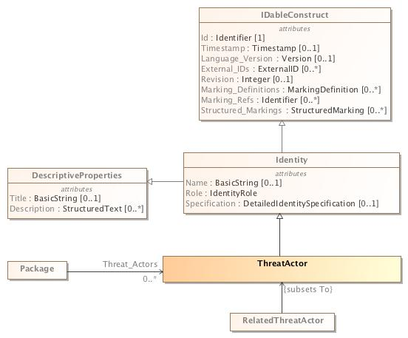
ThreatActor-cenric

Slide 35
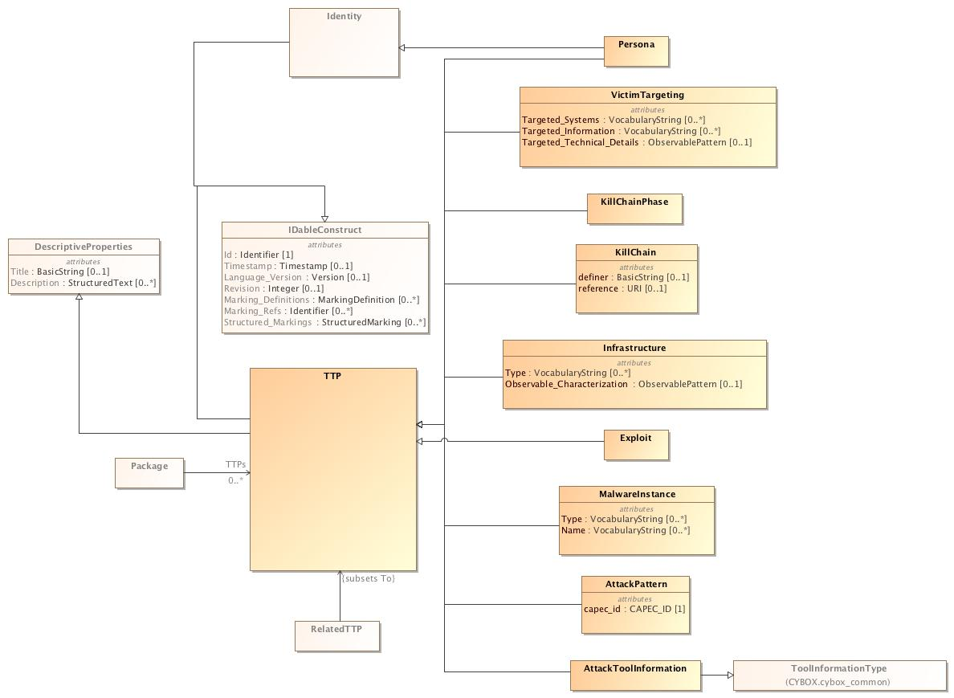
TTP-centric

Slide 36
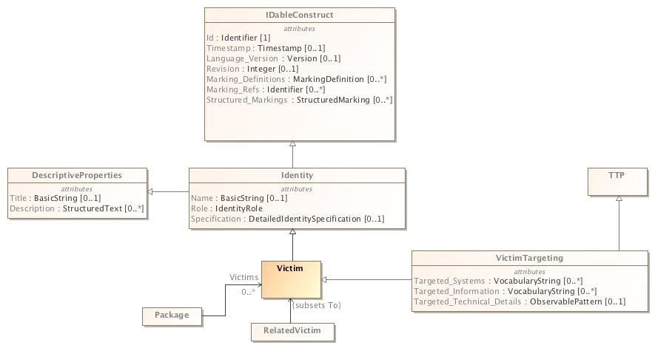
Victim-centric

