Slide 1
Bachelor Thesis
“Detection of the Medical
Mask using Image
Recognition”
Thesis supervisor:
Dr. Lecturer Eng. Nicolaie Cleju
Author: Straticiuc Mihai

Slide 2
Deep Learning
Deep Learning is a sub-category of machine learning.
The idea behind a deep learning algorithm is to simulate the human brain structure.
If we will try to simplify the process the process we can divide neurons linking in layers. Each layer have an input, at his level he process that input and generate an output that will be used as input for the next layer.

Slide 3
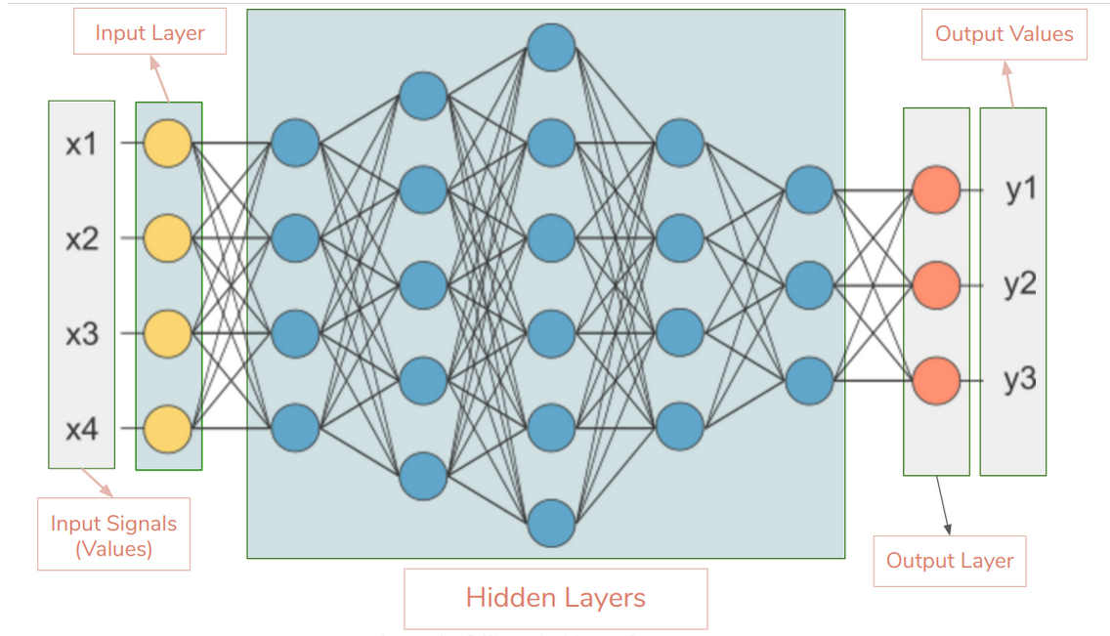
Graphical representation of layer architecture

Slide 4
Here is the list of top 10 most popular deep learning algorithms:
1. Convolutional Neural Networks (CNNs)
2. Long Short Term Memory Networks (LSTMs)
3. Recurrent Neural Networks (RNNs)
4. Generative Adversarial Networks (GANs)
5. Radial Basis Function Networks (RBFNs)
6. Multilayer Perceptrons (MLPs)
7. Self Organizing Maps (SOMs)
8. Deep Belief Networks (DBNs)
9. Restricted Boltzmann Machines( RBMs)
10 Autoencoders

Slide 5
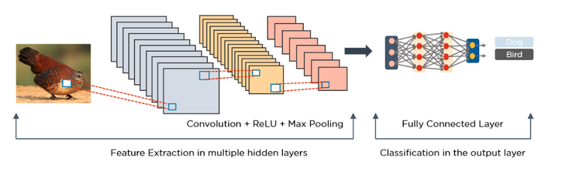
Convolutional Neural Network CNNs
● Known as ConvNets, consist of multiple layers and are mainly used for image processing and object detection.
● The first layer in a CNN network is the CONVOLUTIONAL LAYER
● Second is the ACTIVATION LAYER which applies the ReLu (Rectified Linear Unit)
●Third, is the POOLING LAYER, which involves downsampling of features.

Slide 6
Recurrent Neural Networks (RNNs)
It is one of the most popular algorithms in the field of artificial intelligence.
Steps of training:
1.Input an example from a data-set
2.The network will take that example and apply some complex computations to it using randomly initialised variables (called weights and biases).
3.A predicted result will be produced.
4.Comparing that result to the expected value will give us an error.
5.Propagating the error back through the same path will adjust the variables.

Slide 7
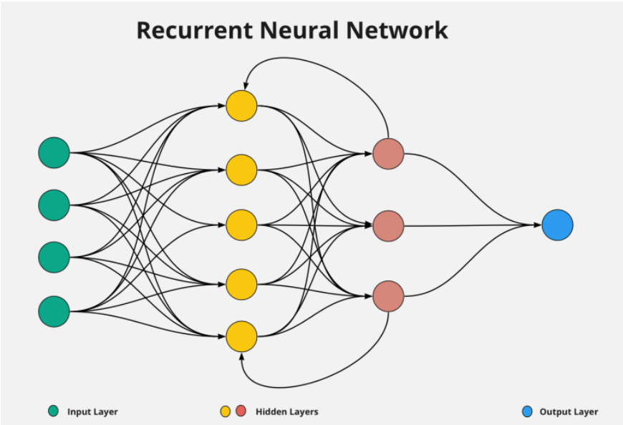

Slide 8
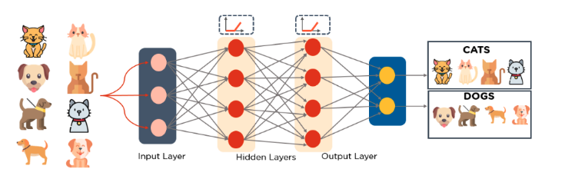
Multilayer Perceptrons (MLPs)
● The algorithm for the MLP is as follows:
MLPs utilize activation functions at each of their calculated layers.
● Once the calculated output at the hidden layer has been pushed through the activation function, push it to the next layer
● Repeat steps one and tow until the output layer is reached.

Slide 9


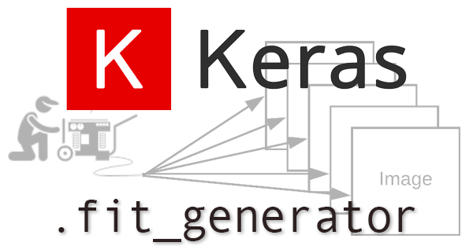
Training Model
● In order to train a model that will be used for image processing we decide to use as a programming language Python and as additional libraries Keras and TensorFlow.
● Python is dynamically-typed and garbage-collected.
● TensorFlow is an open-source library developed by Google for deep learning
● Keras is a high-level API developed for implementing neural network

Slide 10
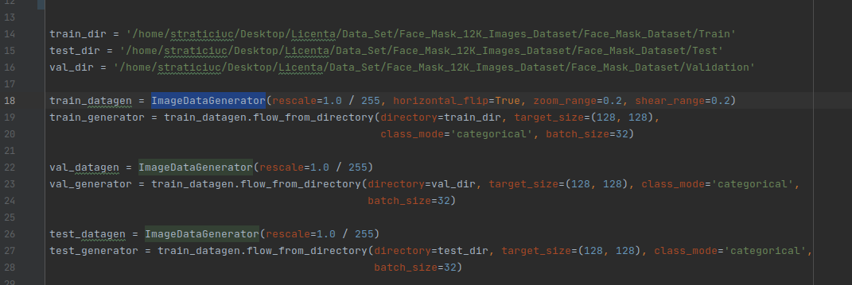
● First step: Define the paths for data set
● Second step: Using function ImageDataGenerator we generate batches of tensor image data

Slide 11
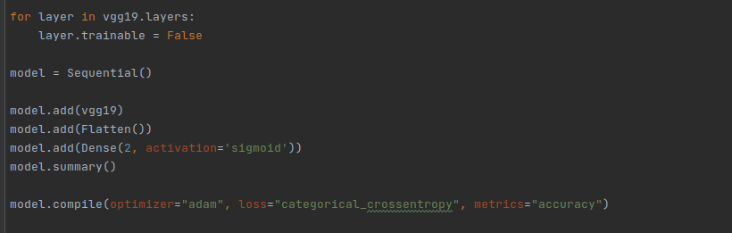
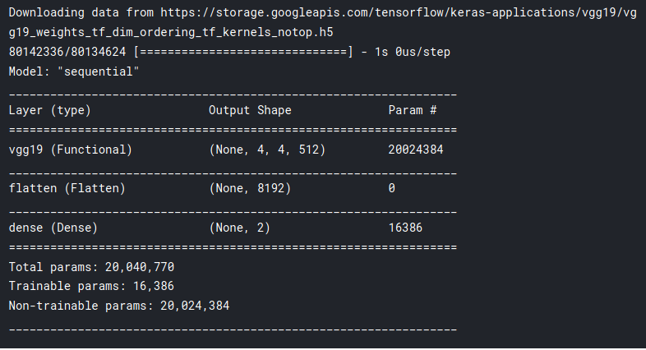
● Third step: Train the model

Slide 12
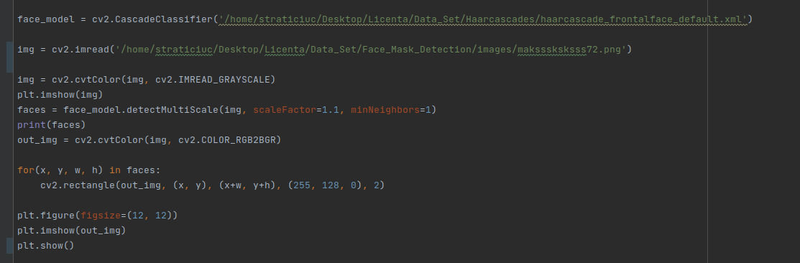
Live Application Examples
The purpose of my first application is to determine if the persons from a image wear the mask or not.

Slide 13

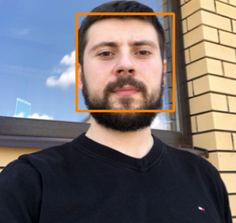
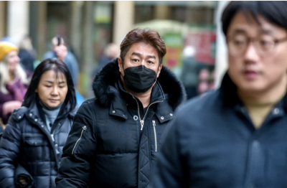
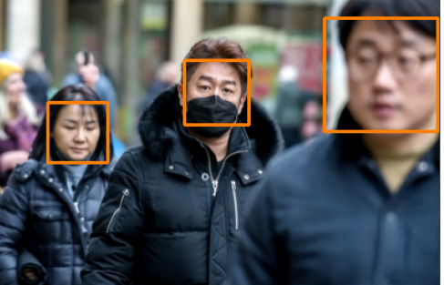

Slide 14
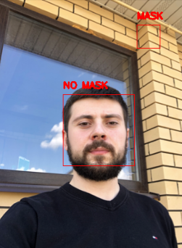
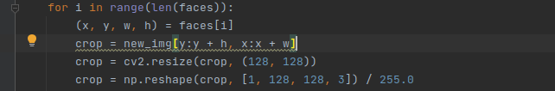
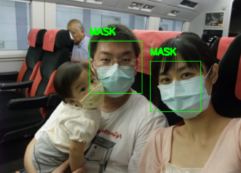
● The next step is to corp image and pass to model for evaluation
and based on the result draw a rectangle around the faces

Slide 15
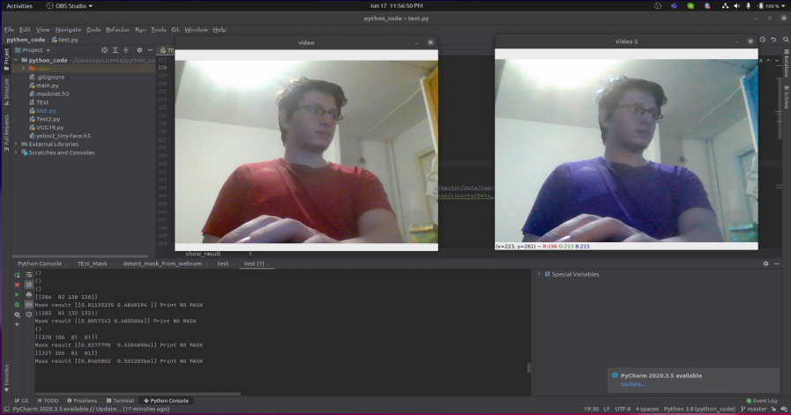
Detection of Mask from a Video
● As we can see in the video the detection if not perfect from my estimation model detect correct in 50% of cases

Slide 16
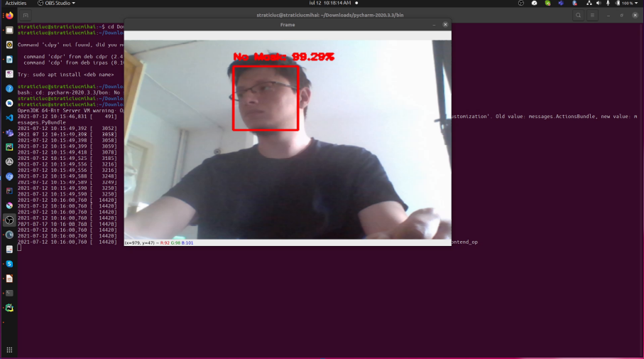
● In order to show the full potential of a such application I have replaced my model with a per-trained one, where was used another data set.

Slide 17
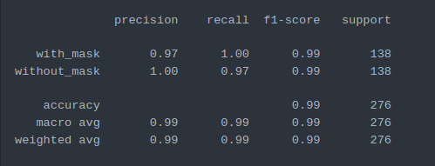
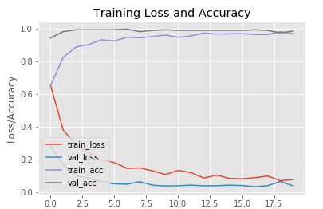
● The results are correct in 98% of the cases this is the result of better training.
● We also can see a graph with training / value loss and accuracy for a easier interpretation because mainly we a interested in models with low losses and high accuracy.

Slide 18
Conclusions
● Artificial neural networks, Deep Learning and Artificial Intelligence are the 3 fields of the computer science that in fact have the one purpose, to make machines to think as a humans.
● According to the statistics we can process only 30-40% from the total amount of data that we posses this is why Machine Learning domain have increased a lot in the past years.
● Even thought the machine learning cant perform miracles as we can see in the examples there a errors and those errors could be caused by different reasons like quality of the image , quality of the images used for training.

Slide 19
Thank you for your attention

