Slide 1
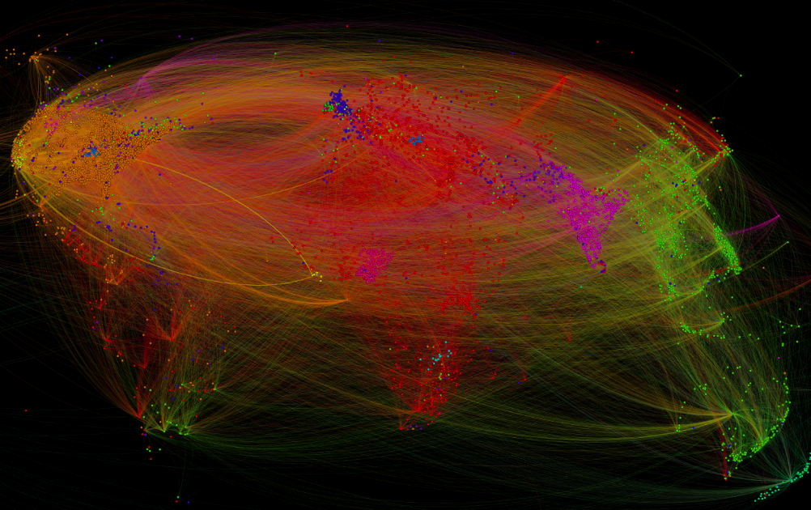
Temporary political map - Watching our world unfold
CS467 Project2

Slide 2
Team members
Panindra Tumkur Seetharamu Shubhanshu Mishra
Xiaodan Zhang

Slide 3
Research question
What events happened between politically significant countries during a specific time period?
How are the associations or relationships across 4 categories (Verbal Cooperation/Conflict and Material Cooperation/Conflict) of the selected country with other countries?

Slide 4
motivation
Understand the relationships between politically significant countries in the world
Find how the relationships between these countries change over time
Promote peace by building technology that helps people better understand each other

Slide 5
Intended audience
People who are interested in political analysis between countries in the world
People who want to promote peace and decrease world conflict between countries
People who like to study history, military and politics

Slide 6
Data source
The Global Database of Events, Language, and Tone (GDELT Project) (http://gdeltproject.org/) is an initiative to construct a catalog of human societal-scale behavior and beliefs across all countries of the world, connecting every person, organization, location, count, theme, news source, and event across the planet into a single massive network that captures what's happening around the world, what its context is and who's involved, and how the world is feeling about it, every single day
Fields we use:
Year, Actor1Geo_CountryCode, Actor2Geo_CountryCode, QuadClass
Reference: https://bigquery.cloud.google.com/table/gdelt-bq:full.events?pli=1

Slide 7
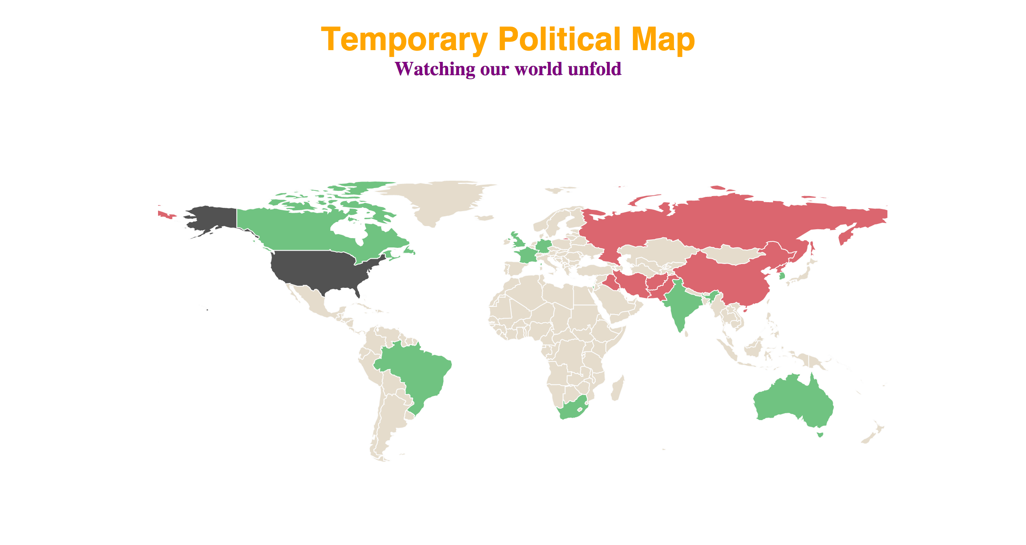
Search Country …
Conflicts
Cooperation
Selected
No Data
1980
1999
2014
Either search or click on the country to see its relation with other countries
Click on the play button to see the evolution across years
Move the slider to focus on a given year
The opacity of the color indicates the number of events
Countries with similar relations with US tend to get clustered together
Concepts used: Overview, Detail, Color Scheme,
Map concepts with edges, nodes and districts.

Slide 8
Search Country …
Russia (1999)
Verbal Cooperation: 20019
Material Cooperation: 4003
Verbal Conflict: 1345
Material Conflict: 30134
Conflicts
Cooperation
Selected
No Data
1980
1999
2014
Mouse-over: Display the detail of the four events statistics of country v.s. the selected country
The opacity of the color indicates the number of events
Countries with similar relations with US tend to get clustered together
Concepts used: Overview, Detail, Color Scheme,
Map concepts with edges, nodes and districts.

Slide 9
Tools & analysis
Tools
Google BigQuery for querying and extracting data from the entire quarter-billion-record GDELT Event Database
D3 for data visualization
Analysis
Use Python to clean and group data extracted from GDELT data base

Slide 10
THANK YOU!
CS467 PROJECT2 – Temporary political map

