Slide 1
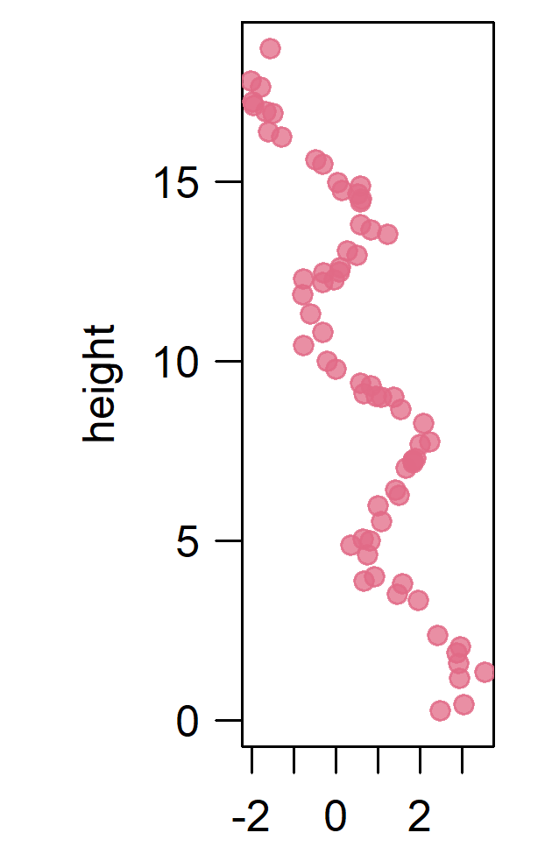
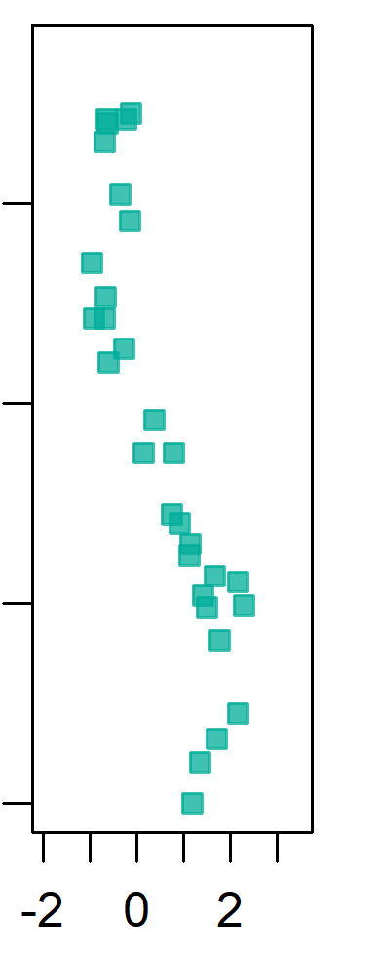
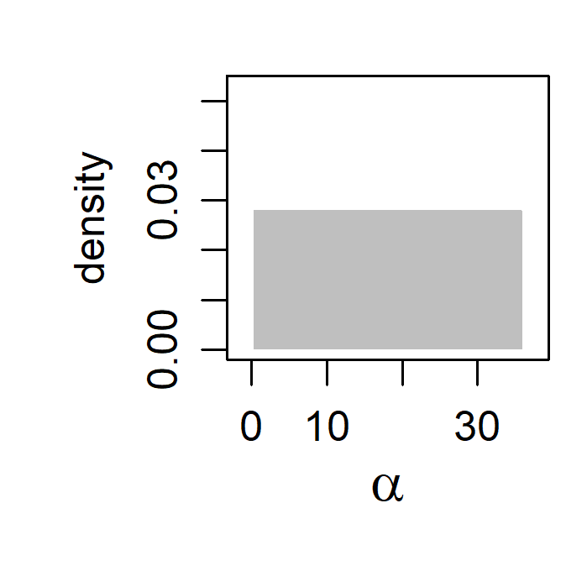
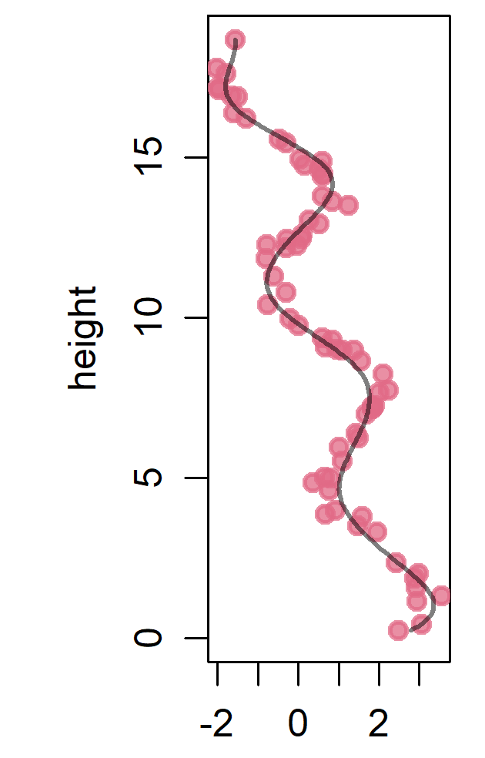
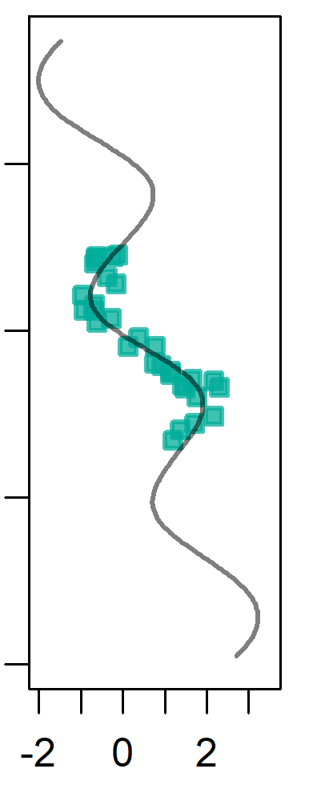
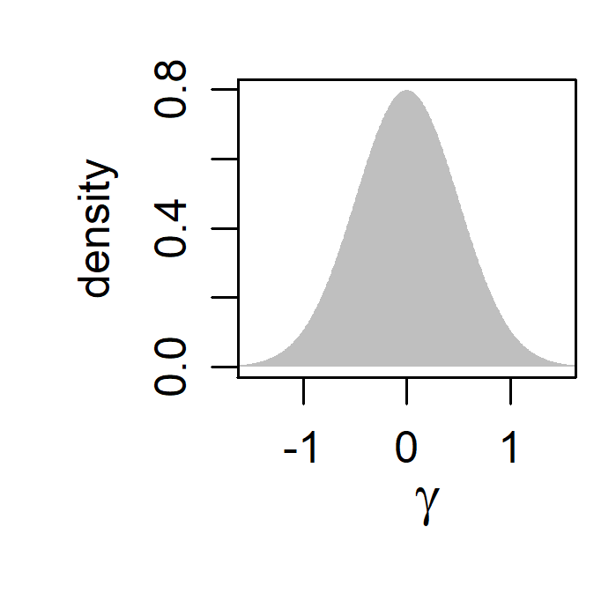
(a)
data
(b)
priors
(c)
alignment
Site 1
(reference site)
Site 2
unaligned
uniform prior on α
Site 1
(reference site)
Site 2
unaligned
α = shift parameter (reference height corresponding to the top of Site 2)
(m)
(m)
α
(m)
MCMC
γ
log-normal prior on γ
γ = relative sedimentation rate (scaling of Site 2 relative to the reference site)
measurement
measurement
ln( )
measurement
measurement

