Slide 1
Factors Affecting Final Grades
UCI Student Performance dataset (student-mat), n = 395 students
Notes:
Speaker notes: learner writes these in their own words

Slide 2
Question and data
Question: how do studytime, absences, family support and midterm grades (G1, G2) relate to final grade (G3)?
Data: UCI student-mat.csv, 395 rows x 33 columns, two schools (GP, MS)
Pipeline, four steps:
Load: read the raw CSV (semicolon-separated), never edited in place
Clean: numeric casts, yes/no to 1/0, pass_fail (G3 >= 10), absence level, risk group
Analyze: group means and std, correlations, three charts
Export: cleaned_students.csv and summary.json
Notes:
Speaker notes: learner writes these in their own words

Slide 3
Base rate: most students pass
265
130
0.671
pass
fail
pass rate
Pass means final grade G3 >= 10 (pass mark on a 0-20 scale)
Total n = 395
Notes:
Speaker notes: learner writes these in their own words

Slide 4
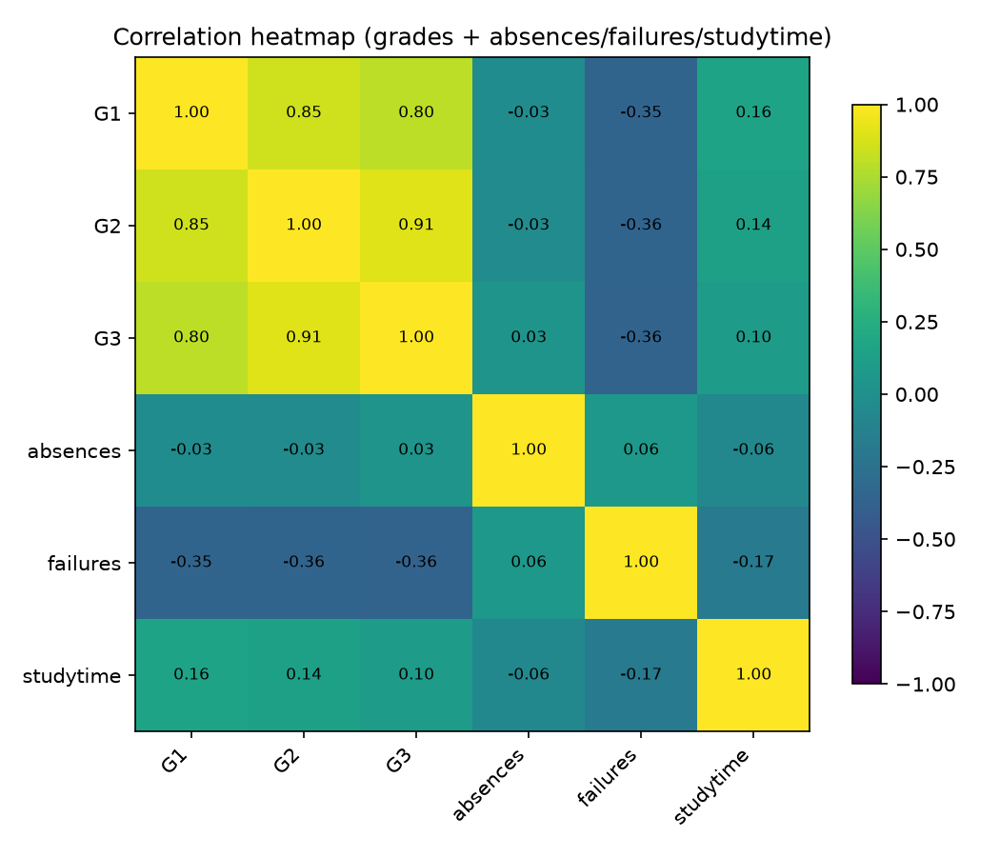
Grades correlate strongly
G2 and G3: 0.905
G1 and G2: 0.852
G1 and G3: 0.801
Midterm G2 is the strongest single correlate of final G3 in this data
Notes:
Speaker notes: learner writes these in their own words

Slide 5
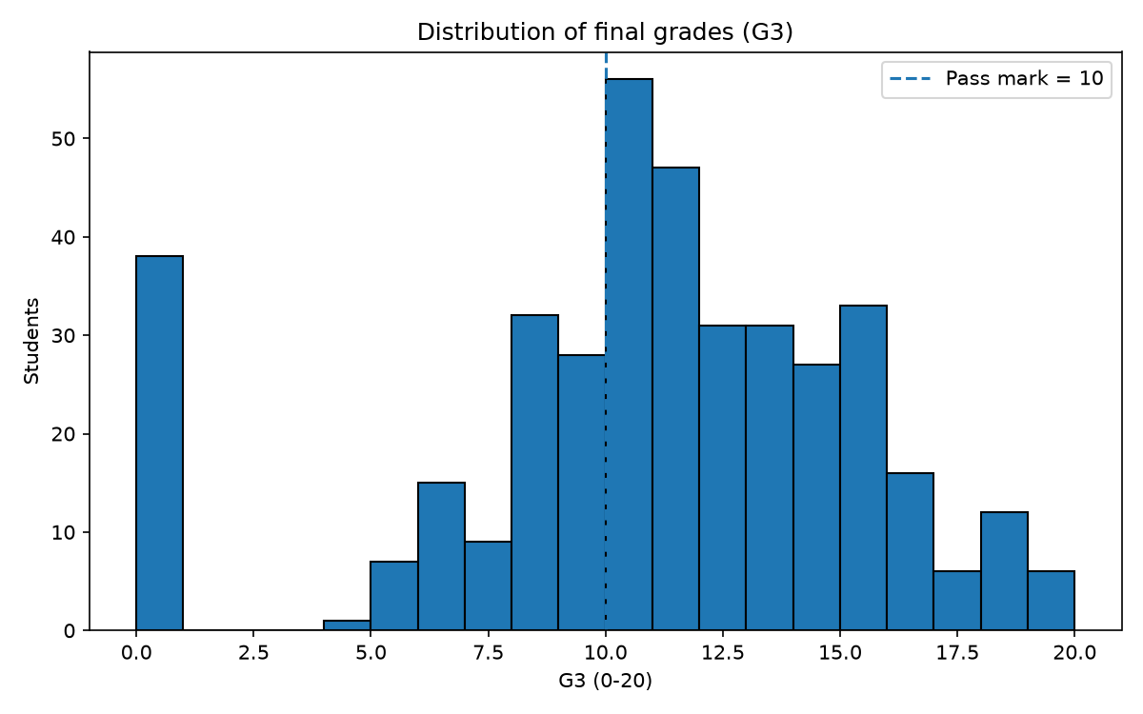
Past failures: the first failure is the biggest drop
Past failures | n | Mean G3
0 | 312 | 11.25
1 | 50 | 8.12
2 | 17 | 6.24
3 | 16 | 5.69
Drop from 0 to 1 failure: about -3.1
Drop from 1 to 2: about -1.9
Drop from 2 to 3: about -0.6
Biggest loss is the first failure, not each repeat
Notes:
Speaker notes: learner writes these in their own words

Slide 6
Risk groups and limits
Risk group | n | Mean G3
Low | 167 | 13.63
Medium | 91 | 11.65
High | 137 | 5.68
One subject and one year (Portuguese math cohort)
Correlation, not causation
No holdout test: the risk rule is not validated on new students
High group is defined partly by G3 (G3 < 10 or 2+ failures), so its gap is not an independent prediction
Notes:
Speaker notes: learner writes these in their own words

Slide 7
Next steps
Add student-por.csv with a subject column, to test whether the pattern holds in a second subject
Test G1 to G2 trajectories over time
Validate the risk rule out-of-sample before any school use
Notes:
Speaker notes: learner writes these in their own words

