Slide 1
StratusLab: Cloud Federation
C. Loomis (CNRS/LAL)
UK e-Science All Hands Meeting (York, UK)
28 September 2011

Slide 2






StratusLab Project
Goal
Create comprehensive, open-source, IaaS cloud distribution
Focus on supporting grid services
Information
1 June 2010—31 May 2012 (2 years)
6 partners from 5 countries
Budget : 3.3 M€ (2.3 M€ EC)
Contacts
Site web: http://stratuslab.eu/
Twitter: @StratusLab
Support: support@stratuslab.eu
CNRS (FR)
UCM (ES)
GRNET (GR)
SIXSQ (CH)
TID (ES)
TCD (IE)

Slide 3




Infrastructure as a Service (IaaS)
Goal
Offer remote access to computing resources
Advantages
Customized environments
Rapid access via simple API
Complete control (root access) with “pay as you go” model
Disadvantages
Non-standard interfaces (vendor lock-in)
Creating new virtual machines is difficult
Software as a Service (SaaS)
Platform as a Service (PaaS)
Infrastructure as a Service (IaaS)

Slide 4
Open source cloud?
Centralized, commercial cloud computing model
Co-locate large, efficient data centers near cheap electricity, cooling
“Cheaper” cycles with no administration costs for physical hardware
Amazon, Google, Microsoft, etc. already doing this
Data management
Some data needs higher level of security (privacy, confidentiality)
Providers are ill-equipped to deal with large transfers of data
Data from scientific instruments is naturally distributed
Reliability called into question by large-scale outages
In the short and medium terms, existing data centers must be able to deploy their own cloud infrastructures and users will want a federated view of them.

Slide 5
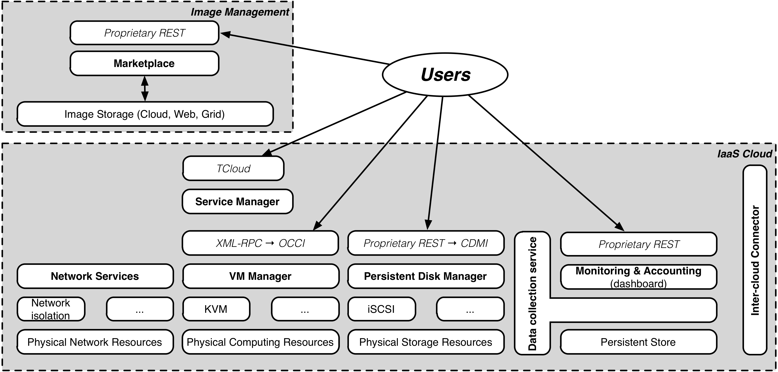
Architecture of StratusLab v2.0
Easy to install CLI
REST web/APIs
jclouds coming soon
OCCI, CDMI planned
Production Release (v1.1)
Continued improvements in Y2
Hybrid cloud deployments
Integration in dist. infra.

Slide 6
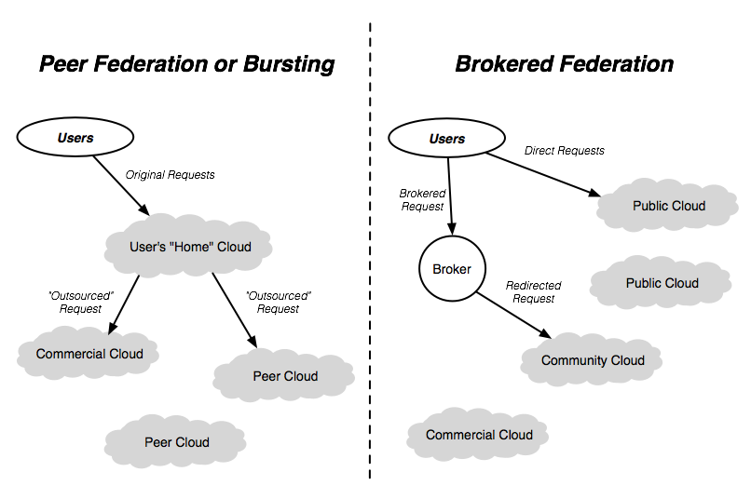
Federation Models

Slide 7
Flexible Authentication
Proxy services
All services are proxied through a common authentication layer
Uses Jetty application container and JAAS framework
Integration with other AAA infrastructures (Argus, Shibboleth) easy
Supported mechanisms “out of the box”
Username/password in password file or from LDAP
Grid cert./proxy in “password” file or from LDAP
Currently user-based, groups and roles coming soon

Slide 8
Marketplace
Machine image creation is a barrier to cloud adoption
Creating virtual machine images is time-consuming
Ensuring that machines are secure and correct is difficult
Sharing existing machines lowers this barrier
Marketplace facilitates sharing of images
Registry of metadata for machine & disk images
Image contents are kept in cloud, grid, or web storage
Supports trust between creators, users, and administrators
Benefits
End-users: browse and use existing images for their analyses
Creators: publicize their work and attract larger user base
Cloud Admins.: Use metadata to evaluate trustworthiness of images

Slide 9
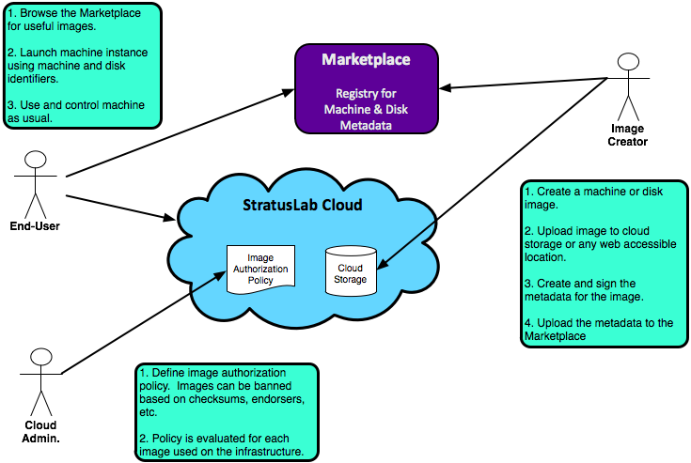
Marketplace Workflows

Slide 10
Federation Challenges
Standard Interfaces
Exist but not widely implemented or interoperable
APIs with plug-ins largely fill this gap
Not really a limitation for hybrid or federated infrastructures
Networking
VLAN in WAN is issue for multi-cloud service deployments
Dynamic, real-time configuration is an issue when migrating machines
Live migration between cloud infrastructures is a real challenge
Image Management
Formats not the same for different hypervisors
Convergence on OVF, but neither universal nor complete now
Translation possible, but time-consuming and error-prone

Slide 11
Current StratusLab Experience
OpenNebula
Plug-in architecture allows incorporation of “other” cloud resources
Still issues with image formats, etc.
Claudia
High-level service for deployment/control of multiple machines
Plug-ins allow multi-cloud deployments (EC2, Flexiant, StratusLab)
Same issues with image formats, etc.
SlipSteam (SixSq)
Commercial product for deployment/testing of multiple machines
Allows multi-cloud deployment for supported clouds
Uses image “recipes” to recreate images on different clouds

Slide 12
Current StratusLab Experience
Multiple sites
Reference infrastructure in Greece as primary cloud resource
Second site at LAL will also soon be publicly available
Used as basis (with commercial providers) for tests of federation

Slide 13
Conclusions
StratusLab releases
Complete, production release available (latest is v1.1)
Continued improvements of v1.x services
Adding hybrid/federated infrastructure support moving towards v2.0
Resolve technical aspects of federation
Identify non-technical (policy, legal, etc.) issues with federation
Collaboration
Open to collaboration with other people, projects, infrastructures, etc.
Working towards integration with EGI sites
Involved in EGI Cloud Federation Task Force
Want feedback (positive and negative) from user, administrators, …

Slide 14
Test Drive
Reference Infrastructure
Open to public (with registration) to provide feedback to project
Send an email to support@stratuslab.eu
GRNET runs a production grid site over a StratusLab cloud
StratusLab Client
Command line scripts in python with few dependencies
Works on Mac OSX, Windows, and Linux
Provided Appliances
Base images: ttylinux, CentOS 5.5, Ubuntu 10.04, OpenSuSE (?)
Grid: CE, SE, WN, APEL/BDII, UI
Bioinformatics: Data server and analysis images

