Slide 1
BATTLE OF THE NEIGHBORHOODS
Aditya Gouroju

Slide 2
Clustering of Neighborhoods
Clustering Neighborhoods based on the venue categories.
Helpful for people moving to far away places
For people who want to find similar kind of Neighborhoods
For people to explore

Slide 3
Data Acquisition and Cleaning
Borough Names , Neighborhood Names , Geographical Coordinates of Toronto City is scraped from here
Borough Names , Neighborhood Names , Geographical Coordinates of New York City are imported from here
Venues in the corresponding Neighborhoods are obtained by requesting API’s from Foursquare.

Slide 4
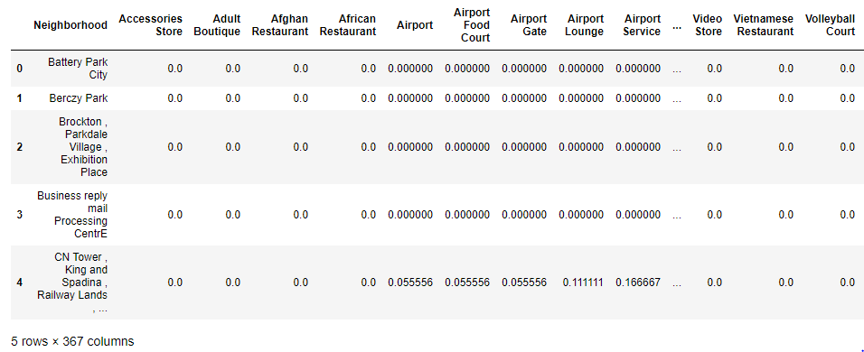
Data Acquisition and Cleaning (contd.)
The final data after making the API calls for the venues contains about 4580 venues combined
Performing One-Hot encoding on the venue categories and applying mean ,The data has 367 unique Venue categories

Slide 5
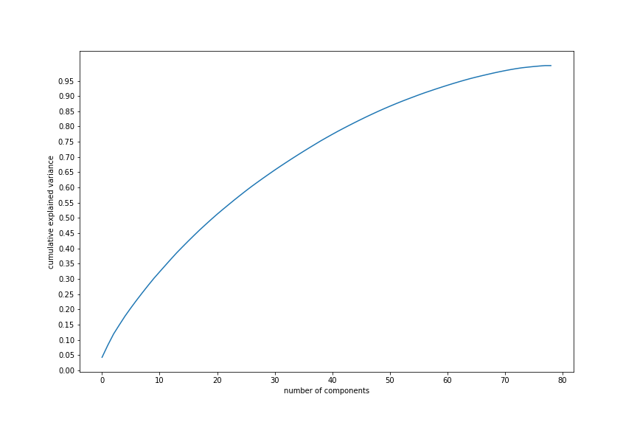
Reducing Dimensionality using PCA
Using Principal Component Analysis to reduce the components to consider for modeling to avoid overfitting of the model
By plotting a Graph between PCA and K the the number of appropriate components chosen are 70.

Slide 6
Modeling
K-Means Clustering Model is used as our model
For details about the K-Means clustering refer here
To Find the optimal number of clusters to be formed in this model
Elbow Point Method
Silhouette Score Method

Slide 7
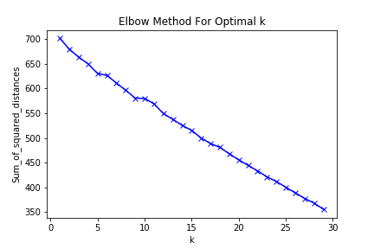
Elbow Point Method
A graph between Mean squared error and K(number of clusters)
The value of K at which the slope of the graph drastically changes is optimal K.

Slide 8
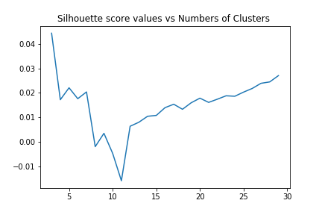
Silhouette Score Method
It is the value of how perfectly an object fits in its own cluster
It Ranges from -1 to 1 . A Graph between Silhouette score and K
Optimal value of K is K with highest Silhouette score

Slide 9
Visualization
K-Means Clustering with 5 clusters .
Neighborhoods with same color labels are of same cluster i.e similar Neighborhoods
Clustered Maps of Toronto and New York for comparison
For more detailed report refer here.

Slide 10
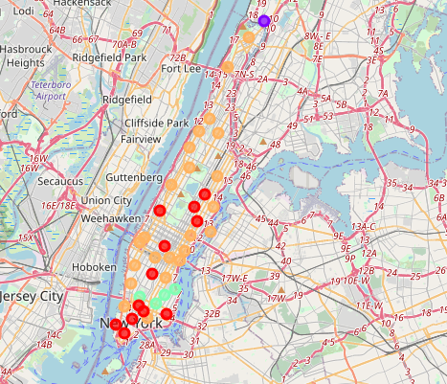
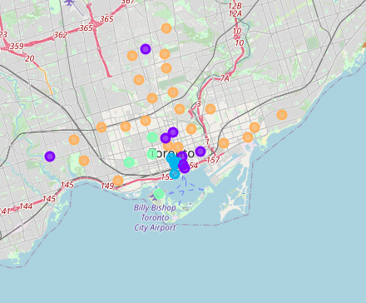
Visualization (contd).

Slide 11
Conclusion
Built model to segment similar type of Neighborhoods based on venue categories in both the cities.
Useful to people moving from one city to another
More analyzation is done and explained in the Report

