Slide 1

Szoftverfejlesztő és -tesztelő 5 0613 12 03 PROJEKT DOKUMENTÁCIÓ
Debreceni SZC Beregszászi Pál Technikum és Kollégium 4032 Debrecen, Jerikó utca 17.
Dokumentáció készítői: Rohoska Dominik, Szilágyi Bence, Topcsiov Zoltán Alex
Osztály: 13/C
2026

Slide 2
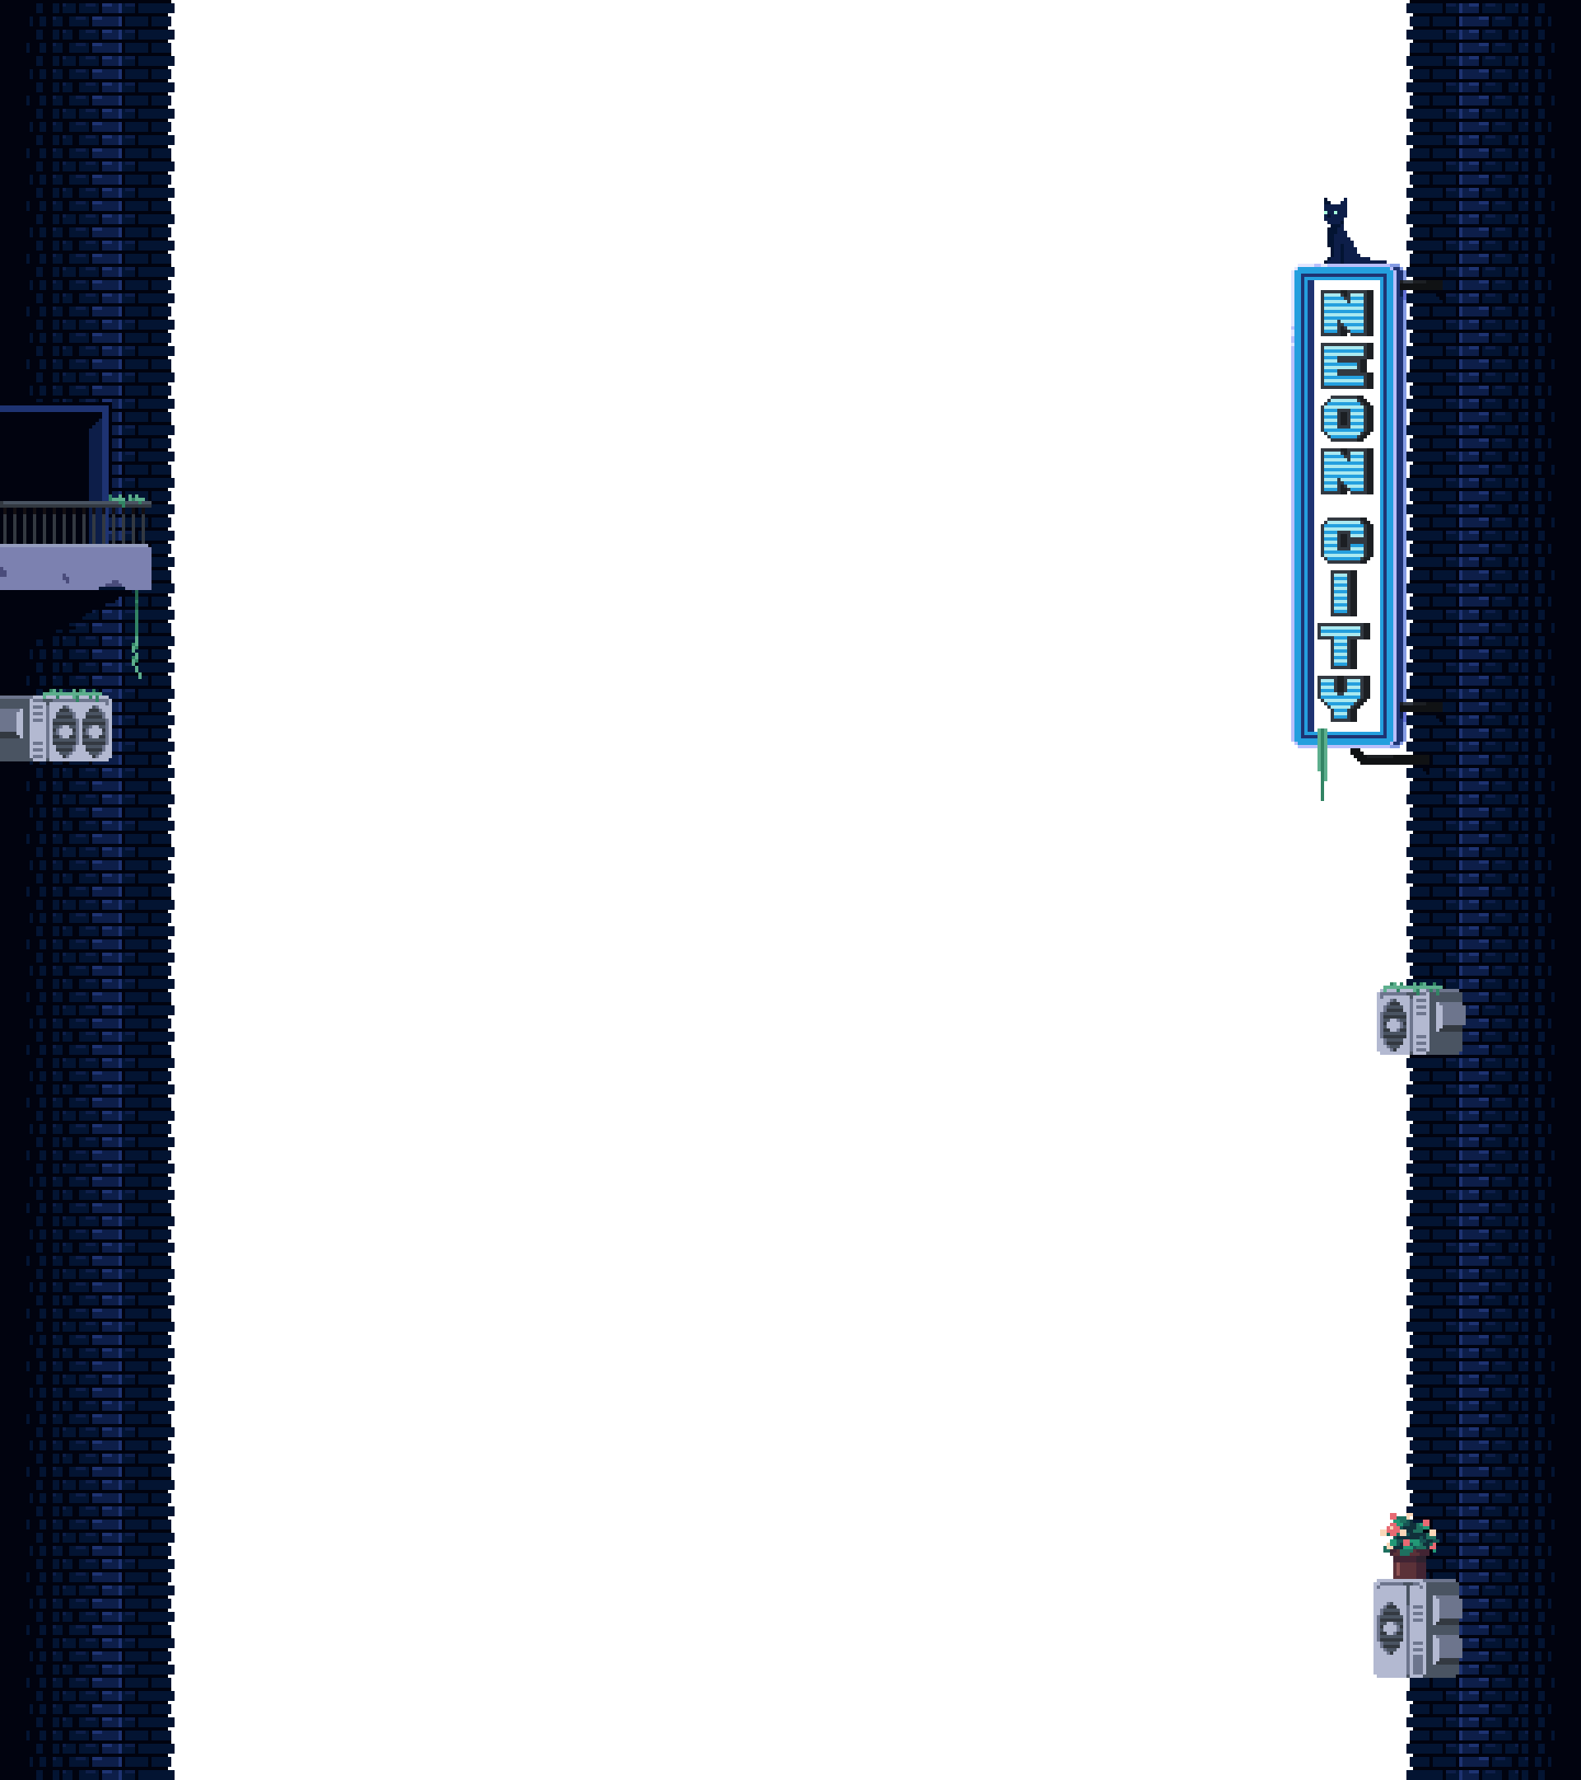
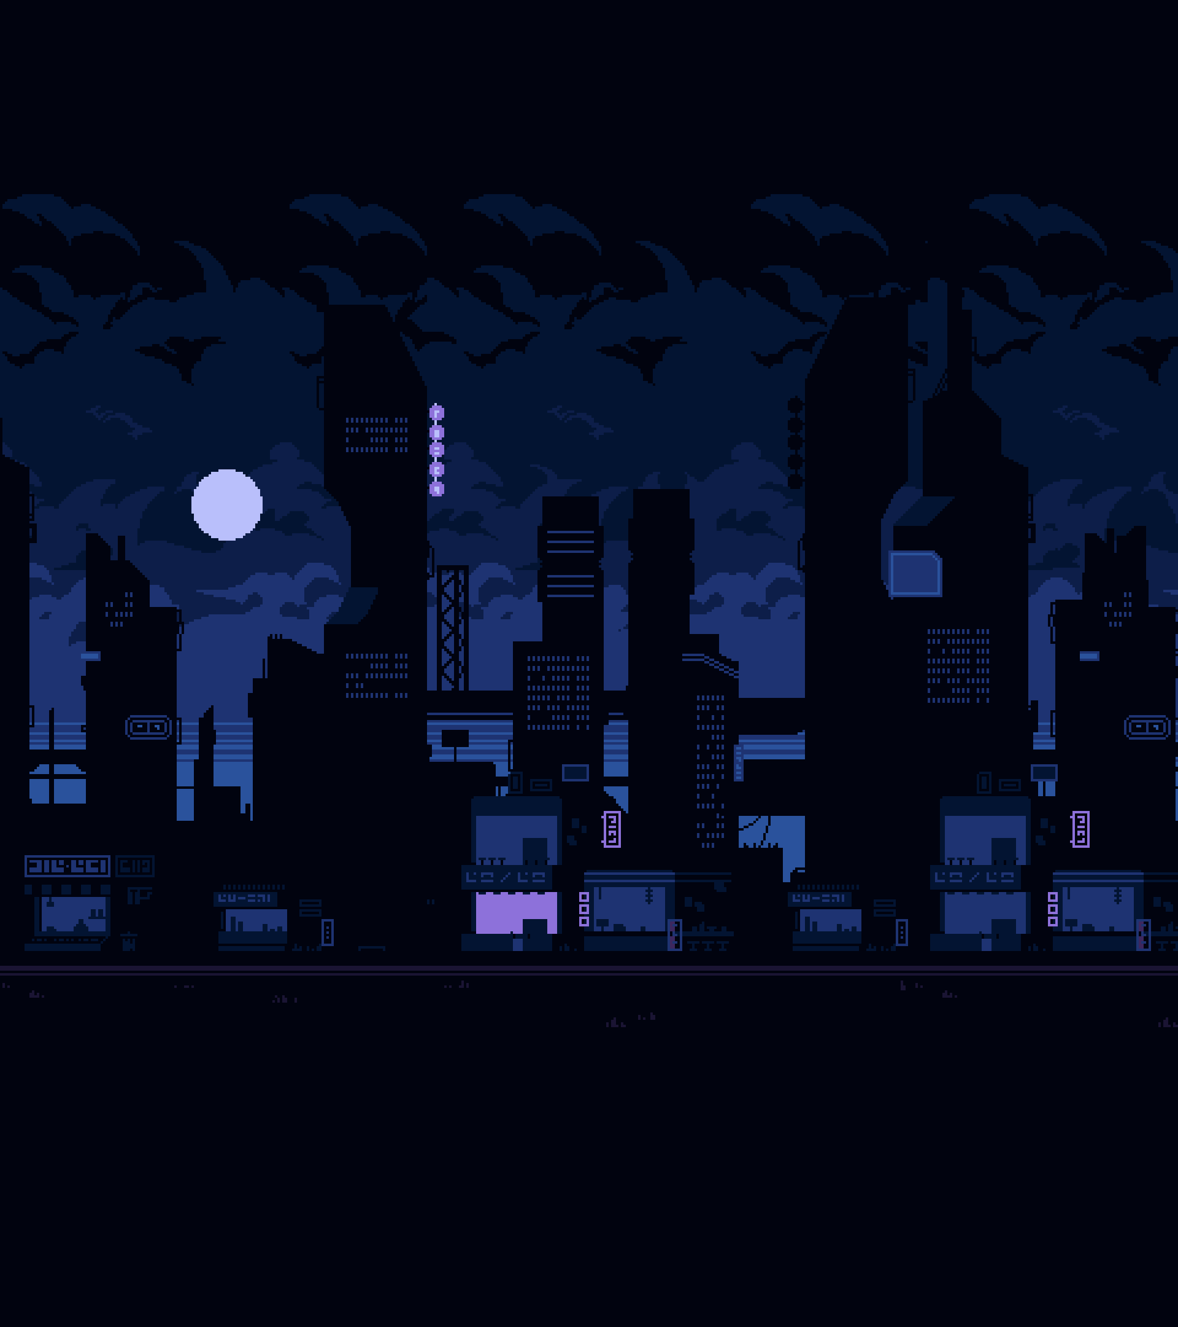

Echo Runner
2D Sci-fi platformer

Slide 3
Game concept
2D Side-scrolling platformer
Jumping, avoiding obstacles
Classic platformer experience with modern elements

Slide 4
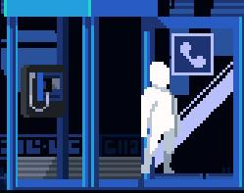

Game story
The Protagonist is an Echo
World ruled by a mega corporation
Goal: complete the levels as quickly as possible

Slide 5

Gameplay
Move left and right
Jumping from platform to platform
Avoid obstacles

Slide 6
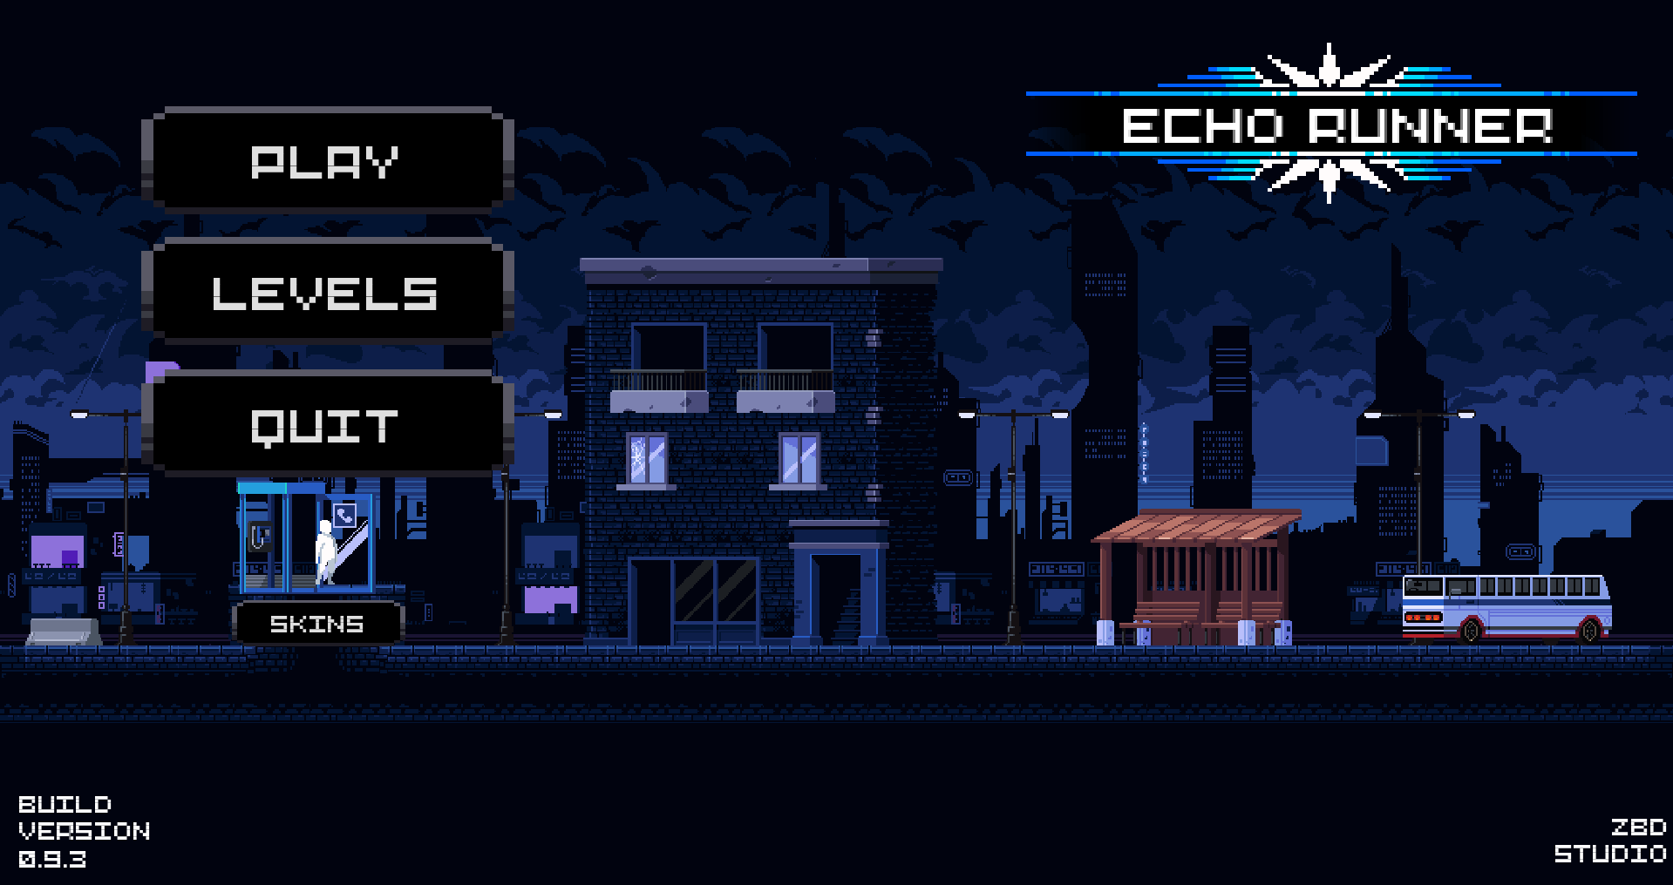
Menus and Huds
Main menu

Slide 7
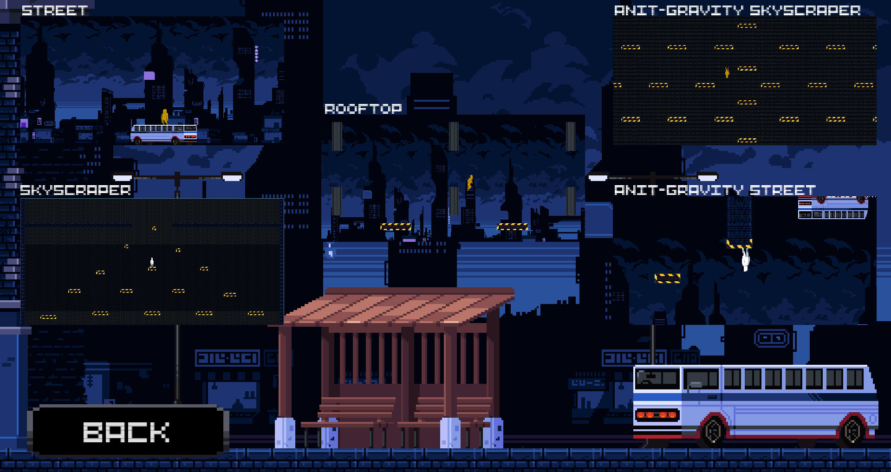
Menus and Huds
Level select

Slide 8
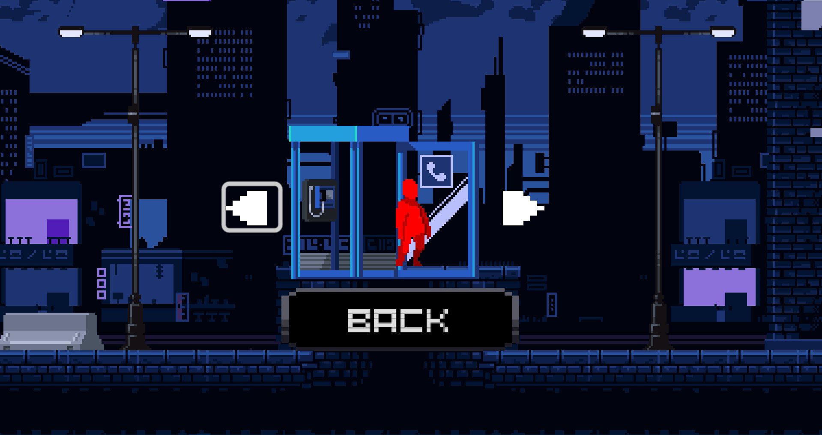
Menus and Huds
Skin Select

Slide 9
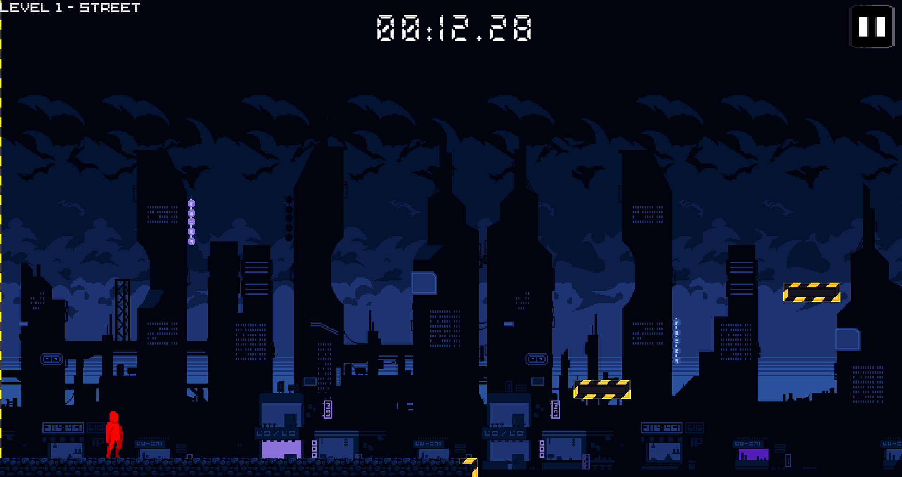
Menus and Huds
In-Game HUD

Slide 10
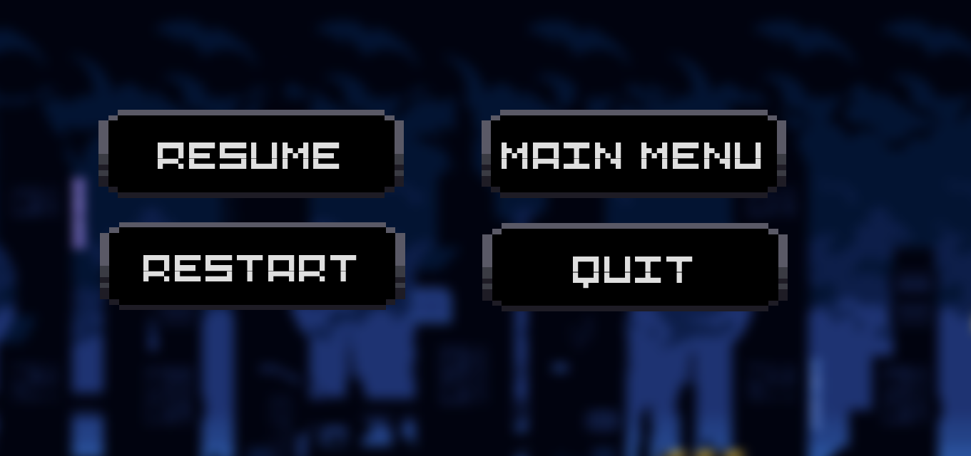
Menus and Huds
Pause menu

Slide 11
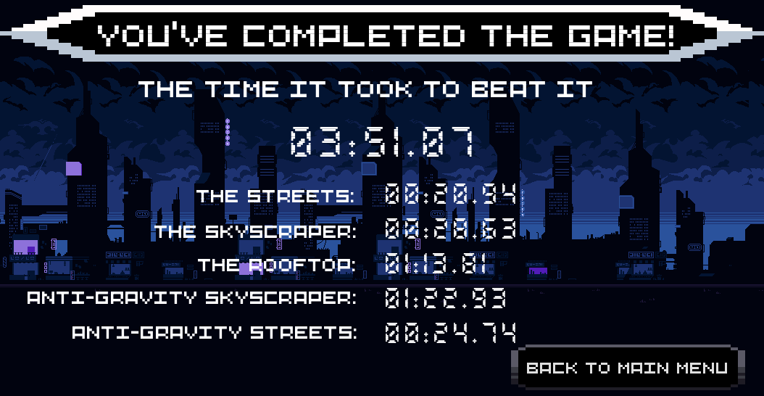
Menus and Huds
End score menu

Slide 12
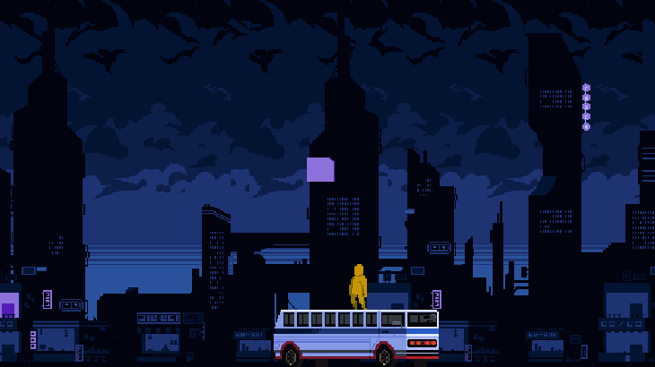
The Streets
The very first level
Quiet easy
Has platforms and moving vehicles

Slide 13
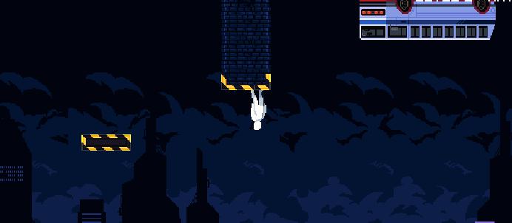
The Streets (EX)
A more difficult Street level
Everything is upside down
Controls are inverted

Slide 14
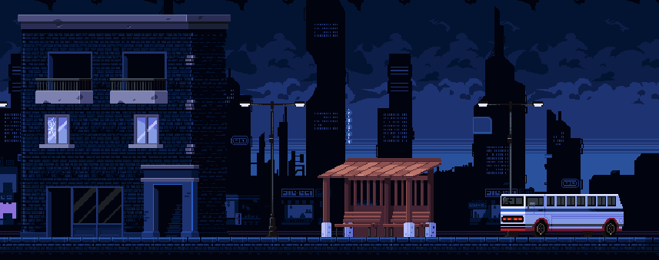
Graphics
Pixel art graphics
Dark colors
Simple animations
Retro atmosphere

Slide 15
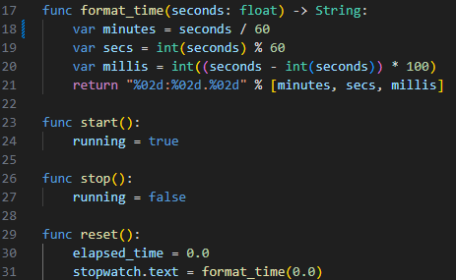

Implementation
Godot engine
GDscript
Keyboard + gamepad controls
Simple physics

Slide 16
Web Presence & Official Website
Technologies Used :
Frontend: HTML · CSS
Backend: PHP
Database: MySQL
Additional features: Responsive design

Slide 17
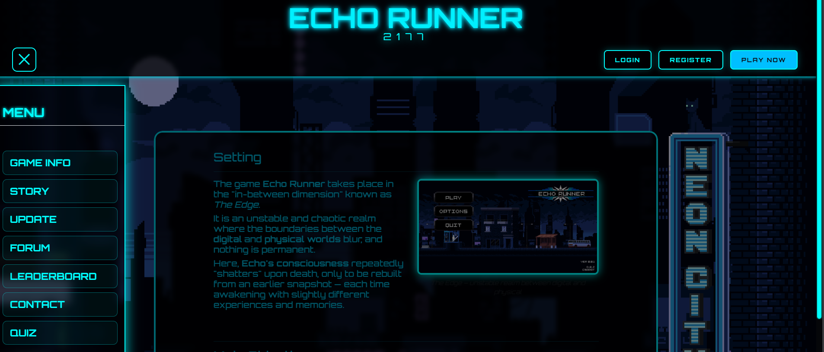
Website Structure & Navigation
Main Menu Sections
Core Pages & Features

Slide 18
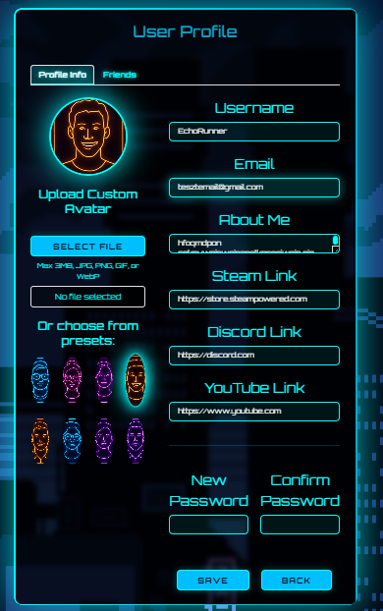
User Profile Customization

Slide 19
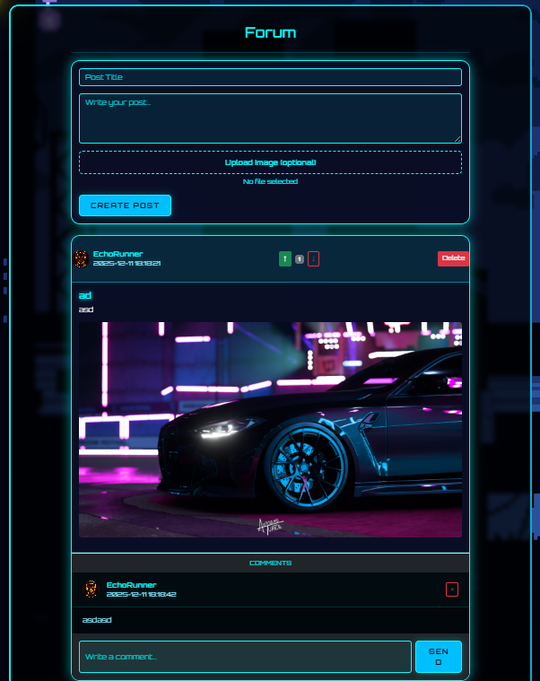
Community Forum
Post
Comment
Vote

Slide 20
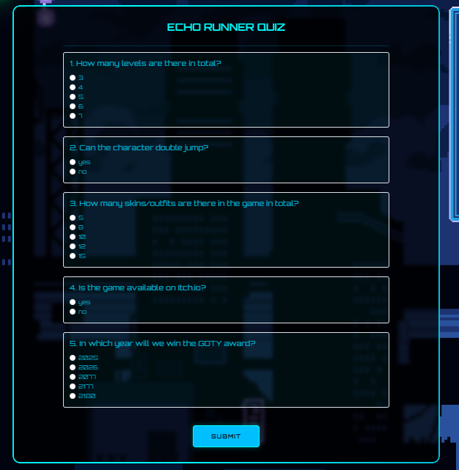
Quiz

Slide 21
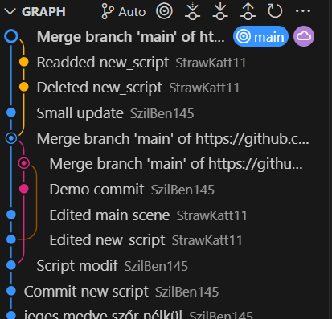
Git Commits

Slide 22
Thank you for your attention!

