Slide 1
Continuous-Time Convolution
Signals and Systems Fall 2023
Prof. Dr. Adnan Kavak
Computer Engineering
Kocaeli University
Textbook: Linear Systems and Signals, B.P. Lathi
These slides are used in EE313 course at the University of Texas at Austin.
They are adopted in this course with Courtesy of Prof. Brian L. Evans

Slide 2
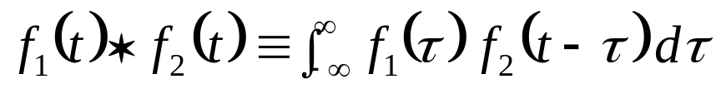
Convolution Integral
Commonly used in engineering, science, math
Convolution properties
  Commutative: f₁(t) * f₂(t) = f₂(t) * f₁(t)
  Distributive: f₁(t) * [f₂(t) + f₃(t)] = f₁(t) * f₂(t) + f₁(t) * f₃(t)
  Associative: f₁(t) * [f₂(t) * f₃(t)] = [f₁(t) * f₂(t)] * f₃(t)
  Shift: If f₁(t) * f₂(t) = c(t), then
  f₁(t) * f₂(t - T) = f₁(t - T) * f₂(t) = c(t - T).
  Convolution with impulse, f(t) * δ(t) = f(t)
  Convolution with shifted impulse, f(t) * δ(t-T) = f(t-T)
important later in modulation
4 - <number>

Slide 3
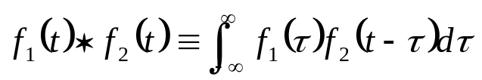
Graphical Convolution Methods
From the convolution integral, convolution is equivalent to
  Rotating one of the functions about the y axis
  Shifting it by t
  Multiplying this flipped, shifted function with the other function
  Calculating the area under this product
  Assigning this value to f₁(t) * f₂(t) at t
4 - <number>

Slide 4
Graphical Convolution Example
Convolve the following two functions:
Replace t with τ in f(t) and g(t)
Choose to flip and slide g(τ) since it is simpler and symmetric
Functions overlap like this:
f(t)
g(t)
2
3
*
t
t
2
-2
2
3
g(t-τ)
2
f(τ)
τ
4 - <number>
2
-2 + t
2 + t

Slide 5
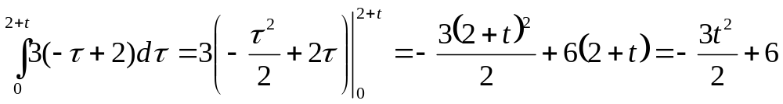
Graphical Convolution Example
Convolution can be divided into 5 parts
  t < -2
    Two functions do not overlap
    Area under the product of the
    functions is zero
  -2 ≤ t < 0
    Part of g(t) overlaps part of f(t)
    Area under the product of the
    functions is
3
g(t-τ)
2
f(τ)
τ
2
-2 + t
2 + t
3
g(t-τ)
2
f(τ)
τ
2
-2 + t
2 + t
4 - <number>

Slide 6
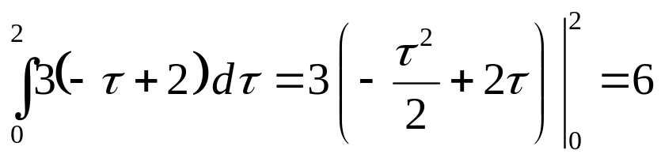
Graphical Convolution Example
  0 ≤ t < 2
    Here, g(t) completely overlaps f(t)
    Area under the product is just
  2 ≤ t < 4
    Part of g(t) and f(t) overlap
    Calculated similarly to -2 ≤ t < 0
  t ≥ 4
    g(t) and f(t) do not overlap
    Area under their product is zero
3
g(t-τ)
2
f(τ)
τ
2
-2 + t
2 + t
3
g(t-τ)
2
f(τ)
τ
2
-2 + t
2 + t
4 - <number>

Slide 7
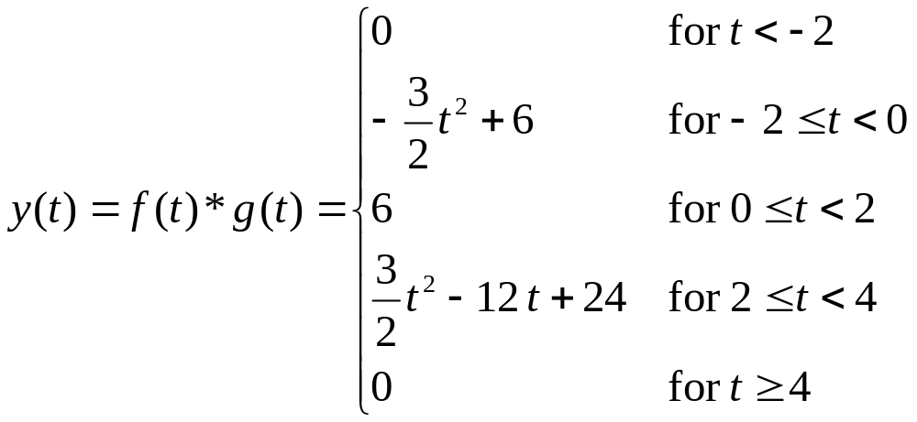
Graphical Convolution Example
Result of convolution (5 intervals of interest):
No Overlap
Partial Overlap
Complete Overlap
Partial Overlap
No Overlap
y(t)
6
t
-2
0
2
4
4 - <number>

Slide 8
Convolution Demos
Johns Hopkins University Demonstrations
  http://www.jhu.edu/~signals
  Convolution applet to animate convolution of simple signals and hand-sketched signals
  Convolve two rectangular pulses of same width gives a triangle (see handout E)
Some conclusions from the animations
  Convolution of two causal signals gives a causal result
  Non-zero duration (called extent) of convolution is the sum of extents of the two signals being convolved
4 - <number>

Slide 9





Example: Transmit One Bit
Transmission over communication channel (e.g. telephone line) is analog
receive ‘0’ bit
‘0’ bit
input
output
Τ_{p}
Communication
Channel
Τ_{h}
Τ_{h}+Τ_{p}
t
t
x(t)
y(t)
-A
-A T_{h}
receive‘1’ bit
Model channel as LTI system with impulse response h(t)
A
1
A T_{h}
Τ_{p}
t
t
t
Τ_{h}
t
Τ_{h}
Τ_{h}+Τ_{p}
‘1’ bit
Assume that T_{h} < T_{p}
4 - <number>

Slide 10


Example: Transmit Two Bits (Interference)
Transmitting two bits (pulses) back-to-back will cause overlap (interference) at the receiver
How do we prevent intersymbol
interference at the receiver?
*
1
=
A
2Τ_{p}
Τ_{h}+Τ_{p}
Τ_{p}
t
Τ_{h}
t
Τ_{p}
t
-A T_{h}
‘1’ bit
‘0’ bit
Assume that T_{h} < T_{p}
‘1’ bit
‘0’ bit
intersymbol interference
4 - <number>

Slide 11
Example: Transmit Two Bits
(No Interference)
Prevent intersymbol interference by waiting T_{h} seconds between pulses (called a guard period)
Disadvantages?
*
1
=
A
Τ_{h}+Τ_{p}
Τ_{h}+Τ_{p}
Τ_{h}
Τ_{p}
t
Τ_{p}
t
t
Τ_{h}
-A T_{h}
‘1’ bit
‘0’ bit
Assume that T_{h} < T_{p}
‘1’ bit
‘0’ bit
4 - <number>

