Slide 1
Discrete-Time Convolution Examples
Signals and Systems Fall 2023
Prof. Dr. Adnan Kavak
Computer Engineering
Kocaeli University
Textbook: Linear Systems and Signals, B.P. Lathi
These example slides are initially prepared by Nabat Hangeldiyeva using the class
notes of Prof.Dr.Adnan Kavak

Slide 2
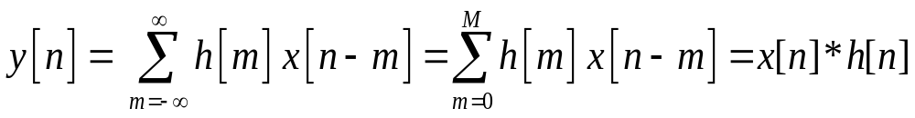
Discrete Time Convolution Example:
Method 1: Running Finite Convolution Sum
x[n]
h[n]
y[n]
h[n] is finite valued between 0 and M.
Other values of h[n] are zero
x[n]
h[n]
3
2
1/2
1/2
1
n
-3
-2
-1
0
1
2
3
4
5
n
-3
-2
-1
0
1
2
3
4
5
Averaging FIR Filter

Slide 3
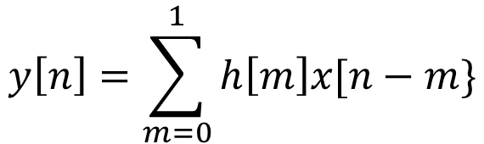
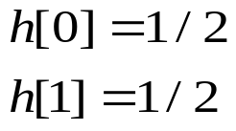
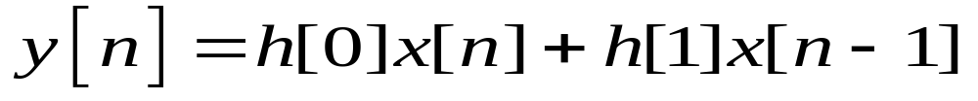
n | -3 | -2 | -1 | 0 | 1 | 2 | 3
x[n] | 0 | 0 | 1 | 2 | 1 | 0 | 0
h[n] | 0 | 0 | 0 | 1/2 | 1/2 | 0 | 0
x[n-1] | 0 | 0 | 0 | 1 | 2 | 1 | 0
h[0] x[n] | 0 | 0 | 1/2 | 1 | 1/2 | 0 | 0
h[1] x[n-1] | 0 | 0 | 0 | 1/2 | 1 | 1/2 | 0
y[n] | 0 | 0 | 1/2 | 3/2 | 3/2 | 1/2 | 0
y[n]
3/2
3/2
1/2
1/2
-3
-2
-1
1
2
3
4
n
0
4 - <number>

Slide 4
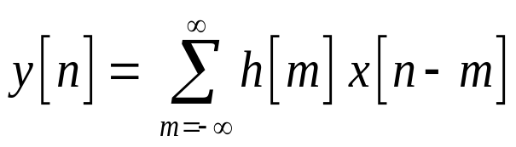

Method 2: Flip and Shift
flip
shift
Step 1: Construct following table for each value of n. Ecah row of the table is the sequence x[n-m] in the convolution sum. For n>0 shift sequence x[-m] by n unit to right, for n<0 shift sequence x[-m] by n unit to the left.
n | -3 | -2 | -1 | 0 | 1 | 2 | 3
x[-m] | 0 | 0 | 1 | 2 | 1 | 0 | 0
h[m] | 0 | 0 | 0 | 1/2 | 1/2 | 0 | 0
n=1 x[1-m] | 0 | 0 | 0 | 1 | 2 | 1 | 0
n=2 x[2-m] | 0 | 0 | 0 | 1 | 2 | 1 | 0
n=-1 x[-1-m] | 0 | 1 | 2 | 1 | 0 | 0 | 0
y[n] | 0 | 0 | 1/2 | 3/2 | 3/2 | 1/2 | 0
4 - <number>

Slide 5
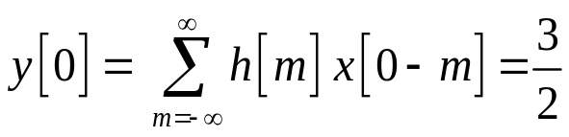
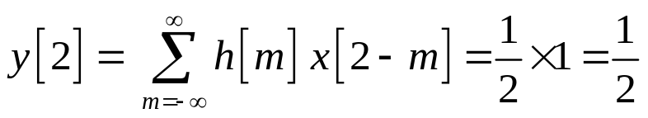
Method 2: Flip and Shift
Step 2: For non-zero overlapping values of h[m] and x[n-m] , calculate convolution.
n=0
n=1
n=2
n=-1
y[-1]=1/2
y[n]
3/2
1/2
-3
-2
-1
1
2
3
4
n
0
4 - <number>

Slide 6
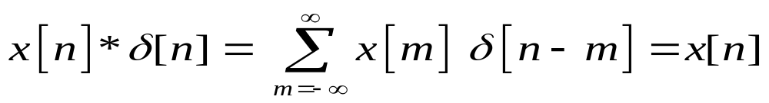

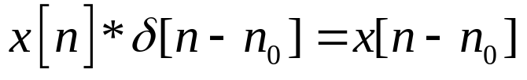

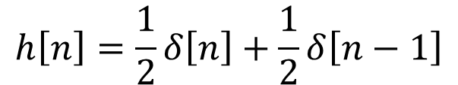

Method 3: Convolution by Impuls Property
1)
n-m=0
m=n
2)
örnek
h[n]
x[n]
1/2
1/2
3
2
1
-3
-2
-1
0
1
2
3
4
5
n
-3
-2
-1
0
1
2
3
4
5
n
4 - <number>

Slide 7
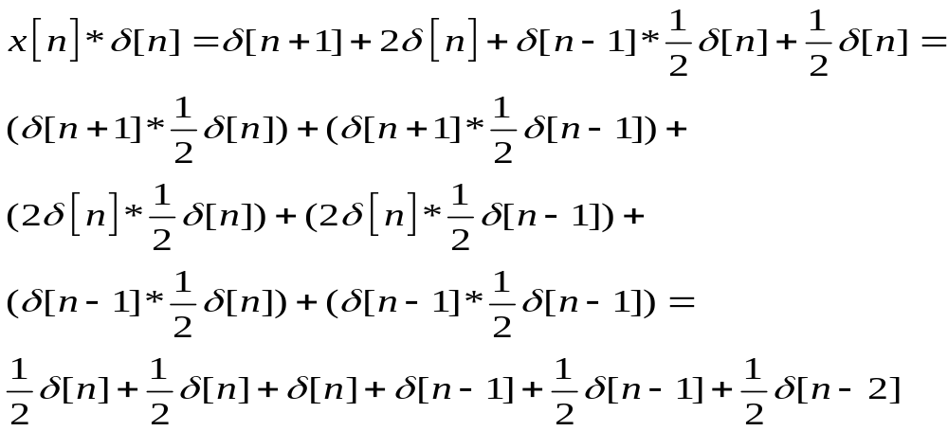
4 - <number>

