Slide 1
Z-Transform
Signals and Systems Fall 2023
Prof. Adnan Kavak
Computer Engineering
Kocaeli University
Textbook: Linear Systems and Signals, B.P. Lathi
This slides were used in EE313 course at UT Austin, which are adopted and used in this course with Courtesy of Prof. Brian L. Evans

Slide 2
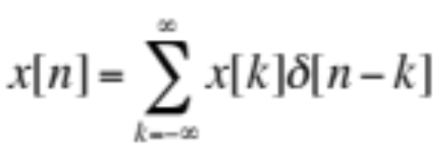
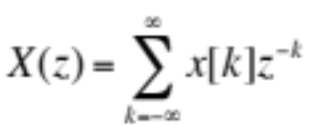
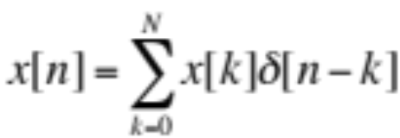
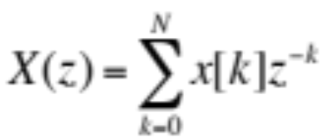
Z-Transforms
Analysis tool for discrete-time signals and systems
  Converts convolution & difference equations into polynomials
  Describes LTI system transfer of input to output frequencies
Adds third domain to time and frequency domains
  Hopefully pick domain in which analysis is the easiest
General definition: z is complex variable
z
time domain
z-domain
Simplified definition for finite-length signal x[n]
z

Slide 3
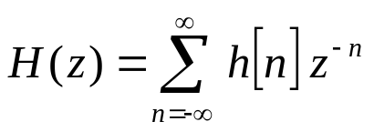
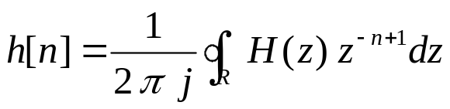
Z-transforms
For discrete-time systems, z-transforms play the same role as Laplace transforms do in continuous-time systems
As with the Laplace transform, we compute forward and inverse z-transforms by use of transforms pairs and properties
Bilateral Forward z-transform
Bilateral Inverse z-transform
21 - <number>

Slide 4
Region of Convergence
Region of the complex z-plane for which forward z-transform converges
Four possibilities (z=0 is a special case and may or may not be included)
Im{z}
Im{z}
Entire plane
Disk
Re{z}
Re{z}
Im{z}
Im{z}
Intersection of a disk and complement of a disk
Complement of a disk
Re{z}
Re{z}
21 - <number>

Slide 5
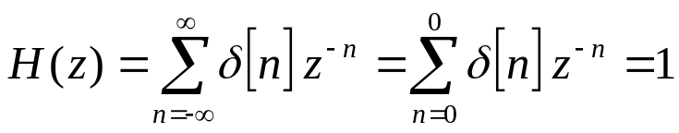
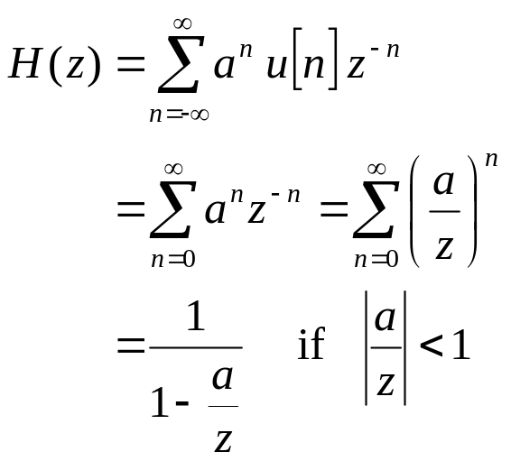
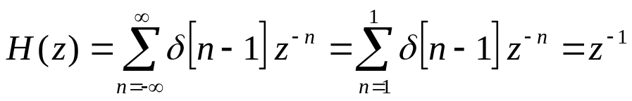
Z-transform Pairs
h[n] = δ[n]
  Region of convergence: entire z-plane
h[n] = δ[n-1]
  Region of convergence: entire z-plane except z = 0
  h[n-1] ⇔ z⁻¹ H(z)
h[n] = a^{n} u[n]
  Region of convergence: |z| > |a| which is the complement of a disk
21 - <number>

Slide 6
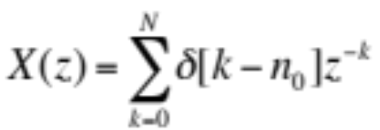
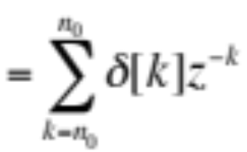


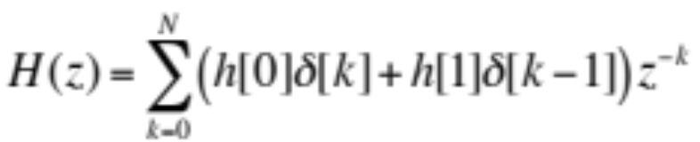


Z-Transform Pairs
Z-transform for finite length signal x[n]
z
Delayed unit impulse
valid for all z
z
valid for all z ≠ 0
Two-point impulse response
z
valid for all z ≠ 0
10-<number>
polynomial in z ⁻¹

Slide 7








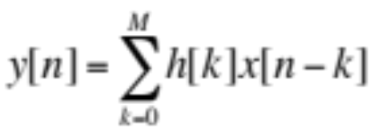
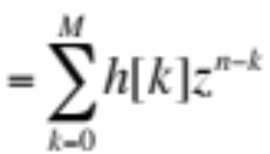
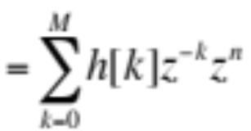
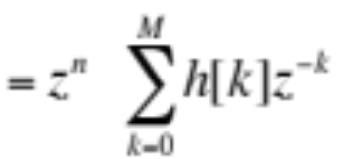

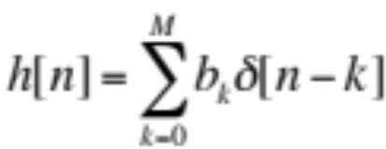
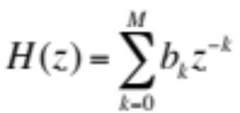
Z-Transform Pairs
Review
FIR filter of Mth order
  Impulse response h[n]
  Let x[n] = z^{n} for –∞ < n < ∞
x[n] | X(z) | Valid
 |  | all z
 |  | z ≠ 0
 |  | z ≠ 0
h[n]
  H(z) is system function, a.k.a. transfer function in z-domain
  H(z) is z-transform of impulse response h[n]
z
polynomial in z ⁻¹
  If H(z) = 1 + 2z⁻¹ + z⁻², what is h[n]?

Slide 8
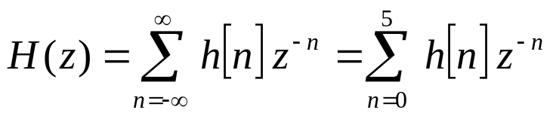
Applying Z-transform Definition
Finite extent signal
  Polynomial in z⁻¹
Five-tap delay line
  Impulse response h[n]
  Transfer function H(z)
h[n]
5
4
3
2
1
1
2
3
4
5
n
h[n] = n ( u[n] – u[n-6] )
n = -1:6;
h = n .* ( stepfun(n,0) - stepfun(n-6,0) );
stem(n, h);
21 - <number>

Slide 9
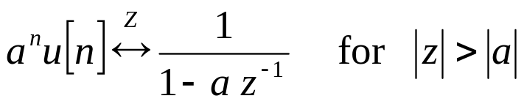
BIBO Stability
Rule #1: Poles inside unit circle (causal signals)
Rule #2: Unit circle in region of convergence
  Analogy in continuous-time: imaginary axis would be in region of convergence of Laplace transform
Example:
  BIBO stable if |a| < 1 by rule #1
  BIBO stable if |z| > |a| includes unit circle; hence, |a| < 1 by rule #2
BIBO means Bounded-Input Bounded-Output
21 - <number>

Slide 10
Inverse z-transform
Definition
Yuk! Using the definition requires a contour integration in the complex z-plane
  Use Cauchy residue theorem (from complex analysis) OR
  Use transform tables and transform pairs?
Fortunately, we tend to be interested in only a few basic signals (pulse, step, etc.)
  Virtually all signals can be built from these basic signals
  For common signals, z-transform pairs have been tabulated
21 - <number>

Slide 11
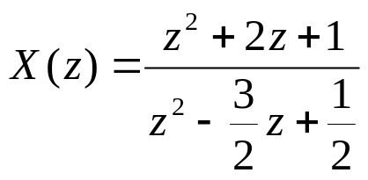
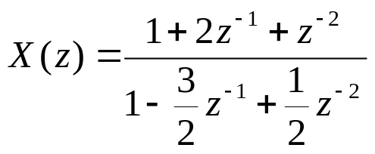
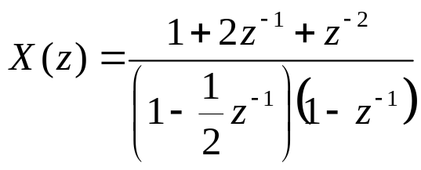
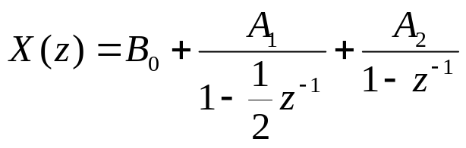
Example
Ratio of polynomial z-domain functions
Divide through by the highest power of z
Factor denominator into first-order factors
Use partial fraction decomposition to get first-order terms
21 - <number>

Slide 12
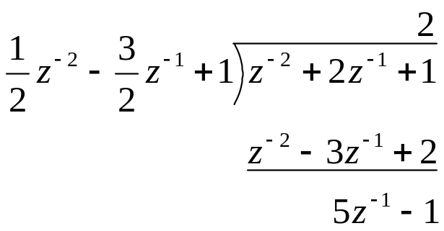
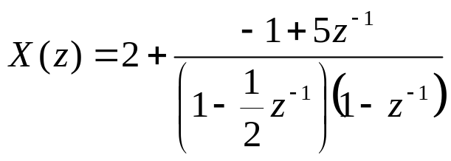
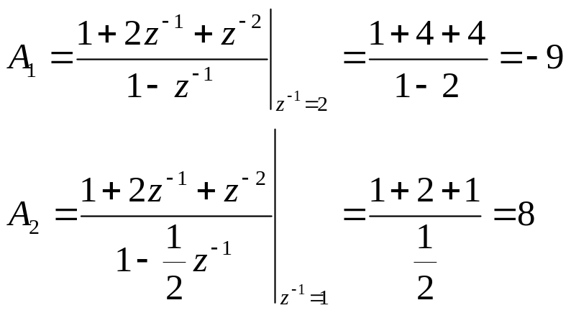
Example (con’t)
Find B₀ by polynomial division
Express in terms of B₀
Solve for A₁ and A₂
21 - <number>

Slide 13
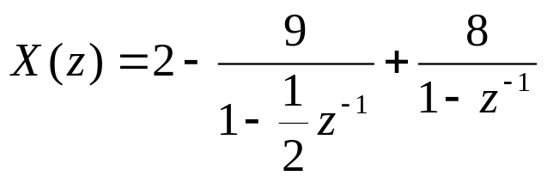
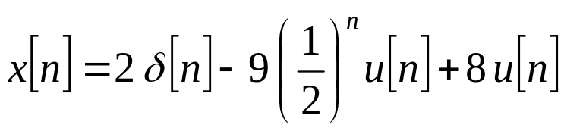
Example (con’t)
Express X(z) in terms of B₀, A₁, and A₂
Use table to obtain inverse z-transform
With the unilateral z-transform, or the bilateral z-transform with region of convergence, the inverse z-transform is unique
21 - <number>

Slide 14
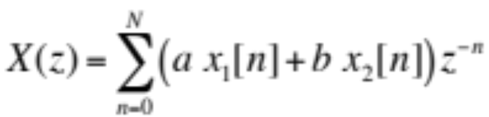

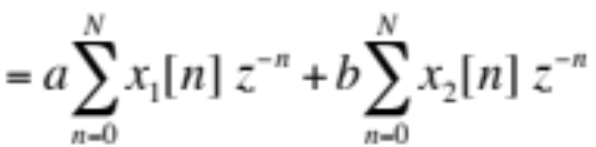

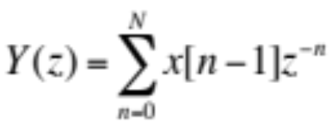
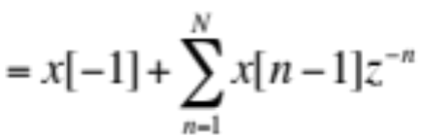

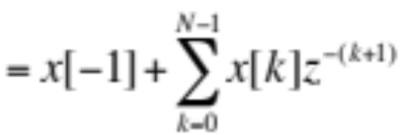


Z-Transform Properties
Z-Transforms – SPFirst Sec. 7-3 & 7-4
Superposition (linearity) property
z
  When viewed as system,
  z-transform has linearity
Time-delay property
  z⁻¹ in z-domain corresponds to time shift of 1 sample
z
x[n]
y[n]
z⁻¹
if x[-1] = 0
system is LTI
initial condition
10-<number>

Slide 15

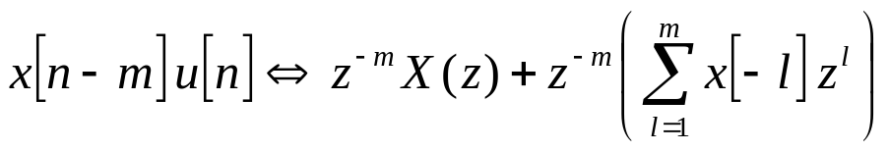
Z-transform Properties
Right shift (delay)
  Second property used in solving difference equations
  Second property derived in Appendix N of course reader by decomposing the left-hand side as follows:
  x[n-m] u[n] = x[n-m] (u[n] – u[n-m]) + x[n-m] u[n-m]
21 - <number>

Slide 16
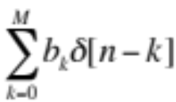
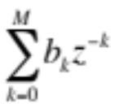








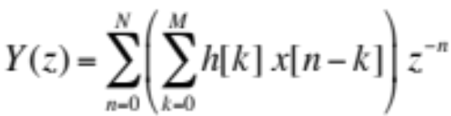
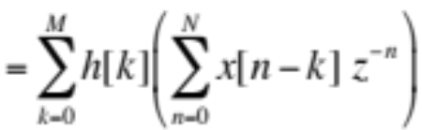
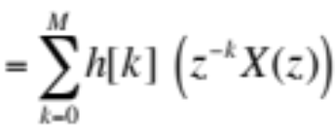
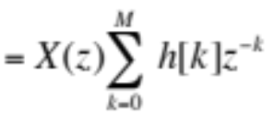

Convolution and the z-Transform
Unit delay
y[n] | Y(z) | Valid
 |  | all z
 |  | z ≠ 0
 |  | z ≠ 0
 |  | z ≠ 0
 |  | **
 |  | z ≠ 0
  h[n] = δ[n-1]
  y[n] = x[n] * δ[n-1] = x[n-1]
  Y(z) = z⁻¹ X(z) = H(z) X(z)
x[n]
y[n]
z⁻¹
if x[-1] = 0
system is LTI
Convolution property
z
Assuming causal x[n]
i.e. x[n] = 0 for n < 0

Slide 17
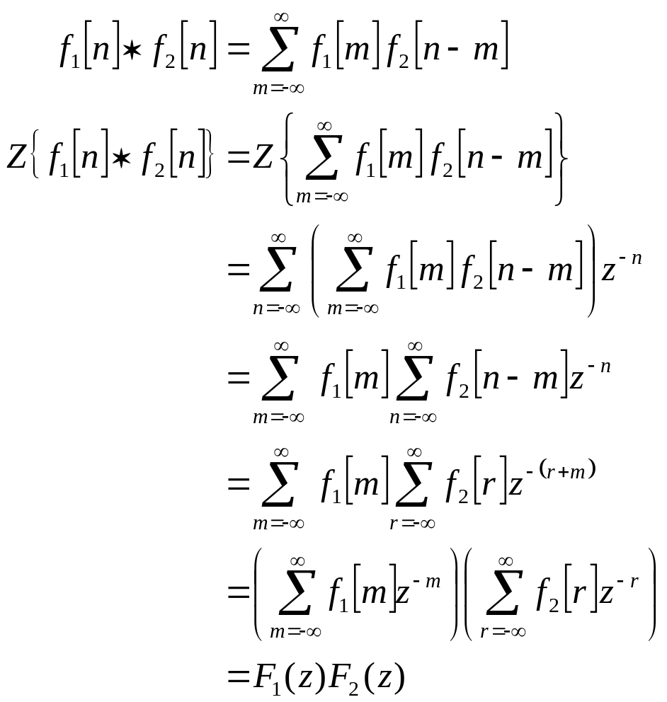
Z-transform Properties
(Proof of Convolution Property)
Convolution definition
Take z-transform
Z-transform definition
Interchange summation
Substitute r = n - m
Z-transform definition
21 - <number>

Slide 18
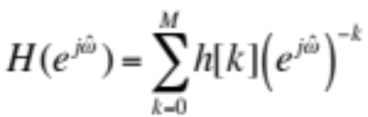
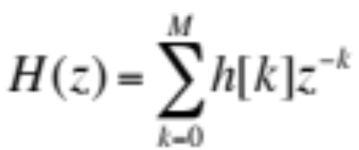
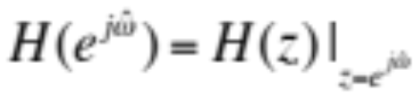













z-Domain and Frequency Domain
Make connection directly from their definitions
Basis for freqz(h) command
How does look in z-domain?
Circle of radius 1 (a.k.a. unit circle)

Slide 19
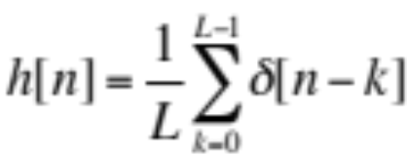

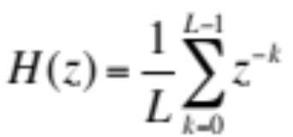
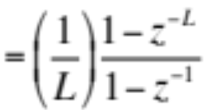
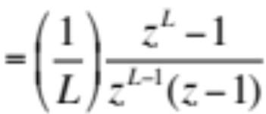
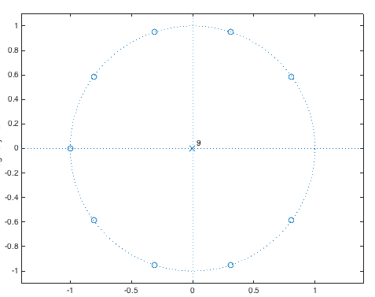




L-Point Averaging Filter
Impulse response:
h[n]
Z-transform
n
-1
0
1
2
L-1
L
L=10
  Roots of numerator (zeros):
  Roots of denominator (poles):
  Zero at z = 1 cancels pole at z = 1
h = (1/10)*ones(1,10);
zplane(h);

