Slide 1
Java: Beginning
Computer Engineering Department
Java Programming Course
Prof. Dr. Ahmet Sayar
Kocaeli University - Fall 2022

Slide 2
JAVA
Platform independent
Compile once run everywhere
JVM - Java Virtual Machine

Slide 3
Applications and Applets
Two kinds of Java programs: applications and applets
Applications
regular programs
meant to be run on your computer
Applets
little applications
meant to be sent to another location on the Internet and run there

Slide 4
Class Structure
package myprojects.javaprojects.prj1;
import java.util.*;
public class Test {
int x;
int y;
public static void main(String args[]){
int a;
int b;
}
}

Slide 5
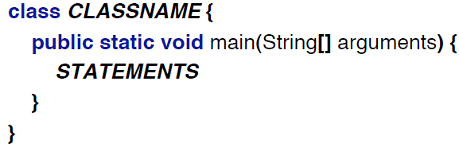
Program Structure

Slide 6
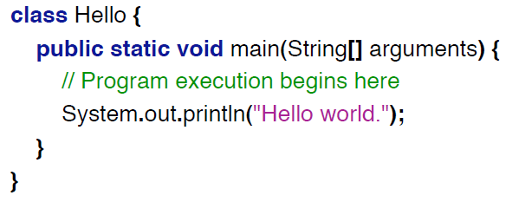
First Program

Slide 7
Some Terminology
The person who writes a program is called the programmer.
The person who interacts with the program is called the user.
A package is a library of classes that have been defined already.
import java.util.*

Slide 8
Some Terminology, cont.
The item(s) inside parentheses are called argument(s) and provide the information needed by methods.
A variable is something that can store data.
an instruction to the computer is called a statement; it ends with a semicolon.
The grammar rules for a programming language are called the syntax of the language.

Slide 9
Printing to the Screen
System.out.println (“Whatever you want to print”);
System.out is an object for sending output to the screen.
println is a method to print whatever is in parentheses to the screen.
How about System.out.print
int var=3;
System.out.println(var + “ time A”); ?

Slide 10
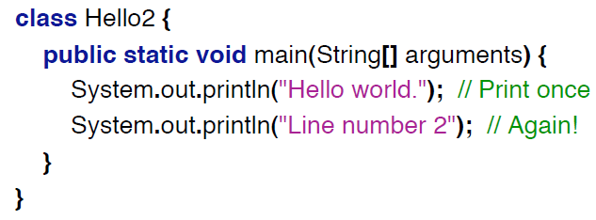
Printing to the Screen

Slide 11
Simple Input
Sometimes the data needed for a computation are obtained from the user at run time.
Keyboard input requires
import java.util.*;
at the beginning of the file.

Slide 12
java.util
import java.util.Arrays;
import java.util.ArrayList;
import java.util.Calendar;
import java.util.Currency;
import java.util.Date;
import java.util.HashMap;
import java.util.LinkedList;
import java.util.Random;
import java.util.Scanner;
import java.util.StringTokenizer;
import java.util.Vector;

Slide 13
Simple Input, cont.
Data can be entered from the keyboard using Scanner keyboard =
new Scanner(System.in);
followed, for example, by
int eggsPerBasket = keyboard.nextInt();
double d1 = keyboard.nextDouble();
which reads one int value from the keyboard and assigns it to eggsPerBasket.

Slide 14
Compiling a Java Program or Class
A Java program consists of one or more classes, which must be compiled before running the program.
You need not compile classes that accompany Java (e.g. System and Scanner).
Each class should be in a separate file.
The name of the file should be the same as the name of the class.

Slide 15
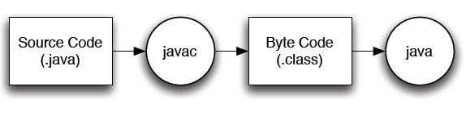
Compiling

Slide 16
Compiling and Running
Use an IDE (integrated development environment) which combines a text editor with commands for compiling and running Java programs.
When a Java program is compiled, the byte-code version of the program has the same name, but the ending is changed from .java to .class.

Slide 17
Compiling and Running, cont.
A Java program can involve any number of classes.
The class to run will contain the words
public static void main(String[] args)
near the beginning of the file.

Slide 18
Java Version History
JDK Alpha and Beta (1995)
JDK 1.0 (January 23, 1996)
JDK 1.1 (February 19, 1997)
J2SE 1.2 (December 8, 1998)
J2SE 1.3 (May 8, 2000)
J2SE 1.4 (February 6, 2002)
J2SE 5.0 (September 30, 2004)
Java SE 6 (December 11, 2006)
Java SE 7 (July 28, 2011)
Java SE 8 (March 18, 2014) (Extended Suppor until March 2025)
Java SE 9 (September 21, 2017) (No extended support)
Java SE 10 (March, 20, 2018) (No extended support)
Java SE 11 – September 2018 (open to free public updates)
Java SE 12 – March 2019 (open to free public updates)
Java SE 13 – September 2019 (open to free public updates)
https://www.java.com/releases/

Slide 19
Netbeans
Roman Staněk formed a company around the project and produced commercial versions of the NetBeans IDE
Netbeans was bought by Sun Microsystems in 1999. Sun open-sourced the NetBeans IDE in June of the following year.
In 2010, Sun (and thus NetBeans) was acquired by Oracle Corporation.
In September 2016, Oracle submitted a proposal to donate the NetBeans project to the Apache Software Foundation,

Slide 20
Netbeans
NetBeans IDE 8.2 was released on 3 October 2016.
Netbeans 9.0, which adds support for Java 9 and 10, was released on 29 July 2018, by the Apache Incubator project.
NetBeans 10.0 was released on 27 December 2018. It brings support for Java 11 and improved support for PHP (7.0–7.3).
NetBeans 11.1 was released on 22 July 2019.
Netbeans 12.5 2021

Slide 21
What does Deprecate Mean in Java?
When you design an API, carefully consider whether it supersedes an old API. If it does, and you wish to encourage developers (users of the API) to migrate to the new API, then deprecate the old API. Valid reasons to deprecate an API include:
It is insecure, buggy, or highly inefficient
It is going away in a future release
It encourages bad coding practices
Deprecation is a reasonable choice in all these cases because it preserves "backward compatibility" while encouraging developers to change to the new API. Also, the deprecation comments help developers decide when to move to the new API, and so should briefly mention the technical reasons for deprecation.

Slide 22
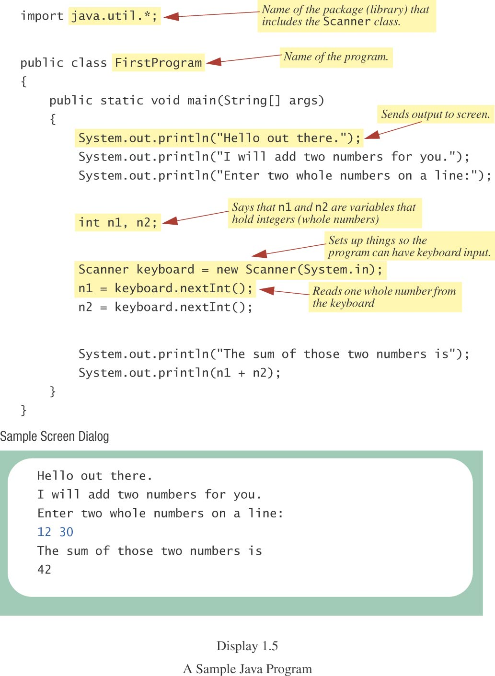
Input from Keyboard - 1

Slide 23
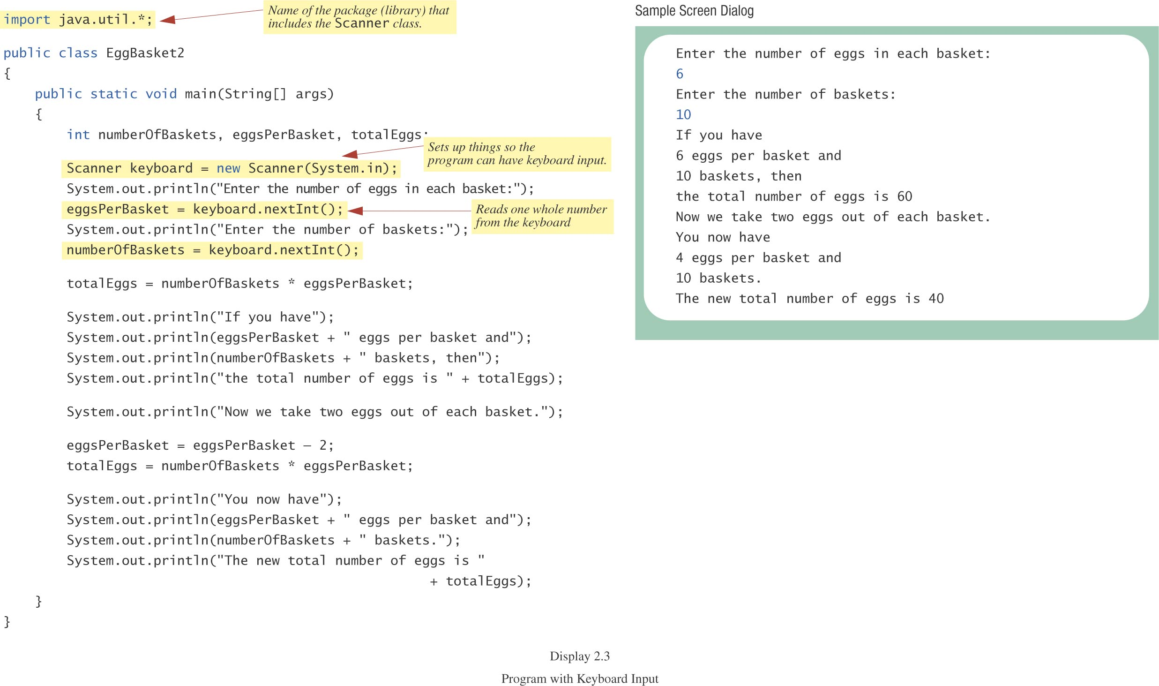
Input from Keyboard - 2

Slide 24
Input from Command Line
package Lab_1;
public class HelloWorld {
public static void main (String args[]) {
System.out.println("Hello World! ");
System.out.println(args[0]);
}
}
Since it is in package Lab_1, it is expected to be located in [project_path]/src/Lab_1/HelloWorld.java

Slide 25
Sample Command Lines Compiling and Running
[project_path]>javac Lab_1/HelloWorld.java
HelloWorld.class is created
This is bytecode class or also called target class
[project_path]>java Lab_1/HelloWorld Ahmet
Output: ???
Hello World!
Ahmet
[project_path]>java Lab_1/HelloWorld Ahmet Sayar
Output: ???
How about output of System.out.println(args[2]); ???

Slide 26
Questions?
What is JVM?
What is byte code, source code, target code
Is java portable how?
What is java SDK?
What is java JRE?
Not specifically for java, in general
What is linking?
What is loading?
What is compiling (derleyici)?
What is interpreting (yorumlayici)?
Is JAVA compiler based or interpreter based programming language? How?

Slide 27
Questions?
What is the extension of sourcecode
What is the extension of bytecode (targetcode)
What is the command to compile a java class?
What is the command to run a java class?
Can java run on every platform?
What is the name of small java codes embedded in html and run on web environment?
What is encapsulation?

