Slide 1
A Lin-Kernighan Heuristic for the DCJ Median Problem of Genomes with Unequal Contents
Zhaoming Yin, Jijun Tang, Stephen Schaeffer, David A. Bader
Presenter: Prof. Jijun Tang, Aug 4th, 2014
Notes:
Self intro
Work since proposal

Slide 2
Outline
Background, Motivations
Proposed Methods
Experimental Results
Notes:
1) Majorly about inferring phylogenetic trees from the modern genome data

Slide 3
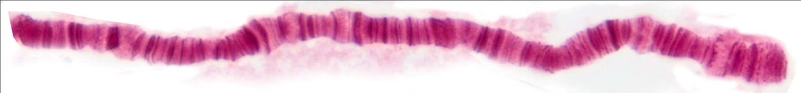
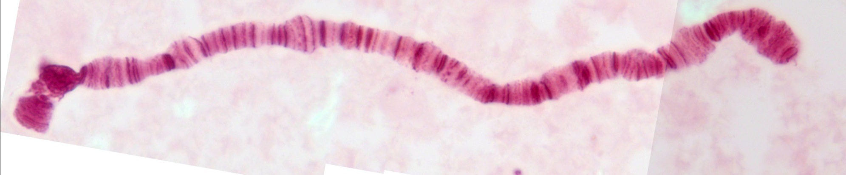
Genome Rearrangement: Chromosome Level
Genome rearrangements observed in Drosophila polytene chromosomes.
DOBZHANSKY, T., and A. H. STURTEVANT, 1938 Inversions in the chromosomes of Drosophila
pseudoobscura. Genetics 23: 28-64.
Notes:
Before diving into the distance computation let’s take a look at the genome rearrangement events
……
Sciencist trying to compare genomes by how many operations are required to transfer one genome into another by minum number of genome rearrangement events.

Slide 4
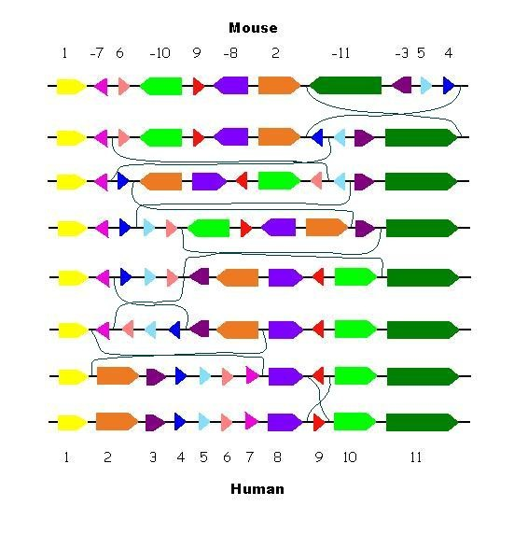

Genome Rearrangement
http://ai.stanford.edu/~serafim/CS374_2006/presentations/lecture17.ppt
Notes:
Let’s take loo at mouse for example
Function similarity
Design drugs

Slide 5
Genome Rearrangement
1 2 3 4 5 6 7 8 9 10
Inversion:
1 2 –6 –5 -4 -3 7 8 9 10
Transposition:
1 2 7 8 3 4 5 6 9 10
Inverted Transposition:
1 2 7 8 –6 -5 -4 -3 9 10
Notes:
If we use numbers to represent genes
Then
Then
then

Slide 6
Genome Median Computation
Genome median is the “virtual” ancestor genome that has minimum distance
between three input genomes.
The possible median order are (g-2)!! . g is the number of genes
1,2,3
4
1,-3,-2
1
-2,-1,3
3
5
1,2,3 -> 1,2,3 = 0
1,2,3 ->-2,-1,3=1
1,2,3 -> 1,-3,-2=1 s
6
2
1,3,2 -> 1,2,3 = 3
1,3,2 ->-2,-1,3=4
1,3,2 -> 1,-3,-2=2
Notes:
What’s a median problem
Given some distance metric, recover a median genome that has the minimum distance between all other three genomes
Take the reversion distance for example

Slide 7
Distance computation for Genome Rearrangement Events
There are many rearrangement patterns
If there are duplications in the genome, the distance computation problem is NP-Hard.

Slide 8
Challenges
the possible number of median order are (g-2)!! . g is the number of genes.
To validate each possible median, if the gene content has duplications, it’s NP-hard.
So the complexity for computing the median for unequal contents genomes is:
NP hard over NP hard!
Notes:
There are still a lot of problems unsolved
Even there are algorithm, they are slow, which needs a lot of improvement

Slide 9
Outline
Background, Motivations
Proposed Methods
Experimental Results
Notes:
In the introduction is top down
Button up to introduce, wihci is from the distance computation

Slide 10
Break Point Graph and DCJ Distance
Suppose we use a number of represent a gene, and a sign to represent
its orientation.
An we use two (head & tail) vertices to represent this gene.
For convenience we assign the vertex id with head(g) = 2*(g-1) and tail with
Tail(g) = 2*(g-1)-1.
If two genes are adjacent to each other, we use an edge to connect their according
Vertices.
1
2
-1
2
0/1^{h}
1/1^{t}
2/2^{h}
3/2^{t}
0/1^{t}
1/1^{h}
2/2^{h}
3/2^{t}

Slide 11
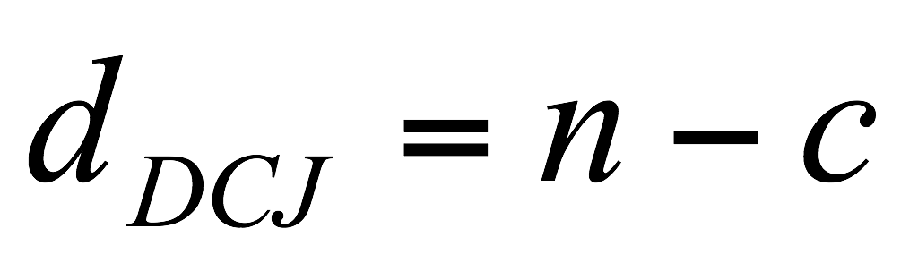
Break Point Graph and DCJ Distance
We can use this rule to construct breakpoint graph for two genomes with same
Gene contents (which means they share the same vertex set).
Suppose there are two genomes, we use red edges to represent one genome
And we use blue edges to represent another genome.
1 2 3 4 5 6
1 -5 -2 3 -6 -4
11/-6
0/+1
1/-1
2/+2
3/-2
4/+3
5/-3
6/+4
7/-4
8/+5
9/-5
10/+6
# genes
# cycles

Slide 12
DCJ Indel Distance
Only one circular
chromosome
Multiple linear
chromosomes
Multiple linear
chromosomes
with insertion/deletion(Indel)
Fortunately, there are still linear algorithms
to solve these distance problems.

Slide 13
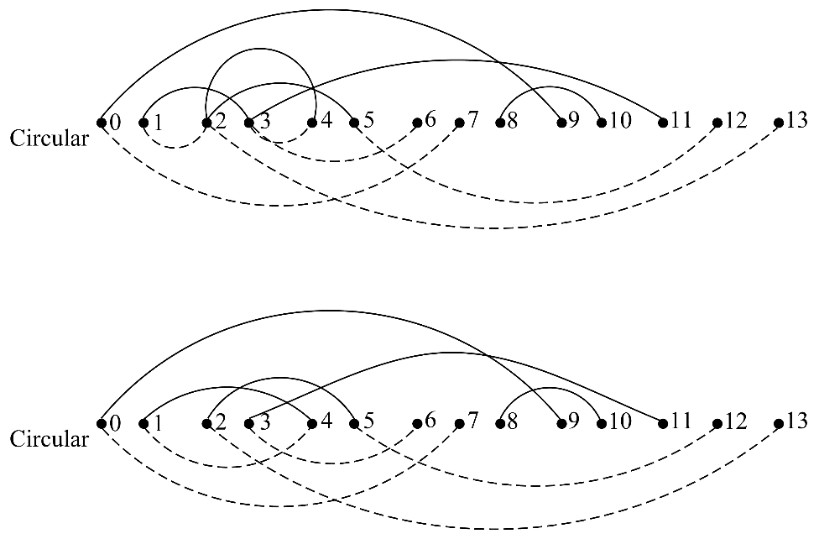
DCJ-Indel-Exemplar Distance
Select a pair of
duplicated genes
as exemplar
Two genomes with
duplications
Delete the rest
duplicated genes
1, -2, 3, 2, -6, 5
1, -2, 3, 2, -6, 5
1, -2, 3, 2, -6, 5
1, 2, 3, 7, 2, 4
1, 2, 3, 7, 2, 4
1, 2, 3, 7, 2, 4
For these two vertices
the duplicated edges
are removed

Slide 14
Edge Shrinking and Problems with BnB
The branch and bound process is based on a edge shrinking process.
5
11
3
8
0
4
7
6
2
1
10
9
Suppose we know a sub-graph is part of the solution.
We want to bridge it out from the graph.
And use the rest of the graph to compute the bounds.

Slide 15
Edge Shrinking and Problems with BnB
5
11
2
0
5
3
4
6
1
0
7
6

Slide 16
Edge Shrinking and Problems with BnB
When unequal content:
Which means there are multiple same colored edge connected to a vertex
5
11
3
8
0
4
7
6
2
1
10
9

Slide 17
Optimization Methods
1) We applied the Lin-Kernighan algorithm primarily to solve the ambiguation problem
2) Proved (regular) Adequate sub-graph is still applicable to search space
reduction.
3) Methods to reduce redundant Lin-Kernighan neighbor search

Slide 18
Outline
Background, Motivations
Proposed Methods
Experimental Results
Notes:
In the introduction is top down
Button up to introduce, wihci is from the distance computation

Slide 19
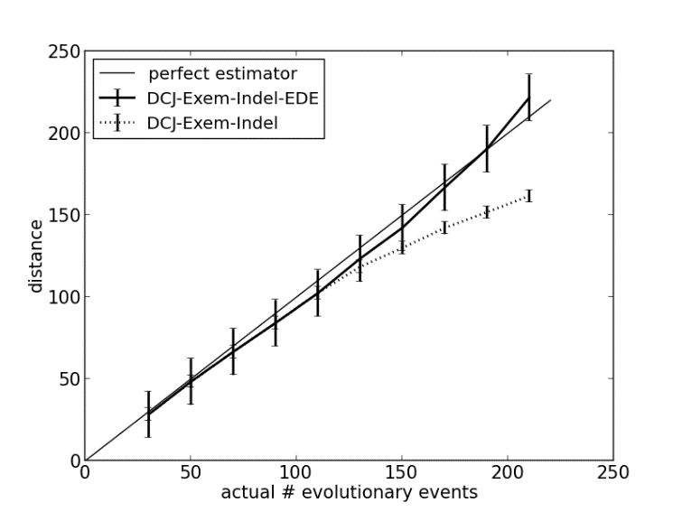
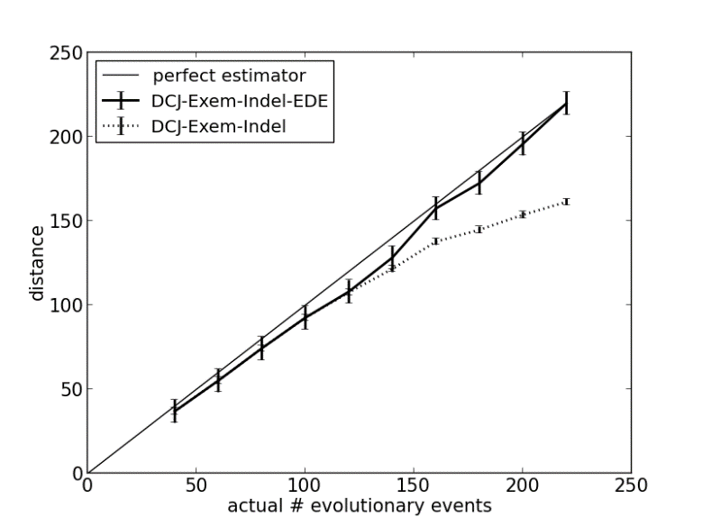

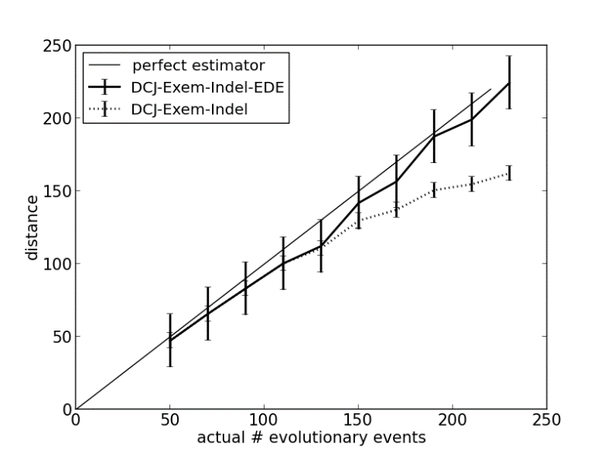
Experimental Results (DCJ-Indel-Exemplar)
- Γ is the indel rate
- Φ is the duplication rate
- Plot with the change of mutation (inversion)
The result is rescaled by number of duplications and EDE method.
Γ=0.05, Φ=0.05
Γ=0.1, Φ=0.05
Γ=0.05, Φ=0.1
Γ=0.1, Φ=0.1
Notes:
Accurate
underestimate
Scaled by both two methods

Slide 20



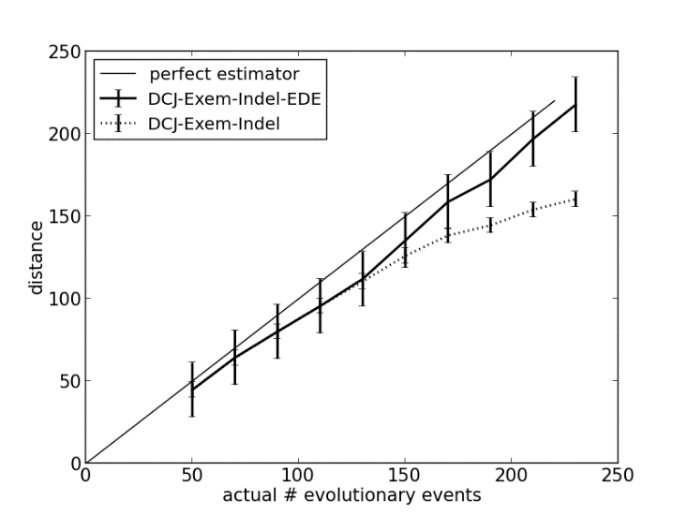
Experimental Results (DCJ-Indel-CD)
We conduct the experiment using the same data with DCJ-Indel-CD distance.
The result is only rescaled by EDE distance.
Γ=0.05, Φ=0.05
Γ=0.1, Φ=0.05
Γ=0.05, Φ=0.1
Γ=0.1, Φ=0.1
Notes:
More flexible
More complicated patterns

Slide 21
Experiment setup
We compare our result with exact median with equal content genes
Then compare our result with simulated seed with unequal content genes
Simulated
seed
Computed
median
exact
median

Slide 22
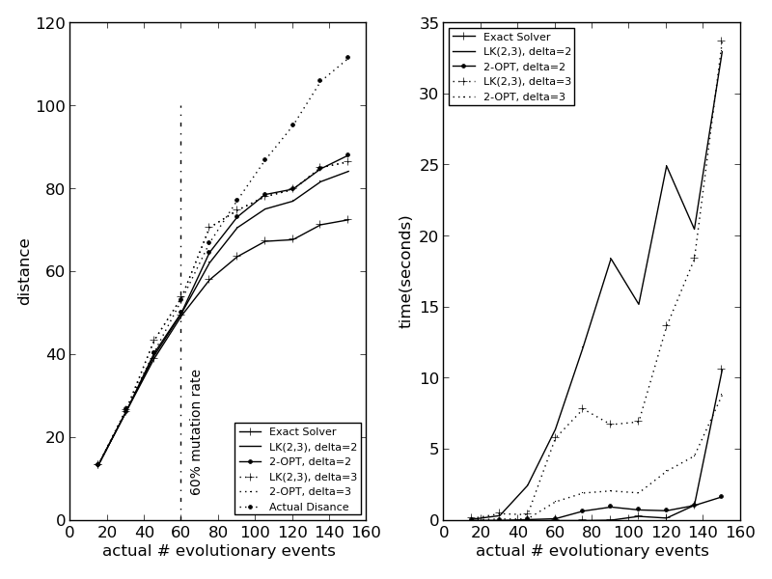
Results (Comparing with the Exact Solver)
Seq len = 100 Median computation results for
γ=Φ=0%
Notes:
We compare with different lk parameters with exact solver
Find that very accrate

Slide 23
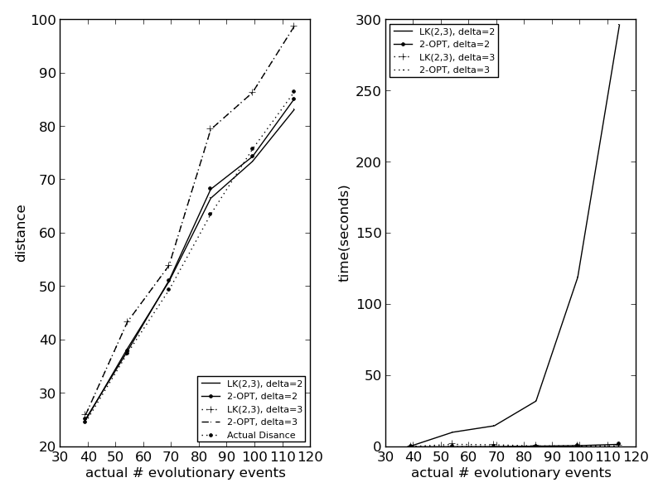
Results (DCJ-Indel-Exemplar Median)
Seqlen = 100, Median computation results for
γ=Φ=5%
Notes:
Since there is no exact solve with unequal

Slide 24


