Slide 1
Enhance the Understanding of Whole-Genome Evolution by Designing, Accelerating and Parallelizing Phylogenetic Algorithms
Zhaoming Yin
Advisor: David A. Bader, Mar 25th, 2014

Slide 2
Outline
Background, Motivations
Genome Distance Computation
Genome Median Computation
Phylogeny Inference
Parallel Branch-and-Bound Algorithms

Slide 3
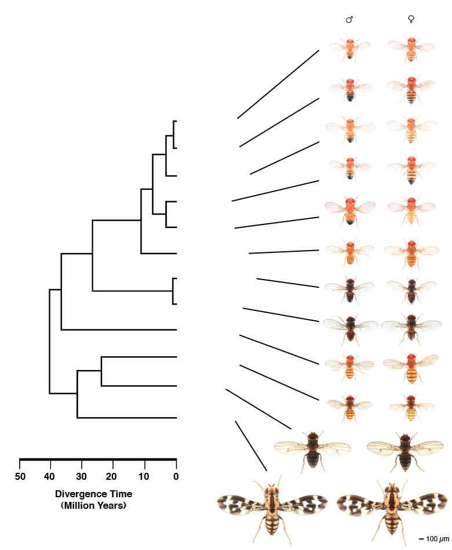
Phylogenetic Tree
This picture presents the phylogeny of the “12 Drosophila.”
From http://flybase.org/static_pages/species/sequenced_species.html
Fly Images were provided to FlyBase
By Nicholas Gompel
D. simulans
D. sechellia
melanogaster subgroup
D. melanogaster
melanogaster group
D. yakuba
D. erecta
D. ananassae
Sophophora
obscura group
D. pseudoobscura
willistoni group
D. persimilis
D. willistoni
repleta group
D. mojavensis
virilis group
D. virilis
Drosophila
Hawaiian Drosophila
D. grimshawi

Slide 4
Maximum Parsimony Concept
Suppose we have N modern species
We use a node and an unique number to represent a species.
1
2
3
4
We want to organize them into a tree
If it is a binary un-rooted tree, there will be N-2 number of internal nodes
And there will be (N-3)!! number of possible topologies
5
6
1
2
3
4

Slide 5
Maximum Parsimony Concept
Suppose we can compute the distances between each related species,
we will get a weight for each edge in the tree
Maximum parsimony criteria assumes that species take the least amount
of effort to evolve, hence, the tree with minimal weight is the most possible tree.
5
5
5
6
5
6
1
5
5
1
5
5
5
2
2
4
3
1
4
3
2
1
14
25
3
5
6
This is the maximum
parsimonious tree
2
2
2
11
2
1
4
2
3

Slide 6
Genome Median Computation
With a given topology, to evaluate a tree, we need to recover the gene order
of the internal nodes in the tree. (But we don’t know)
?
?
2
4
3
1
We can tackle this problem by solving medians
Stepwise addition and
Solve the median
Select three species
Solve the median
4
3
3
3
1
1
5
1
5
2
2
2

Slide 7
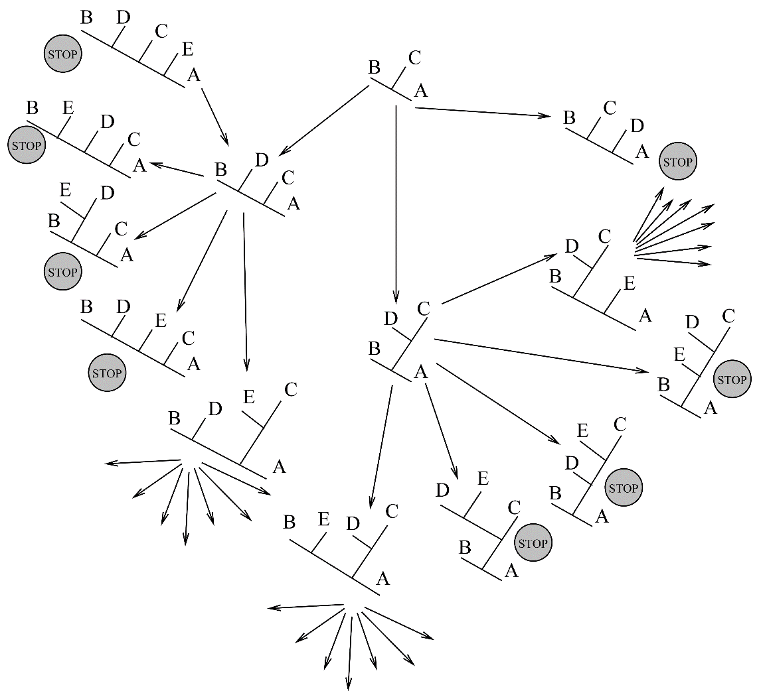
Genome Median Computation

Slide 8
Genome Median Computation
Genome median is the “virtual” ancestor genome that has minimum distance
between three input genomes.
The possible median order are (g-2)!! . g is the number of genes
1,2,3
4
1,-3,-2
-2,-1,3
3
1
1,2,3 -> 1,2,3 = 0
1,2,3 ->-2,-1,3=1
1,2,3 -> 1,-3,-2=1 s
5
6
2
1,3,2 -> 1,2,3 = 3
1,3,2 ->-2,-1,3=4
1,3,2 -> 1,-3,-2=2

Slide 9
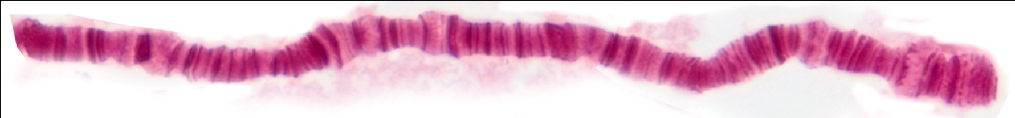
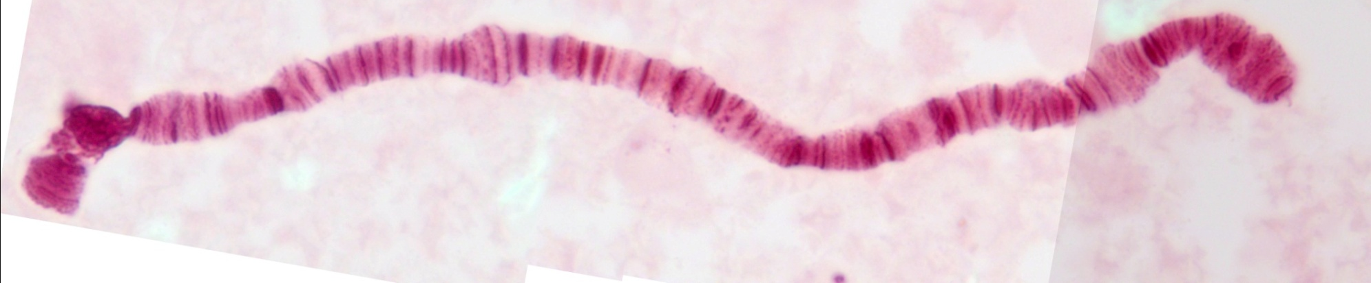
Genome Rearrangement: Chromosome Level
Genome rearrangements observed in Drosophila polytene chromosomes.
DOBZHANSKY, T., and A. H. STURTEVANT, 1938 Inversions in the chromosomes of Drosophila
pseudoobscura. Genetics 23: 28-64.

Slide 10
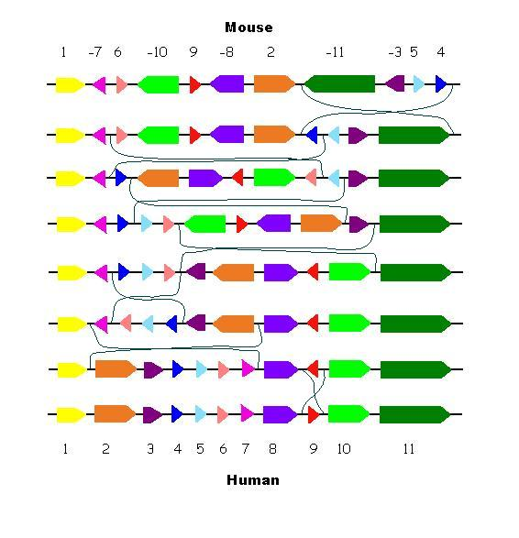

Genome Rearrangement
http://ai.stanford.edu/~serafim/CS374_2006/presentations/lecture17.ppt

Slide 11
Genome Rearrangement
In 1980s Jeffrey Palmer studied evolution of plant organelles by comparing mitochondrial genomes of the cabbage and turnip, 99% similarity between genes, These surprisingly identical gene sequences differed in gene order, This study helped pave the way to analyzing genome rearrangements in molecular evolution.
1 2 3 4 5 6 7 8 9 10
Inversion:
1 2 –6 –5 -4 -3 7 8 9 10
Transposition:
1 2 7 8 3 4 5 6 9 10
Inverted Transposition:
1 2 7 8 –6 -5 -4 -3 9 10

Slide 12
Distance computation for Genome Rearrangement Events
There are many rearrangement patterns
If there are duplications in the genome, the distance computation problem is NP-Hard.

Slide 13
Challenges
For N genomes, there are (N-3)!! number of possible tree topologies.
For each topology, we need to compute at least one different median, the possible median order are (g-2)!! . g is the number of genes.
To validate each possible median, if the gene content has duplications, it’s NP-hard.
So the complexity for computing the MP tree with unequal contents genomes is:
NP hard over NP hard over NP hard!

Slide 14
Contribution
Research Contributions
-Distance algorithms to evaluate dissimilarity between genomes with unequal gene contents.
-Median algorithm cope with input genome of unequal gene contents.
-Bucket processing algorithm to parallelize branch-and-bound methods.
Engineering Contributions
-A software package called DCJUC is designed for phylogeny inference.
-A software package called OPT-Kit is designed for parallel branch-and-bound algorithms.

Slide 15
Outline
Background, Motivations
Genome Distance Computation
Genome Median Computation
Phylogeny Inference
Parallel Branch-and-Bound Algorithms

Slide 16
Break Point Graph and DCJ Distance
Suppose we use a number of represent a gene, and a sign to represent
its orientation.
An we use two (head & tail) vertices to represent this gene.
For convenience we assign the vertex id with head(g) = 2*(g-1) and tail with
Tail(g) = 2*(g-1)-1.
If two genes are adjacent to each other, we use an edge to connect their according
Vertices.
1
2
-1
2
0/1^{h}
1/1^{t}
2/2^{h}
3/2^{t}
0/1^{t}
1/1^{h}
2/2^{h}
3/2^{t}

Slide 17
Break Point Graph and DCJ Distance
We can use this rule to construct breakpoint graph for two genomes with same
Gene contents (which means they share the same vertex set).
Suppose there are two genomes, we use red edges to represent one genome
And we use blue edges to represent another genome.
1 2 3 4 5 6
1 -5 -2 3 -6 -4
11/-6
0/+1
1/-1
2/+2
3/-2
4/+3
5/-3
6/+4
7/-4
8/+5
9/-5
10/+6
# genes
# cycles

Slide 18
DCJ Indel Distance
Only one circular
chromosome
Multiple linear
chromosomes
Multiple linear
chromosomes
with insertion/deletion(Indel)
Fortunately, there are still linear algorithms
to solve these distance problems.

Slide 19
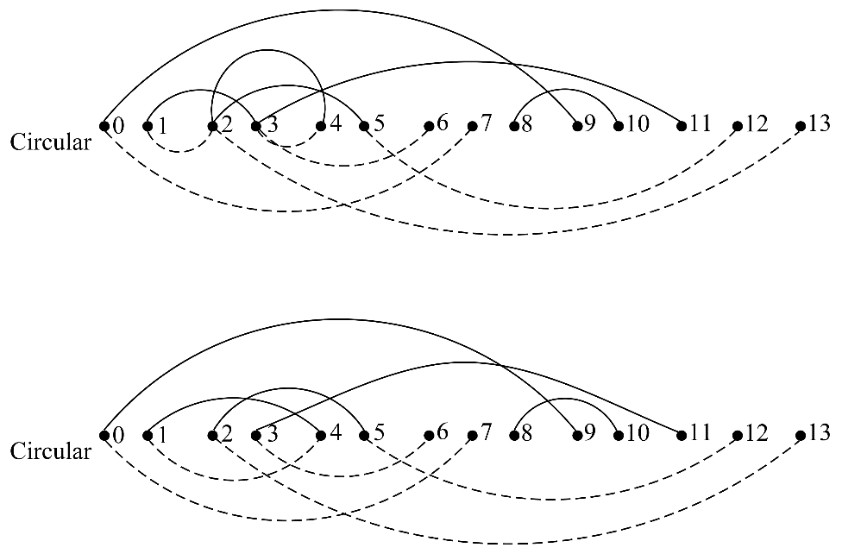
DCJ-Indel-Exemplar Distance
Select a pair of
duplicated genes
as exemplar
Two genomes with
duplications
Delete the rest
duplicated genes
1, -2, 3, 2, -6, 5
1, -2, 3, 2, -6, 5
1, -2, 3, 2, -6, 5
1, 2, 3, 7, 2, 4
1, 2, 3, 7, 2, 4
1, 2, 3, 7, 2, 4
For these two vertices
the duplicated edges
are removed

Slide 20
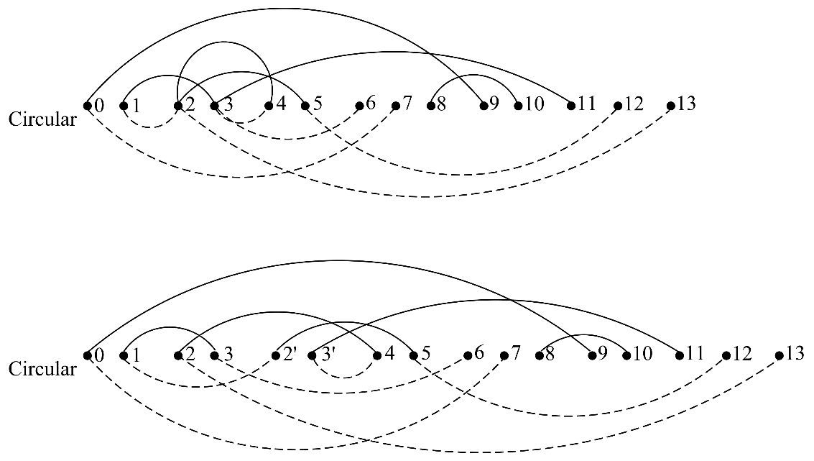
DCJ-Indel-CD(cycle decomposition) Distance
Give every occurrence
Of duplicated genes a
mapping
Rename the
duplicated genes
Two genomes
With duplications
1, -2, 3, 2, -6, 5
1, -2, 3, 2, -6, 5
1, -2’, 3, 2, -6, 5
1, 2, 3, 7, 2, 4
1, 2, 3, 7, 2, 4
1, 2’, 3, 7, 2, 4
For these two vertices
the duplicated edges
are renamed

Slide 21
BnB algorithm & Optimization Methods
Upper bound: randomly map duplicated genes
Lower bound: delete all duplicated genes
Streaming graph analytics:

Slide 22
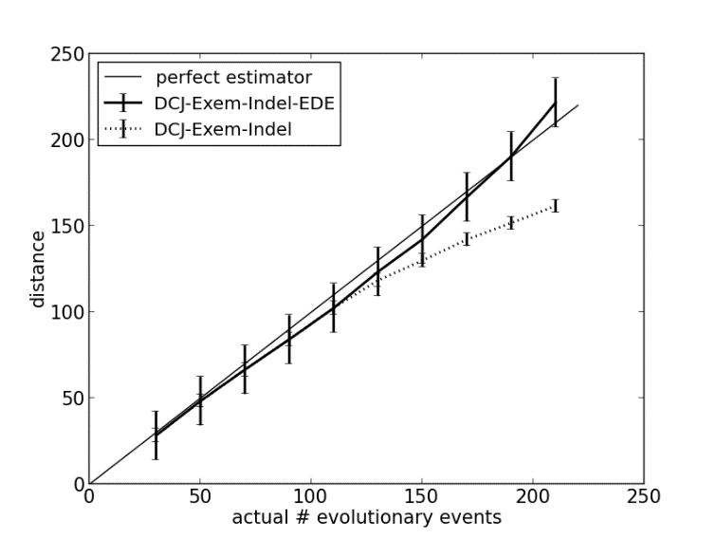
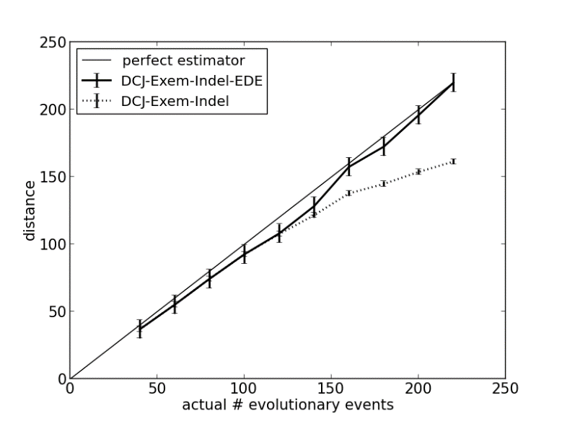

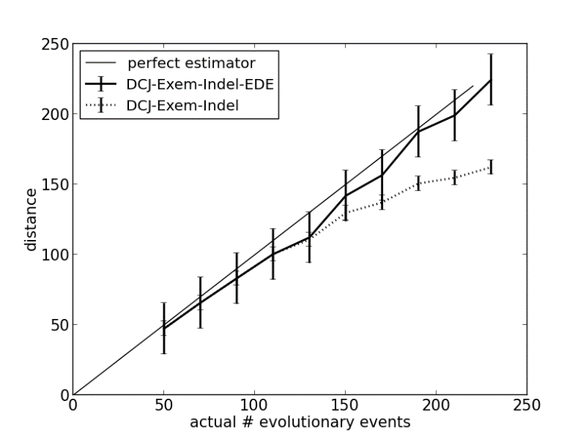
Experimental Results (DCJ-Indel-Exemplar)
- Γ is the indel rate
- Φ is the duplication rate
- Plot with the change of mutation (inversion)
The result is rescaled by number of duplications and EDE method.
Γ=0.05, Φ=0.05
Γ=0.1, Φ=0.05
Γ=0.05, Φ=0.1
Γ=0.1, Φ=0.1

Slide 23



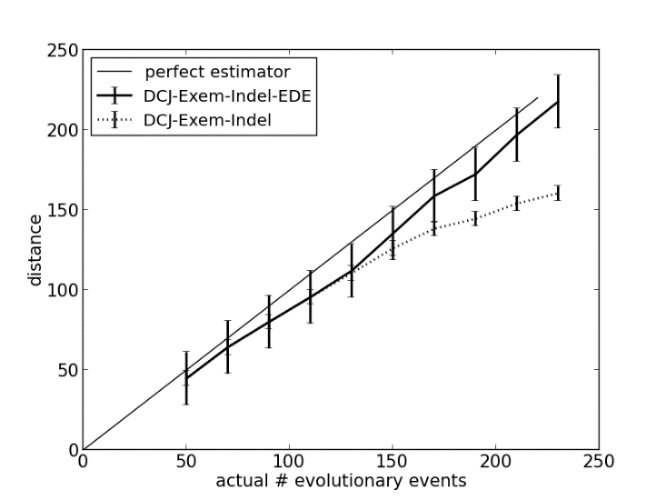
Experimental Results (DCJ-Indel-CD)
We conduct the experiment using the same data with DCJ-Indel-CD distance.
The result is only rescaled by EDE distance.
Γ=0.05, Φ=0.05
Γ=0.1, Φ=0.05
Γ=0.05, Φ=0.1
Γ=0.1, Φ=0.1

Slide 24
Outline
Background, Motivations
Genome Distance Computation
Genome Median Computation
Phylogeny Inference
Parallel Branch-and-Bound Algorithms

Slide 25
Edge Shrinking and Problems with BnB
The branch and bound process is based on a edge shrinking process.
5
11
3
8
0
4
7
6
2
1
10
9
Suppose we know a sub-graph is part of the solution.
We want to bridge it out from the graph.
And use the rest of the graph to compute the bounds.

Slide 26
Edge Shrinking and Problems with BnB
5
11
2
0
5
3
4
6
1
0
7
6

Slide 27
Edge Shrinking and Problems with BnB
When unequal content:
Which means there are multiple same colored edge connected to a vertex
5
11
3
8
0
4
7
6
2
1
10
9

Slide 28
Optimization Methods
1) We applied the Lin-Kernighan algorithm primarily to solve the ambiguation problem
2) Proved (regular) Adequate sub-graph is still applicable to search space
reduction.
3) Methods to reduce redundant Lin-Kernighan neighbor search

Slide 29
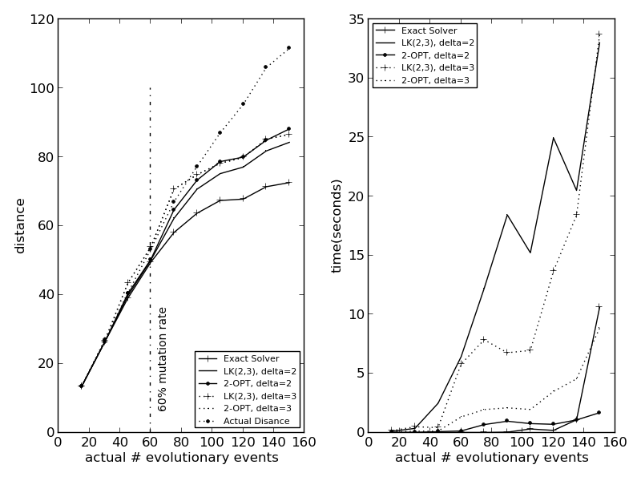
Results (Comparing with the Exact Solver)
Median computation results for γ=Φ=0% and θ varies from 10% to 100%

Slide 30
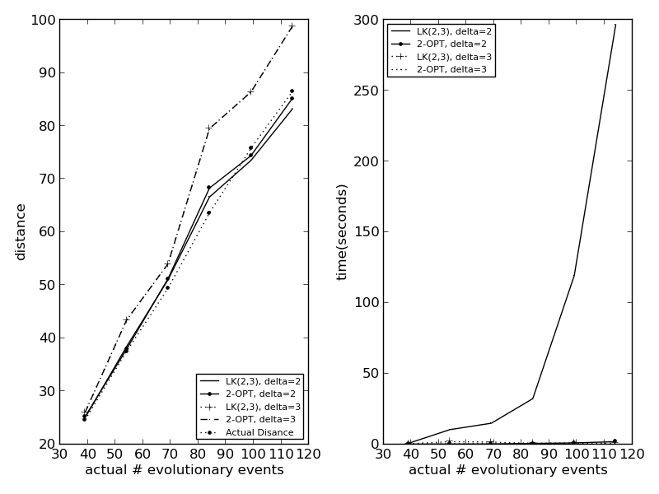
Results (DCJ-Indel-Exemplar Median)
Median computation results for γ=Φ=5% and θ varies from 10% to 100%

Slide 31
Outline
Background, Motivations
Genome Distance Computation
Genome Median Computation
Phylogeny Inference
Parallel Branch-and-Bound Algorithms

Slide 32
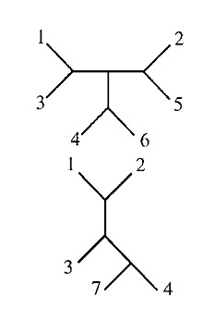
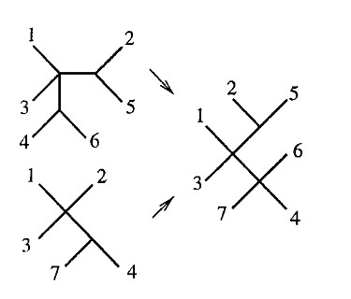
Step 3: Merge Disks
Decomposition of
The disks
Construct a tree
for each disk
Merge the tree using
A specific consensus method:
Strict, majority etc…
Disambiguation

Slide 33
Initialization
Init by insertion
Which is local
4
1
3
5
6
c
X
2
b
1
2
e
Init by prospection
Which is global.
d

Slide 34
Iterative Refinement
1
2
a
b
3
4

Slide 35
Review
Step 1: Spectral partition
Step 2: Sub-tree construction
Step 3: Consensus-tree merge
Step 4: Initialization of complete tree using General Adequate Sub-graph (GAS) method.
Step 5: Iterative Refinement until the complete tree converged.
http://sourceforge.net/projects/dcjuc/

Slide 36
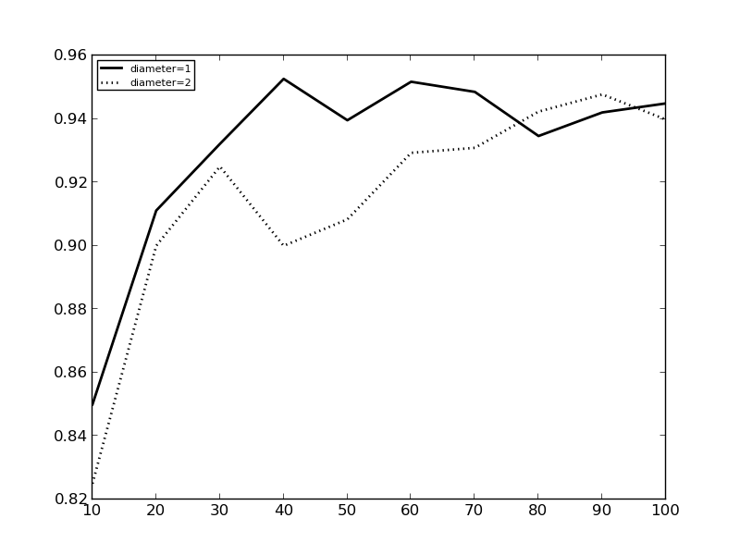
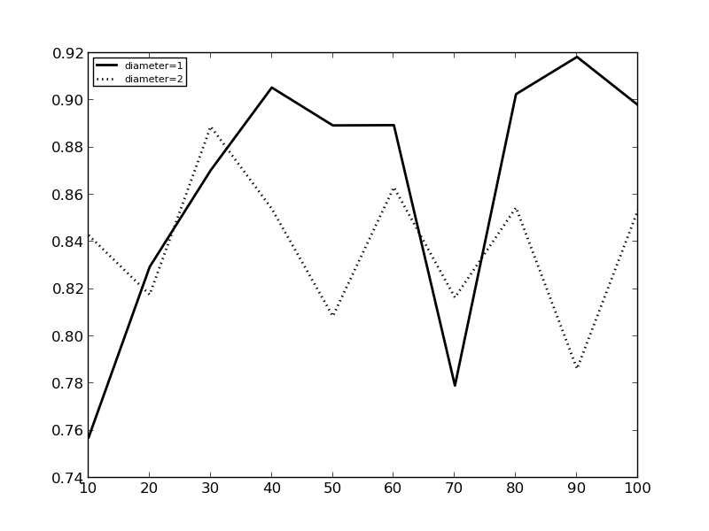
Results: Phylogeny Inference
NJ Method
Using data with
Γ=0.1, Φ=0.05, θ=0.2
MP Method
NJ method performs better than MP method
NJ method is more stable than MP method
Why MP method performs a bit worse?
LK heuristics
Consensus tree method

Slide 37
Outline
Background, Motivations
Genome Distance Computation
Genome Median Computation
Phylogeny Inference
Parallel Branch-and-Bound Algorithms

Slide 38
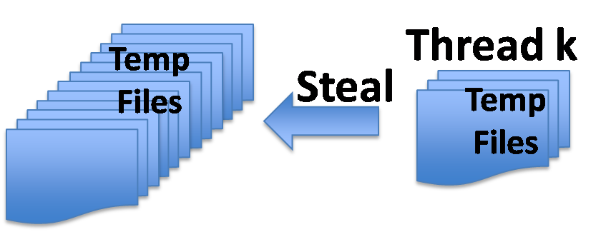
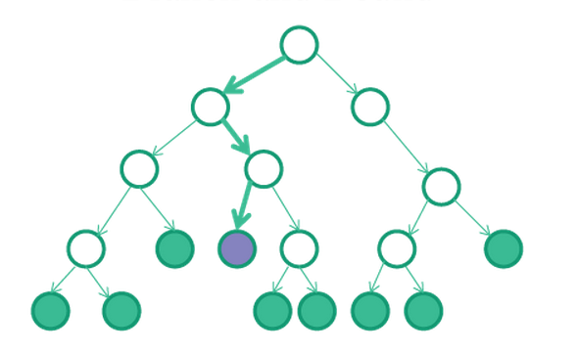
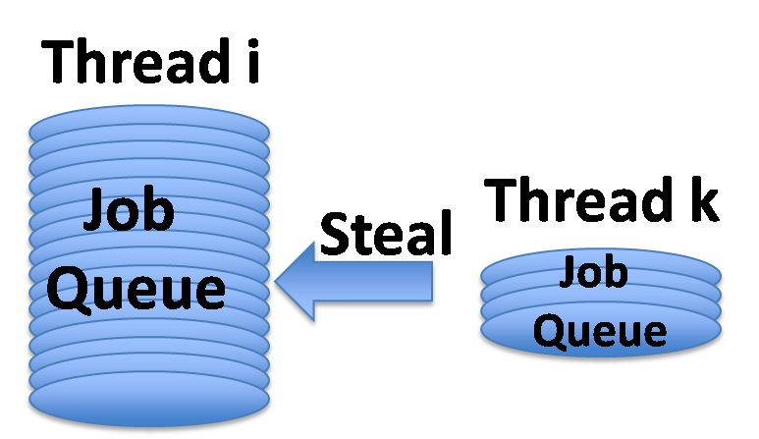
Parallel Method
Load Balancing
Parallel search

Slide 39
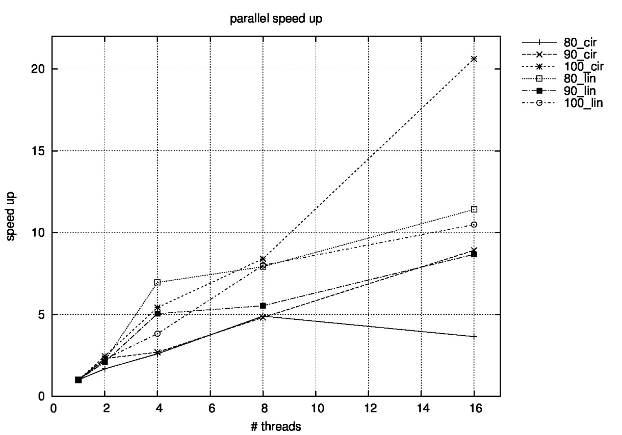
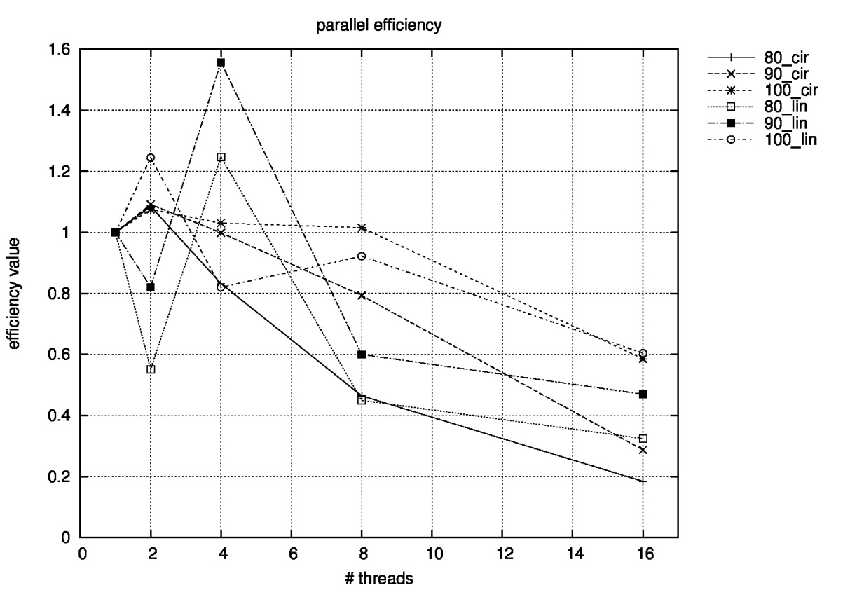
Experimental Results (Parallel)

Slide 40
Why Many-core BnB?
So many distributed memory MIP BnB frameworks (PICO, PEBBL, ALPS, COIN-OR).
Load balance of distributed BnB is highly relied on Ramp up, run time load balancing is not efficient.
But nowadays Peta-flops machines are mostly hybrid systems(distributed + many-core (or accelerators)).

Slide 41
Lessons from ∆-Stepping
Label-correcting algorithm: Can relax edges from unsettled vertices also
∆ - stepping: “approximate bucket implementation of Dijkstra’s algorithm”
∆: bucket width
Vertices are ordered using buckets representing priority range of size ∆
Each bucket may be processed in parallel

Slide 42
Parallel ∆-Stepping
There is contentions when multiple threads are relaxing edges that has the same end vertex.
We use parallel partition method, partition edges to request array into 256 bins, and process the bins in parallel.

Slide 43
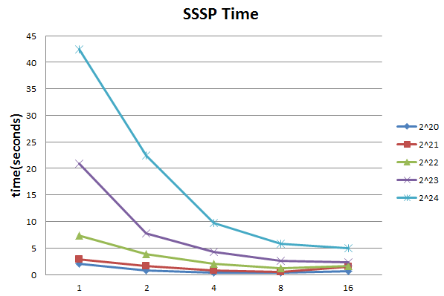
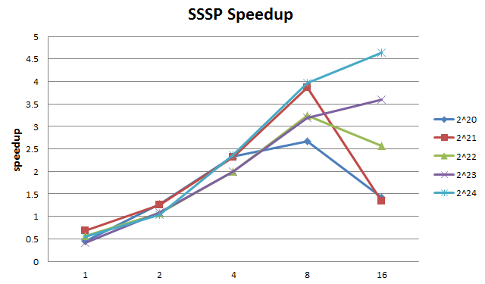
Parallel ∆ - stepping Algorithm: Single Node results

Slide 44
Parallel BnB: Bucket Processing Algorithm
1
2
1
1
2
2
1
2
1
2
1
1
2
2
1
2
1
2

Slide 45
Modeling BnB Algorithms
Thread Based:
T_t = (m+c)/p + o
Bucket Based:
T_b = (m+c+m’)/p
Knapsack problem:
m/c is high
DCJ-Indel-CD distance problem:
m/c is low

Slide 46
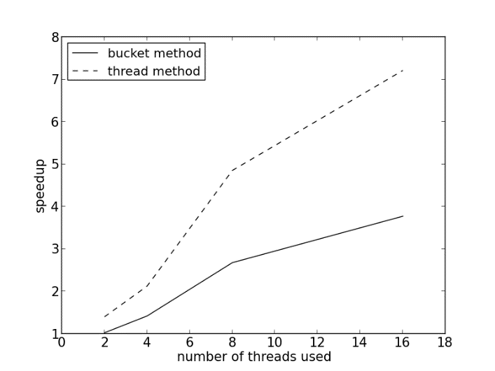
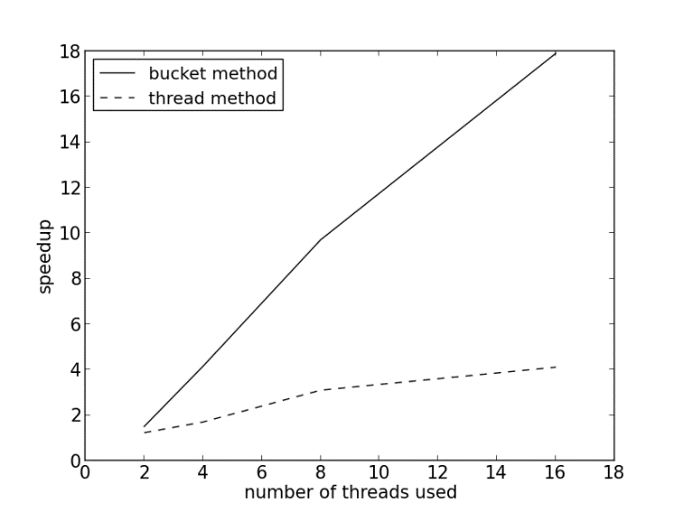
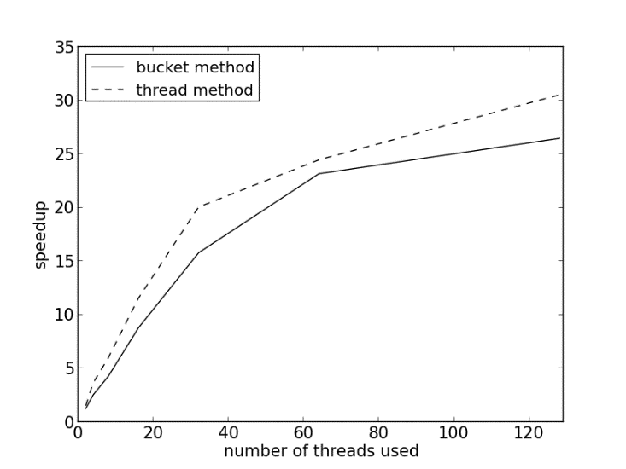
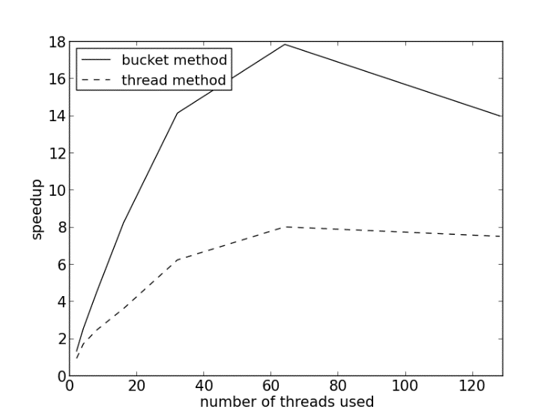
Experimental Results
Knapsack CPU
DCJ-Indel-CD CPU
Knapsack Phi
DCJ-Indel-CD Phi

Slide 47
Result : OPT-Kit
User only need to define evaluation methods and branch methods.
Plan to support GPU, MPI.
Plan to support MIP.
http://sourceforge.net/projects/optec/files/

Slide 48
Conclusion and Future Work
It’s still long way to go to process real high resolution genome data
How to combine the MP method with empirical methods such as Maximum Likelihood methods.

Slide 49
Publications
[1] Zhaoming Yin, Jijun Tang, Stephen Schaeffer, David A. Bader, A Lin-Kernighan Heuristic for the DCJ Median Problem of Genomes with Unequal Contents. (Submitted,COCOON 2014 : International Computing and Combinatorics Conference,Atlanta, USA)
[2] Satish Nadathur et. al Navigating the Maze of Graph Analytics Frameworks using Massive Graph Datasets, SIGMOD 2014, Snowbird, USA 2014
[3] Zhaoming Yin, Jijun Tang, Stephen Schaeffer, David A. Bader, Streaming Breakpoint Graph Analytics for Accelerating and Parallelizing DCJ Median of Three Genomes. International Conference on Computational Science, Barcelona, Spain, June, 2013
[4] Zhihui Du, Zhaoming Yin, Wenjie Liu, David A. Bader On Accelerating Iterative Algorithms with CUDA: A Case Study on Conditional Random Fields Training Algorithm for Biological Sequence Alignment Workshop on Data-mining of Next- Generation Sequencing Data (In conjunction with BIBM 2010) Hongkong, China, Dec 17, 2010
[5] Zhihui Du, Zhaoming Yin, David. A. Bader A Tile-based Parallel Viterbi Algorithm for Biological Sequence Alignment on GPU with CUDA IEEE International Parallel and Distributed Processing Symposium (IPDPS) 2010 HiComb Workshop, Atlanta USA.
[6] Zhaoming Yin, Huarui Zhang Research on Chinese n-gram Statistical Rule and its application 14th Youth Conference on Communication (YCC) 2009, Dalian, China. (ISTP: 000270587500121)

Slide 50


