Slide 1
Streaming Breakpoint Graph Analytics for Accelerating and Parallelizing the Computation of DCJ Median of Three Genomes
Zhaoming Yin, Jijun Tang,
Stephen W. Schaeﬀer and David A. Bader

Slide 2
Our Contribution
Use the Streaming Graph Analysis Method to speed up the computation of updating information on Breakpoint graphs that handle both circular and linear chromosomes.
Reduction of Branch and Bound algorithm search space.
Parallelization of DCJ median Branch and Bound algorithm.

Slide 3
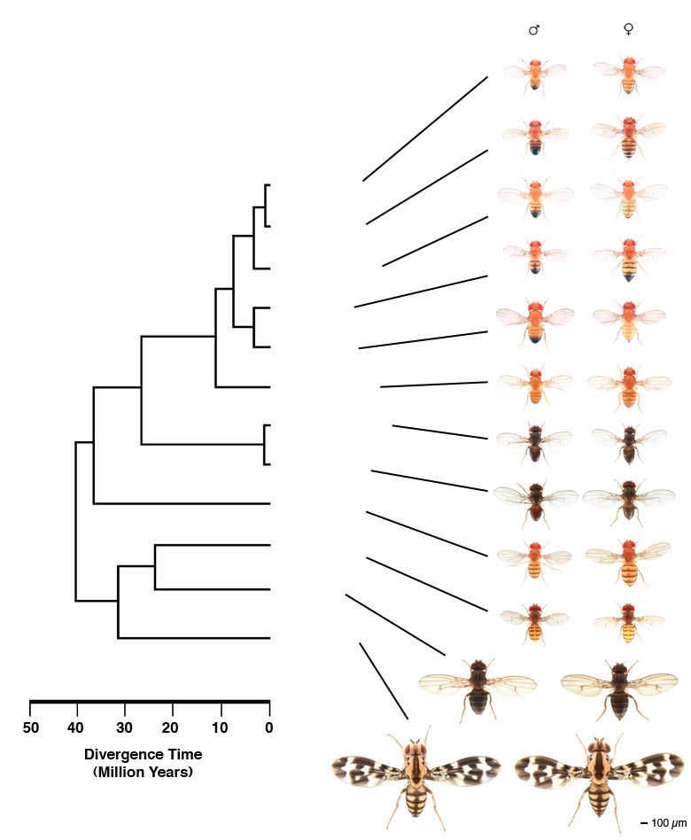
Phylogenetic Tree
This picture presents the phylogeny of the “12 Drosophila.”
From http://flybase.org/static_pages/species/sequenced_species.html
Fly Images were provided to FlyBase
By Nicholas Gompel
D. simulans
D. sechellia
melanogaster subgroup
D. melanogaster
melanogaster group
D. yakuba
D. erecta
D. ananassae
Sophophora
obscura group
D. pseudoobscura
willistoni group
D. persimilis
D. willistoni
repleta group
D. mojavensis
virilis group
D. virilis
Drosophila
Hawaiian Drosophila
D. grimshawi

Slide 4
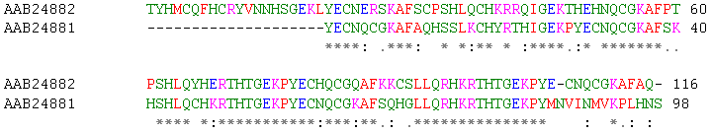
Sequence Alignment [Du et al., 2010(1), 2010(2)]
Sequence alignment is a way of arranging the sequences of DNA, RNA, or protein to identify regions of similarity that may be a consequence of functional, structural, or evolutionary relationships between the sequences.
...

Slide 5
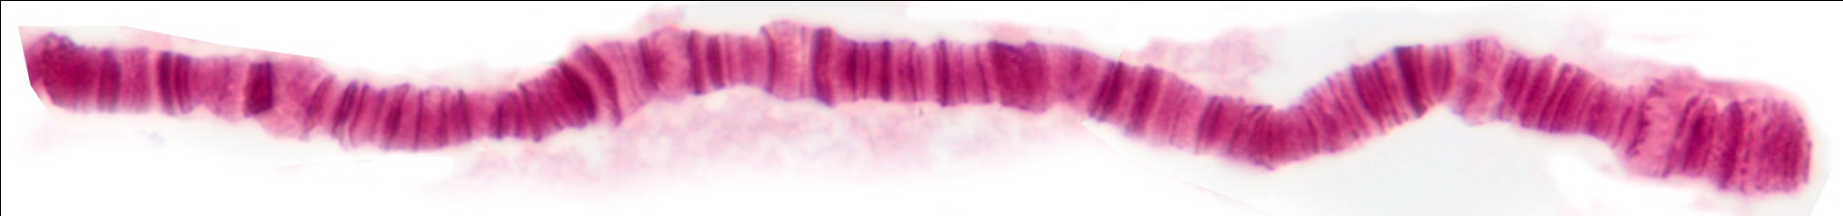
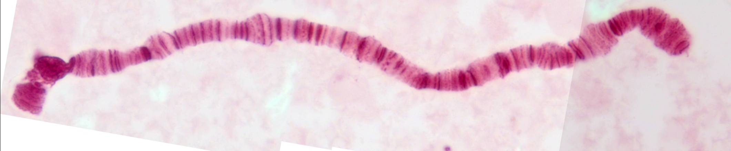
Genome Rearrangement: Chromosome Level
Genome rearrangements observed in Drosophila polytene chromosomes.
DOBZHANSKY, T., and A. H. STURTEVANT, 1938 Inversions in the chromosomes of Drosophila
pseudoobscura. Genetics 23: 28-64.

Slide 6
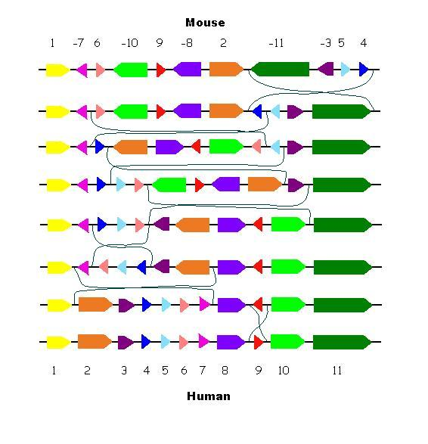

Genome Rearrangement
http://ai.stanford.edu/~serafim/CS374_2006/presentations/lecture17.ppt

Slide 7
Genome Rearrangement
In 1980s Jeffrey Palmer studied evolution of plant organelles by comparing mitochondrial genomes of the cabbage and turnip, 99% similarity between genes, These surprisingly identical gene sequences differed in gene order, This study helped pave the way to analyzing genome rearrangements in molecular evolution.
1 2 3 4 5 6 7 8 9 10
Inversion:
1 2 –6 –5 -4 -3 7 8 9 10
Transposition:
1 2 7 8 3 4 5 6 9 10
Inverted Transposition:
1 2 7 8 –6 -5 -4 -3 9 10

Slide 8
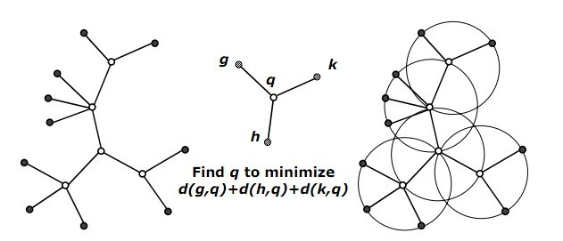
Fundamentals
Maximal Parsimony Phylogeny is to optimize each ancestral node of an unrooted phylogeny in terms of its three or more immediate neighbours, modern or ancestral, and to iterate across the tree until convergence of the objective function (to a local optimum) at all nodes.
Andrew Wei Xu and David Sankoﬀ, Decompositions of multiple breakpoint graphs and
rapid exact solutions to the median problem., K.A. Crandal l and J. Lagergren (Eds.):
Proceedings of the Workshop on Algorithms in Bioinformatics, WABI 2008, Lecture
Notes in Bioinformatics 5251,Springer.

Slide 9
Break Point Graph and DCJ Distance
1 2
-1 2
0/+1
1/-1
2/+2
3/-2
1/-1
0/+1
2/+2
3/-2
11/-6
0/+1
1/-1
2/+2
3/-2
4/+3
5/-3
6/+4
7/-4
8/+5
9/-5
10/+6
1 2 3 4 5 6
1 -5 -2 3 -6 -4
Double cut and join operation:
# genes
# cycles

Slide 10
Multiple Break Point Graph(MBG)/DCJ Median
1 2 3 4 5 6
1 -5 -2 3 -6 -4
1 3 5 -4 6 -2
1 -5 -3 2 -4 6
[Alekseyev 09]
NP-Hard
More than 10,000 vertices
Given three genomes
Construct a multiple break point graph
Find 0-matching that maximize # of cycles
Map 0-matching back to genome which is the median.

Slide 11
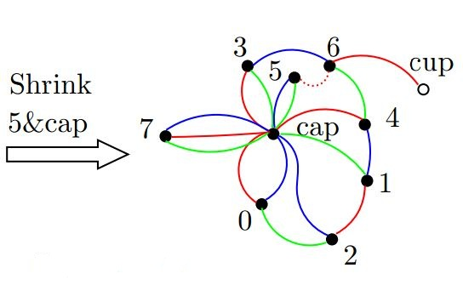
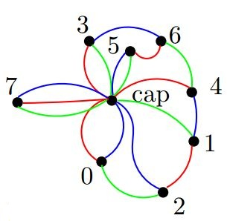
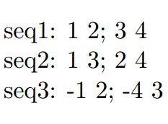
Multiple Breakpoint Graph
One end vertex of telomere gene is point to a cap vertex
When shrinking on cap vertex, edges that originally point to cap is then pointed to a cup vertex.

Slide 12
DCJ Distance Metrics
Circular
Chromosome
(same content):
N - #cycles
[Xu 08]
N - #cycles +
#
+
#
+
#
+
#
+
#
+
#
Linear
Chromosome
(same content):
2
+
+
min
#
#
min
#
#
[Xu 10]

Slide 13
Branch and Bound Algorithm
upper
bound
lower
bound
upper
bound
lower
bound
continue search
........................
upper
bound
lower
bound
upper
bound
upper
bound
.............
lower
bound
lower
bound
Adequate sub-graph [Xu 08, 10]

Slide 14
BnB when no AS detected
3
5
3
5
2
6
2
6
3
4
5
2
6
1
1
7
7
1
8
8
7
8
3
4
5
3
4
5
2
6
2
6
1
1
7
7
8
8
3
4
5
2
6
3
4
5
3
4
5
1
2
6
2
6
7
8
1
1
7
7
8
8

Slide 15
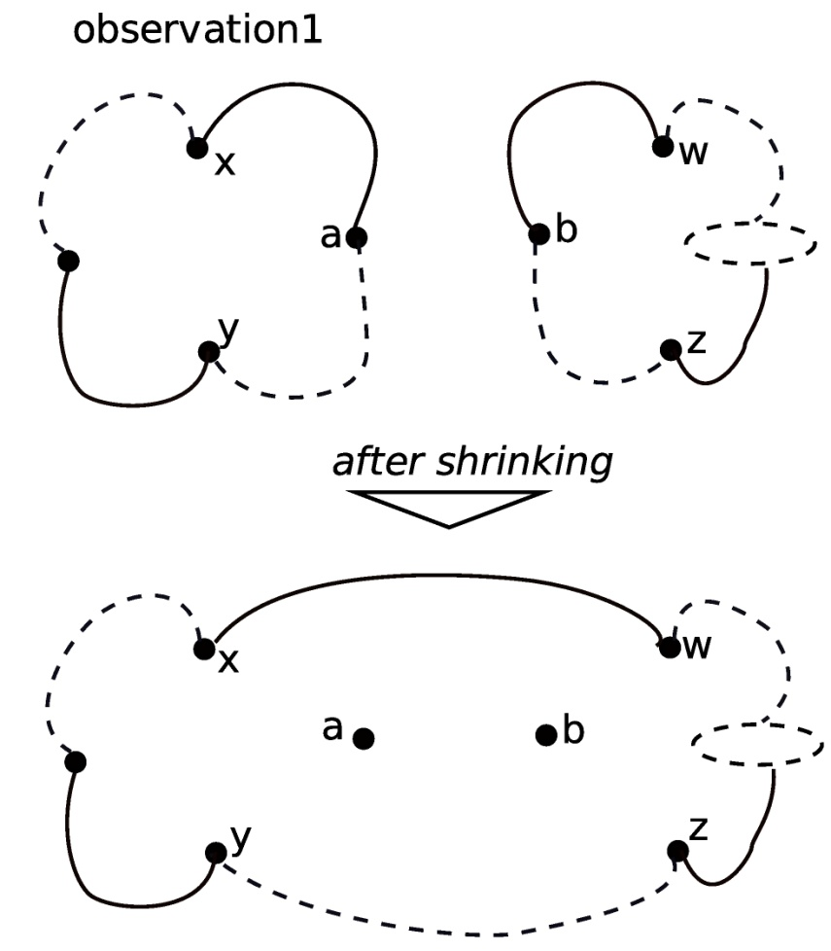
Streaming Graph Analysis Method
If a and b are in different connected component (cc), after change, the number of cc in the new BPG will decrease 1.

Slide 16
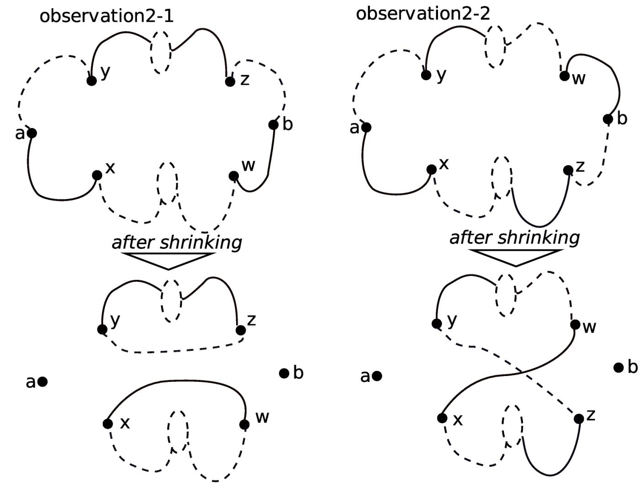
Streaming Graph Analysis Method
If a and b are in the same component, and at least one of them are in a cycle, after shrinking, the number of ij_c could be changed within 1 (increase 1, or stay the same).

Slide 17
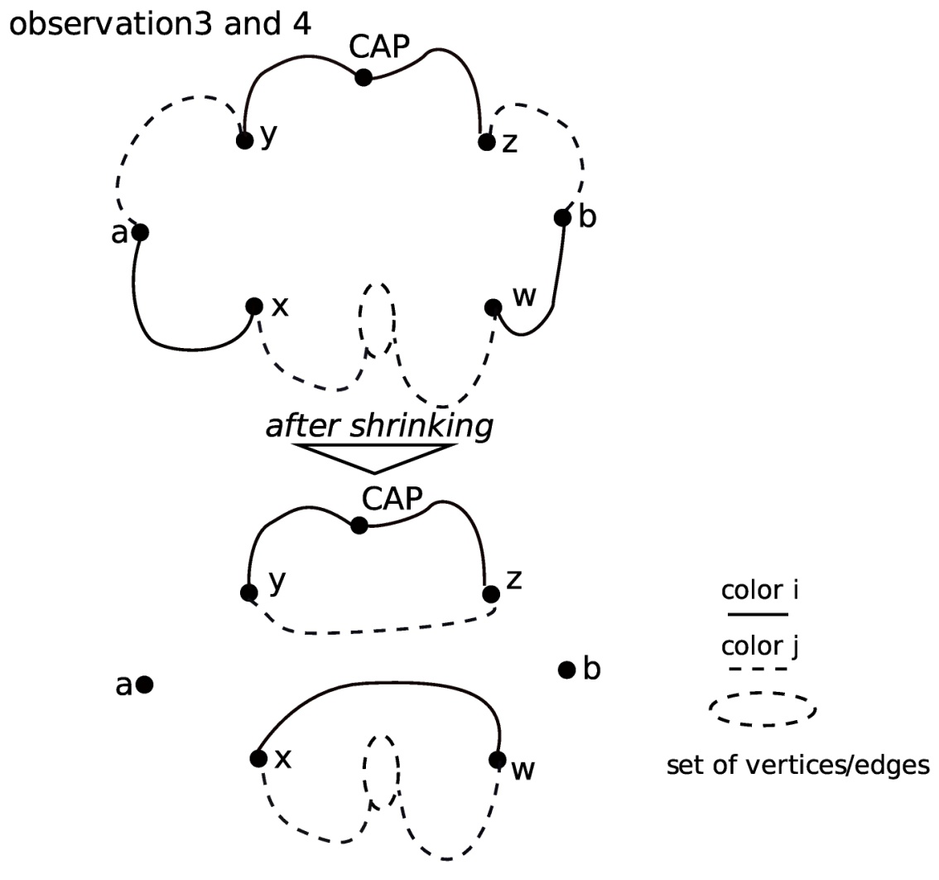
Streaming Graph Analysis Method
If a and b are in the same connected component, and at least one of them are in a cycle, after shrinking, the number of cycle will be increased if and only if x and w are in the same adjacent vertices set after the component is separated by a and b.
If at least one of a and b are in a path, after shrinking, the number of path stays the same.

Slide 18
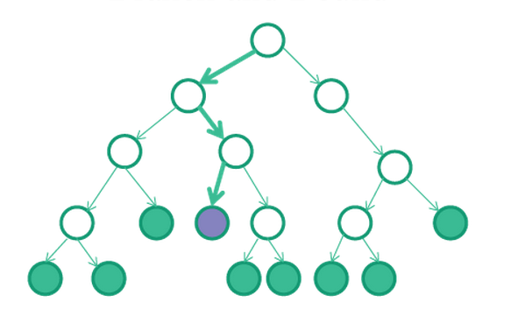
Compressed Data Structure
trail O
O
trail O +
Changes A
trail O +
Changes B
A
B
1) Each search node has a pointer to its parent search “trail”.
2) Each search node has keep the information of the difference between their parent search node.

Slide 19
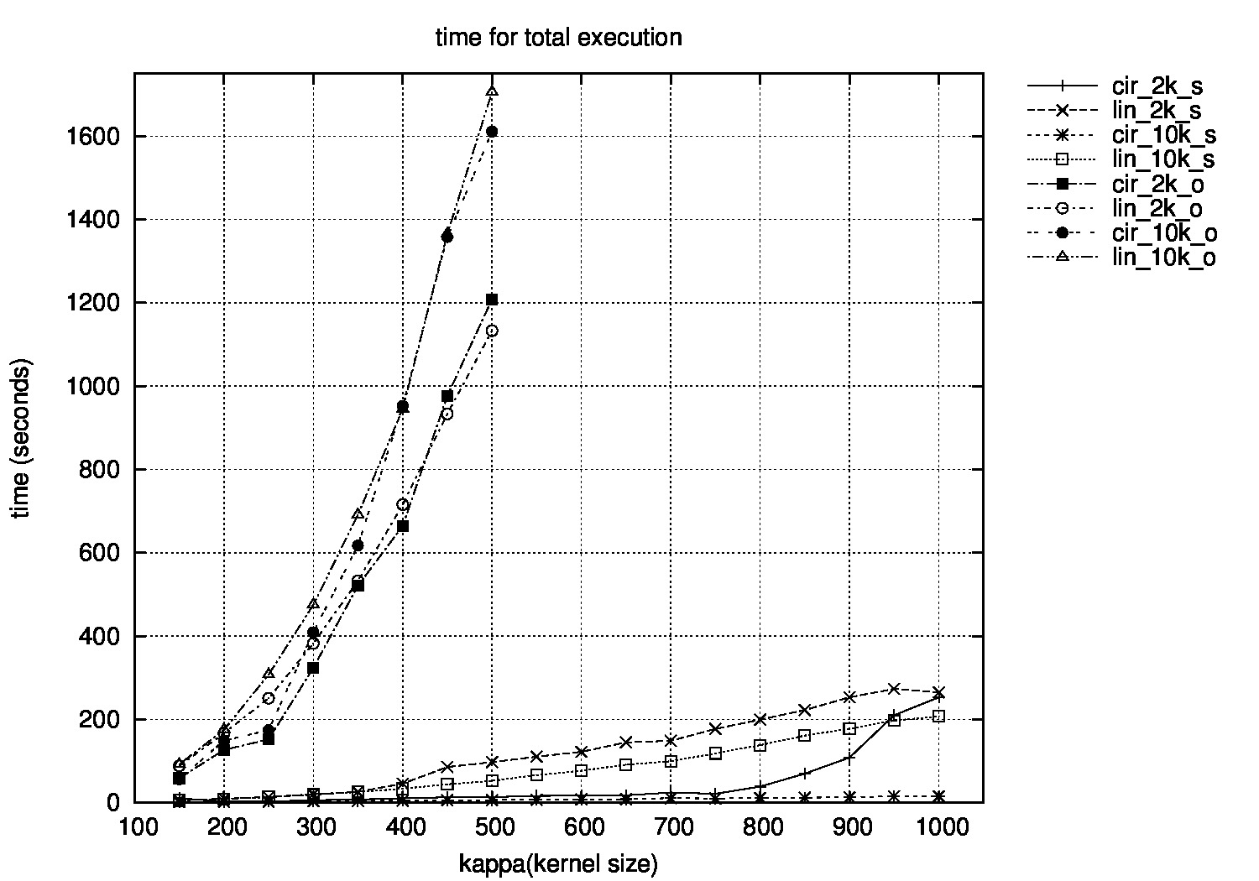
Experimental Results (Time)

Slide 20
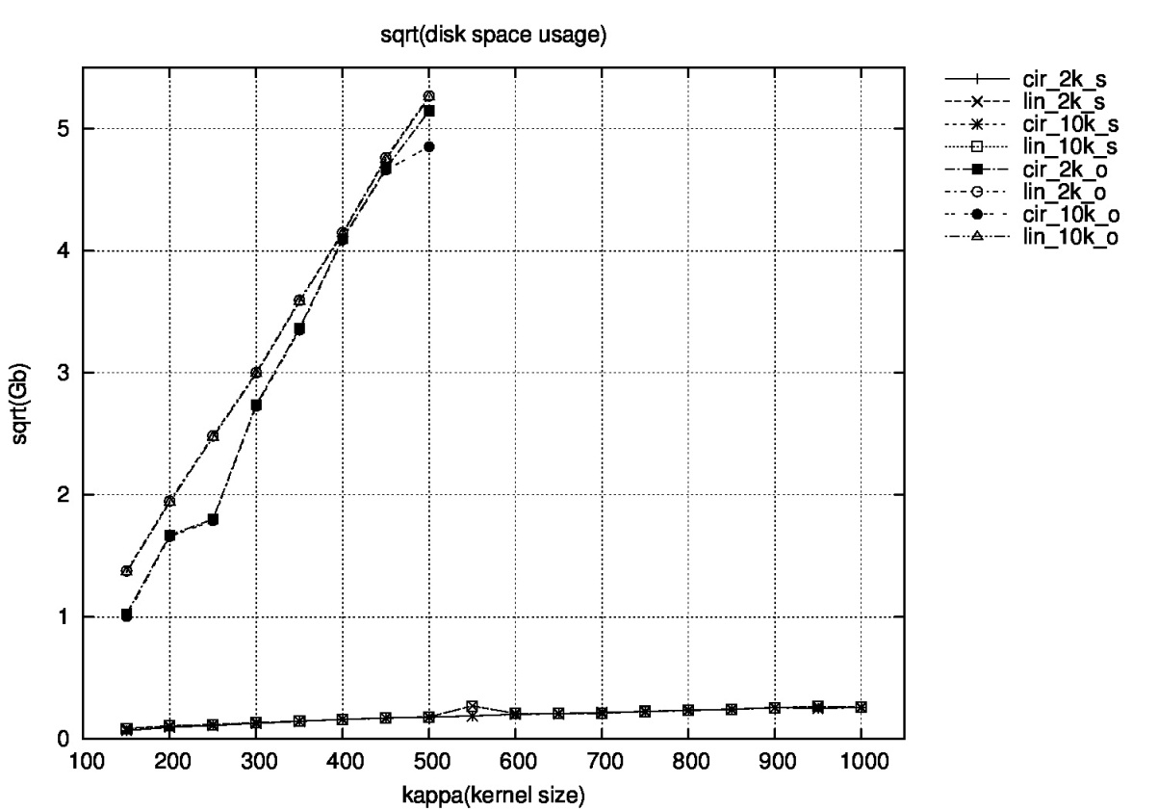
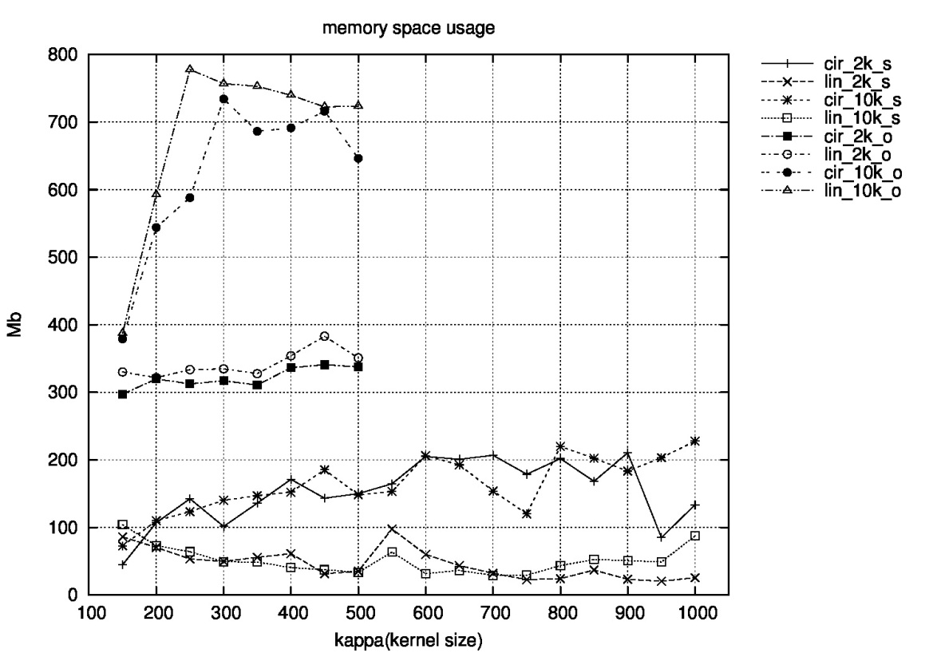
Experimental Results (Space)

Slide 21
Search Space Reduction
if 0-matching (i, j) in x same 0-k cycle (k ∈ 1,2,3), then after DCJ operation, the expected 0-k cycle change will be:
0.5*x + 0.5*0 – (3-x)= 1.5x-3.
We can select edges vertex v to continue search if ∑(v, s) (s is all other vertices except v)

Slide 22
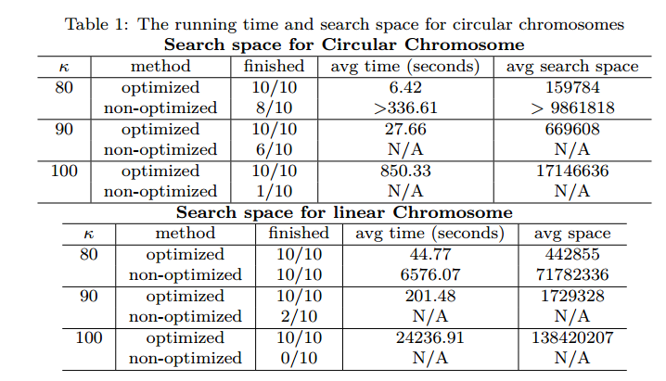
Search Space Reduction (Results)

Slide 23
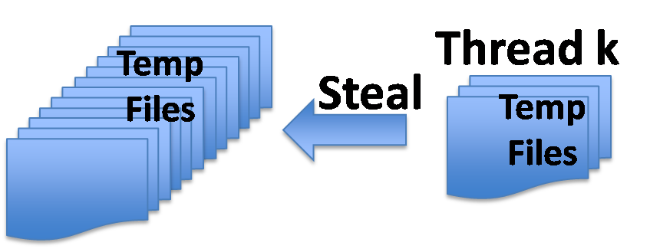
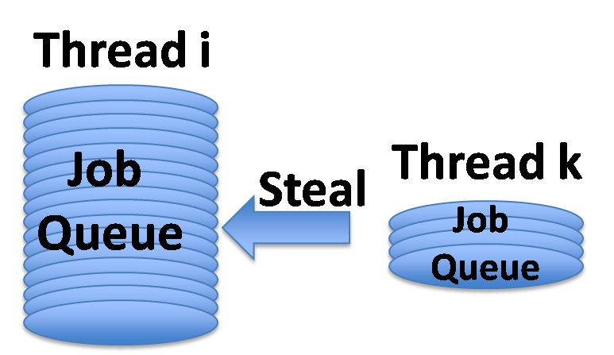
Parallel Method [Bader 05]
Load Balancing
Parallel search
Expand a frontier then search in parallel.

Slide 24
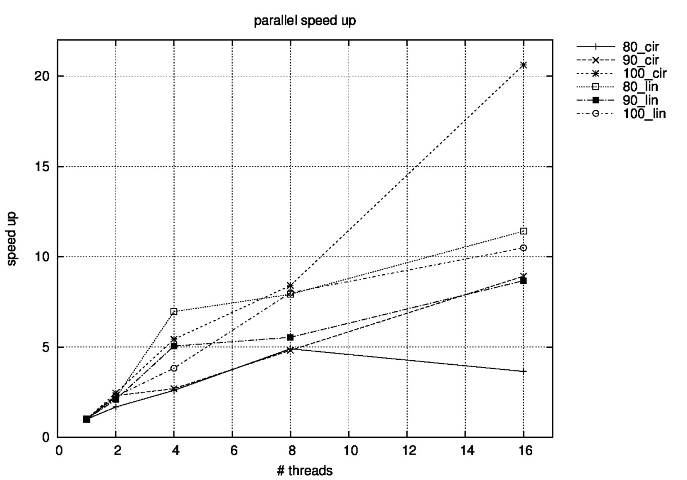
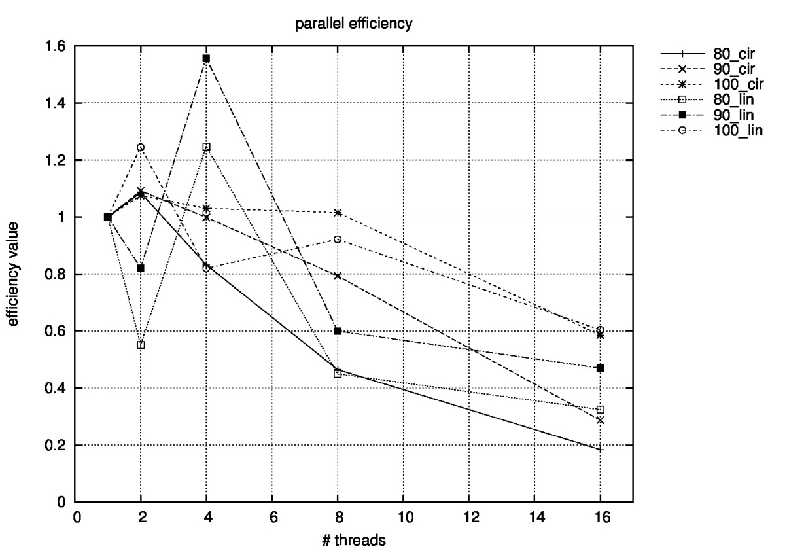
Experimental Results (Parallel)

Slide 25
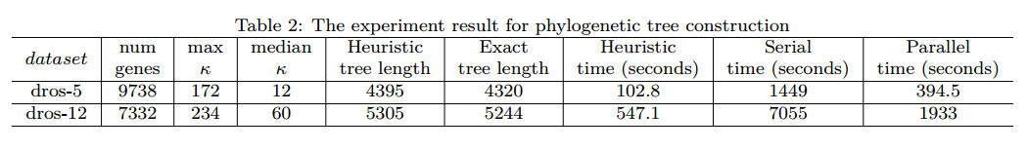
Results on Real Drosophila Data

Slide 26
Acknowlegement
This Research was sponsored in part by the:
NSF PetaApps Grants OCI-0904461 (Bader), OCI-0904179 (Tang), OCI-0904166 (Schaeﬀer)
and NSF OCI-1214504 (Bader).

