Slide 1
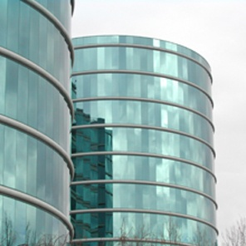
One Way Replication with SCA
Zhaoming Yin
01/20/2016

Slide 2
Overview
Demonstration of one way replication path using SCA;
Example OraTst.
General design;
Breakdown of test steps.

Slide 3
Demonstration
We have a two database environment;
Start Admin Server (AS);
Create Extract, Replicat through AS;
Start Distribution Server (DS) through AS;
Start path between Distribution Server and Receiver Server (RS) using DS;
Generate workload in source database;
Verify convergence.

Slide 4


SCA Test Blueprint
curl/restap
AS
AS
DS
RS
source
target
EXT
trails
trails
REP
…
SVR
PMP
SVR
…
MGR

Slide 5
Some Details
There are 40 tables in source and target database, s00 ~ s39 and d00 ~ d39 respectively;
There are 19 trail pairs;
DS ~ RS is responsible for trail T1, T2, T3, T4, T5, [T6 ~T10], [T11 ~T15], [T16 ~T20], [T21~T30];
DS ~ SVR is responsible for trail T31 T32 T33 … T39;
PMP ~ RS is responsible for trail T40;
Some paths are compressed.

Slide 6
Step by Step – Step 1, Initialization
curl/restap
AS
AS
DS
RS
source
target
EXT
trails
trails
REP
…
Define
Insert
SVR
PMP
SVR
…
MGR
validate

Slide 7
Step by Step – Step 2, Recovery Test
curl /restap
AS
AS
DS
RS
source
target
EXT
trails
trails
REP
…
Insert
SVR
PMP
SVR
…
MGR
validate

Slide 8
How to run
setenv OGG_BUILD <your_build.zip>
oratst -d tkmain_ggsca1 [ step={1|2} ]
genlrgmk –v
farm submit -platform LINUX.X64 -rh50_x64 lrgggsca1

Slide 9
Discussion
Integrated Extract do not work when created by AS;
Replicat abends randomly;
Need to restart Replicat.
Have to manually restart DS, RS.
Service Manager will handle this.

Slide 10

Questions

