Slide 1


GM Homelessness Prevention Strategy Action Plan
What now, what next, and how GMHAN can help.

Slide 2
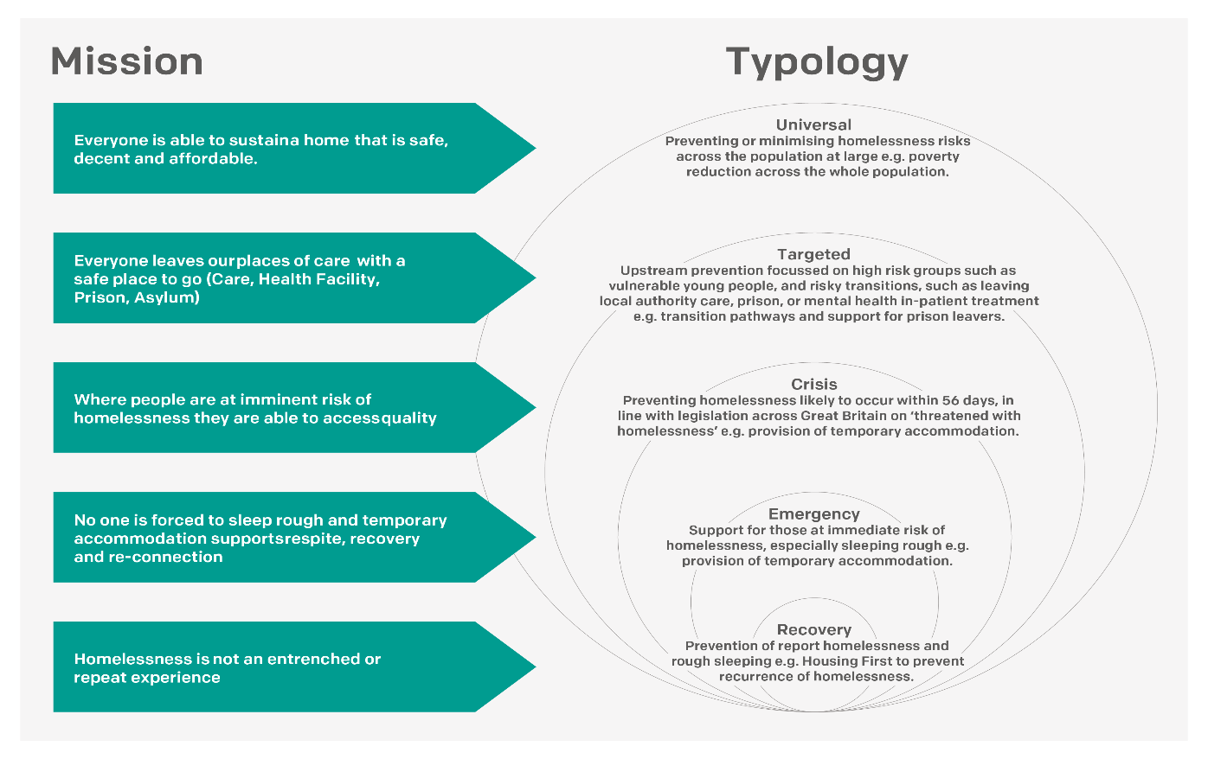
GM Homelessness Prevention Strategy
People
Participation
Prevention

Slide 3
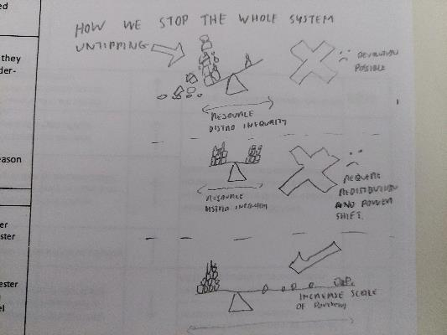
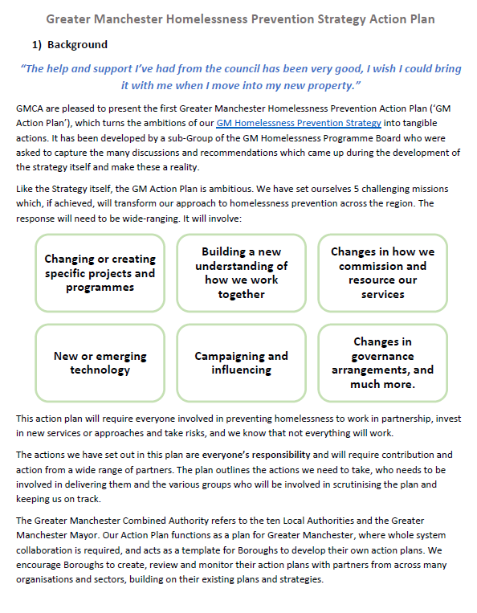
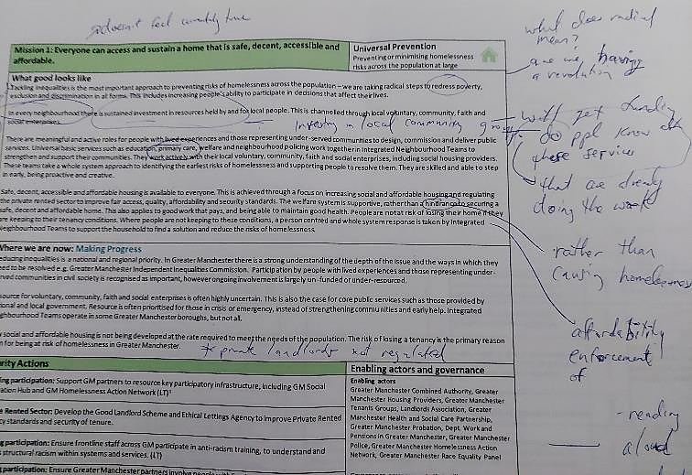
Strategy -> Action Plan

Slide 4
How do you deliver a homelessness prevention strategy when…?
The problem we are all trying to solve is incredibly complex.
No one organisation has a ringfenced budget dedicated to delivering the strategy.
The statutory burden of preventing homelessness falls mainly on individual Local Authorities, but…
…Every organisation across the whole system has an interest in, and a role to play in preventing homelessness.

Slide 5
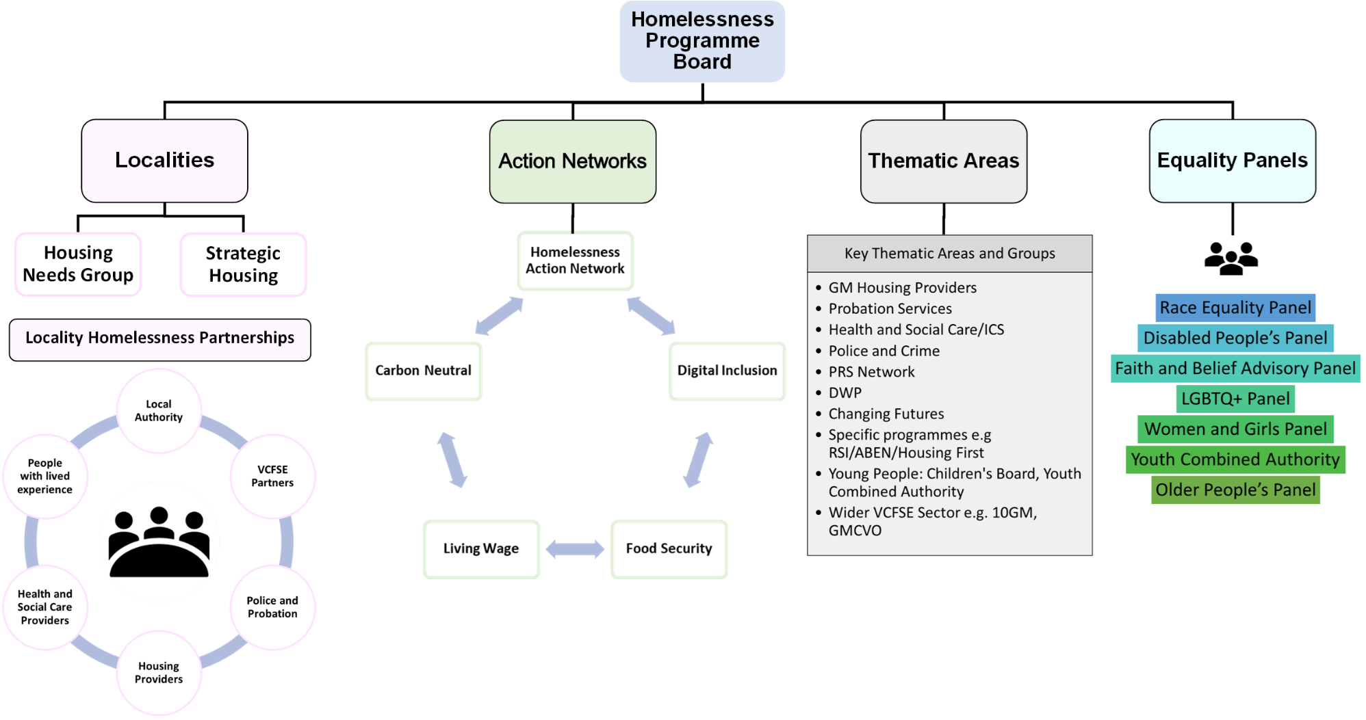

Slide 6
Role of GMCA
We collectively need to… | GMCA can support this through…
Keep the strategy alive: | Strategic Direction: Working with the Action Networks and cross-sector colleagues to generate enthusiasm and lobby at a local, regional and national level for fundamental systems change. Promote the Strategy and Action Plan as a way of thinking about, and ‘doing about’ homelessness prevention.
Support stakeholders to make progress: | Building Capacity and Learning Supporting Local Authority colleagues and Locality Partnerships to develop and deliver homelessness strategies. Providing capacity, structure and expertise across thematic areas to ensure strategy in policy is aligned.
Hold ourselves to account: | Collaborative Governance: Establishing governance processes for the strategy and action plan across a number of different contexts. Generating high quality data on whether or not the whole system is becoming more preventative.

Slide 7
But the Prevention Strategy belongs to us all!
No one organisation can (or should) ‘own’ the Strategy or action plan.
We all have to work together to achieve these missions, otherwise we will all fail.
As a collection of people who are all fully committed to ending homelessness in Greater Manchester, GMHAN is well placed to:
Be honest about whether these missions are really being achieved.
Work with partners to find ways to make them a reality.
Challenge ‘the system’ to do better.
Share learning from our successes and mistakes.

Slide 8
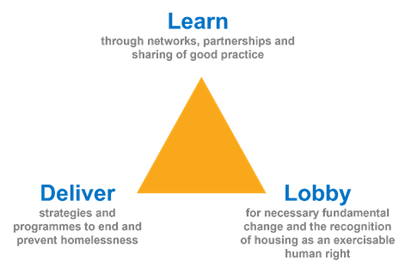
Embedding best practice from across our network into the HP Strategy and Action Plan.
New ideas for the action plan
New ways of thinking about prevention
Things we can control
Learning from working with other bits of the system
Perspectives from other action networks
Things we might be able to control
Working to help make the action plan a reality in partnership with Locality Homelessness Partnerships.
Influencing local, regional and national policy which gets in the way of a preventative system.
Intractable problems
‘Big’ systems issues
Things we can’t control

Slide 9

Tools to do the job: Delivery Group
Priority Actions
We Will…
Provide person-centred support and advice to people with outstanding immigration issues: By increasing the capacity and availability of quality independent legal advice, asylum advice and advocacy (LT) | Indicator: We’ll know it’s working when… More people are being successfully supported by Local authorities to prevent them from becoming homeless
Support homeless families: Implement recommendations of the Homeless Families Review including: Developing a GM Homelessness and Health Leads network, Develop a joint procurement framework/standards for B&B accommodation whilst moving to eliminate it Create a directory of services that acts as a single point of information for support for families and children.
Create services delivered by people with lived experience of homelessness. Develop a GM Peer Advocacy model where advocates are paid fairly, have experience accessing services and have the power and independence to scrutinise agencies that are not carrying out good practise and identify gaps in the system. (LT)
Get better at sharing data across agencies: Use GM Data Discovery process and Data Accelerator resource to further develop the GMThink principles across the GM system - prioritising ownership, accuracy, access, and transparency. (LT)
Develop specialist Substance Misuse and Mental Health services Develop integrated service specifications for commissioned Mental Health and Substance Misuse, using initial pilot and specialist services for joint commissioning and future funding opportunities.
Improve the way in which we support victims of domestic abuse Establish a cross-border protocol of local authority co-operation which defines responsibilities for the provision of housing, care, and support services when victims of violence and abuse move between local authority areas.
Ensure Social Housing providers play a key role in preventing homelessness. GM Housing Providers implement and monitor Homes for Cathy commitments and Domestic Abuse Housing Association accreditation.

Slide 10
Tools to do the job: Lobbying Group
Working with National Government | Mission
Embedding prevention - welfare reform: Lobbying the government on essential welfare reform including ensuring people’s housing affordability and sustainability is not adversely impacted by changes to their welfare benefits, ensuring that starting part time work is beneficial to overall income. | Universal
Social Housing and Private Rented Sectors: Continuing to work constructively with government on innovative ways to increase and accelerate genuinely affordable housing supply in Greater Manchester, including collaboration on projects such as Affordable Homes Programme, Rough Sleeper Accommodation Programme and ensuring learning from these programmes influences public policy, including the Renter’s Reform Bill | Universal
Person centred - asylum and immigration: influence the Home Office to make significant changes to asylum and immigration policy that drives people into homelessness and destitution, with a particular focus on the No Recourse to Public Funds policy and 28-day eviction notice period. | Targeted
Person centred - offending: work collaboratively with Ministry of Justice through the delivery of the Integrated Rehabilitation services and Tier 3 Community Accommodation Service to reduce repeat offending for people in the criminal justice system, prevent homelessness on prison release and ensure learning and innovation from these projects results in policy change. | Targeted
Embedding prevention – welfare reform: lobbying the government for welfare reform with a particular focus on the Under 35s room rate, No Recourse to Public Funds, and opening eligibility to apply for welfare before leaving a place of care. | Targeted

Slide 11
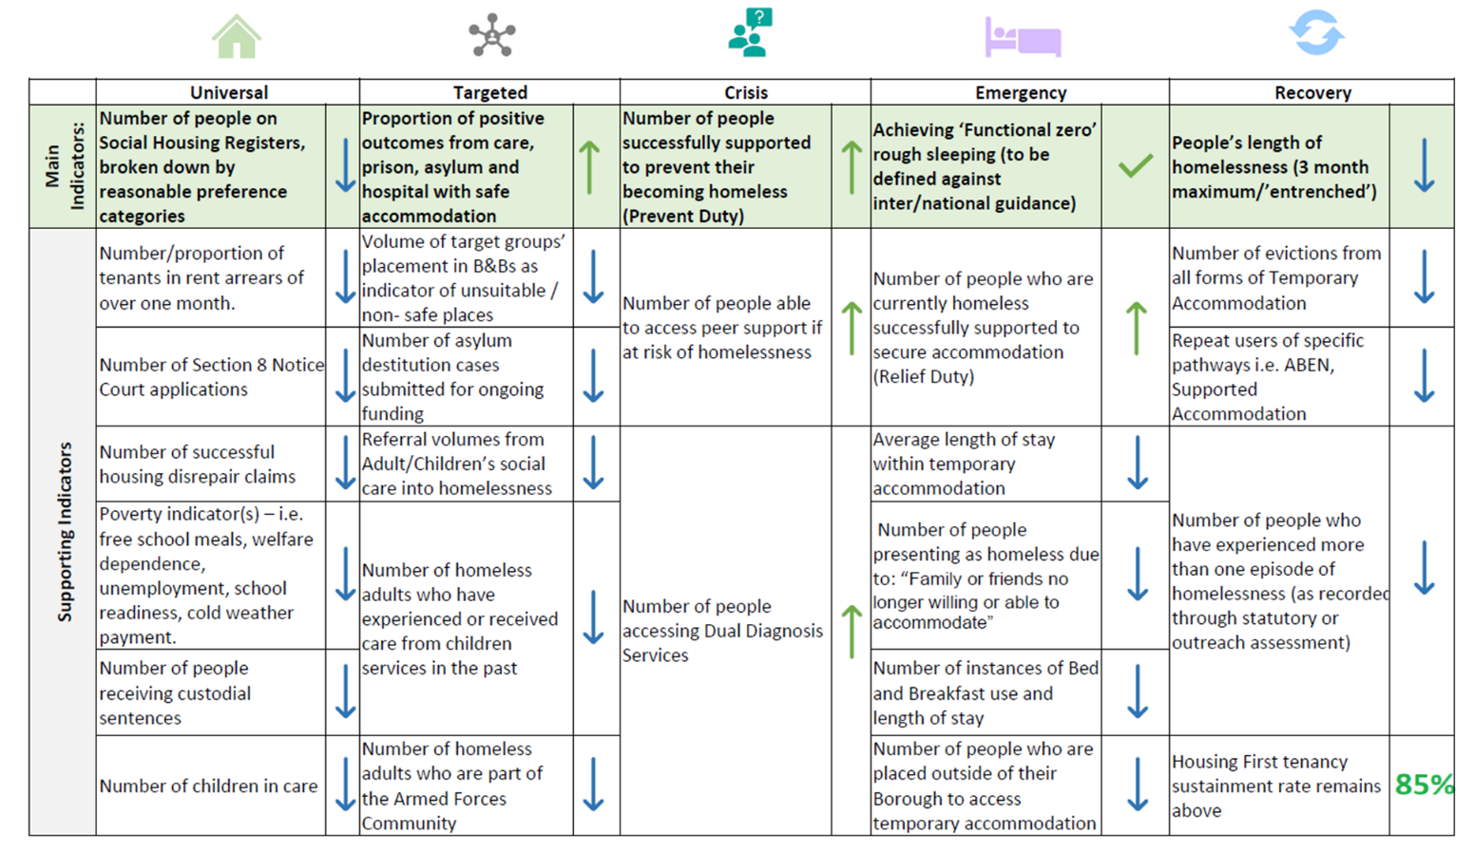
Tools to do the job: Learning Group

