Slide 1
Introduction to CJS Accommodation Pathways
Sarah Paul & Jill Corcoran
GM Homelessness Prevention Team
March 2024

Slide 2
What we know about accommodation related need
11,435 people were released from prison homeless 2018-19 (HMIP 2020)
Accommodation Need
Drug & Alcohol misuse
Lifestyle challenges
Employment issues
Problematic relationships
Limited education & training
Abuse, mistrust, rejection
Vulnerabilities
Mental Health Issues
Trauma
Physical Health challenges
Difficulties managing emotions
Accommodation is key to resettlement & rehabilitation.
Housing insecurity increases risk of recidivism.
Those with an accommodation need were more likely to have associated needs in relation to drug and alcohol misuse, families and relationships, lifestyle and associates, and employment, training and education.
HMIP Accommodation Thematic 2020 found key deficits in:
identifying and analysing accommodation and associated support needs
knowledge and skills to work effectively on accommodation issues and ability to engage appropriately with local housing authorities
60% of prisoners have expressed that having a settled home would help them stop reoffending.
Risk Assessment & Management/
Protection of the Public

Slide 3
Prison Releases
Best Practice in Standard Prison Releases
.
INGEUS Referral
AP
See best practice APs (CAS1)/ CAS2 Move On
Suspected vulnerability/
priority need
Housing Needs & vulnerabilities
assessed, recorded & referral consent taken
CPP supports LHA to identify interim temp option
INGEUS, AfEO LHA via PHPs, & CPP Support move on to longer term accommodation
Comprehensive 56 Day DTR
Not suitable for AP
CPP works with INGEUS to identify release address including referral to GMCAS3 as appropriate
No vulnerability or intentionality
Timeline
Entrance into custody & POM-COM Handover
4 months -12 weeks prior to release
56 Days Prior to release
Outcome feedback 2 weeks after DTR
4-6 weeks prior to release
Initial 3 months of release
Release Date
Not currently available for remanded/ unconvicted people

Slide 4
Prison Releases
Best Practice for Short Sentences/Early Releases (anything 14 days or less)
.
AP
Y
See best practice APs (CAS1)/ CAS2 move on
N
EMERGENCY REFERRAL
CAS3 Team will assess suitability of referral/will liaise with LHA if concerns over PN decision
4 Key Emergency Activities for CPP to Co-ordinate
INGEUS Emergency Referral completed *
GMIRS, AfEO scheme, LHA via PHPs, & CPP Support move on to longer term accommodation
Suspected
Vulnerability
Priority Need
CPP supports LHA to identify Temp options
Duty to Refer – Consent, and completion to be prioritised by INGEUS/ Prison Release Teams
No
Vulnerability
Priority Need
Consider ABEN Referral
Timeline
Entrance into Custody
Outcomes within 48 hours
Property identified prior to release
Initial 3 months of release
Release Date
Not available for unconvicted people

Slide 5
Things to consider alongside accommodation pathways
Risk factors alongside the presence and strength of protective factors
Current situation, potential victims and circumstances when risk is increased
Person’s motivation & capacity to change
Monitoring & controls to manage risk
Ability to manage situations & build on protective factors to support desistance
Access to potential victims & reduction of risk to specific individuals.
Safeguarding of adults and children
How to reduce the opportunities to offend and enable enforcement action where required
Responsibility to protect the public
Directed not to live somewhere
Restrictive Licence Conditions
Civil Orders & Prohibtions
Evicted from multiple Acc options
No local connection
Perceived as chaotic
Exclusion
Zones
Lack of consent for DTR
Too risky for housing
Mobility
Issues
Unstable
Mental Health
Actively using substances
Disengaged from services
Need supported accommodation
Vulnerable but intentionally homeless

Slide 6
HMPPS Community Accommodation Services
CAS Tier 1
Approved Premises
public protection placement with
24-hour staffing.
CAS Tier 2
NACRO BASS
low & medium risk HDC, Bail & alternative to recall
CAS Tier 3
Community Accommodation Service
Homelessness Pathway
The HMPPS CAS system offers a three-tier structure of temporary accommodation for people on probation, prison leavers or those on bail who require public protection measures or are at risk of being homeless.
All three tiers provide a bridge back into the community, appropriate to the risk of harm presented, but are not a settled accommodation provision
12 Regional Homelessness Prevention Teams
To lead and co-ordinate regional probation response to reducing homelessness for people on Probation, in collaboration with key partners.

Slide 7
HMPPS Accommodation Targets & Recording
Tackling homelessness and rough sleeping as a key priority. HMPPS agreed to contribute towards the aim to eliminate rough sleeping by the end of the current Parliament 2023/24.
SL14 Target – first night of release
Our aim is to ensure that every person released from prison has somewhere to stay on their first night of release.
Our target is that 90% of people being released from prison are accommodated on their first night
SL15 3 months post release/ post disposal
We are working towards understanding sustainability of accommodation and challenges encountered.
Ensure that 80% of individuals are in settled accommodation, either three months after their release or upon receipt of a community-based sentence.
Routine scrutiny of outcomes
Understand all negative outcomes
Dip sample 5% positives
Limitations of categories
Build confidence/ data accuracy
Share learning
Shared understanding of unmet need

Slide 8
GMPS Homelessness Prevention Team Ethos
Whole Systems Approach
Shared responsibility, accountability & improved outcomes
Strengthen relationships & align with existing & developing system
Evidence localised understanding of unmet need & share learning
Relevant information available & considered in a timely way

Slide 9

CAS3 Community Accommodation Service Tier 3
Provided by 10 GM Local Housing Authorities
GMPS own & contextualise risk & decision making
Enhanced Support Provision by LHAs & VCSE
Improved access to move on pathways
CAS3 is transitional accommodation in dispersed properties for up to 84 nights for people on Probation:
being released as homeless from prison, following a custodial sentence;
moving-on as homeless from CAS1 Approved Premises/ CAS2 (Nacro BASS) residence.
has been assessed by the Local Authority as ineligible for interim accommodation (not priority need/ deemed to be intentionally homeless)
subject of a Licence or PSS for a period of 84 nights
and who have given consent to be referred into the CAS3 service

Slide 10
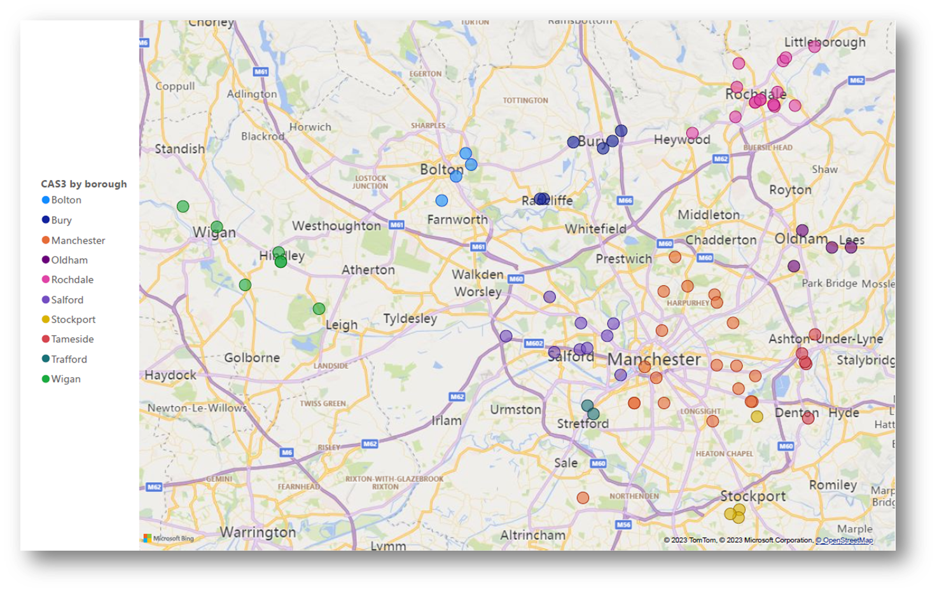
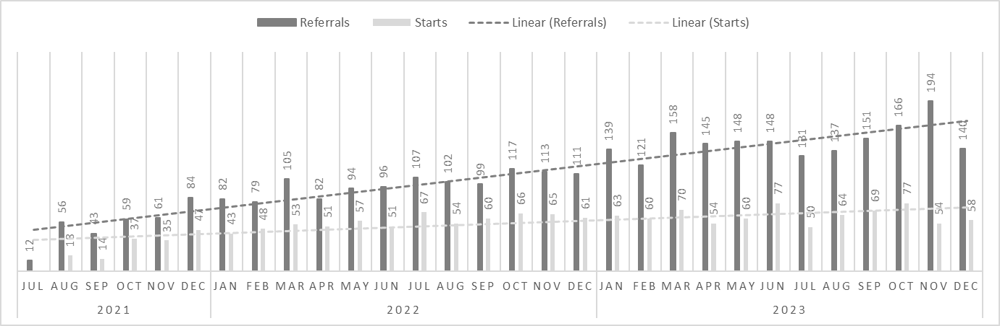
Greater Manchester CAS3
By borough:
Demand:
An opportunity to highlight what works, identify barriers (evidenced by data) and address within policy iterations for re-settlement and homelessness prevention at a regional and national level

Slide 11
Structures around people being released from prison
Strategic Housing Specialists
Prison Release Meetings
Accommodation Leads Network
Shared Workforce Development
CAS3 Service Delivery Reviews
CAS3 Move on Meeting
GM Strategic Steering Group
GM Commissioners Meeting
48 across prison establishments nationally
Local Authority & GMPS led meetings identifying pathways
Each PDU has Accommodation SPOs involved in process
CJ Homelessness Prevention Group
Multi-agency prison accommodation pathway group
Improving understanding, skills & collaboration
Oversight of CAS3 Partners and system impact
Move on focus of CAS3 Partners led by GMHPT
Oversight by MOJ, DLUHC and Reducing Reoffending Directorate
Monthly meetings with CAS3 Local Authority Leads Meeting
Resettlement Boards
Multi agency approach addressing needs pre-release
Governance Boards
2/3 weeks prior to release addressing outstanding actions
CAS3 Operational Meetings
CAS3 Partners: LHA, GMHPT, Acc & Support Providers
Peer Learning Forum
Joint activity to identify & address barriers

Slide 12





GM Integrated Rehabilitation Services (GMIRS) Ambition: to improve outcomes and experiences for people on Probation, victims, witnesses and the communities and neighbourhoods in which they live.
Co-commissioned and Co-designed GMIRS
* Principles of co-design, co-production, co-commissioning and co-investment
* Opportunity to better align services for Greater Manchester
* Better engagement with a wider range of services with their heart in the communities
* Really demonstrate the value of Lived Experience
* Shared transparency & accountability
* Support whole system change
Regional Outcomes and Innovations Fund (ROIF)
Support investment in wider services that may help reduce re-offending; new and innovative ways of working
Opportunity to fund local services.
Ingeus Housing
Advocacy:
Sourcing accommodation and related services for people at risk of homelessness in custody and in the community.
Substance
Misuse:
Dependency & recovery
with relapse prevention strategies and support in managing key triggers
Achieve ETE:
Developing
opportunities and a focus on pre-employment support & achieving jobs.
Community Led
Initiatives
Peer Mentoring:
Peer support service providing person centered interventions that are risk & needs led.
Women’s
Alliance:
Dedicated, gendered response to the needs of women on Probation & meaningful sentencing
ROIF – a range of services including:
A Bed Every Night, On the Out, JustLife, Knife Crime, Neurodiversity Assessment Programme, Atlas Programme (GMFRS), LGBTQ+ Reflective Space, Learning Difficulties & Autism Support, Football initiatives, Young Person specific interventions, CJS & Race & Ethnicity

Slide 13
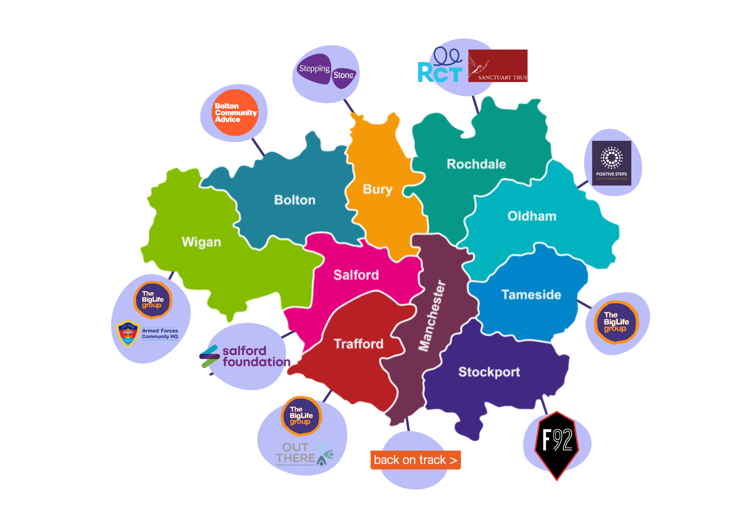
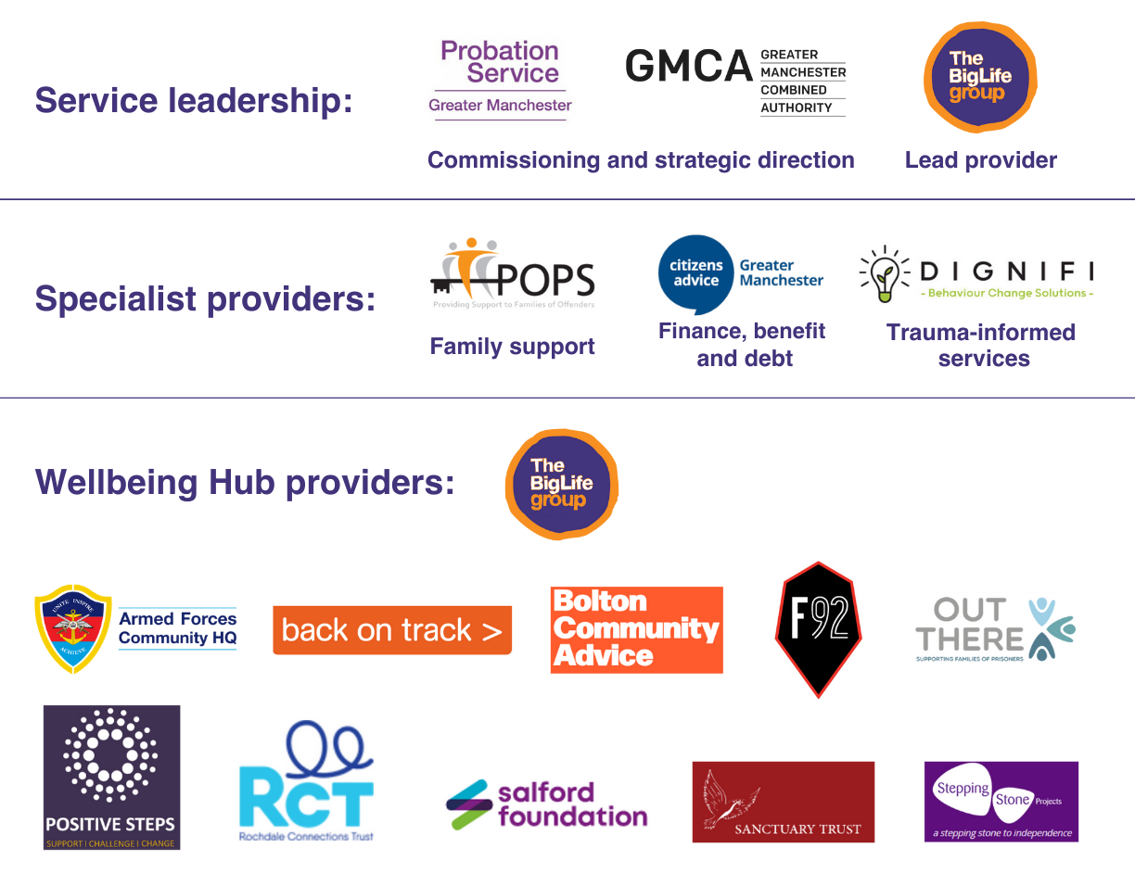
GM Wellbeing Hubs: Emotional Regulation & Decision Making, Family Support & Mediation, Wellbeing Support & Healthy Choices, Finance Benefit & Debt Advice, Behaviour Change

Slide 14
Things that have made and would make a huge difference:
Have made:
Working to strengthen relationships
Whole system approaches to improve outcomes
GMPS & GMCA Community Accommodation Service Tier 3 and CAS3 Partners including lived experience providers
GMPS relationships with Local Authorities
Where available DLUHC’s ‘Accommodation for Ex-Offenders Funding Scheme’ (AfEO)
Suggestions progressed through CJHPG
JustLife One Team Approach commission
Manchester Community Safety Partnership Funding for accommodation related services
The concept of commissioning to learn
Would make:
Improving prevention activity on arrival in Custody
Timely & comprehensive Duty to Refer
Homelessness Assessment prior to release from Custody
Improve workforce capacity across the board
Development of a Prison Housing Protocol
Ensuring the right people are directed through the right pathways
Access to specialist supported accommodation
Longer term wrap around support

Slide 15
Thank you so much for listening
Please do share feedback, thoughts & suggestions:
Sarah Paul GM Homelessness Prevention Lead sarah.paul@justice.gov.uk
Jill Corcoran HPT Operational Lead jill.corcoran2@justice.gov.uk

