Slide 1
@HOME

Slide 2
GMAT Pilot Statistics
Since September 2022:
93 Families (124 adults & 204 children)
23 section 21 eviction notices
48 Serious disrepair
11 serious overcrowding

Slide 3







20 Family Zone
schools

Slide 4
Shelter training
Triage concerns
Direct Partner referrals
Ameliorative support
Strategic change

Slide 5
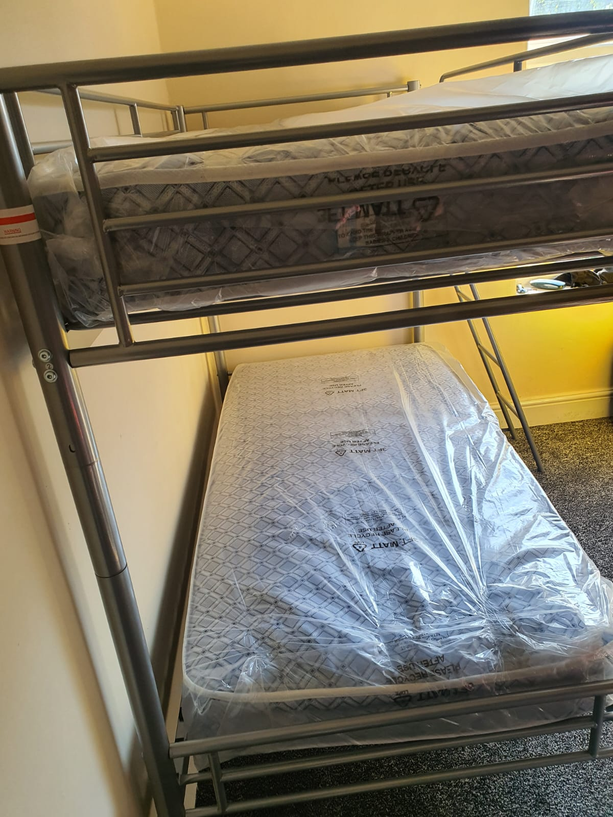
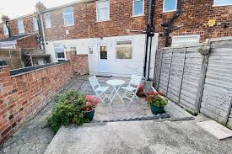
A place to call home

Slide 6
How does homelessness impact upon education?
What could/should schools and colleges be doing to support their students?
What resources are needed to effectively provide this support?
What other organisations / support could schools be tapping into?
Add your thoughts, ideas, suggestions and comments at:
https://jamboard.google.com/d/1WzbGGuUx7R2xEyLZhgumneG1_MJJlTE3Ee9FYJ5wfgY/edit?usp=sharing

