Slide 1
Prison Resettlement Pathway

Slide 2
Workshop Objectives
Understand the structure of HMPPS
Learn the prison resettlement pathway
Identify risks and development opportunities

Slide 3
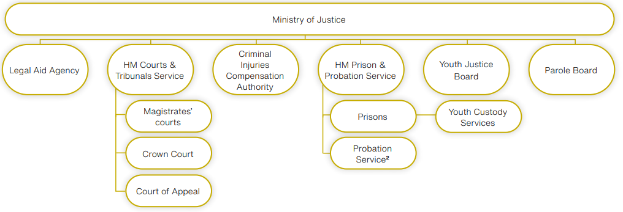
Ministry of Justice

Slide 4
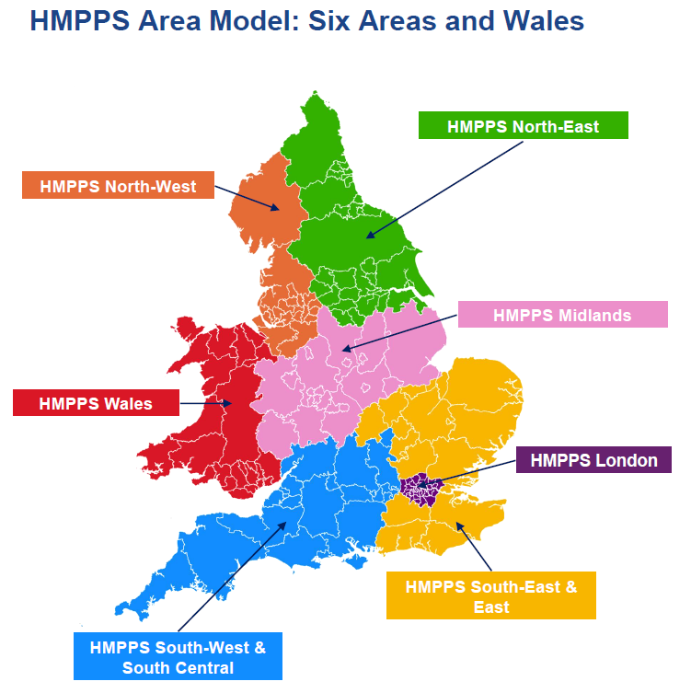
One HMPPS
Area Executive Director
Prison Group Directorate – GMMC (SHS)
HMP Forest Bank, Hindley, Buckley Hall, Manchester
Probation Region - Greater Manchester
Community Integration Team
Homeless Prevention Team
HM Inspectorate of Prisons evaluates prisons on the four ‘healthy prison’ areas: safety, respect, purposeful activity and resettlement.

Slide 5
Role of SHS
Managed by the Prison Group Directorate.
Accommodation Pathway lead
Strategic support for Head of Reducing Reoffending
Interrogate release data – promote evidence-based learning
Deliver training & consultancy
Ensure delivery of Duty to Refer (awareness, policy framework)
Prison/community point of contact

Slide 6
Resettlement Pathway

Slide 7
Prison Processes
Reception
Admitted to prison reception from court with remand or sentencing warrant.
Screened by healthcare services.
Belongings placed in property.
Cell sharing risk assessment.
Moved from reception to induction wing.
Induction facilitated by the Information Advice & Guidance service (Employment, Education and Resettlement advice).

Slide 8
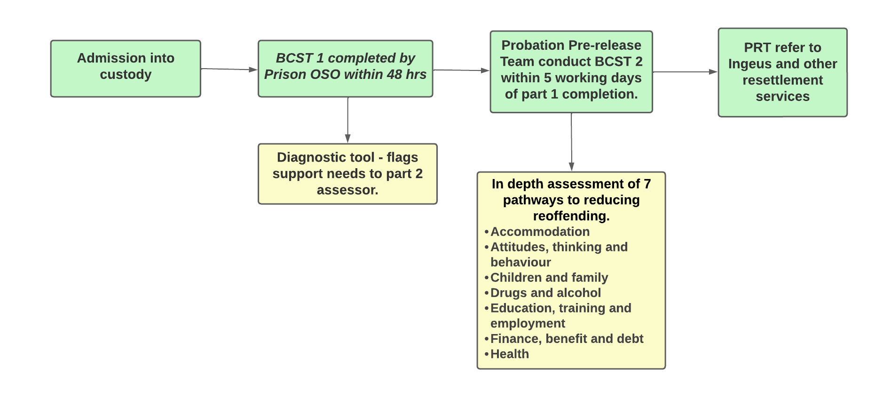
Identification of Resettlement Needs

Slide 9
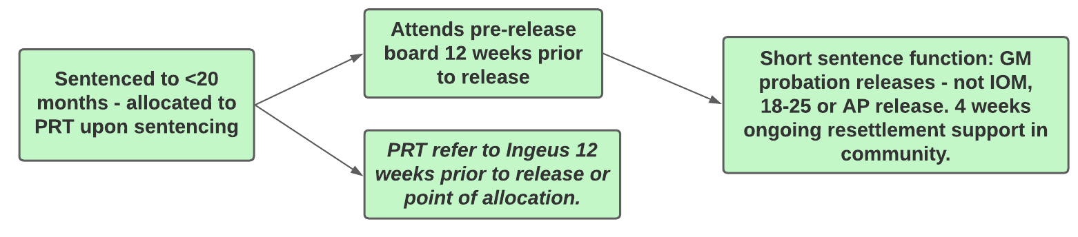
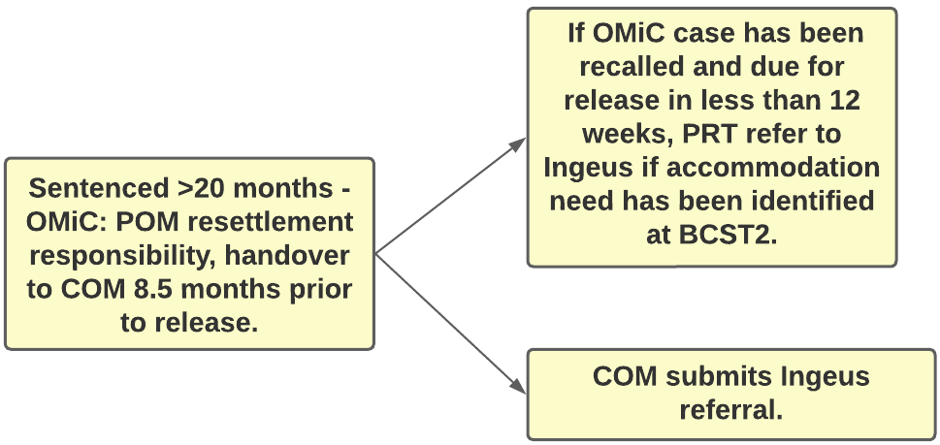
Resettlement Allocations

Slide 10
Resettlement Pathways
Ingeus Referral*
AP for high risk
Suspected vulnerability/PN
Local Authority to provide s.188 interim accommodation.
Entrance into custody POM-COM Handover @8.5 months
Probation Pre-release Team
Comprehensive 56 Day DTR
Not Suitable for AP or HDC
No vulnerability/ Priority Need
COM refer to CAS3 and Ingeus to refer to other providers (84 nights of self-contained probation run accom.)
Timeline
6 months -12 weeks prior to release
56 Days Prior to release
Outcome feedback 2 weeks after DTR
4-6 weeks prior to release
Initial 3 months of release
Release Date
Notes:
Probation, Prison and Local Authority pathway
HDC eligible if sentence between 4 years-12 weeks. No violent or sexual offences. Previous failure of HDC curfews. Low risk. Must serve at least 28 days or ¼ of sentence. Max HDC period is 180 days prior to release.

Slide 11
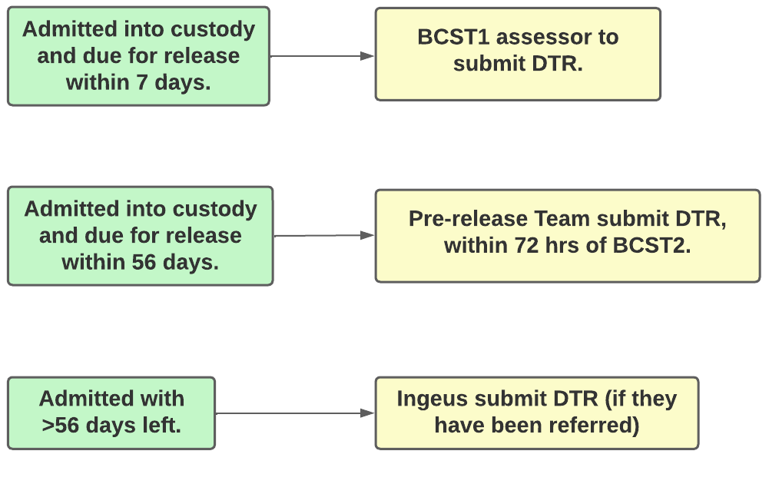
Duty to Refer Responsibility
HMP Forest Bank

Slide 12
Resettlement Boards
If prisoners are sentenced or subject to recall, they will automatically be invited at the 12-week pre-release stage to attend a resettlement board.
This is an in person opportunity to speak to services which will support with the following areas:
Accommodation | Education, Training and Employment | Finance, Benefit & Debt | Substance Misuse | Attitude, Thinking, Behaviour and Health.
The discussions with services are then written up in an individualised resettlement action plan.
Governance Boards
3/4 weeks prior to release progress on resettlement plans is checked by the PEL, SHS and SPO.
Any outstanding actions are chased up.
To ensure all possible resettlement support is in place prior to release.

Slide 13


Prison Resettlement Services
Ingeus provides a resettlement and accommodation service for those under Greater Manchester Probation and returning to GM areas.
We support with homelessness applications to local councils, referrals to shared, supported and some recovery- based accommodations and will be increasing our links within private rented sectors moving forward.
Benefit Enquiries
Arranging appointments at the Jobcentre, following release
Advice and guidance about employment and training opportunities
Help you to access support services in the community.

Slide 14


Prison Resettlement Services
GM RECONNECT is part of Greater Manchester Community Health and Justice services, assisting in the preparation of release of prison release.
We support engagement with appropriate health services and other care and support providers in the community. Following a referral, we will gain consent and assess physical, mental and emotional health needs, while helping to identify barriers that may reduce or stop engagement.
Achieve North West Connect delivers intensive case managed support in both custodial and community settings.
Individuals are supported through ‘the prison gate’ into the community, retaining continuity while assisting with your journey towards gaining new skills and employment.

Slide 15


Prison Resettlement Services
CV Writing
Job Applications
CV, Cover / disclosure letters
Mock interviews
Employment courses
ID (Birth certificate, driving licence or biometric resident permit).
Offers Bank Account applications for those that have 6 or more weeks in custody.
The Street Soccer Academy Coach and Personal Development Programme is a 6-week full time programme consisting of both practical coaching experience (delivered on the astroturf) and classroom-based theory sessions.
Street soccer works closely with all resettlement partners and offers continued “through the gate support” via football centres based around Greater Manchester and Lancashire providing support in the community for as long as required.

Slide 16
Activity: SWOT Analysis of Prison Accommodation Pathway
In Groups of 4/5 identify the following:
Strengths
Weaknesses
Opportunities:
- Are there any initiatives that have worked well that your organisation has undertaken which has been effective in supporting a vulnerable demographic?
- Are there any opportunities for your organisation to collaborate with prison services, to better support prison leavers?
Threats:
- From your area of experience and expertise, what are the risks/threats posed to accommodating prison leavers?

Slide 17
Thank you for your participation!
For any further questions, please contact us at either:
Tom.Warden@justice.gov.uk
Jonathan.Penman1@justice.gov.uk

Slide 18
Acronyms
BCST Basic Custody Screening Tool
COM Community Offender Manager
DTR Duty to Refer
FTR Fixed Term Recall
IOM Integrated Offender Management
OMiC Offender Management in Custody
PPCS Public Protection Casework Section
POM Prison Offender Management

