Slide 1



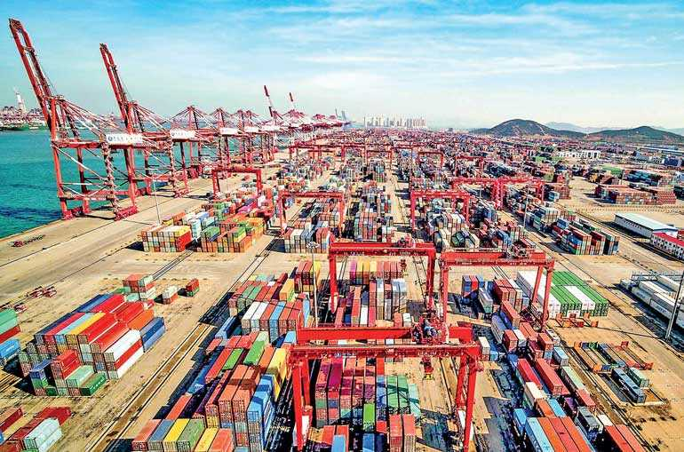







MODULE 3:
The fragmentation of production processes

Slide 2
CONTENTS
Definition of production fragmentation
Key Drivers Technological innovation
Global Value Chains (GVCs)
Types of Fragmentation
Benefits of Fragmentation
Challenges and Risks
Future Trends

Slide 3
Definition of production fragmentation
Production fragmentation refers to the process where different stages of the production process are spread across various geographic locations. Companies break down production into discrete tasks that can be performed in different countries based on cost, skills, and efficiency.

Slide 4
Importance in Global Trade and Economics
Enables countries to specialize in specific tasks or sectors
Drives down production costs and increases efficiency
Promotes international trade and interdependence
Allows firms to access global talent and technology
Encourages economic integration and global

Slide 5
Key Drivers of Production Fragmentation
Four key drivers explain the trend of fragmented production processes:
Technological Innovation (ICT, Transport)
Trade Liberalization
Cost Reduction Strategies
Specialization and Comparative Advantage

Slide 6
Key Drivers of Production Fragmentation
Four key drivers explain the trend of fragmented production processes:
Technological Innovation (ICT, Transport)
Advances in information and communication technologies (ICT) and transportation have enabled coordination and movement of goods across borders with unprecedented speed and accuracy. These innovations reduce transaction and logistics costs, facilitating global supply chains.
Trade Liberalization
The reduction of trade barriers, such as tariffs and quotas, and the establishment of trade agreements have allowed firms to access international markets more freely, promoting outsourcing and offshoring of production tasks.

Slide 7
Key Drivers of Production Fragmentation
Cost Reduction Strategies
Companies seek to minimize production costs by locating different stages of the value chain in countries where inputs and labor are cheaper. This allows firms to remain competitive in global markets.
Specialization and Comparative Advantage
Nations and regions specialize in specific production tasks where they have a comparative advantage. This specialization increases overall productivity and efficiency in the global production network.

Slide 8
Global Value Chains (GVCs)
GVCs refer to the full range of activities that firms and workers perform to bring a product from its conception to end use and beyond, divided across different countries and regions.
GVCs are structured as a sequence of interlinked activities — such as design, production, marketing, distribution, and support — carried out across various locations. They involve multiple firms, including lead firms that coordinate and suppliers that execute specific tasks.

Slide 9
Examples of Fragmented Production
Smartphones: design in the US, components from Japan, Korea, Taiwan, assembly in China.
Automobiles: engines in Germany, electronics in Japan, assembly in Mexico.
Apparel: raw materials in India, manufacturing in Bangladesh, branding and retail in Europe.

Slide 10
Types of Fragmentation
Fragmentation in production can take multiple forms, reflecting different strategies for dividing work and allocating resources globally:
Vertical vs. Horizontal Fragmentation
Offshoring vs. Outsourcing
Task-Based Trade

Slide 11
Vertical Fragmentation: different stages of production occur in different locations (e.g., design in one country, assembly in another)
Horizontal Fragmentation: same stage of production spread across different regions (e.g., identical manufacturing in multiple countries)

Slide 12
Offshoring: relocating business processes to another country (can be within the same company)
Outsourcing: contracting out business functions to external parties (can be domestic or international)
Combination: offshoring + outsourcing is common in global production strategies

Slide 13
Task-Based Trade
Trade is increasingly organized around tasks rather than final goods.
Countries specialize in specific tasks within global value chains (e.g., coding, manufacturing, logistics).
Reflects finer fragmentation and international division of labor.

Slide 14
Benefits of Fragmentation
Fragmentation of production allows firms to optimize operations by distributing tasks across locations based on cost, expertise, and efficiency advantages.
Cost Efficiency and Economies of Scale
Lower labor and operational costs in offshore locations
Mass production enables economies of scale
Resource allocation becomes more efficient across the value chain
Flexibility in Production
Firms can scale operations quickly in response to demand changes
Easier to shift production across suppliers or regions
Supports lean and just-in-time production models
Access to Specialized Skills and Inputs
Firms tap into regions with niche expertise or resource advantages
Promotes high-quality outputs by leveraging global talent
Encourages strategic partnerships and collaboration
Faster Innovation
Collaboration with global partners accelerates R&D
Cross-border knowledge sharing enhances product development
Reduces time-to-market for new products and services

Slide 15
Challenges and Risks
While fragmentation offers significant benefits, it also introduces a range of challenges and risks that firms must manage effectively.
Supply Chain Disruptions
Natural disasters, pandemics, and geopolitical tensions can halt production
Just-in-time systems increase vulnerability
Delays in one region can affect the entire global value chain
Loss of Control and Quality Issues
Outsourcing reduces direct oversight of operations
Variability in standards and practices across regions
Inconsistent product quality or delivery reliability
Coordination Complexity
Requires advanced logistics and communication systems
Time zone differences and cultural barriers add difficulty
Increases managerial and administrative burden
Ethical and Labor Concerns
Poor labor conditions in low-cost regions raise reputational risks
Environmental degradation and human rights violations
Growing demand for transparent and sustainable supply chains

Slide 16
Future Trends
As global dynamics evolve, production fragmentation is being reshaped by trends such as technological innovation, environmental pressures, and shifting geopolitical strategies.
Reshoring and Regionalization
Companies are moving production closer to home to reduce risk
Trade tensions and COVID-19 exposed global supply vulnerabilities
Regional trade blocs and nearshoring strategies are gaining momentum
Sustainability and ESG Pressures
Increasing demand for ethical and transparent supply chains
Firms are adopting circular economy principles
Compliance with environmental, social, and governance (ESG) standards is becoming crucial
Digital Supply Chains and Industry 4.0
Integration of IoT, AI, and blockchain for real-time visibility
Automation enhances speed, accuracy, and coordination
Smart factories and predictive analytics optimize global operations

