Slide 1


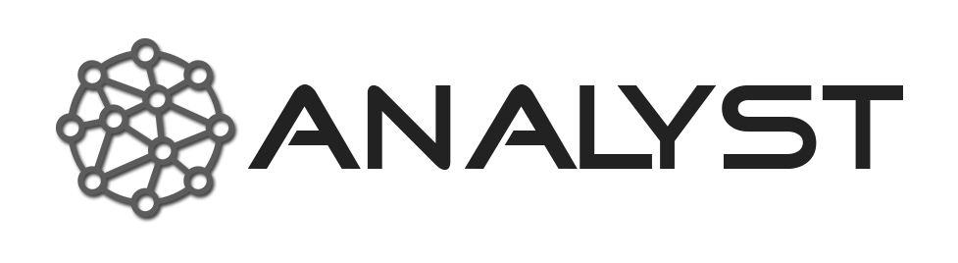








Familiarizing with countries & finding relevant sources
MASSIVE OPEN ONLINE COURSE (MOOC)
Project N. 2023-1-IT02-KA220-HED-000161770
ANALYST - A New Advanced Level for Your Specialised Training

Slide 2
Objective: Analyzing a country’s security environment, assess risk, and identify threat actors impacting corporate security.
Key Outcomes:
Understand corporate security and business continuity
Understand strategic vs. real-time intelligence
Identify and assess threats to business continuity and a company’s assets
Create a practical country risk profile

Slide 3
Understanding corporate security: what are you trying to protect?
Corporate security encompasses measures taken by an organization to protect its physical, financial, intellectual, and human assets from internal and external threats such as theft, fraud, cyberattacks, natural disasters, crime, terrorism, political uncertainty, economic turmoil or diplomatic crisis.
What are the assets of the company? Among others:
Personnel (employees): executives, contractors, workers etc.
Physical assets: buildings, manufacturing facilities, warehouses, equipment, machinery, vehicles

Slide 4
Understanding corporate security: what are you trying to protect?
Intellectual Property: Patents, copyrights, trademarks, trade secrets, and proprietary processes that provide competitive advantages.
Financial Assets: Cash reserves, bank accounts, stocks, bonds, investments, and other securities that ensure liquidity and financial stability
Technology and IT Systems: Computers, servers, software systems, and digital infrastructure supporting business functions
Supplier Contracts: Agreements with suppliers that ensure steady access to resources necessary for production
Strategic Partners: Organizations or individuals that collaborate on joint ventures, product development, or market expansion.
Subcontractors: Third-party vendors or service providers who perform critical functions or deliver specialized services.

Slide 5
Company’s profile and Business Continuity
It is essential to have a good understanding of the company’s operations and overall business environment in order to accurately and relevantly identify risks and threats.
Which is key to ensure business continuity:
Business continuity is the ability of a company to keep essential operations running during and after unexpected disruptions. It involves planning and preparation to minimize downtime and ensure a quick recovery.

Slide 6
Company’s profile and Business Continuity
General Company Profile
What is the company’s core business and main products or services?
Identifies critical operations that must be prioritized in continuity planning.
Who are the company’s primary customers or target markets?
How is the company structured (e.g., departments, hierarchy, ownership)?
What are decision-making chains and resource allocation in crisis scenarios?

Slide 7
Company’s profile and Business Continuity
Context and external factors
What industry or sector does the company operate in?
Who are the main competitors and what is the company’s market position?
What are the key trends or changes currently affecting the sector?
What regulations or compliance requirements impact operations?
What are the biggest operational challenges the company faces (e.g., supply chain, technology, workforce)?
What external factors (economic, political, environmental) have recently impacted operations?
How does the company respond to disruptions or unexpected events in its sector?
What strategies are in place to ensure operational resilience and business continuity?

Slide 8
Strategic Monitoring Vs Real-Time Intelligence
Aspect | Strategic Monitoring | Real-Time Intelligence
Focus | Long-term trends, global context. | Immediate events and incidents. Rapid response.
Tools | Reports, analysis, prospective analysis | Threat intelligence platform, alerts systems, other relevant OSINT tools
Use Case | Investment, long-term risk mitigation, strategic planning | Incident response, crisis management.

Slide 9
Strategic Monitoring Vs Real-Time Intelligence
Timeframe | Probability | Description & examples
Short-term (1 day-1 year) | High | Rapidly evolving threats targeting critical infrastructure, businesses, and individuals. Supply chain disruptions. Unrest, terrorist attacks, crime etc.
Medium-Term (1-3 years) | High to moderate | Inflation. Policy shifts in response to crises. Elections, political transition.
Long-term (3 years and beyon) | Moderate to low | Resource scarcity. Technological Disruption. Climate change related issues.

Slide 10
Understanding a Country’s Security Environment
Security environments vary widely by country and region, affecting business continuity in many possible ways.
At Hozint we consider
Travel risk
Terrorism
Crime
Political violence
Health and epidemic
Natural Hazards
Transportation
It of course necessary to add:
Financial and trade risk (tariffs and customs).

Slide 11
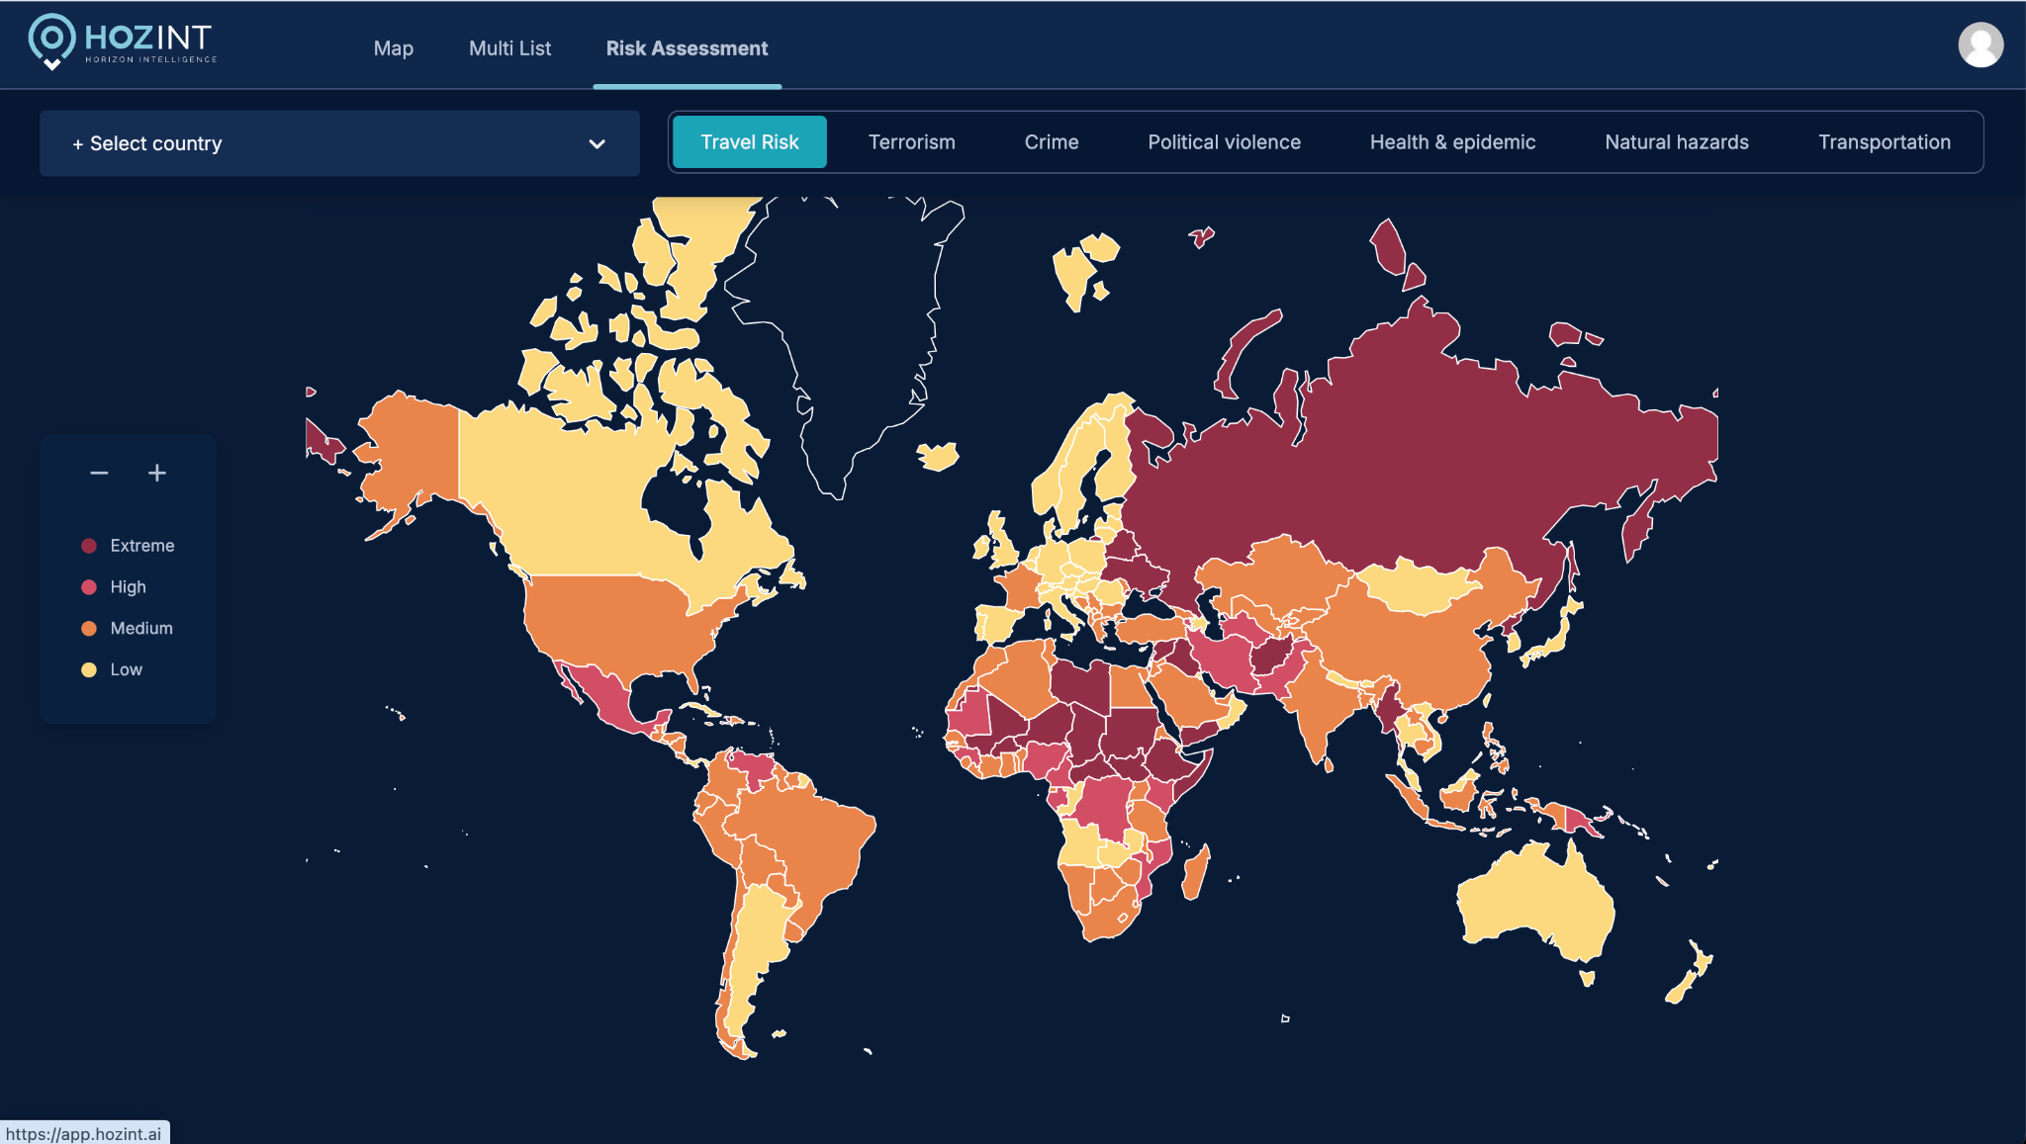
Subtitle/section

Slide 12
Assessment tools
If you don’t have access to a threat intelligence platform like ours starting with travel advisories is a very good start, they are in general:
Well made by security and intelligence professionals specialized in travel risks
Brief and clear, often with good maps and visuals
Comprehensive: they consider most of the abovementioned risks
Up to date: some ministers of foreign affairs monitor closely the latest developments and update some advisories sometimes twice a day.

Slide 13
Some of the most remarkable ones:
French MFA
British FCO
Australian DFA (really very good)
US State Department
Government of Canada

Slide 14
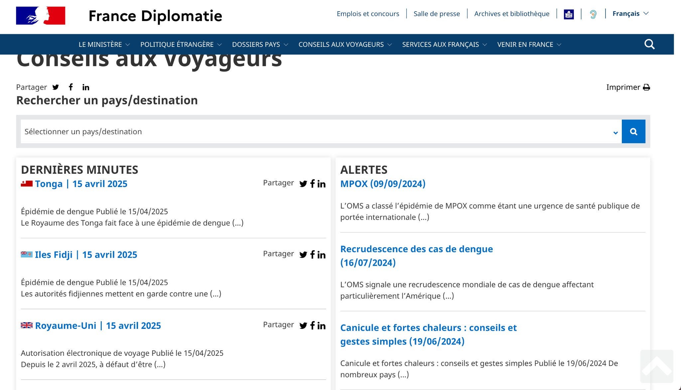

Slide 15
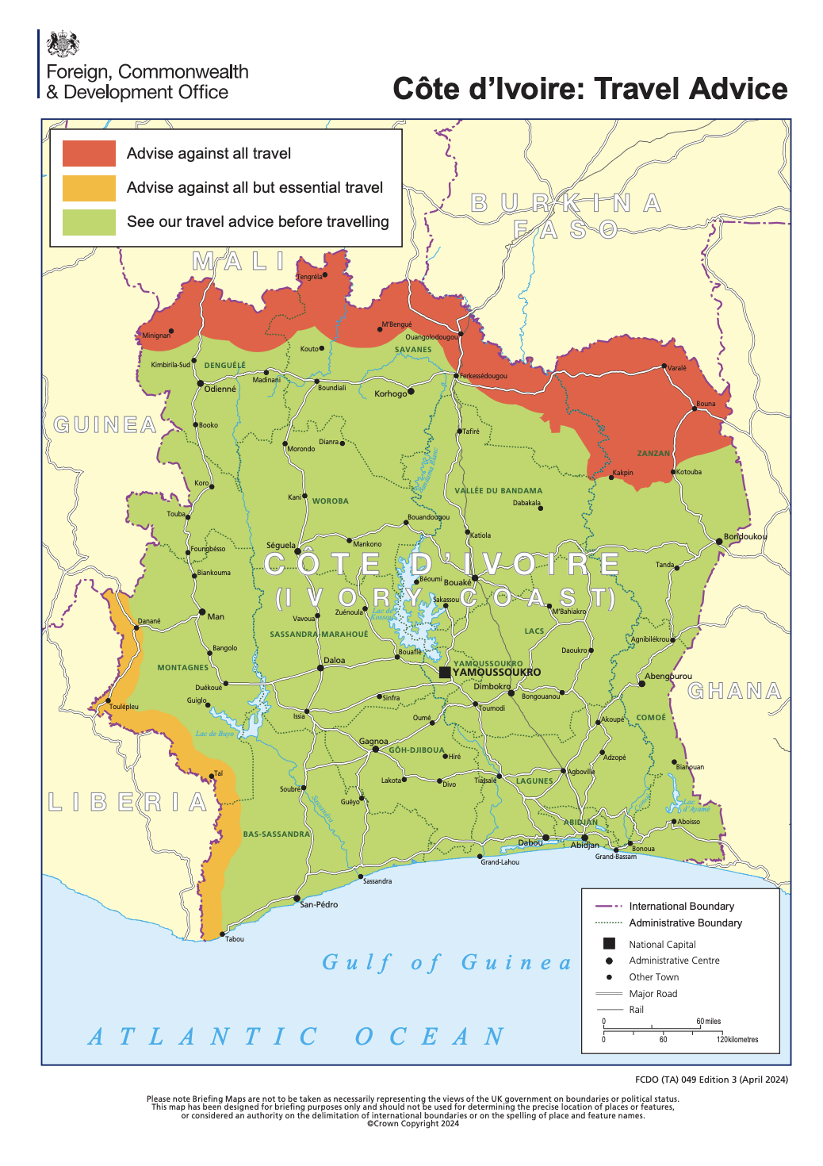

Slide 16
Country databases
IMF Country information
World Bank Open Data
European Data
CIA World Fact Book
Transparency International
Amnesty International
OECD - Countries & Regions
UN Data

Slide 17
Rating Agencies
Risk ratings highlight complex country-specific threats into actionable insights, supporting informed, risk-aware strategies.
Quantify Risk Exposure: Ratings summarize these risks into clear scores, helping organizations compare countries and understand the likelihood of negative events impacting returns
Identify Key Risks: Rating agencies assess a country’s political, economic, and social risks—such as political instability, sovereign default, and economic downturns—that could affect investments or business operations.
Benchmark and Monitor: Regularly compare ratings across countries and over time to spot changes in risk level, enabling proactive risk management and early warning for emerging threats

Slide 18
Rating Agencies
S&P Global Ratings www.spglobal.com/ratings
Moody’s Investors Service www.moodys.com
Fitch Ratings www.fitchratings.com
DBRS Morningstar www.dbrsmorningstar.com
Kroll Bond Rating Agency www.krollbondratings.com
Japan Credit Rating Agency www.jcr.co.jp
Rating and Investment Info www.r-i.co.jp
Dagong Global Credit Rating www.dagongcredit.com
ICRA Limited www.icra.in
CRISIL www.crisil.com

Slide 19
Identifying Potential threats
Collect Multi-Dimensional Data:
Security: crime rates, organized crime activity, terrorism threats, and law enforcement effectiveness.
Economic indicators: GDP growth, inflation, external debt, balance of payments.
Political factors: governance quality, stability, policy consistency, conflict history.
Social dynamics: demographic trends, civil unrest, migration patterns.
Regulatory environment: legal system strength, regulatory changes, trade policies.
Environmental risks: natural disasters, climate vulnerability.

Slide 20
Prioritizing identified threats
Assess Likelihood and Impact
Probability (chance of occurrence): Estimate how probable it is that a threat will materialize, using historical data, expert judgment, and trend analysis.
Impact (severity if occurs): Evaluate the potential consequences if the threat occurs—consider financial loss, operational disruption, reputational damage, and effects on people or assets.
Risk Matrix:
High Probability/High Impact
High Impact/Low Probability
Low Impact/High Probability
Medium Probability/Medium Impact

Slide 21
Prioritizing identified threats
Risk = Threat × Vulnerability × Impact
Threat: The probability that a harmful event (e.g., political unrest, cyberattack) will occur.
Vulnerability: How exposed or unprotected the country, organization, or system is to that threat.
Impact: The severity of consequences if the threat materializes (financial loss, operational disruption, reputational damage).
Formula in Action:
Assign scores (e.g., 1–5) to each factor and multiply:
Risk = Threat × Vulnerability × Impact
Higher scores indicate higher overall risk, helping prioritize which threats need urgent attention and mitigation.

