Slide 1











OSINT for Real-Time Intelligence
MASSIVE OPEN ONLINE COURSE (MOOC)
Project N. 2023-1-IT02-KA220-HED-000161770
ANALYST - A New Advanced Level for Your Specialised Training

Slide 2
What is OSINT?
OSINT (Open-Source Intelligence) for real-time intelligence focuses on using publicly available data to gather immediate, actionable information that can support decision-making during ongoing events or crises.
The goal is to provide timely insights that can be used to respond quickly to evolving situations.
Introduction to OSINT for real-time intelligence:

Slide 3
What is OSINT?
Real-time Monitoring Tools:
Social media: Platforms like X, Facebook, Telegram, Reddit, and Instagram
Commercially available AI-driven tools
News and Live Feeds
Government alerts and advisories

Slide 4
OSINT Tools
Leveraging Social Media for OSINT:
Social media can provide real-time updates from people on the ground, reporters, eyewitnesses, and even official sources. Social media often provides immediate, on-the-ground insights that are hard to capture through traditional intelligence channels.
Geotagged posts and videos can be crucial in confirming the location of events, such as protests, natural disasters, or military engagements.
Hashtags and trending topics can reveal the focal point of public discourse and highlight areas of concern.

Slide 5
OSINT Tools
Challenges using social media for OSINT
Information overload: social media platforms generate a huge amount of data every second, making it difficult to sift through noise and find relevant, reliable and useful information.
Misinformation (unintentional false information) and disinformation (deliberate false information).

Slide 6


OSINT Tools
Social media verification techniques
Verification technique | Description | Tools and Resources
Check the source | Review the profile of the post for credibility indicators such as account verification activity history and engagement levels | Profile review tools (manual), social media platform features
Cross referencing with other sources | Cross check the post with news outlets, other social media posts, or official statements to ensure consistency in details | Google News, X (Formerly Twitter), Fact checking websites.
Reverse image search | Perform a reverse image search to identify the origin of an image or verify if it has been altered or used before | Google Images, TinyEye
Video Verification | Analyse video metadata, frame by frame and audio/visual cues to confirm context and authenticity of the video. | Video-editing tools, InVID, YouTube Data Viewer
Geolocation Verification | Use tags of visual clues from images or videos to confirm the location of the event/incident. | Google Earth, Google Maps, OpenStreet Map

Slide 7
OSINT Tools
Leveraging News Media for OSINT
News outlets provide a wealth of publicly available data that can be leveraged for analysis, whether it's for monitoring political events, natural disasters, conflict zones, or social trends.
News outlets are often the first to report on conflicts, political unrest, military movements, or diplomatic changes.

Slide 8
OSINT Tools
Tools for Accessing News Media for OSINT
Google News: An excellent tool for aggregating the latest news articles from a wide range of sources. It can be filtered by region, topic, and keywords.
RSS Feeds: News sites often offer RSS feeds that can be used to monitor specific topics of interest.
News Aggregators: for monitoring global or regional topics as they evolve, especially during crises or breaking news events.

Slide 9
OSINT Tools
Leveraging Government Alerts and Advisories
These official notifications provide critical, reliable, and often time-sensitive information about a variety of issues, from national security threats to public health emergencies, natural disasters, and travel advisories
Official advisories are highly reliable and mostly timely, early warnings from these sources are vital for timely response and risk mitigation

Slide 10
OSINT Tools
Types of Government Alerts and Advisories
National Security and Terrorism Alerts
Cybersecurity Alerts
Travel Advisories
Public Health Alerts
Economic Sanctions and Trade Restrictions

Slide 11
OSINT Tools
AI-Driven Monitoring Tools for OSINT
AI-driven OSINT (Open-Source Intelligence) monitoring tools are software platforms that leverage artificial intelligence to automate the collection, analysis, and interpretation of publicly available data from various open sources, such as social media, news websites, blogs, forums, and other online platforms.

Slide 12
OSINT Tools
Features of AI-Driven monitoring tools
Real-Time Data Collection:
Automatically scan and categorise data from multiple online sources via Machine Learning.
Natural Language Processing (NLP):
Process and analyse unstructured text data to understand context, sentiment, and key entities.
Sentiment Analysis:
Measure the tone of discussions (positive, negative, neutral) to gauge public opinion and sentiment.
Geospatial Analysis:
Map data to specific locations to understand regional trends or threats.
Advanced Search and Filtering:
Help users sift through massive amounts of data to identify the most relevant information.

Slide 13
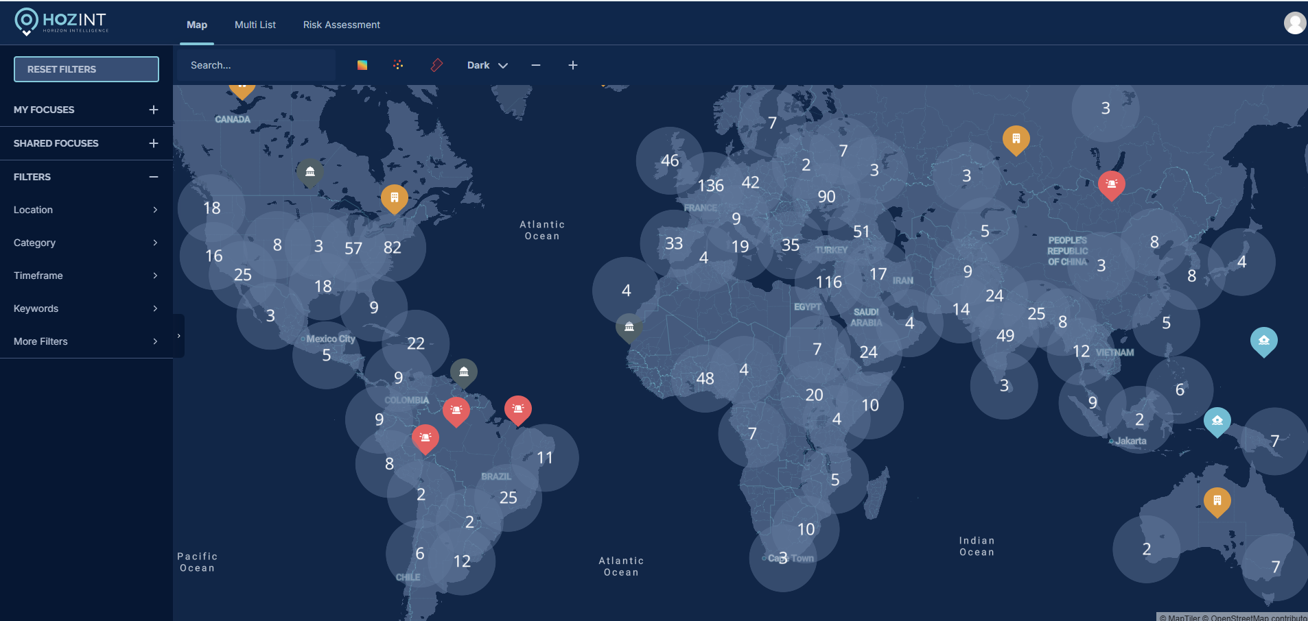
Example: HOZINT

Slide 14
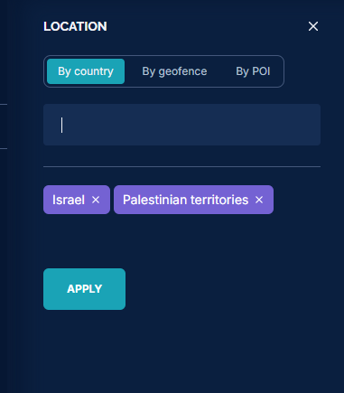
Example: HOZINT

Slide 15
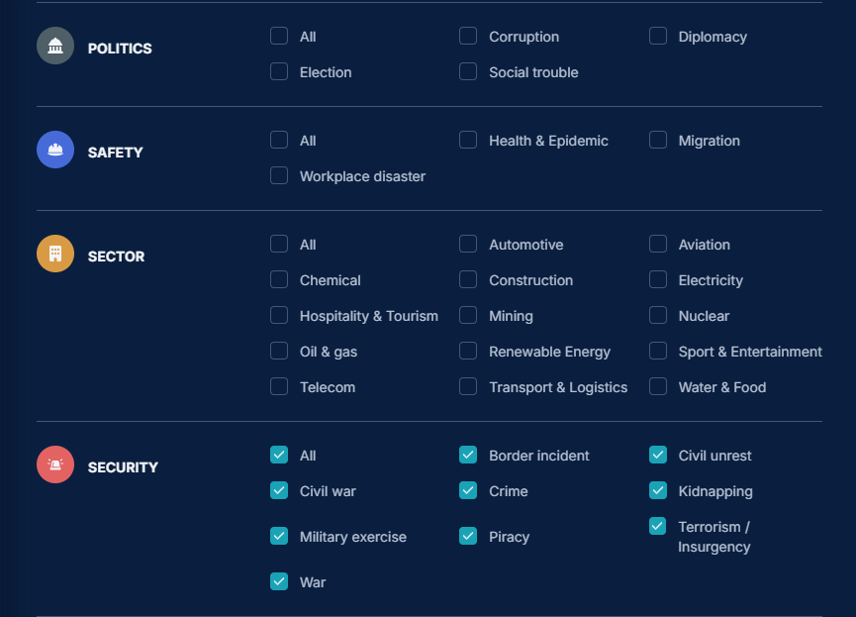
Example: HOZINT

Slide 16
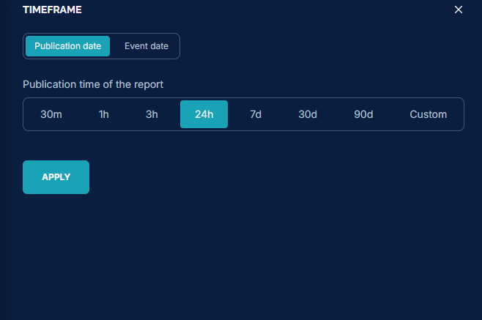
Example: HOZINT

Slide 17
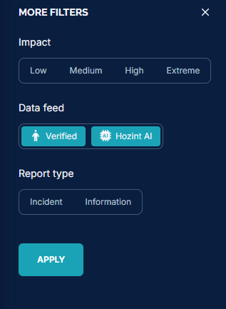
Example: HOZINT

Slide 18

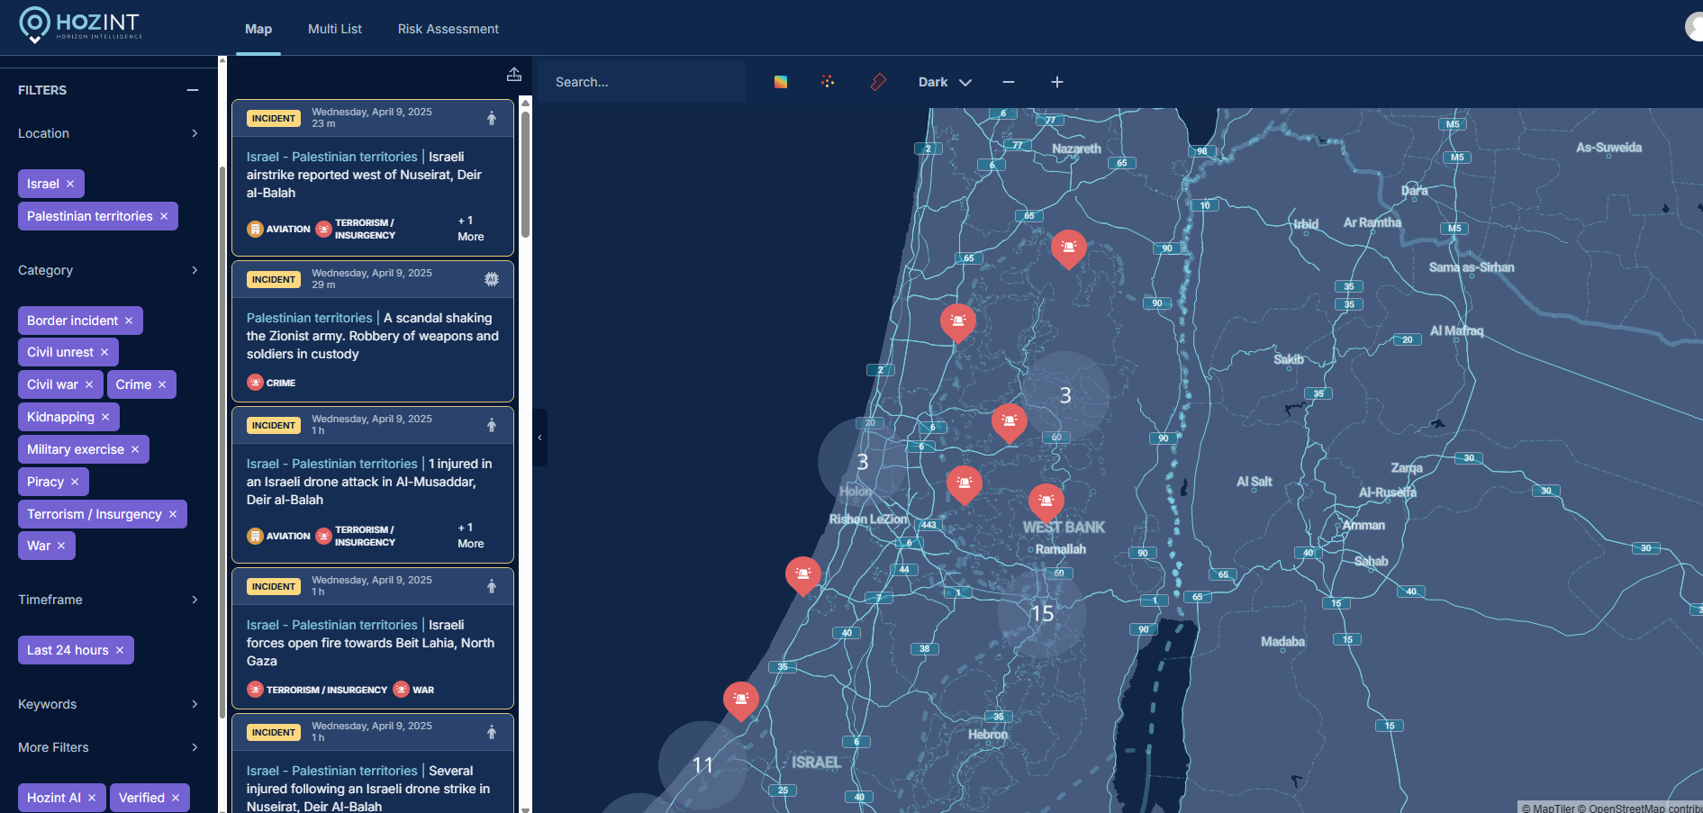
Example: HOZINT

Slide 19
OSINT Tips
Using Boolean Operators while using OSINT tools
Boolean operators are powerful tools for refining search queries, helping you narrow down or expand your search results in OSINT tools. By combining or excluding specific terms, Boolean operators allow you to better focus on relevant data and filter out unnecessary noise.
Precision: By combining multiple terms or excluding irrelevant ones, you can narrow down results to the most relevant sources and data.
Efficiency: Boolean operators help streamline the search process by eliminating irrelevant data, allowing you to focus on only the most useful results.
Better Data Analysis: By structuring your queries thoughtfully with operators, you can uncover connections or patterns that are not immediately obvious, especially in complex investigations involving large datasets.
Flexibility: Boolean operators allow you to construct queries at different levels of complexity, making them suitable for both simple searches and in-depth, multi-faceted investigations.

Slide 20
OSINT Tips
Operator | Description | Example | Usage
AND | Finds results that include both terms. | "cybersecurity" AND "data breach" | Narrow results to only those that mention both terms.
OR | Finds results that include either term. | "cybersecurity" OR "data breach" | Broader results, including either term.
NOT | Excludes results that contain the specified term. | "cybersecurity" NOT "malware" | Exclude results related to malware.
" " (Quotes) | Searches for an exact phrase. | "data breach incident" | Find results with the exact phrase.
( ) (Parentheses) | Groups terms and operators for logical structure. | ("cybersecurity" OR "data breach") AND "2025" | Use parentheses to structure complex queries.
*** (Wildcard)** | Represents any number of characters. Useful for variations of words. | "cyber*" OR "security*" | Find results with words like "cyber," "cybersecurity," or "cyberattack."
? (Wildcard) | Represents a single character. Used to find variations with one character. | "data?breach" | Find results with terms like "data breach" or "databreach."
~ (Tilde) | Finds results similar to the term, often used for fuzzy matching. | ~"data breach" | Fetches results similar to the phrase "data breach."
site: | Limits search results to a specific website or domain. | site:gov "cybersecurity" | Search only on .gov websites.
filetype: | Limits search results to a specific file type. | filetype:pdf "cybersecurity report" | Search only for PDF files.
intitle: | Limits search results to pages with the specified term in the title. | intitle:"cybersecurity threat" | Search for pages with "cybersecurity threat" in the title.
inurl: | Limits search results to pages with the specified term in the URL. | inurl:"data breach" | Search for pages that have "data breach" in their URL.

Slide 21
OSINT Tips
Using keywords in OSINT
Core Keywords: These are the main terms or phrases that directly relate to the subject you're investigating
Keywords Variation: Try different variations of your keywords to get more comprehensive results. For example, "data breach" might also appear as "data leak," "cyber attack," or even "security breach.“
Add locations and time constraints: These include location (e.g., city, country) or time-related keywords (e.g., “since 2020”) can make your search more specific.
Keywords and Boolean Operators: Combining keywords using operators like AND, OR, and NOT can refine your search.

Slide 22
OSINT Tips
Early Warning Signals while using OSINT
Increase in Social Media Activity – increase in social media activity – increase in the use of hashtags, or discussions to a specific event or issue.
Use of certain keywords - emergence of frequent use of certain types of keywords that are unusual or have a strong connotation such as ‘war’ or ‘attack’ or ‘coup’.
Unusual geolocation data – like internet shutdowns or telecommunications blackouts, can be a significant sign of a larger event or crisis.
Sudden military mobilisation and military movement – reports of images, or videos showing unusual military activity such as troop movements, military equipment or mass mobilisation.

Slide 23
THANK YOU FOR YOUR
ATTENTION!

