Slide 1


JavaScript Variables
var-let-const

Slide 2
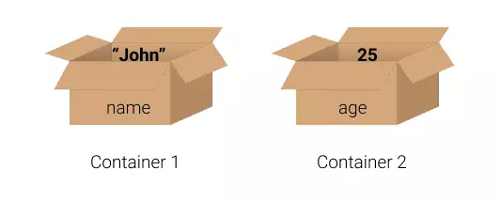
Variable
Variable is a special container that stores data.
Variables can hold different types data such as numbers and texts.
You can consider variable as a box where you store things to recall.
JavaScript uses the keywords var, let and const for variables.
= (assignment operator) is used to assign values to variables.

Slide 3
var-let-const
When to use var?
var keyword is used in all JavaScript code from 1995 to 2015.
let and const keywords were added to JavaScript in 2015.
If you want your code to run in older browsers, you must use var.
When to use const?
const is used if you will not need to change your variable value.
const variables have final values which cannot be changed.
When to use let?
Variables defined with let can be updated-reassigned with a new value.

Slide 4
Variable Naming
We can use only characters (a-z, A-Z), digits (0-9), under score (_), dollar sign ($) and other currency characters for naming the variables
A variable name cannot contain space character.
A variable name cannot start with a digit, but digits can be within the variable name.
Upper and lower case are different characters. EX/ SUM and sum or Sum are different.
A variable name cannot be a reserved keyword by JavaScript (var or let).
A variable name cannot be used twice in the same block of the program.
A variable name must be meaningful to increase the code readability.
Variable name is also known as identifier.

Slide 5
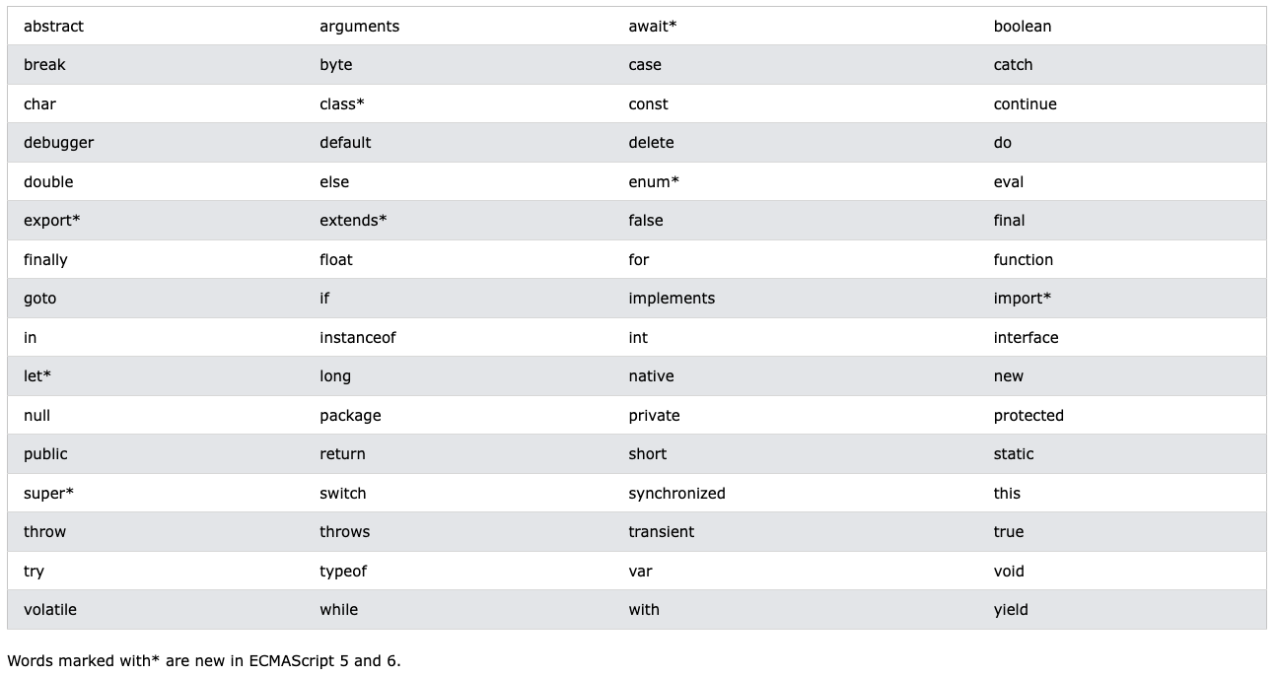
Reserved Keywords in JavaScript
In JavaScript, a keyword is a word that is reserved with a predefined meaning.
Those reserved keywords cannot be used to name variables, classes, methods etc.
EX/ let, var, const

Slide 6
Practice
Which of the following naming variables are true?
let age;
let AGE;
let shift$;
let number of students;
let _firstLetter;
let 8students;
let isWheatherSnowing#;
let @balance;

Slide 7
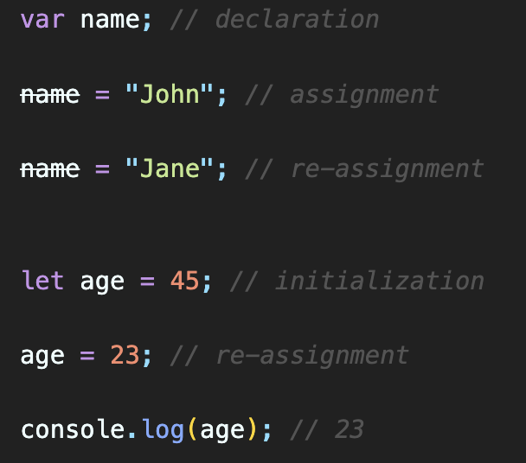
Variable Declaration-Assignment-Initialization
Variable Declaration:
Variable declaration is the process of introducing a new variable to the JavaScript program.
It involves using the var, let, or const keyword, followed by the variable name.
Declaration reserves a memory space for the variable to hold a value.
Variable Assignment:
Variable assignment is the process of giving a value to a declared variable.
It involves using the assignment operator (=) to assign a value to the variable.
Assignment initializes the variable with the assigned value.
Variable Initialization:
Variable initialization is the combined process of declaring and assigning a value to a variable in a single step.

Slide 8
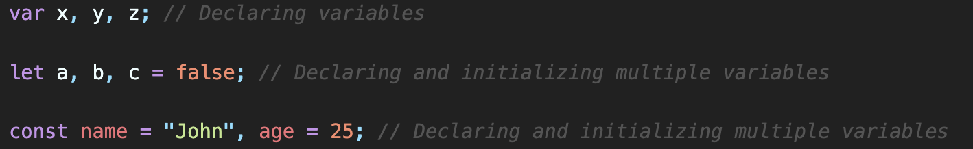
Declaring-Initializing Multiple Variables
You can declare and initialize multiple variables in a single statement using either the var, let, or const keyword.

Slide 9
Practice
Which of the following naming variables are true?
const name, age;
let n1 = 45, n2;
const num1 = 45, num2;
let x, let y;
let a; let b;
let i1; i2;

