Slide 1


JavaScript Data Types
PRIMITIVES – REFERENCE TYPES

Slide 2
Data Types in JavaScript
Primitive Data Types
There are 7 primitives: String, Number, Bigint, Boolean, Undefined, Null, Symbol
Reference Data Types (non-primitives) - Objects
The object data type can contain arrays, objects, collections, etc.

Slide 3

String
A String is a sequence of characters like "John Doe".
Strings are written with quotes. You can use single or double quotes but mostly double quotes.

Slide 4
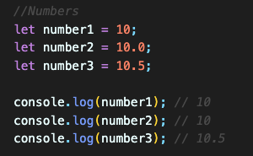
Number
All JS numbers are stored as decimal numbers (floating point).
Numbers can be written with, or without decimals.

Slide 5

BigInt
All JS numbers are stored in a a 64-bit floating-point format.
JavaScript BigInt is a new datatype (2020) that can be used to store integer values that are too big to be represented by a normal JavaScript Number.

Slide 6
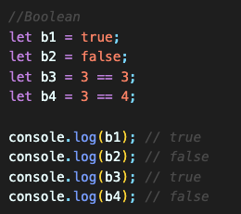
Boolean
Boolean can only have two values: true or false.
It is used often with conditional statements.

Slide 7
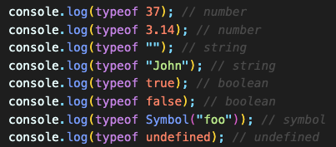
The typeof Operator
JS typeof operator helps finding the type of a variable.
The typeof operator returns the type of a variable or an expression.

