Slide 1


JavaScript Numbers - Math
Number/BigInt/Math
Properties/Functions

Slide 2
Numbers in JavaScript
JS has only one type of number that can store whole or decimal numbers.
Many other languages has other number types like byte, short, int, long, float, double etc.
JS numbers are always stored as double precision (up to 15-16 digits)
JavaScript uses the + operator for both addition and concatenation. Numbers are added. Strings are concatenated.
JS converts all the strings to numbers with all the other numeric operations.

Slide 3
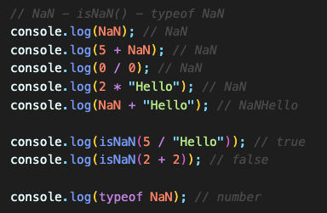
NaN – Not a Number
NaN is a JavaScript reserved word indicating that a number is not a legal number.
Trying to do arithmetic with a non-numeric string will result in NaN (Not a Number).
We can use the global JavaScript function isNaN() to find out if a value is a not a number.
typeof NaN returns a number.

Slide 4

Infinity
Infinity (or -Infinity) is the value that JS will return if you calculate a number outside the largest possible number.
typeof Infinity returns a number.

Slide 5
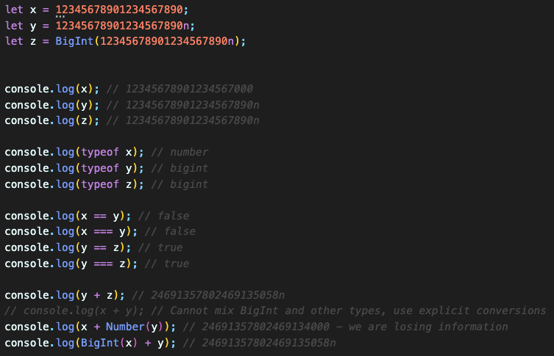
BigInt
JavaScript BigInt variables are used to store big integer values that are too big to be represented by a normal JavaScript Number.
JavaScript numbers are always stored as double precision (up to 15-16 digits) and they are not accurate for larger numbers.
All the operators that can be used on a Number can also be used on a BigInt.
HOWEVER, arithmetic between a Number and a BigInt is not allowed (type conversion required).
To create a BigInt, append n to the end of an integer or use BigInt().
typeof BigInt is bigint.

Slide 6
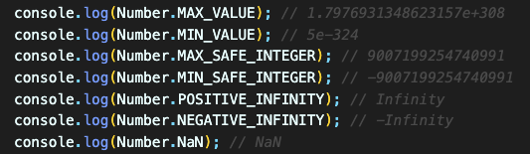
JavaScript Number Properties
Property Description
MAX_VALUE The largest number possible in JS
MIN_VALUE The smallest number possible in JS
MAX_SAFE_INTEGER The maximum safe integer
MIN_SAFE_INTEGER The minimum safe integer
POSITIVE_INFINITY Infinity (returned on overflow)
NEGATIVE_INFINITY Negative infinity (returned on overflow)
NaN A "Not-a-Number" value

Slide 7
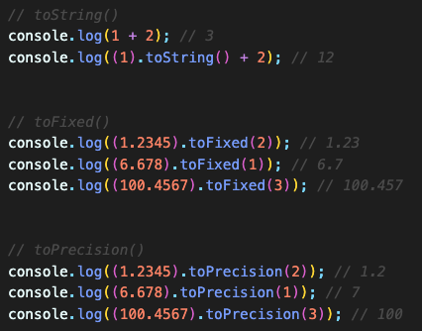
JavaScript Number Functions
toString() - returns a number as a string
toFixed() - returns a number written with a number of decimals
toPrecision() - returns a number written with a specified length

Slide 8
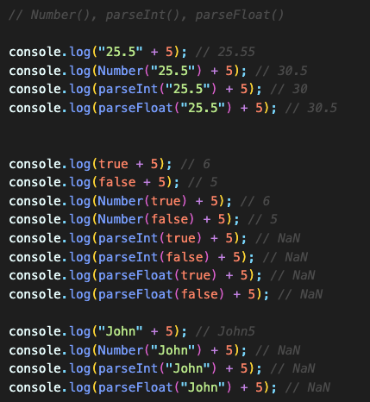
Converting Variables to Numbers
There are 3 JavaScript methods that can be used to convert a variable to a number:
Number() - returns a number converted from its argument.
parseFloat() - parses its argument and returns a floating-point number
parseInt() - parses its argument and returns a whole number

Slide 9
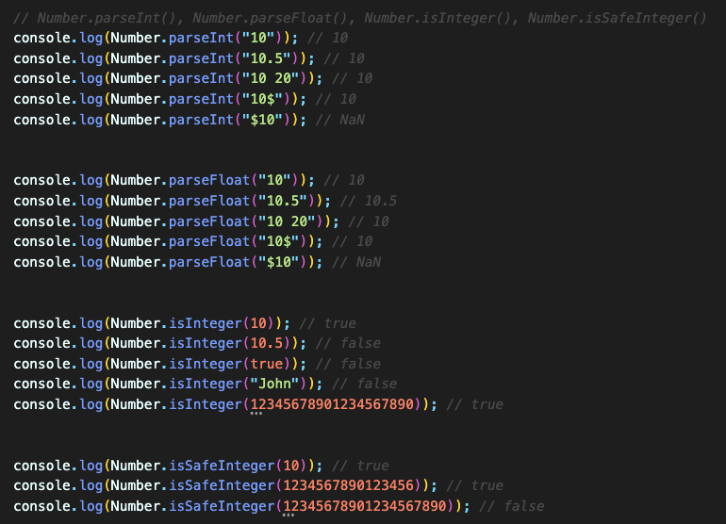
Number Object Functions
Number.isInteger() - returns true if the argument is an integer
Number.isSafeInteger() - returns true if the argument is a safe integer
Number.parseFloat() - converts a string to a number
Number.parseInt() - converts a string to a whole number

Slide 10
JavaScript Math Object
JavaScript has Math Object and provides many useful functions that allows us to perform mathematical tasks on numbers.
All properties/functions of Math can be called by using Math as an object, without creating it.
Mostly used Math functions are max(), min(), abs(), round(), trunc(), pow() and random().

Slide 11
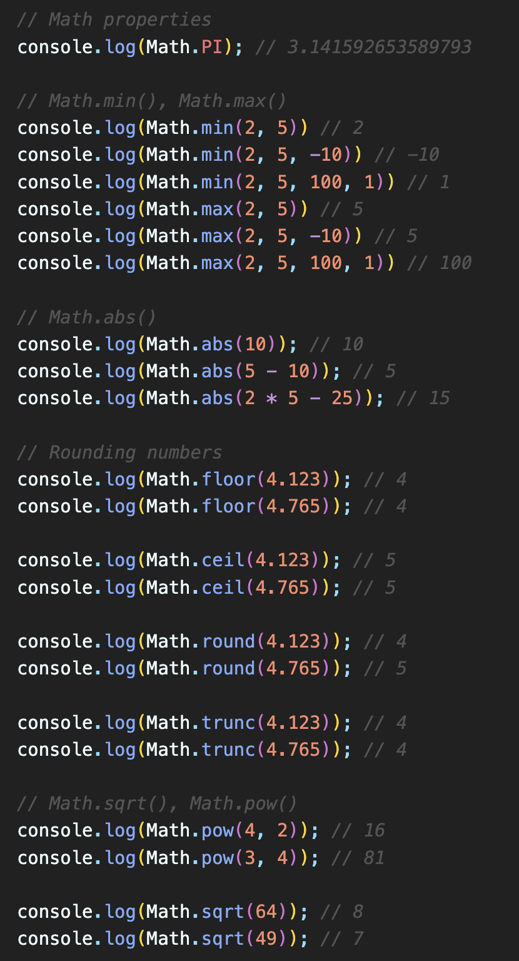
JavaScript Math Object Functions
abs(x) - returns the absolute value of x
ceil(x) - returns x, rounded upwards to the nearest integer
floor(x) - returns x, rounded downwards to the nearest integer
max(x1,x2,..) - returns the number with the highest value
min(x1,x2,..) - returns the number with the lowest value
pow(x, y) - returns the value of x to the power of y
random() - returns a random number between 0 and 1 (0 included but 1 excluded)
round(x) - rounds x to the nearest integer
sqrt(x) - returns the square root of x
trunc(x) - returns the integer part of a number (x)

Slide 12
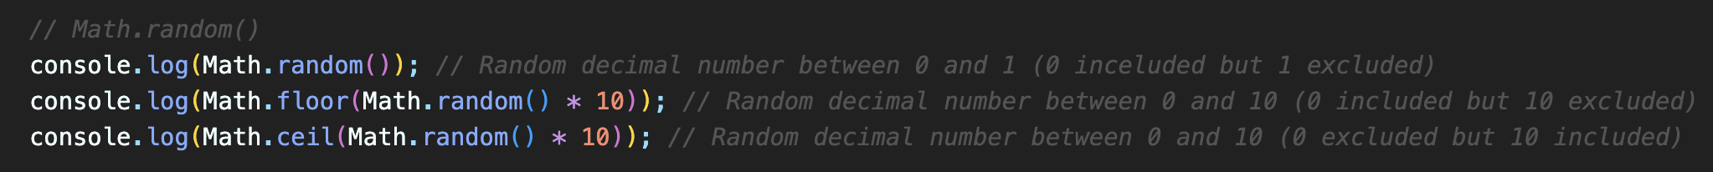
Generating Random Numbers
random() - returns a random number between 0 and 1 (0 included but 1 excluded)
We can work around this function to generate random numbers within a range we specified.
EXAMPLE: Generate a random number between 0 and 10.

