Slide 1


JavaScript Strings
String Templates
String Functions

Slide 2
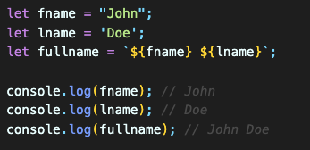
Strings in JavaScript
JS strings are useful for holding data that can be represented in text form.
A JS string is zero or more characters written inside quotes.
We can use either double or single quotes to create a string.
NOTE: backtick (`) is also used for strings
Backticks are an ES6 feature that allows you to create strings in JavaScript.
Backticks are mostly used for code embedding purposes.
Besides, using backticks makes it easier for string operations.

Slide 3
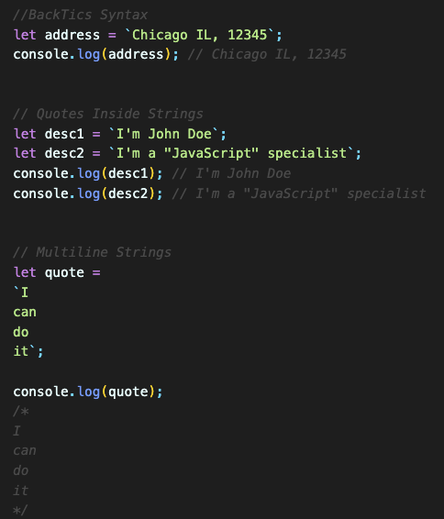
String Templates
String templates terminology is also known as template strings, template literals or backticks syntax.
String templates use backticks (``) rather than single or double quotes to define a string.
Template literals makes it easy to embed single or double quotes into your string.
Template literals allows to create multiline strings.

Slide 4
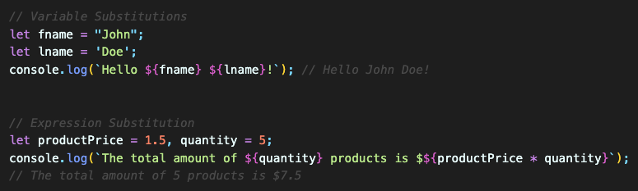
String Interpolation
It is replacing variables or expressions with real values.
Template literals provide an easy way to interpolate variables and expressions into strings.
The method is called string interpolation. ${...}
Variable Substitution: Template literals allow variables in strings. ${variable}
Expression Substitution: Template literals allow expressions in strings. ${expression}

Slide 5
String Functions
JavaScript provides a variety of string functions to manipulate, analyze, and work with strings more effectively.
Strings are an essential data type in programming, representing sequences of characters, and they are used extensively in web development, data processing, and various other applications.
Here are some reasons why JavaScript offers a wide range of string functions:
Here are some reasons why JavaScript offers a wide range of string functions:
Manipulation: Modify strings by adding, removing, or changing characters.
Analysis: Examine strings to find specific characters or substrings and obtain information like length and position.
Text Processing: Perform tasks like searching, matching, and splitting strings based on patterns.
Validation: Check if strings adhere to specific rules or formats.
Internationalization (i18n): Handle case conversions and locale-specific rules for international applications.
Formatting: Format strings, especially for dates, times, and numbers.
Data Transformation: Convert data between different formats, e.g., JSON to a string.
Text Templating: Generate dynamic content or templates for web pages.
Regular Expressions: Use complex pattern matching and manipulation in strings.
User Input Handling: Process and validate user-provided data, ensuring security and usability.

Slide 6

String length Property
The length property is used to find the length of a string
length of a string = total number of characters in a string including the whitespaces.

Slide 7
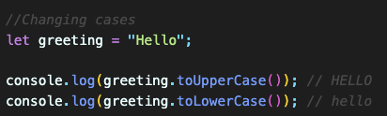
String - Changing Cases
toUpperCase() – return a string with all characters converted to uppercase.
toLowerCase() – return a string with all characters converted to lowercase.

Slide 8
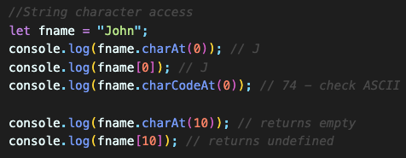
String - Extracting Characters
charAt() - returns the character at a specified index (position) in a string.
charCodeAt() - returns the unicode of the character at a specified index in a string.
Property access with []

Slide 9
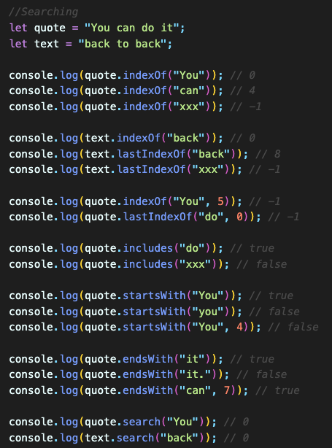
String - Searching
search() – searches a string for a string (or a regular expression) and returns the position of the match.
indexOf() – get the index of the first occurrence of a substring in a string.
lastIndexOf() – find the index of the last occurrence of a substring in a string.
includes() – check if a string contains a substring.
startsWith() – check if a string starts with another string.
endsWith() – determine if a string ends with another string.
match() - returns an array containing the results of matching a string against a string (or a regular expression).
matchAll() - returns an iterator of results after matching a string against a regular expression.

Slide 10
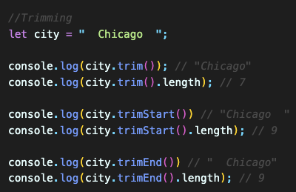
String - Trimming
trim() – remove whitespace characters from a string.
trimStart() – remove the leading whitespace characters of a string.
trimEnd() – remove the ending whitespace characters of a string.

Slide 11
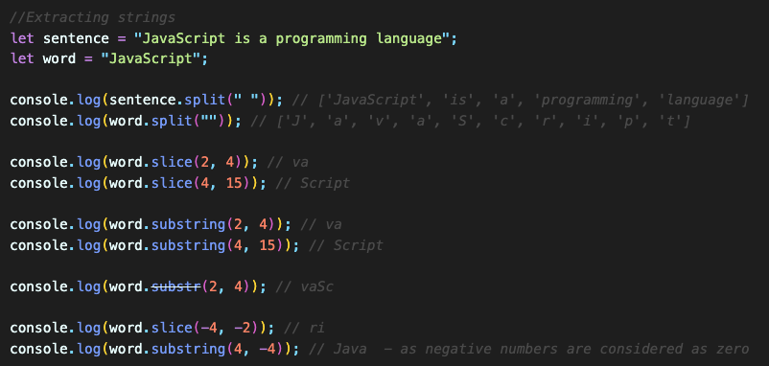
String - Extracting Partial Strings
split() – split a string into an array of substrings.
substring() – extract a substring from a string.
substr() - extract a part of a string with the length specified. (deprecated)
slice() – extract a part of a string.

Slide 12
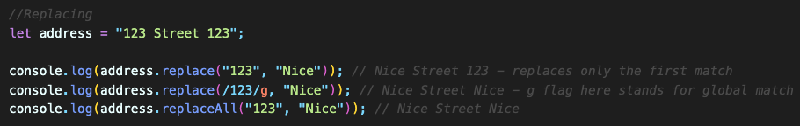
String - Replacing Strings
replace() – replace a substring in a string with a new one.
replaceAll() – replace all occurrences of a substring that matches a pattern with a new one.

Slide 13
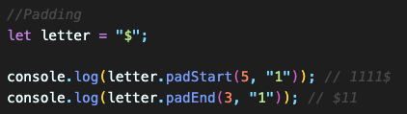
String - Padding
padStart() & padEnd() – pad a string with another string until the result string reaches the given length.

Slide 14
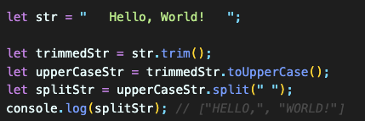
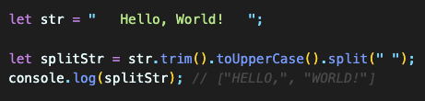
Function Chaining
Chaining methods allows you to perform multiple operations on the same object in a concise and readable way.

