Slide 1


JavaScript Basic Functions
WHY FUNCTIONS?

Slide 2
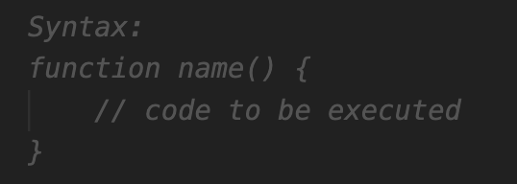
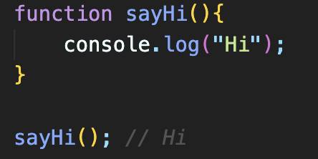
Functions in JavaScript
A function is a block of code that performs a specific task
Functions are also known as methods or behaviors of the class
A JS function is defined with the function keyword, followed by a name, and by parentheses ().
The parentheses may include parameter-argument names separated by commas.

Slide 3
Function Components
name- It is an identifier that is used to refer to the function in a program, could be any name but should be meaningful to increase readability of your code.
function body - It includes the programming statements that are used to perform some tasks. The function body is enclosed inside the curly braces { }.
function parameters – Arguments that we pass inside the function parentheses.
return - used to return a value from function which can be used later outside the function. return will terminate the function.

Slide 4
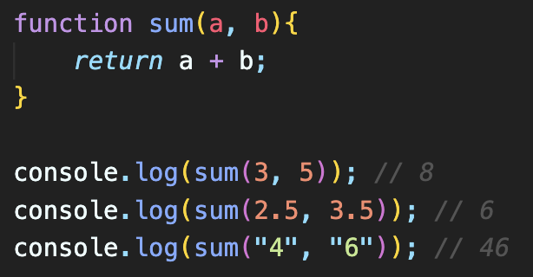
Function Parameters
A function parameter is a value accepted by the function.
A function can have any number of parameters.
Parameters act as variables inside the function.

