Slide 1
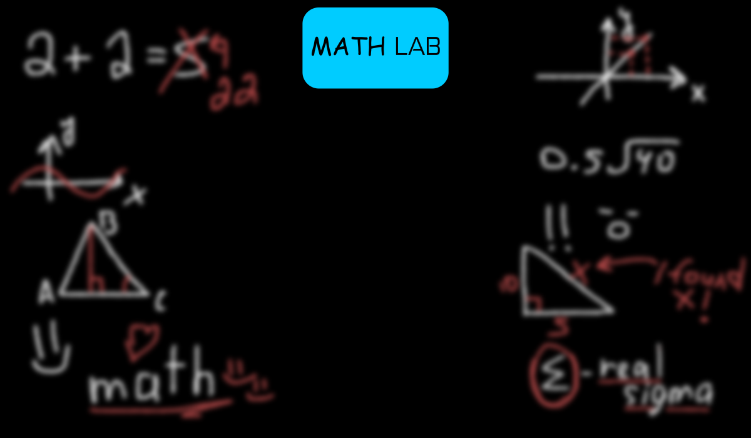
MATH-LAB project
presentation
by Egor Murzakov

Slide 2

The MATH-LAB project was created based on the math
learning methods in the United States. The main goal of this
project is to provide a very good math-learning app for both
Russian and, (especially) American students. As the creator
of MATH-LAB, I can confidently say that this app is very useful
for understanding how math truly works.
☺

