Slide 1

“Random”HongBao
Britney(Song Jingyi)

Slide 2
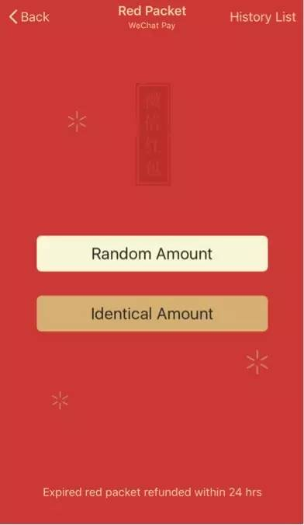

Slide 3
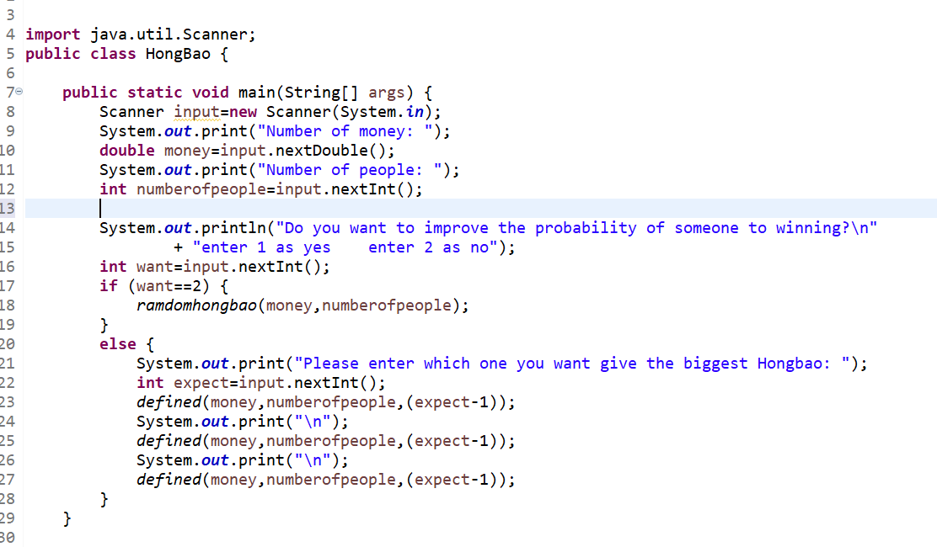
Main part

Slide 4
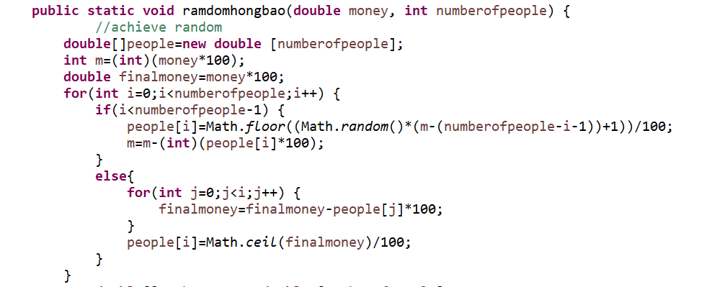
How to come out Random Amount HongBao?

Slide 5
I used people[i] to store the amount of money of everyone
If the total money is 100￥, and there are 10 people can take part in grabbing Hongbao,
The first amount of people[i] is between 0.01-99.91￥(since everyone should get a Hongbao)
Let the amount of first one be 45￥
So, the next amount of people[i] is between 0.01-54.2￥
……

Slide 6
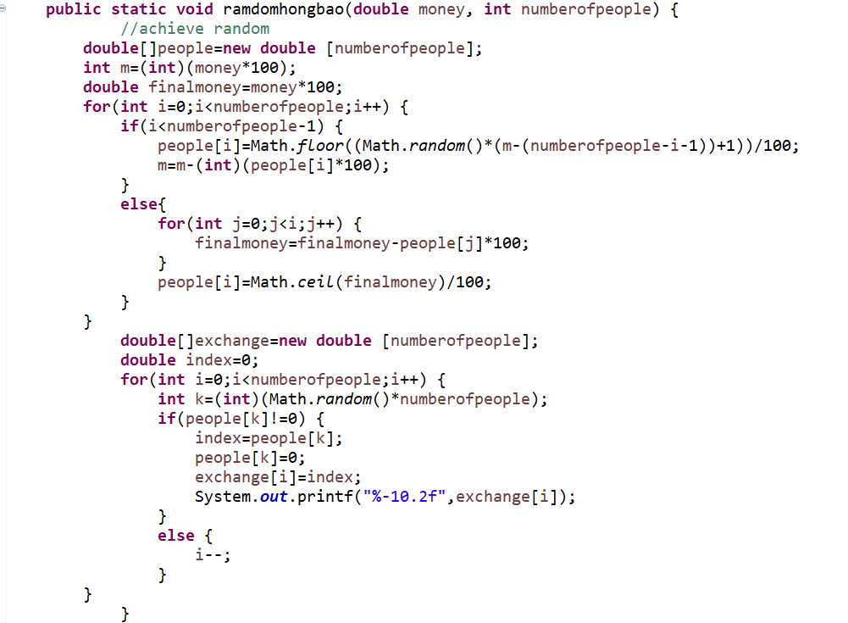
How to achieve random

Slide 7
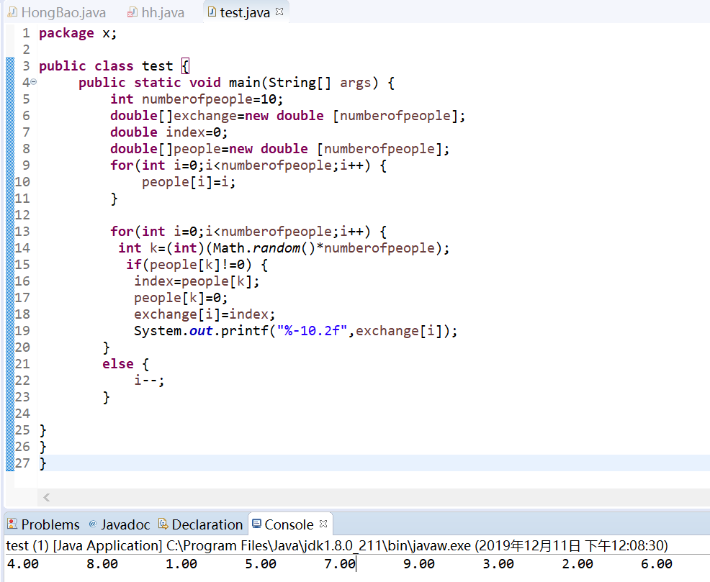

Slide 8
Common way to Random Amount HongBao

Slide 9
How can we get the biggest Hongbao?

Slide 10
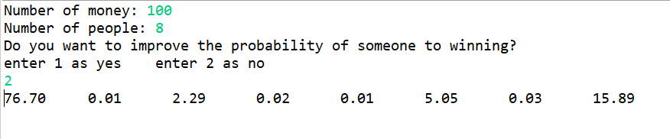
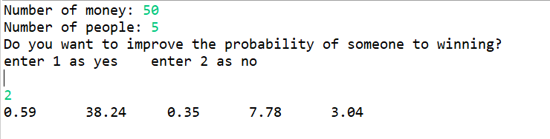
Result

Slide 11
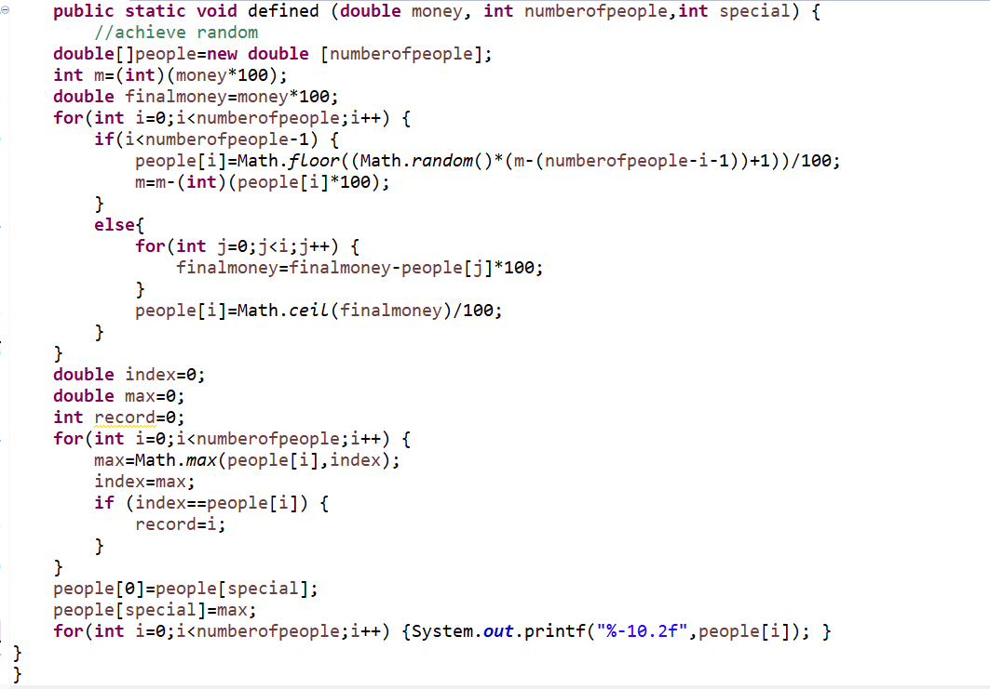
A special way to assign one person to get the biggest one

Slide 12
Give the biggest value to special people

Slide 13
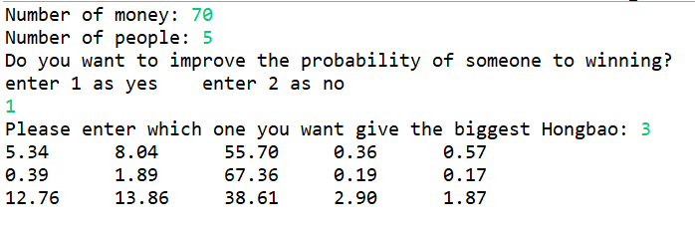
Result

Slide 14
Thank you

