Slide 1
Barbershop Operations Analytics
Business performance case study | Power BI-style portfolio
From operational data to management insights
September 2025 – August 2026
Portfolio project | Simulated / anonymized data

Slide 2
Executive Summary
TOTAL REVENUE
$344,656
TOTAL CLIENTS
9,557
AVERAGE TICKET
$36.06
AVG CLIENTS / OPEN DAY
30.5
Revenue remains relatively stable across the 12-month period.
Average ticket stays close to $36, suggesting a consistent service mix and pricing structure.
Full Service generates the largest revenue contribution among the four tracked services.
The dataset is synthetic/anonymized and intended for portfolio demonstration.
Portfolio project | Simulated / anonymized data

Slide 3
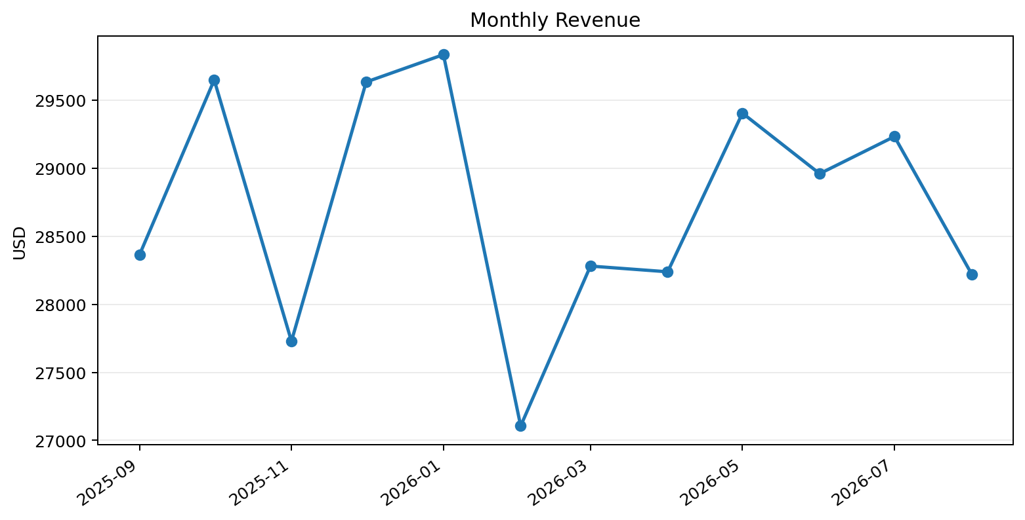
Revenue Trend
12-month revenue totals $344,656.
Highest monthly revenue: $29,835.
Lowest monthly revenue: $27,106.
Monthly variation is present but does not show a dramatic structural break.
Portfolio project | Simulated / anonymized data

Slide 4
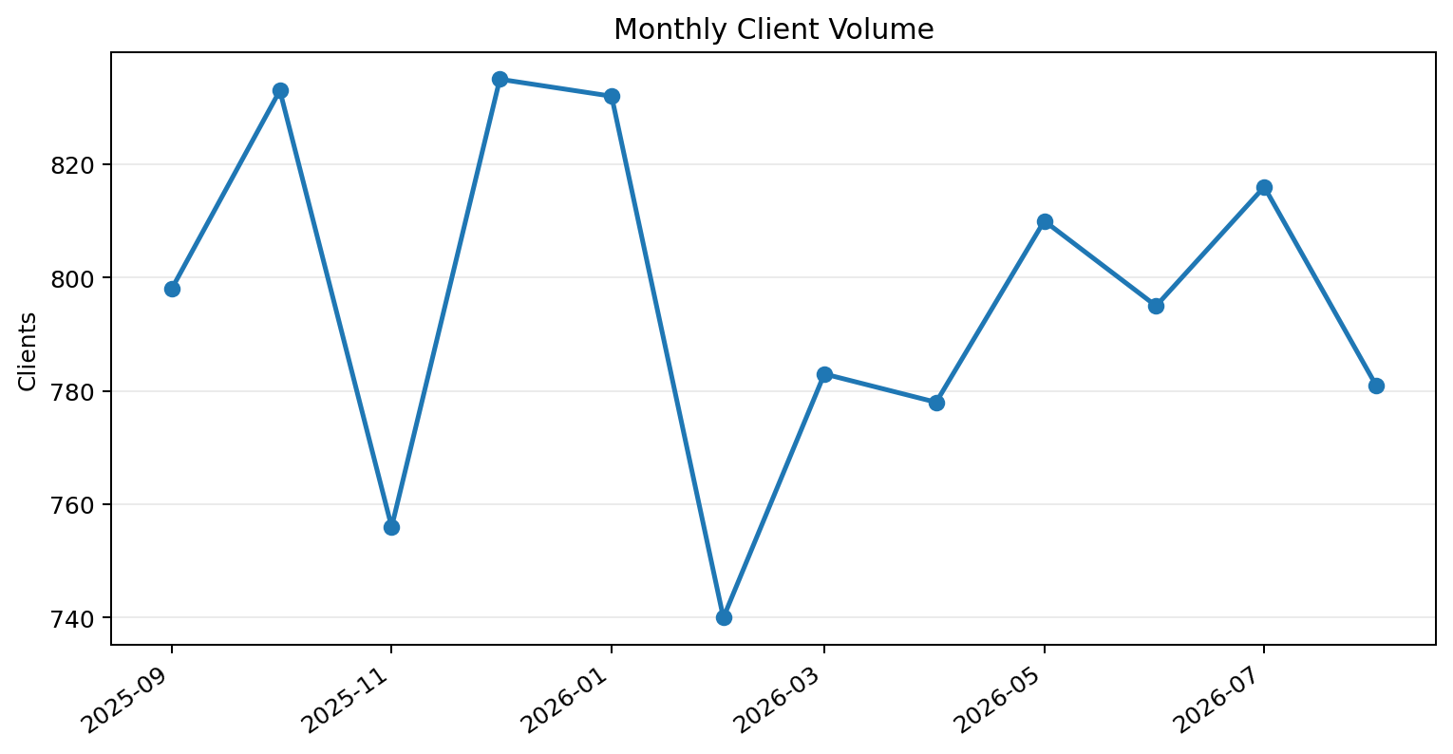
Client Volume
Total recorded visits: 9,557.
Average ticket: $36.06.
Average clients per open day: 30.5.
Client volume follows a broadly stable monthly pattern with normal fluctuations.
Portfolio project | Simulated / anonymized data

Slide 5
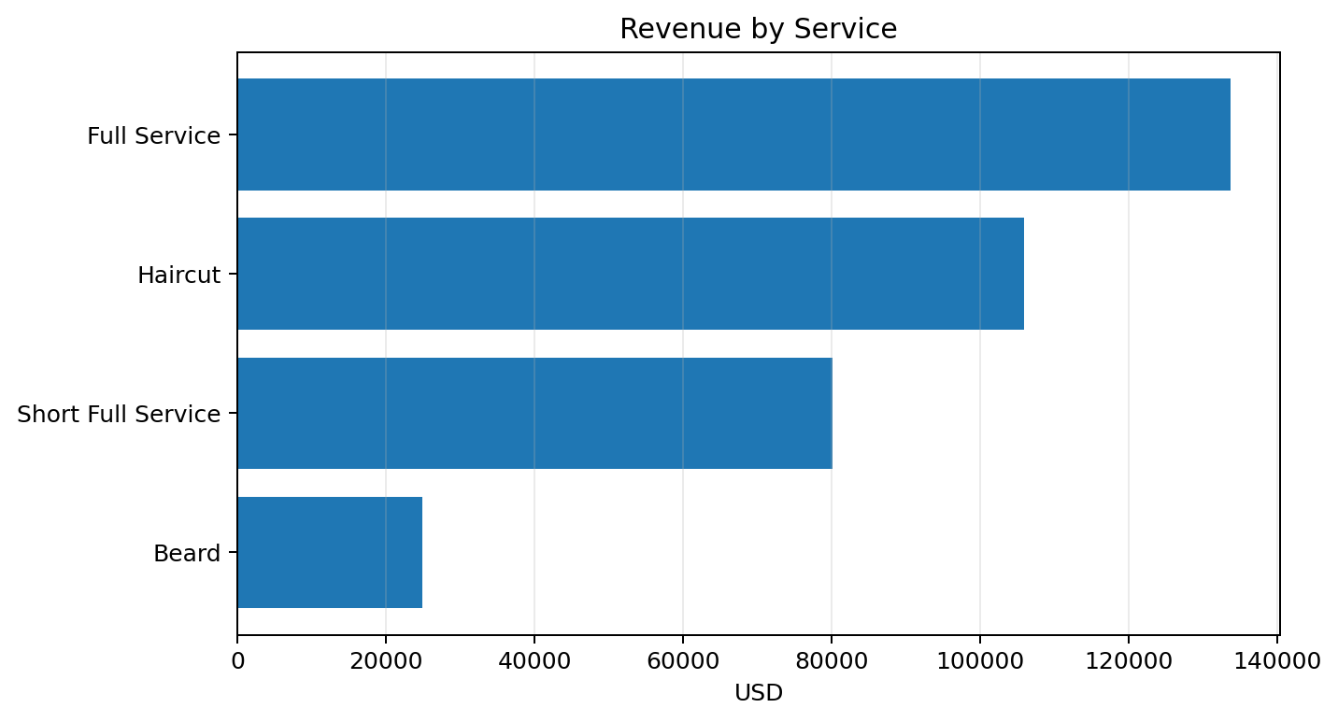
Service Mix & Revenue
Service | Clients | Revenue | Avg ticket
Full Service | 2,882 | $133,712 | $46.40
Haircut | 3,425 | $105,930 | $30.93
Short Full Service | 2,081 | $80,153 | $38.52
Beard | 1,169 | $24,861 | $21.27
Portfolio project | Simulated / anonymized data

Slide 6
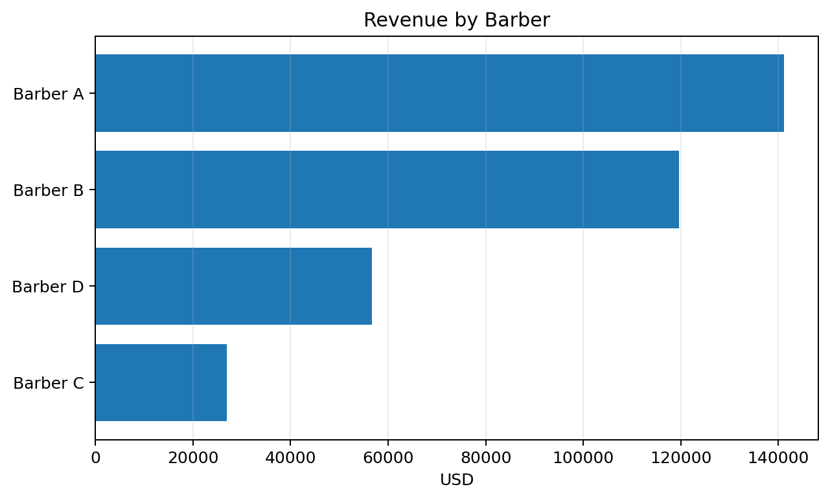
Barber Performance
Barber | Clients | Revenue | Avg ticket
Barber A | 3,798 | $141,208 | $37.18
Barber B | 3,187 | $119,720 | $37.57
Barber D | 1,522 | $56,746 | $37.28
Barber C | 1,050 | $26,982 | $25.70
Portfolio project | Simulated / anonymized data

Slide 7
Management Insights
Monitor service mix: revenue is concentrated in higher-ticket Full Service and Short Full Service offerings.
Use barber-level revenue and client volume together, rather than revenue alone, to understand workload and productivity.
Track monthly demand against available capacity to identify underused or overloaded time windows.
Use Power BI slicers for date, barber, service and day-of-week to move from headline KPIs to operational diagnosis.
The next analytical layer should connect demand, capacity and staffing decisions.
Portfolio project | Simulated / anonymized data

Slide 8
Data & Methodology
Period: September 2025 – August 2026.
Currency: USD.
Data: simulated and anonymized for portfolio publication.
Core entities: transactions, capacity, barbers, services, dates.
Power BI model concept: star-style analytical model with DAX measures for revenue, clients, average ticket, capacity utilization and period-over-period change.
Purpose: demonstrate business analysis, dashboarding and decision-support skills.
Portfolio project | Simulated / anonymized data

