Slide 1
ECE470 Final Presentation
Weiang Wang Yuhao Wang
Yixuan Li Yiming Li

Slide 2
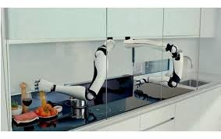
Introduction
Have you ever been lying in bed, wanting to grab a drink or a snack, but not wanting to get out of bed?
Have you ever sat comfortably on the couch watching TV but refused to get up and grab some snacks?
Now we have a solution for that. With only two ur3 robots arms, one camera and one car, we can deliver food from kitchen to where you are.

Slide 3
Video

Slide 4
Thanks for watching!

