Slide 1
Songci
Motivation
Market Targeting
Stock Price Prediction
President Election Prediction
…

Slide 2
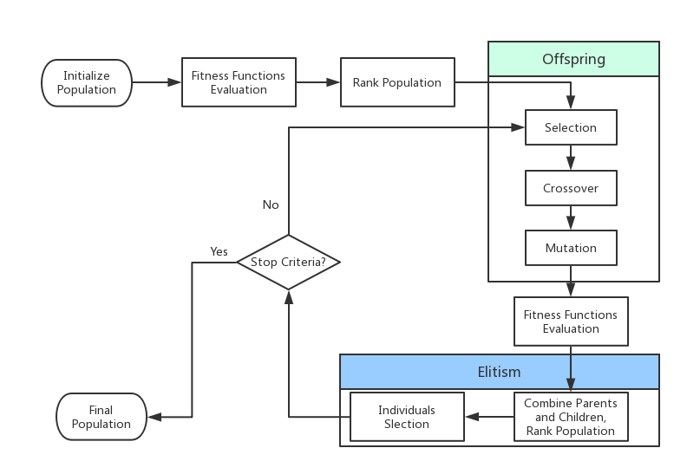
Genetic Algorithm
Notes:
GA belongs to evolutionary algorithm. GA commonly used in optimization and search problem.
Inspired by genetic operations such as mutation, crossover and selection.
Population: a set of candidate poems. Each individual has a set of properties such as consistent, word meaning. Initially generate by random.
Generation: population in each iteration.
Fitness function: value of objective function. Evaluate the performance of candidate poems.
Selection: based on fitness, select best n individuals as parents.
Mutation: randomly change words in poems.
Crossover: randomly exchange part of the sentences in poems.

