Slide 1
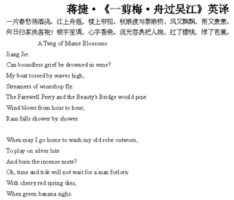
Background
Ci(词): A poetic form, originally means ‘lyric’.
Fixed number of Chinese characters
A rhyme scheme of level and oblique tones
In form of “long and short sentences”
Cipai(词牌): Cipai is the title of tune patterns that determined the number of characters in each line and the arrangement of tone.
Notes:
Ci: In early times, Ci are required to be arranged with music and to be sung, so there are some constrains on the format of Ci
Cipai: There are around 800 set of patterns, each associated with a particular title. Therefore, it’s common for several ci to share the same title.

Slide 2
Dataset
Dataset: Quan Song Ci(全宋词)
Character and Word:
Pingze(平仄): 1, 2
Rhythm: 24 rhythm
Correlation: word2vec
Cipai:
Sentence Format and Pingze:
Huanxisha(浣溪沙): ['0201021', '0102211', '0102211', '0201122', '0102211', '0102211']
Delimiter Format:
Huanxisha(浣溪沙): [ ， 。 。| ， 。 。]
Poet_Num | Poem_Num | Cipai_Num | Sentences_Num | Ave_Sentence_Length
1346 | 18986 | 929 | 268341 | 4.88
Notes:
Pingze is represent two type of tunes.

Slide 3
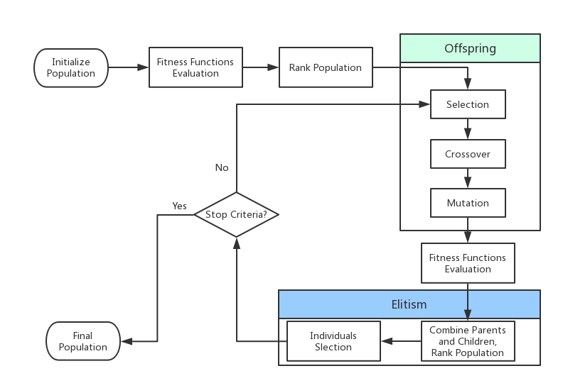
Genetic Algorithm
Changle Zhou, Wei You, Xiaojun Ding. “Genetic Algorithm and Implementation of Automatically Songci Generation. (2010)”
Notes:
GA belongs to evolutionary algorithm. GA commonly used in optimization and search problem.
Inspired by genetic operations such as mutation, crossover and selection.
Population: a set of candidate poems. Each individual has a set of properties such as consistent, word meaning. Initially generate by random.
Generation: population in each iteration.
Fitness function: value of objective function. Evaluate the performance of candidate poems. Consider, principle of syntax, semantic relationship to each other and keywords, rhythm consistency.
Selection: based on fitness, select best n individuals as parents.
Mutation: randomly change words in poems.
Crossover: randomly exchange part of the sentences in poems.
Form new population, evaluate fitness value, choose best n poems
Stop criteria: over 200 generations or fitness value greater than m.
Apply many artificial constrains.

Slide 4
Result
Genetic Algorithm: Huanxisha(浣溪沙)
别来已是二十年,寒轻离别岸呜咽.阳春归路转千年.
借问春寒梅旧否,夜来去后雨轻扇.佳人含笑立尊前.
It’s been twenty years since I left. At that moment, the river cried. Now it’s spring, and I don’t know when can I go back. It’s still cold, I asked whether plum blossom like before. Rain comes without a sound during night. My loved one stand in front of me with smell.

