Slide 1
Songci
Motivation
Market Targeting
Stock Price Prediction
President Election Prediction
…

Slide 2
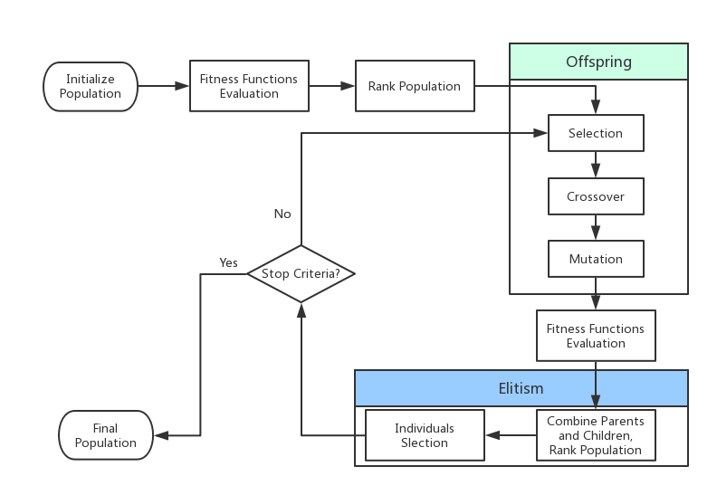
Genetic Algorithm
Notes:
In the last few years, deep neural networks have dominated pattern recognition.

Slide 3
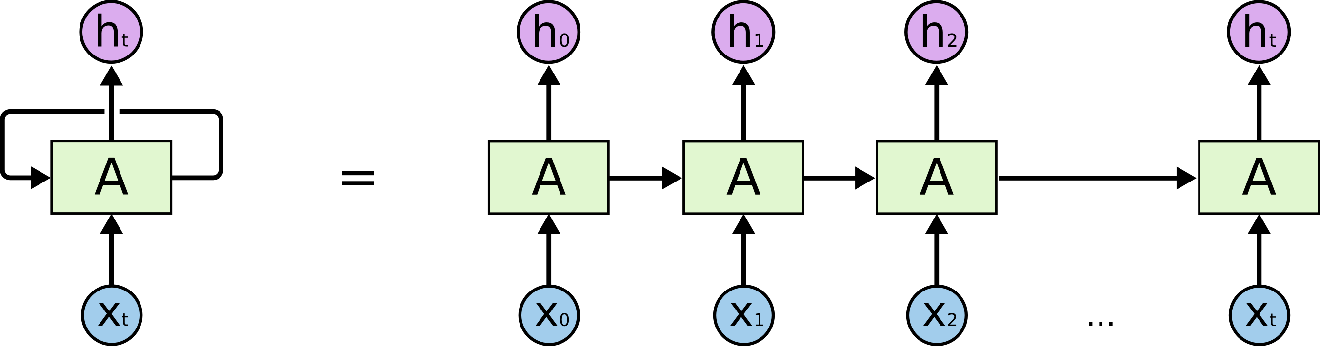
Recurrent Neural Network

Slide 4
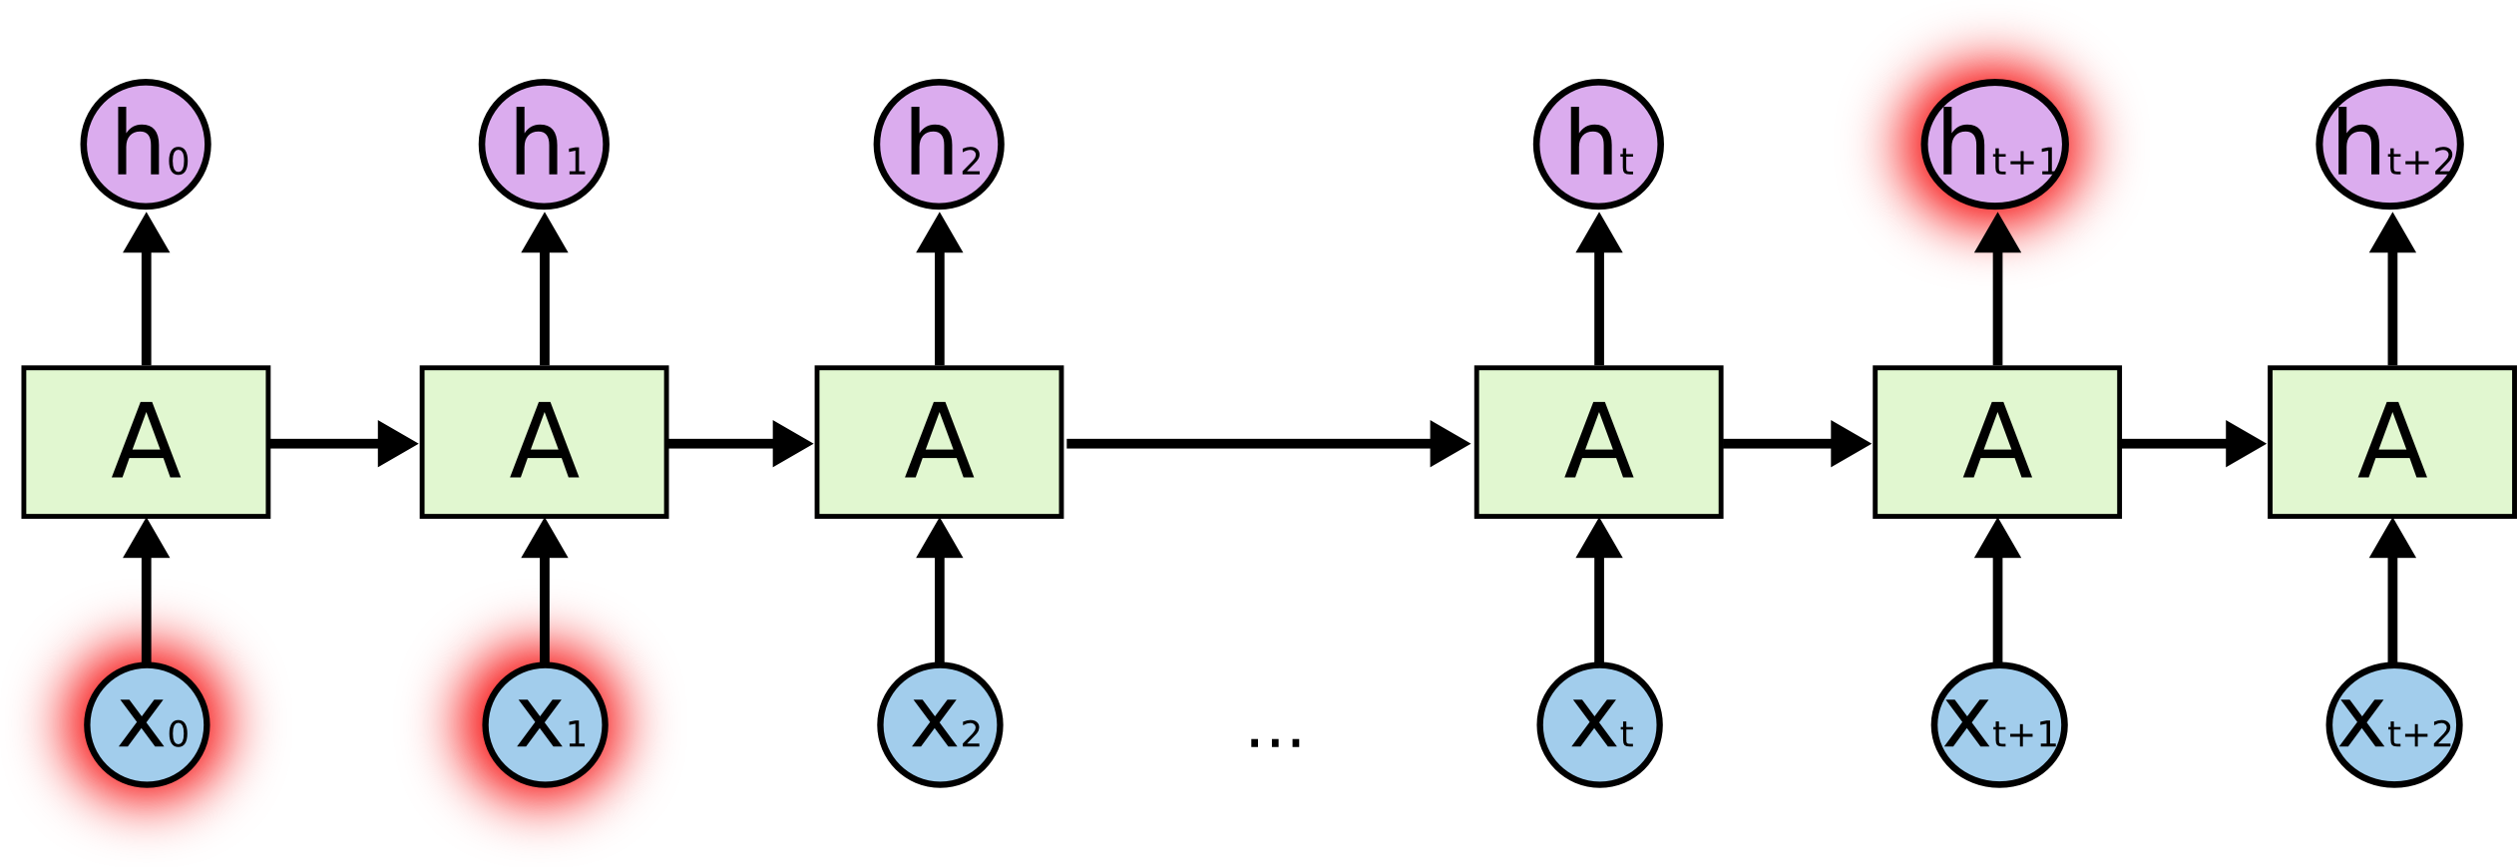
Long Short Term Memory

Slide 5

LSTM Network

Slide 6
Outline
Background & Motivation
System Architecture
Evaluation
Future Work

Slide 7
Deep Tweeting Overview
Training Data
Tokenize
Word Embedding
Unseen
tweet
RNN Model
Tokenize
Word Embedding

Slide 8
Tokenization
Notes:
This website is amazing !!! https://zhuangdizhu.github.io #just #kidding
this website is amazing ! <url> <hashtag> just <hashtag> kidding
@MrL you are so cooooooooool :-) <3
<user> you are so cool <smile> <heart>

Slide 9
Tokenization
<User Name>
<Emotion>
<Abbreviation>
Notes:
This website is amazing !!! https://zhuangdizhu.github.io #just #kidding
this website is amazing ! <url> <hashtag> just <hashtag> kidding
@MrL you are so cooooooooool :-) <3
<user> you are so cool <smile> <heart>

Slide 10
Tokenization
@MrL you are so cooooooooool 👍 :-) <3
<user> you are so cool <emoji> <smile> <heart>
<User Name>
<Emotion>
<Abbreviation>
Notes:
This website is amazing !!! https://zhuangdizhu.github.io #just #kidding
this website is amazing ! <url> <hashtag> just <hashtag> kidding
@MrL you are so cooooooooool :-) <3
<user> you are so cool <smile> <heart>

Slide 11
Tokenization
@MrL you are so cooooooooool 👍 :-) <3
<user> you are so cool <emoji> <smile> <heart>
<User Name>
<Emotion>
<Abbreviation>
<URL>
<Hashtag>
Notes:
This website is amazing !!! https://zhuangdizhu.github.io #just #kidding
this website is amazing ! <url> <hashtag> just <hashtag> kidding
@MrL you are so cooooooooool :-) <3
<user> you are so cool <smile> <heart>

Slide 12
Tokenization
@MrL you are so cooooooooool 👍 :-) <3
<user> you are so cool <emoji> <smile> <heart>
<User Name>
<Emotion>
<Abbreviation>
Amazing website !!! https://wtitter.com #just #kidding
amazing website ! <url> <hashtag> just <hashtag> kidding
<URL>
<Hashtag>
Notes:
This website is amazing !!! https://zhuangdizhu.github.io #just #kidding
this website is amazing ! <url> <hashtag> just <hashtag> kidding
@MrL you are so cooooooooool :-) <3
<user> you are so cool <smile> <heart>

Slide 13
Word Embedding
<实验画出来图太丑了>
<考虑要不要放这一页>

Slide 14
RNN Training
Input:
Output:
RNN Model
batch size
batch size
embedding size
2
(pos, neg)
tweet length
Notes:
https://www.tensorflow.org/api_docs/python/tf/nn/softmax_cross_entropy_with_logits

Slide 15
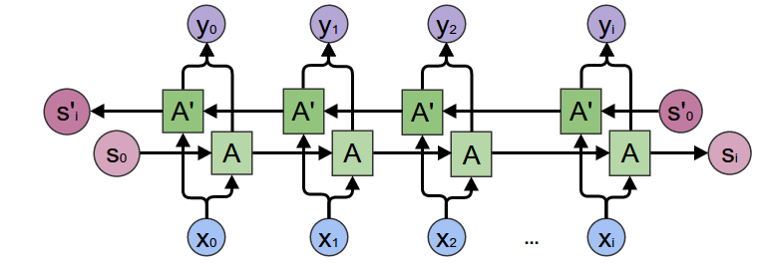
Bi-directional RNN Model

Slide 16
Outline
Background & Motivation
System Architecture
Evaluation
Future Work

Slide 17
Evaluation Setup
Twitter Dataset
<帮我填一下谢谢>
We compare with 3 different Models
SVM model
Naïve Bayesian model
Convolution Neural Network Model

Slide 18
Evaluation Setup
Programming
Python 2.7, Tensorflow

