Slide 2

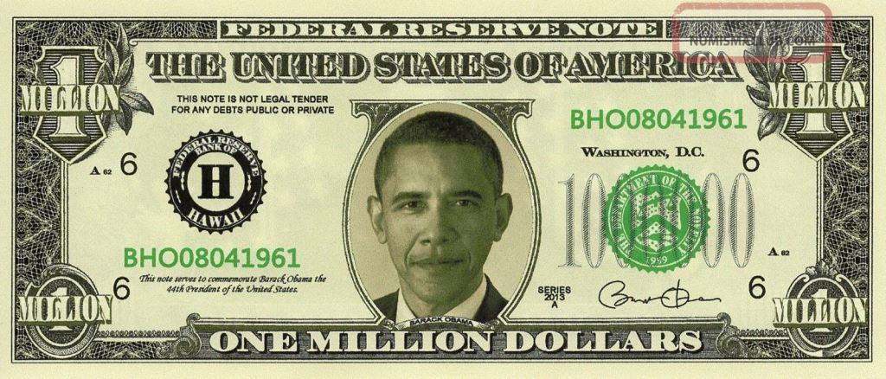

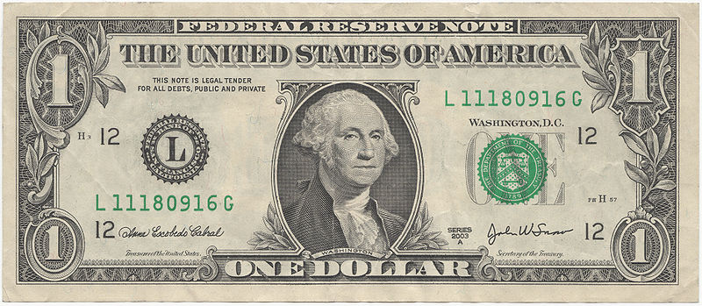
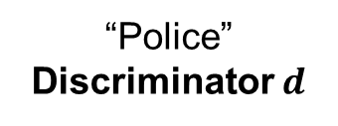
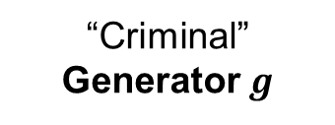
Generative Adversarial Networks (GANs)
Generative Model
Generated Sample
“Criminal”
Generator $g$
“Police”
Discriminator $d$
Training Sample
$$g^{∗}=\arg{\min_{g}{\max_{d}{v(g, d)}}}$$

Slide 3
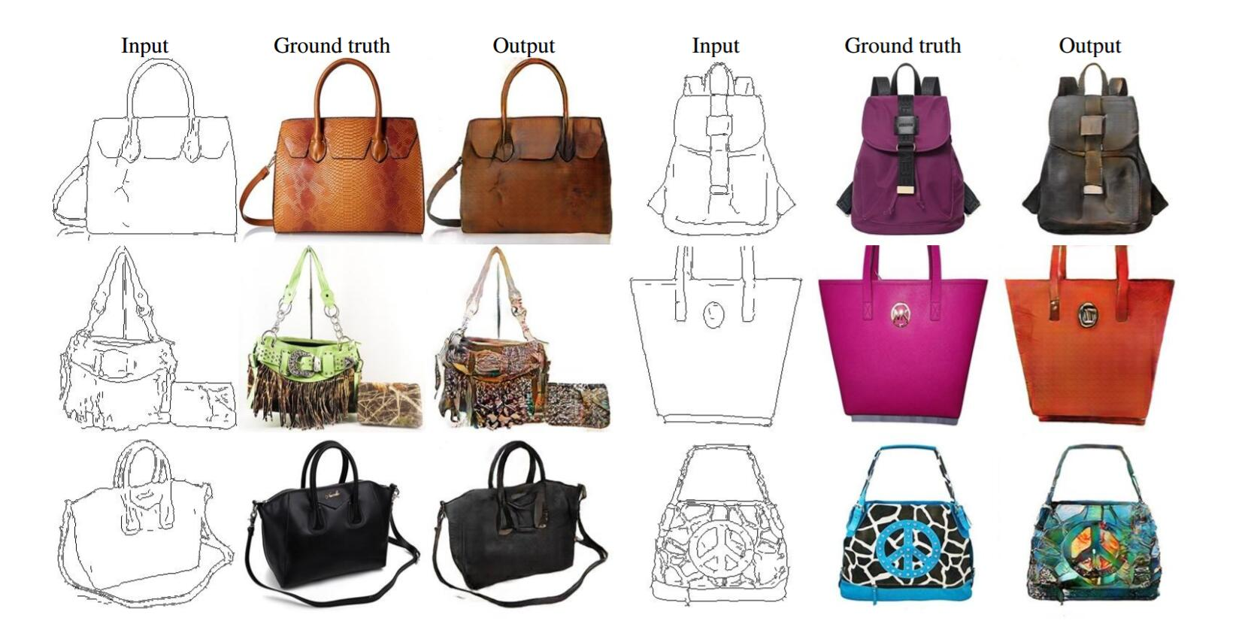
GANs
Isola, Phillip, et al. "Image-to-image translation with conditional adversarial networks." arXiv preprint arXiv:1611.07004 (2016).

Slide 4
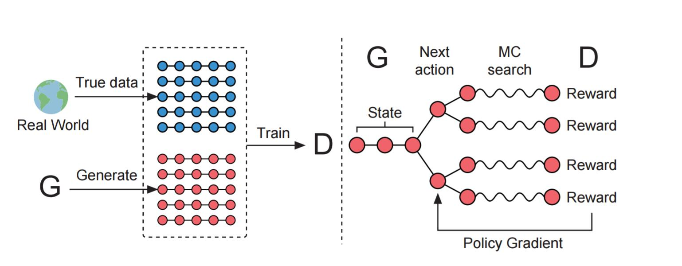
SeqGAN
Yu, Lantao, et al. "SeqGAN: sequence generative adversarial nets with policy gradient." AAAI 2017 (2017).

Slide 5
GANs Result
Able to learn Chinese words
Failed to catch hidden structure
一日凉秋报，
In one day, the fall season starts
风云入故乡。
Wind and cloud enter my hometown

