Slide 1

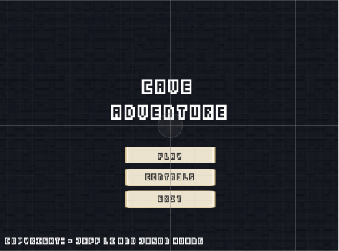
Cave Adventure
2D- Platformer
By: Jason Huang & Jeff Li

Slide 2
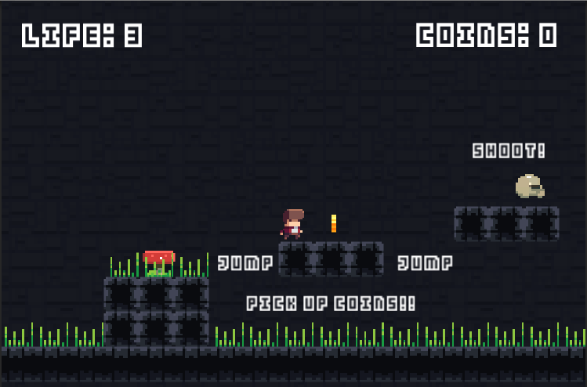
Background
The game setting is in a cave.
Cave contains:
Treasure (Coins)
Enemies
Hazards (Spikes)
Its about a treasure hunter who accidently fell into a cave and needs to find a way to escape.

Slide 3


Character
Main Character:
Joe is a treasure hunter.
Male, wears a red jacket with a white shirt and has a funky haircut
Enemy:
Slobs are rare creatures but are abundant wherever there is treasure
Harmless unless you touch their treasure.
Gender: Unknown

Slide 4
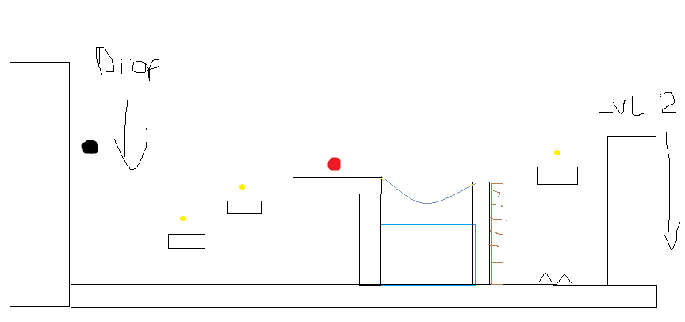
Planning
Idea of a 8-bit plat former, with platforms and obstacles to avoid
Code Requirements were done by using previous scripts that we had and we did brainstorming
Generated ideas by asking other people and watching tutorials on Youtube
Order: Levels Creation, Scripts, Prefabs, Audio and Animations

Slide 5
Game Overview
Objective of the Game :
Kill enemies
Jump over obstacles
Avoid spikes
Collect coins (coins are our only pickup in the game)
Players can kill enemies by shooting an arrow at the slobs
Enemies patrol mostly on the ground and do not shoot any projectiles at the player

Slide 6
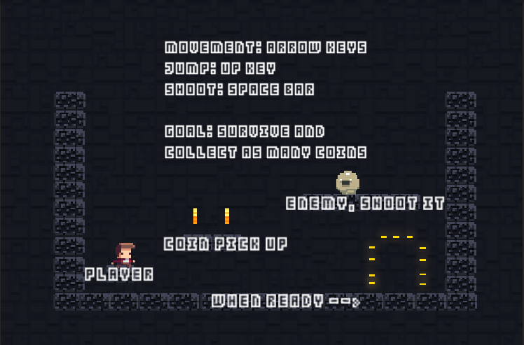
Controls
Standard controls
Movement (Left, Right, Down arrow keys)
Up arrow key is used for
Jump
Climbing Ladder
Shooting (spacebar)

Slide 7
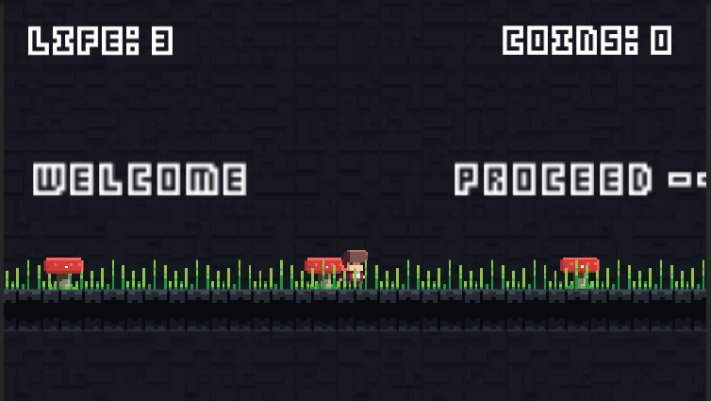
Scoring/UI
The User Interface of the game contains
Life on the top left
Coins on the top right
When the game is over there will be a game over text as well as display your high score.
Our game has one scoring system
Coins, where each pick up of the coin grants 1 points to the coin score
Killing enemy is not important to try as Joe is a treasure hunter

Slide 8
Assets/External Programs
Here are the assets/programs we used for our project:
“Super Plat former Asset” by Merve Talun (sprites, animations, level tiles, etc. from asset store)
“Tiled” by Thorbjorn Lindeijer (used to create our levels easily)
“Tiled2Unity” by Sean Barton (used to import the level into unity)
“8-bit SFX” by Little Robot Sound Factory (coin sound from asset store)
“3rd Note SFX Vol.1” by 3rd Note (jump sound from asset store)
Special Thanks to “Kay Lu” for making the menu and audio tracks for our game

Slide 9
What We Learned
How to code ladder (probably use Clamp method next time)
New unity syntax (for example: application load level is obsolete and it now SceneManager.LoadScene (“name”); )
How to use Tiled and Tiled2unity
How to build the game
How to use branches on Github
Create a Schedule to list out the tasks to be done

Slide 10
Future Possibilities
Add a “flying enemy”
Add power ups
Add a boss

