Slide 1
ResQFlow
Emergency Dispatcher
Semester Project | Group 1 | Midterm presentation

Slide 2

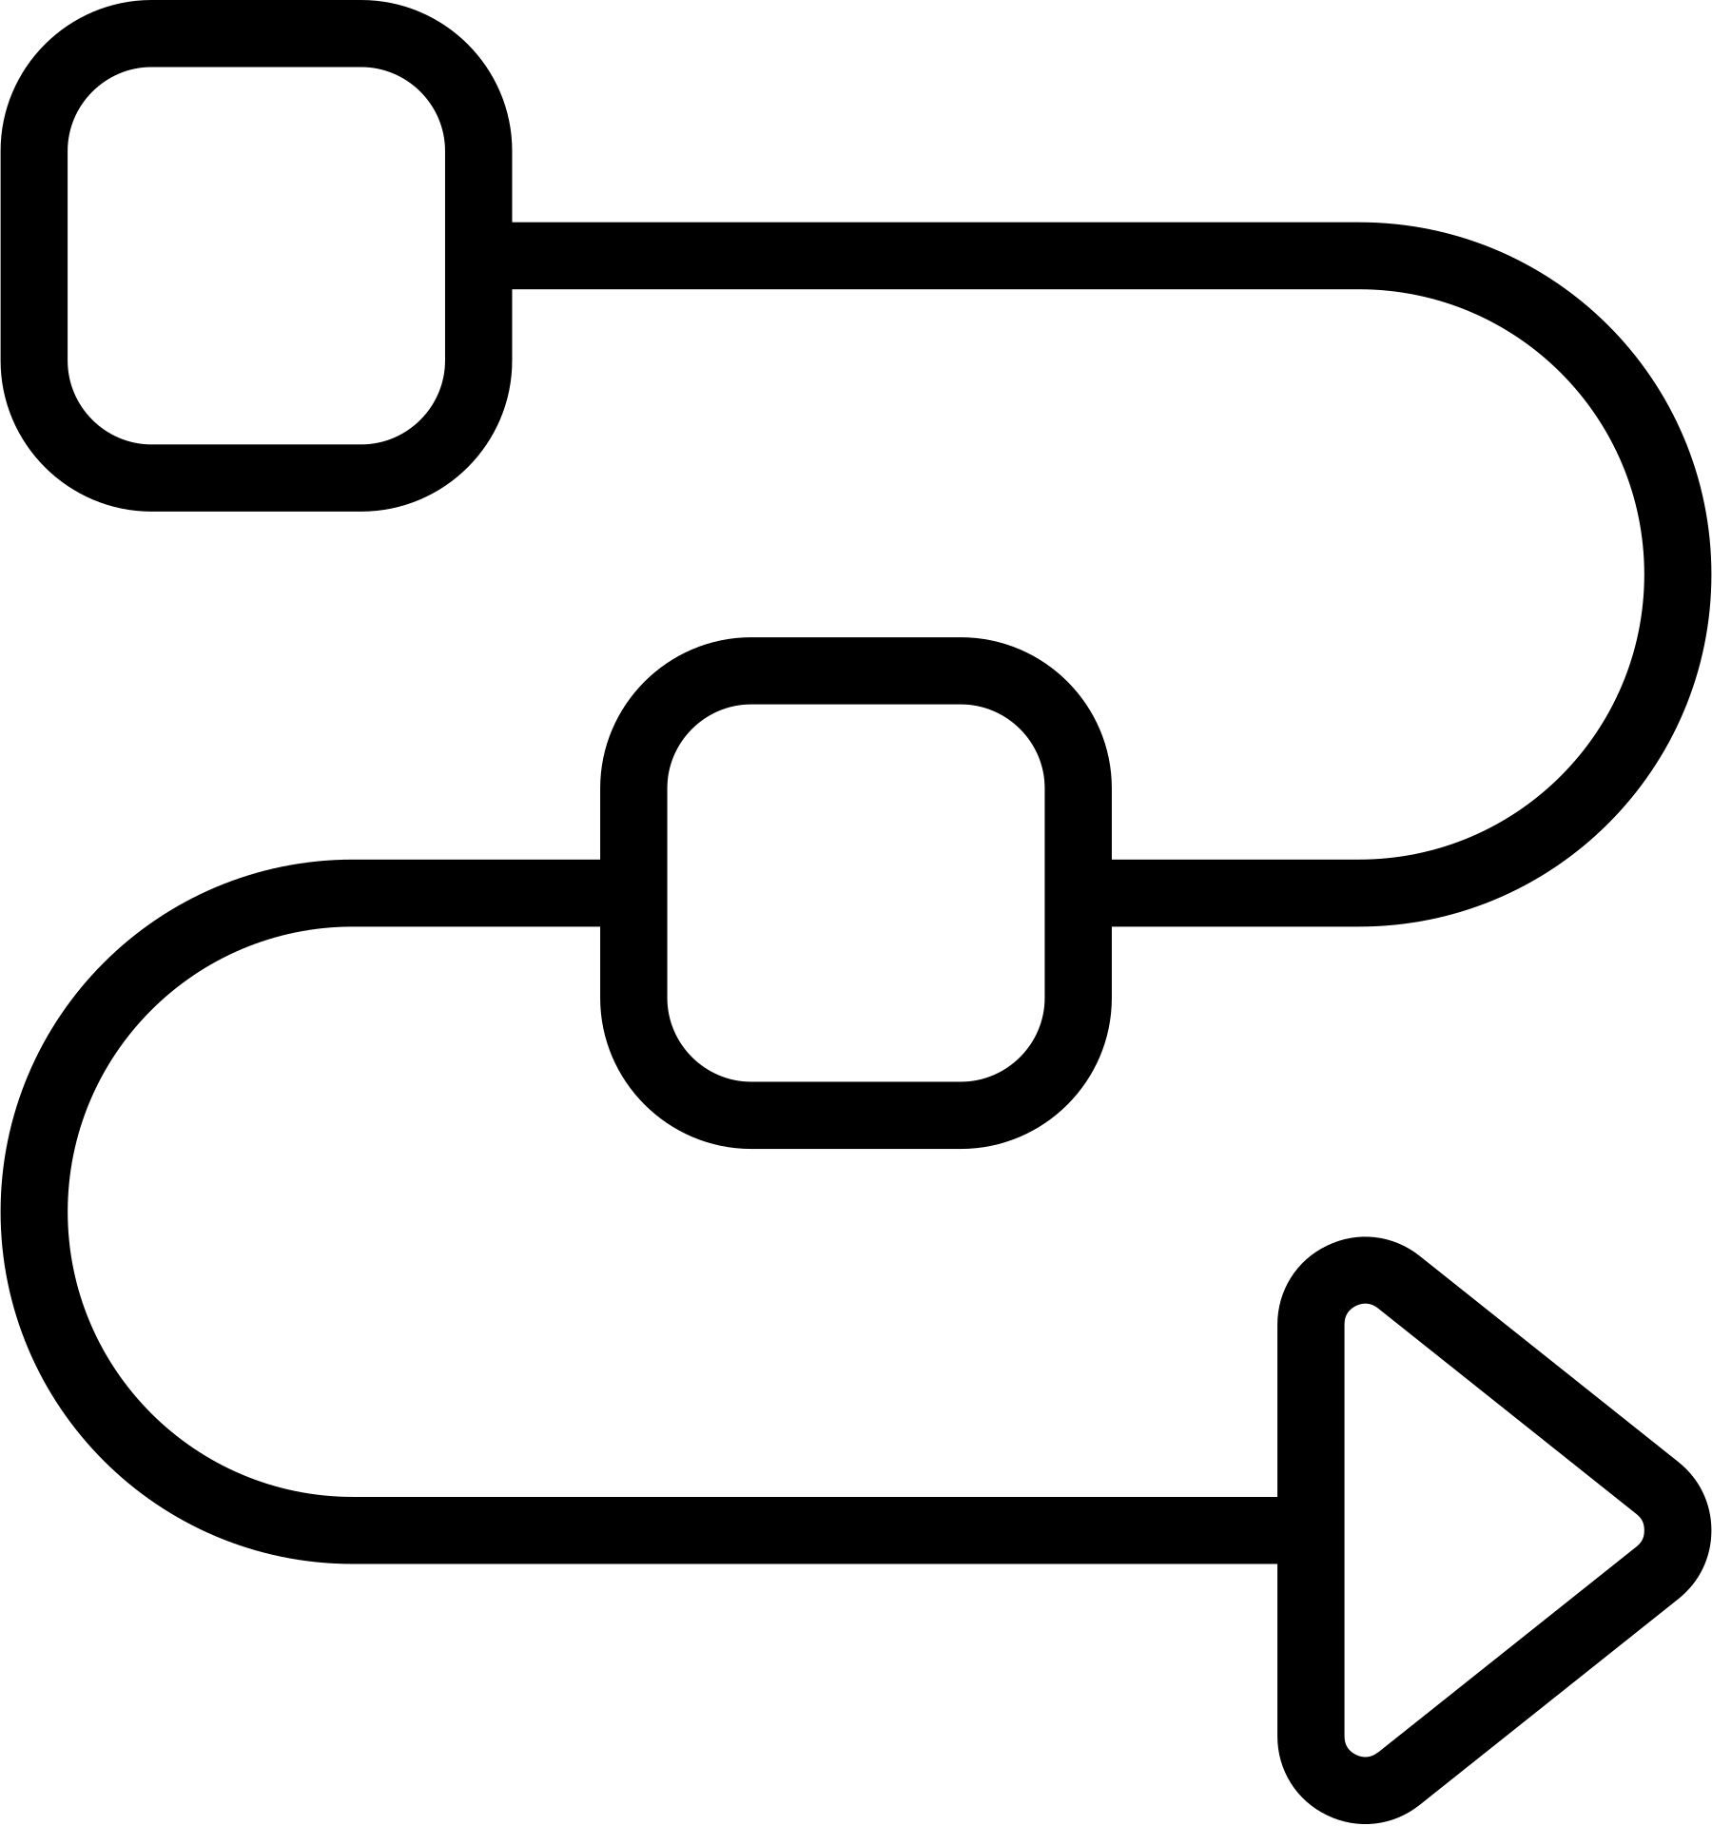

Introduction
1 · INTRODUCTION TO THE PROJECT
What is ResQFlow
Why we chose it
Why it fits us
A console application that helps dispatchers receive, prioritise and respond to emergency incidents
Real-world application with potential for actual use
A project that allows everyone to develop and apply their skills

Slide 3
Problem statement
2 · PROBLEM STATEMENT
11.8%
of reviewed same day deaths were potentially preventable
Source: Andersen et al., 2014
Dispatcher overload
Delayed decisions
Potential consequences
72%
of potentially preventable deaths involved dispatch protocol errors
Source: Andersen et al., 2014
Our question: How could ResQFlow help dispatchers make critical decisions more quickly and efficiently?

Slide 4



Our solution
2 · PROBLEM STATEMENT
See every incident
Know your units
Decide fast
Overview of incoming incidents
Availability of every vehicle
The dispatcher chooses which units to send
Our goal: faster and more efficient dispatch decisions

Slide 5
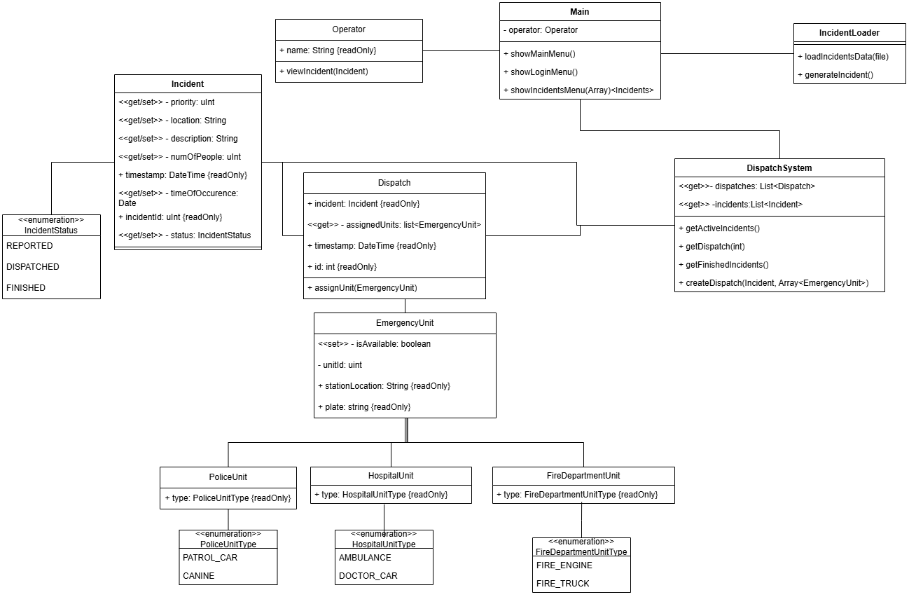
UML class diagram
3 · SOFTWARE DESIGN

Slide 6
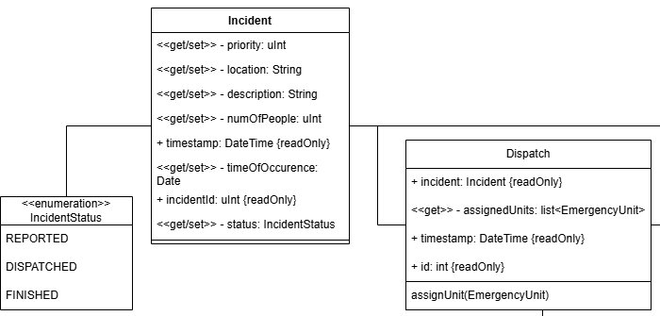
Data: Incident & Dispatch
3 · SOFTWARE DESIGN
Each incident progresses through three status

Slide 7
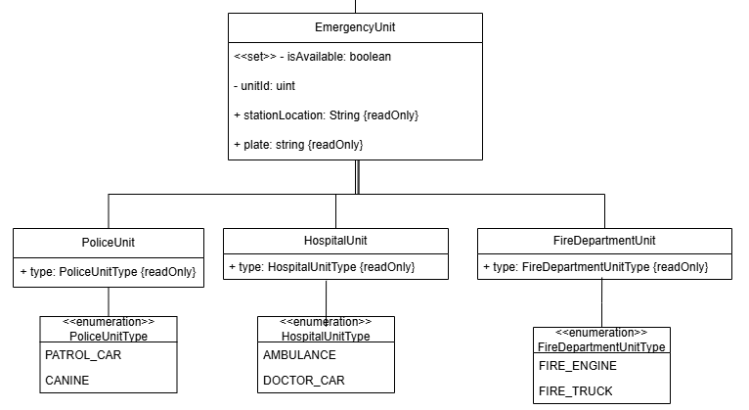
Units: EmergencyUnit
3 · SOFTWARE DESIGN
A common base class with three unit types

Slide 8
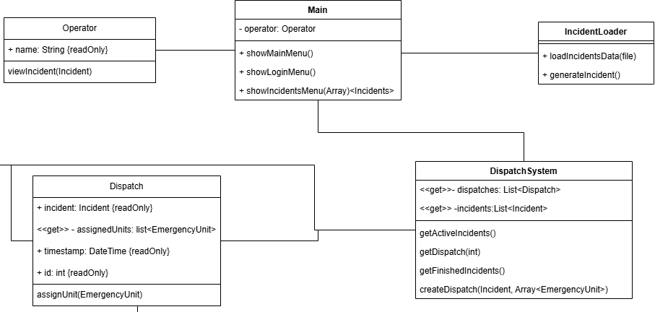
System & interface
3 · SOFTWARE DESIGN
DispatchSystem coordinates operations, while Main manages the console interface

Slide 9
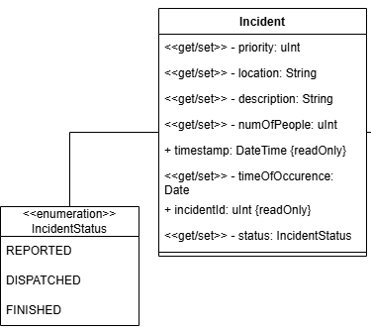
Code: Incident class
3 · SOFTWARE DESIGN
namespace ResQFlow;
public class Incident
{
private uint priority { get; set; }
private string location { get; set; }
private string description { get; set; }
private uint numOfPeople { get; set; }
public DateTime timestamp { get; }
private DateTime timeOfOccurrence { get; set; }
public uint incidentId { get; }
private IncidentStatus status { get; set; }
}

Slide 10
Remaining work
4 · PLAN FOR REMAINING WORK
1
2
3
Implementation
Testing
Write the report
Must-haves first: incident overview, vehicle availability, manual dispatch
Then: random incidents, priority order, history
Test core classes and dispatch logic
Check that the console menus are easy to use

Slide 11
Challenges & next steps
5 · CHALLENGES AND NEXT STEPS
Different levels of technical experience can slow collaboration.
A shared modular design, small implementation tasks and regular review keep the work coordinated

