Slide 1
Welcome
Group 1
Semester project

Slide 2
Problem formulation
To address the critical bottleneck of dispatcher overload, our software simplifies the workspace during high-stress periods—allowing personnel to quickly manage competing priorities by displaying real-time unit availability, hospital capacities, and customizable emergency triage. Prioritizing emergency calls under intense mental pressure often leads to delayed response times, contributing to Denmark's estimated 1,200 to 3,000 annual preventable medical deaths. By streamlining decision-making when speed matters most, the software reduces response times to minimize casualties, mitigate avoidable injuries, and ultimately save lives.

Slide 3
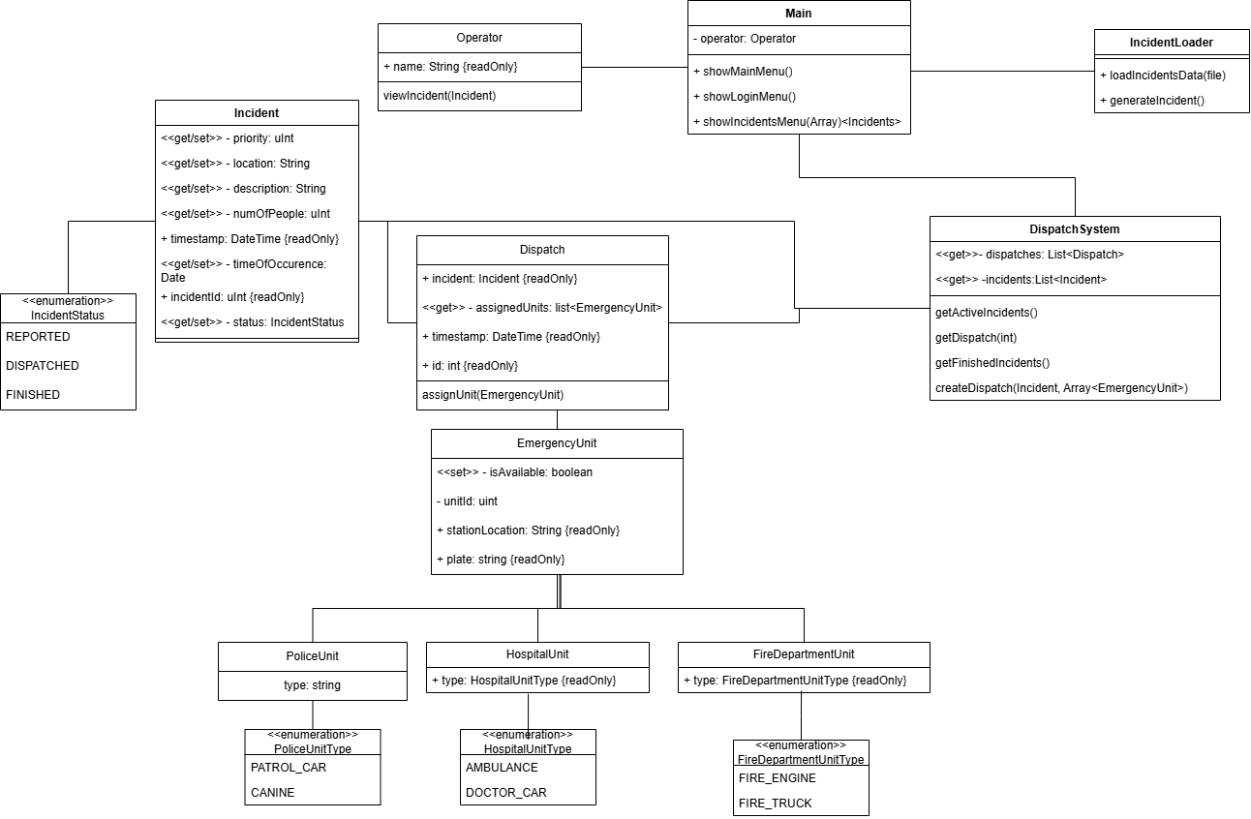
Software design

Slide 4
Remaining work
- Proper implementation
- Testing
- Write the report

Slide 5
Challenges & next steps
- due to different levels of technical knowledge, adjusting to meet everyone’s level can be difficult

Slide 6
Thanks for attention

