Slide 1
Predicting Video Frames Using Deep Learning
Authors: Ali Ashraf & Muhammad Umais
FAST NUCES, Islamabad
Contact: i210605@nu.edu.pk, i200854@nu.edu.pk

Slide 2
Project Overview
Goal: Predict and generate future frames in video sequences.
Dataset: UCF101
Key Models: ConvLSTM, PredRNN, Transformer-based

Slide 3
Problem Definition
Predict subsequent video frames from short input sequences.
Extract motion patterns to generate natural continuations.
Applications: Video compression, animation automation, autonomous vehicles.

Slide 4
Significance
Reduces manual effort in video production.
Enhances streaming quality and simulation scenarios.
Bridges the gap in human-like visual perception.

Slide 5
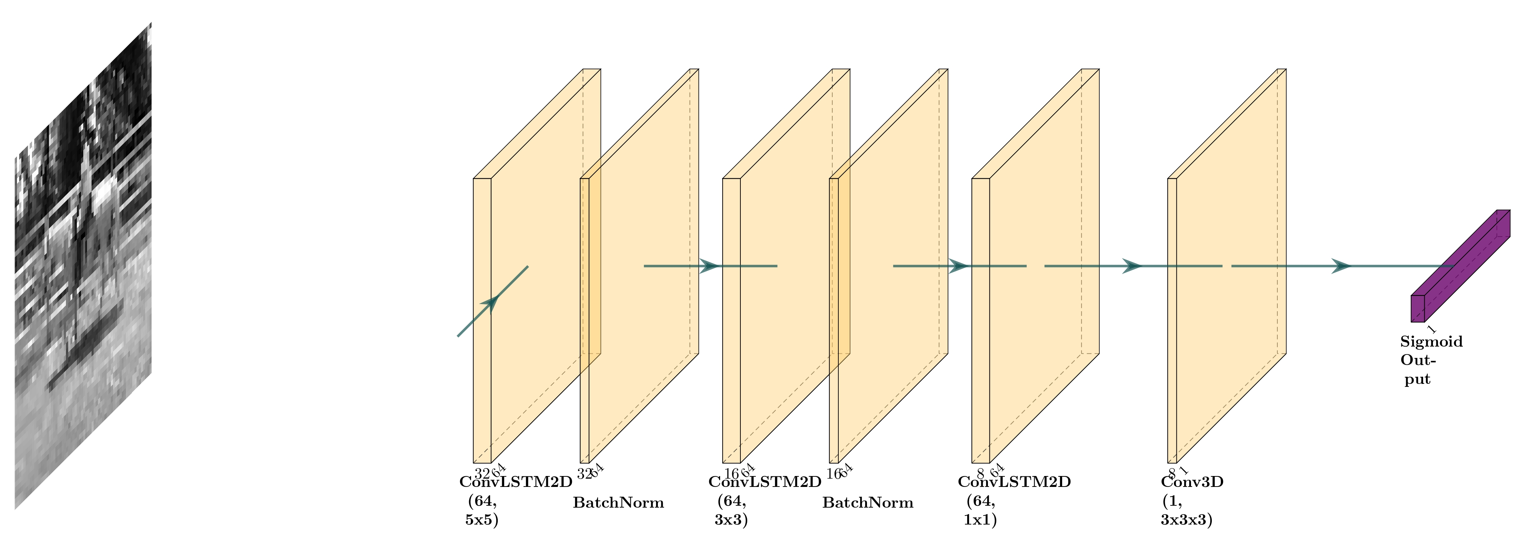
Model Architectures
ConvLSTM: Combines convolution and LSTM for short-term patterns.

Slide 6
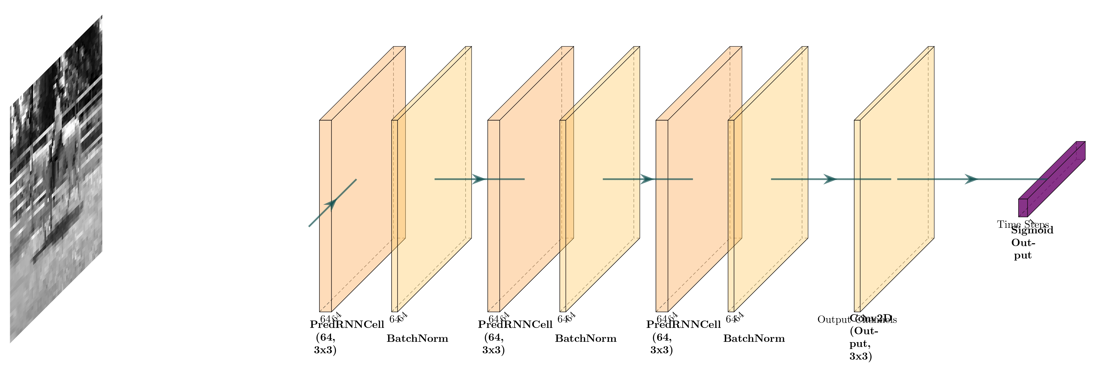
Model Architectures
PredRNN: Improves temporal modeling for smoother transitions.

Slide 7
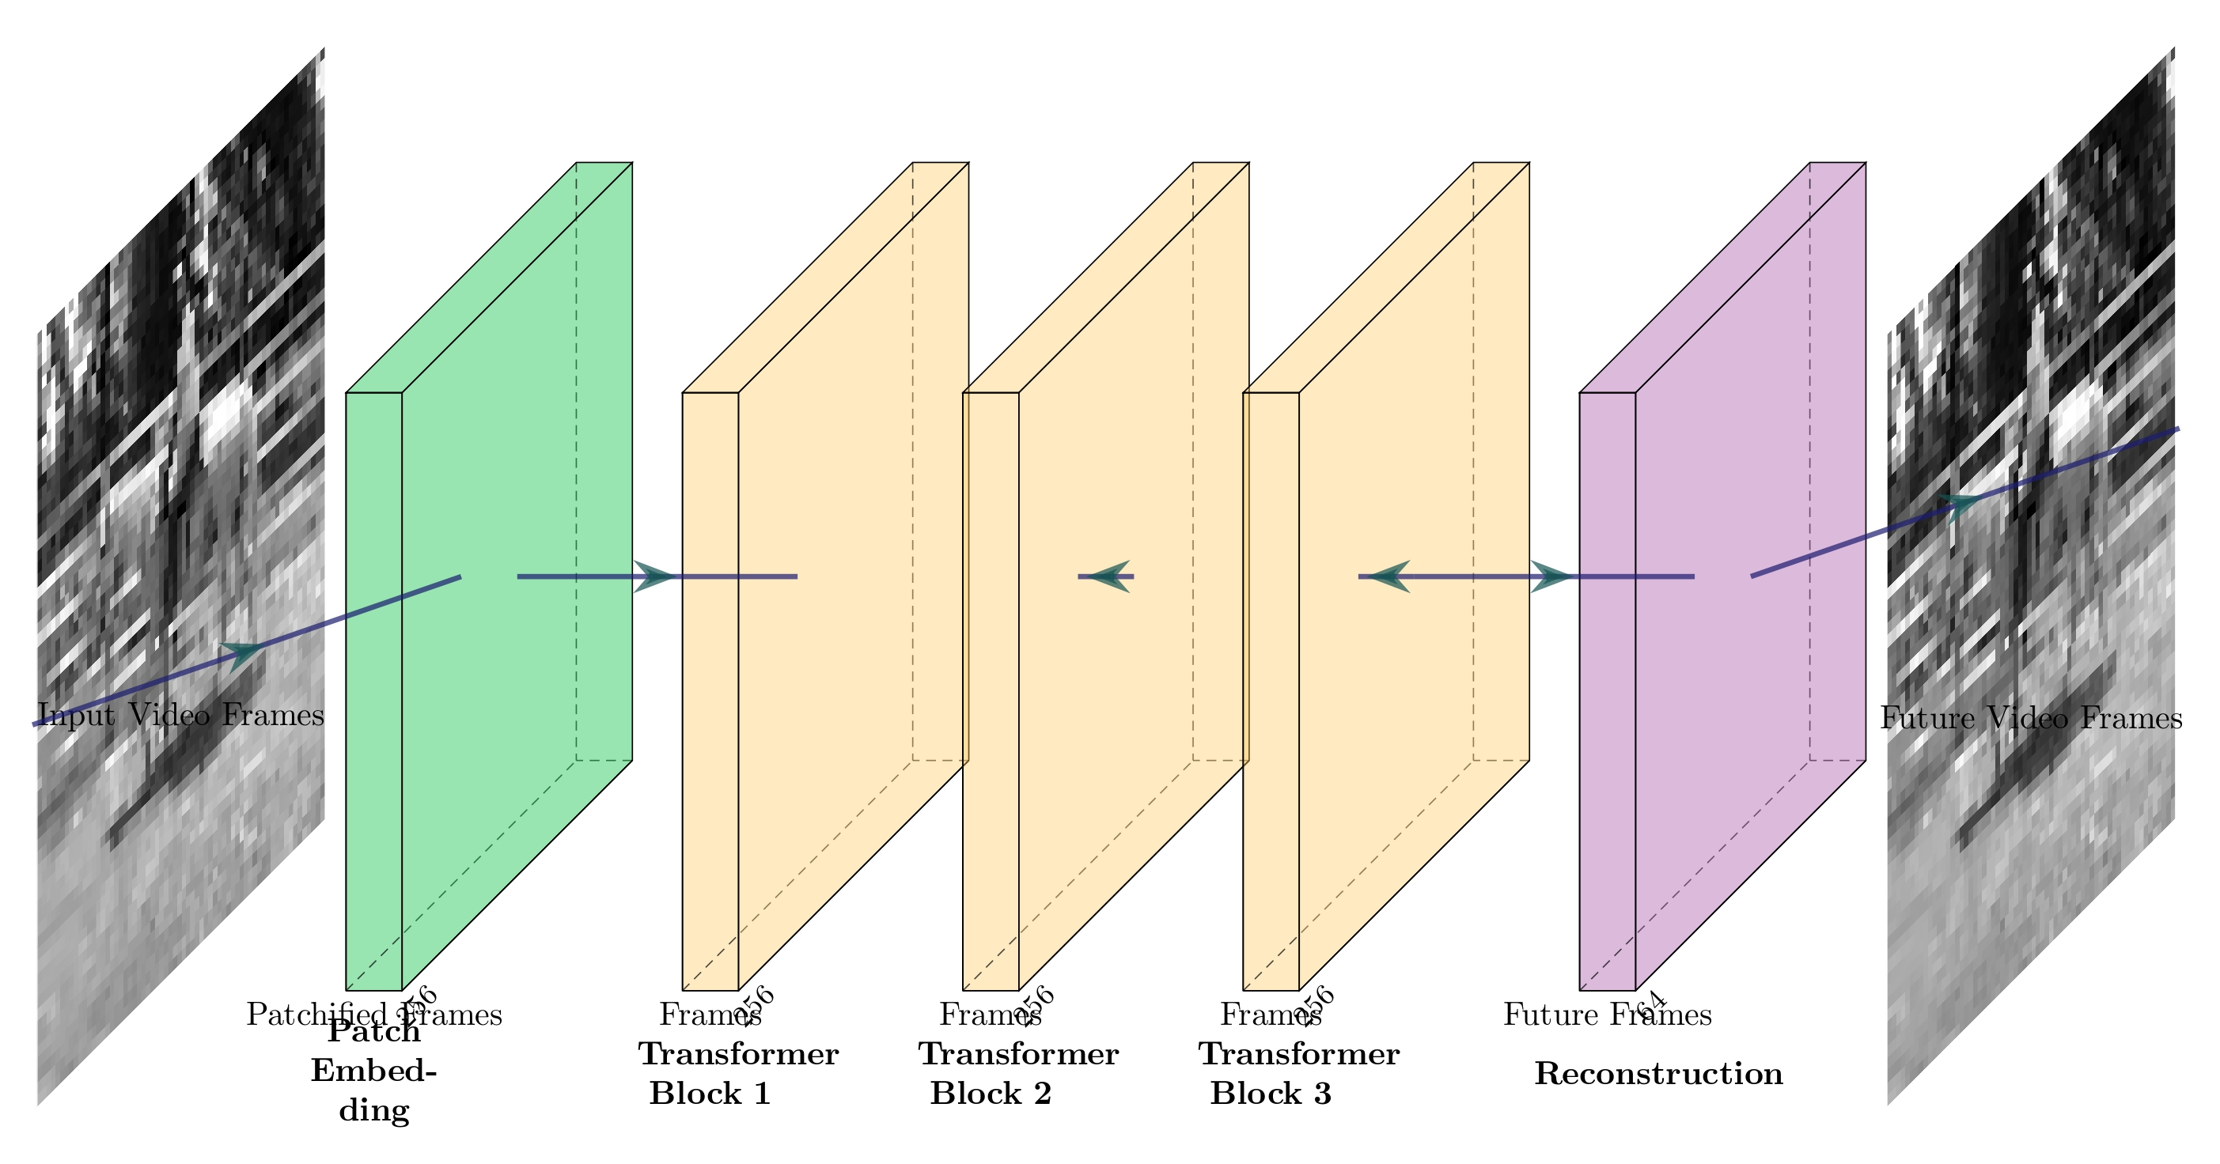
Model Architectures
Transformer: Excels in capturing long-term dependencies.

Slide 8
Dataset and Preprocessing
Dataset: UCF101
Frames resized to 64x64 and gray-scaled for faster training.
Augmentation techniques include rotation, flipping, and cropping.

Slide 9
Training Setup
Optimizer: Adam (Learning Rate: 0.001)
Epochs: LSTM: 20, PredRNN: 50, Transformer: 60
Early stopping and batch size of 8.

Slide 10
Evaluation Metrics
Mean Squared Error (MSE): Measures prediction accuracy.
Structural Similarity Index (SSIM): Measures visual quality.

Slide 11
Results Comparison
LSTM: Best performance for short videos.
PredRNN: Not as good as LSTM but visually satisfying.
Transformer: Most resource intensive

Slide 12
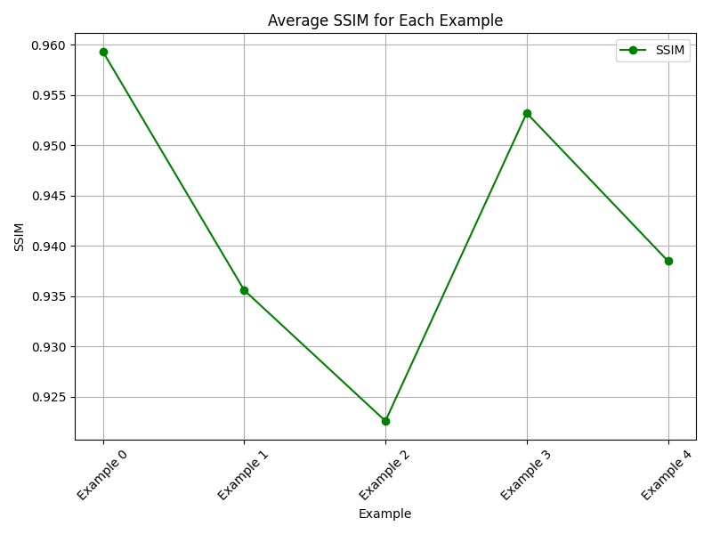
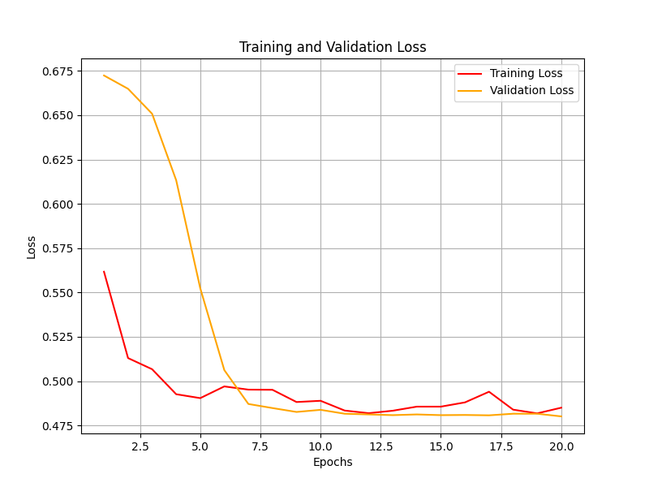
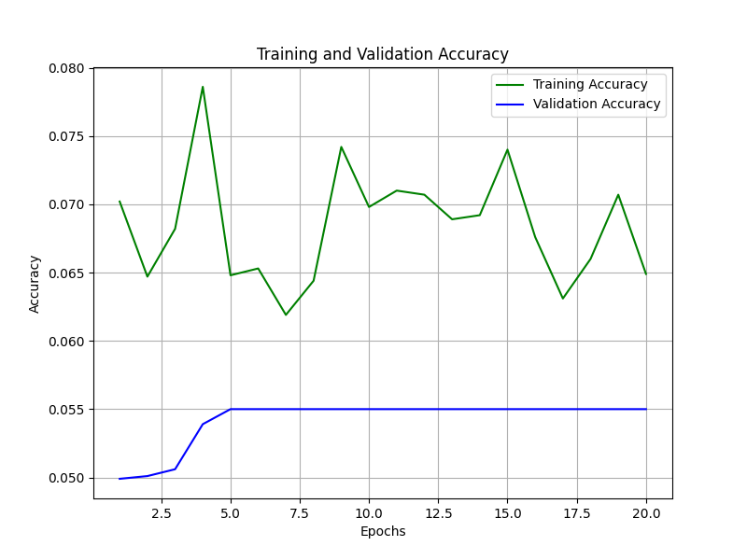
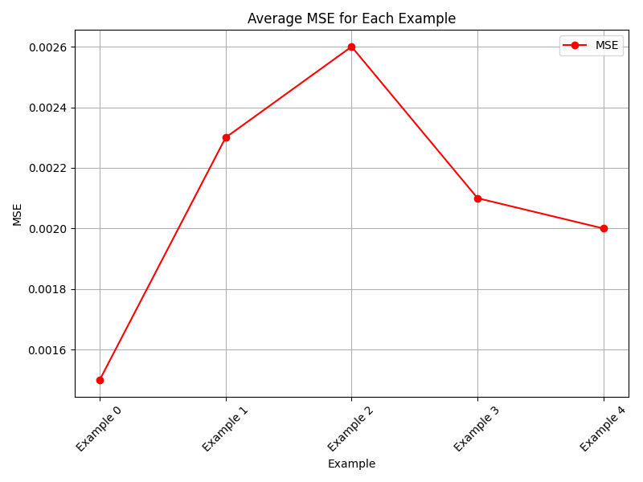

Slide 13
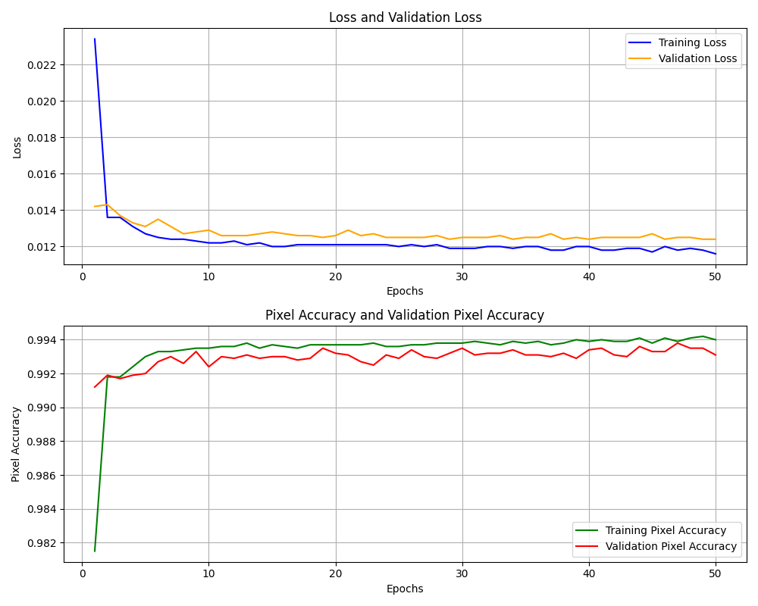

Slide 14
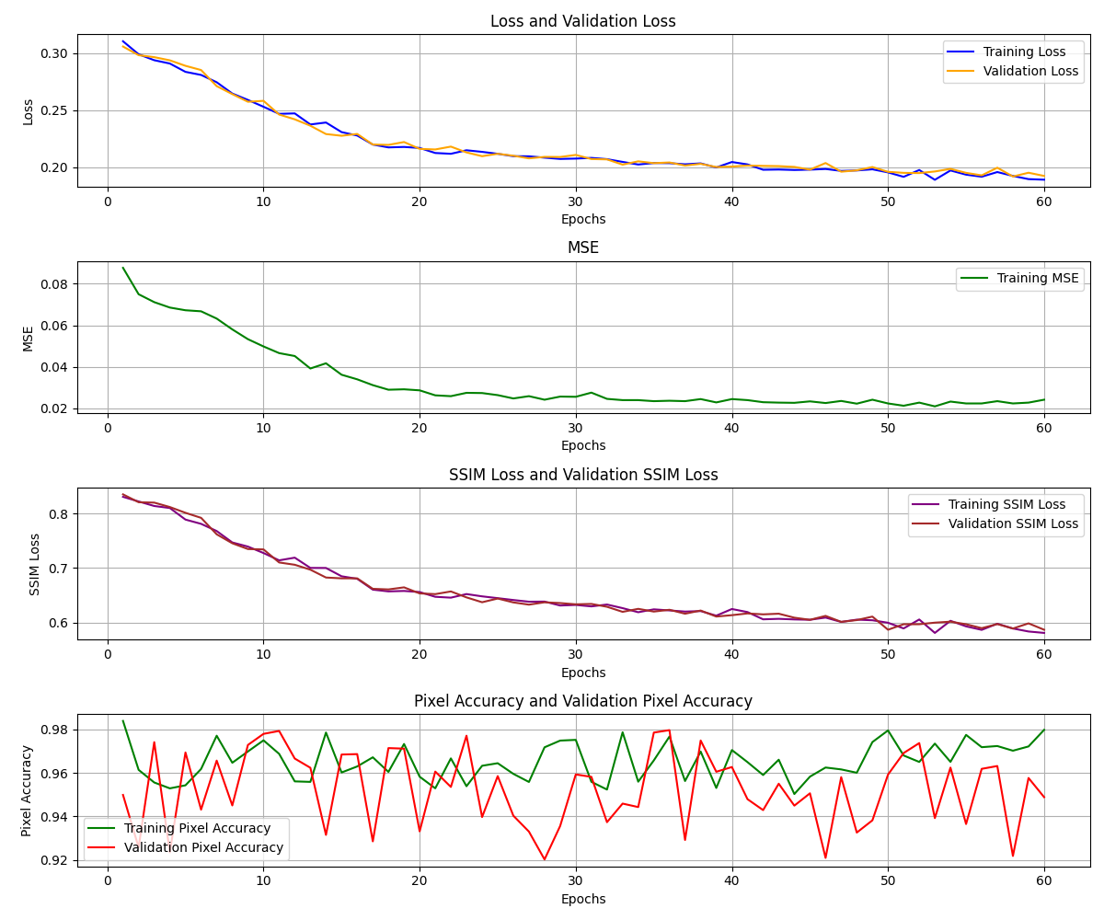

Slide 15
Conclusion
LSTM is effective for short videos with limited resources.
PredRNN and Transformer models excel with more training and data.
Future Work: Explore larger datasets and advanced architectures.

