Slide 1



Back-propagandist
Team 8 · AI-Driven Chaos Engineering for Cloud-Native Resilience · Bosch AI Innovation Challenge
An AI that chooses which faults to inject into a real online shop, explains what broke and how to fix it. A person approves every run.
Code measures
Models explain
A person decides
github.com/StrikerEureka34/Back-propagandist
Notes:
We are Back-propagandist. In one line: the AI plans the chaos experiments and explains them, code measures every number, and a person approves each run before anything touches the cluster.

Slide 2

The team
Team 8 · Back-propagandist
Nethra Arun
Dev Tated
Tanmay Bains
Ayush Kumar
Vaibhav
Institute
Manipal Institute Of Technology, Manipal
Graduating batch
2027
Repository: github.com/StrikerEureka34/Back-propagandist
Notes:
Team 8. Fill in roll numbers, institute and batch before submitting.

Slide 3






Break the shop on purpose, and learn from it
Bosch asked for an AI that decides what to break, when and how safely, then explains what the failure revealed and how to fix it.
What the solution must do
The trap we designed around
Map the app
its services, dependencies and data flows
Score an AI by damage and it learns to break everything. Any search rewarded for damage drifts toward the most destructive scenarios, not the most useful ones.
Flooding the front door breaks any shop and teaches nothing. 10 % packet loss breaking checkout is a real finding.
So we rank findings by leverage: damage per unit of push.
Plan the experiments
the most useful and riskiest ones, from the map
Inject failures safely
stop on error rate, latency or blast radius
Observe
errors, slowdowns and recovery time
Report
ranked weaknesses, fixes and a resilience score
Notes:
Five things the solution must do, straight from the problem statement. The part we thought hardest about is on the right: if you reward damage, the AI learns to break everything. That's why we rank by leverage.

Slide 4
A hybrid agent: code, models and a person
Models are good at reading context and explaining. They're bad at arithmetic and they invent names. So we split the work.
Code
measures and computes
Models
plan and explain
A person
decides
Maps the shop from its own Jaeger traces
Runs krkn under a kill switch checked every second
Rates damage from Prometheus, against a clean baseline
Computes leverage, the resilience score and the evidence check
Drops invented fault ids and builds the only pairs allowed
Planner ranks the pool by expected leverage, with a hypothesis, predicted tier and reason
Analyst explains each run: what broke, why, and a follow-up
Fixer proposes one fix per root cause, from a fix catalog
Summary writes the report's opening lines
Picks the pool of faults and the run budget
Approves, skips or stops each run
Reorders the queue, or hits Emergency stop
Applies a fix, then re-runs its fault
Every number comes from rules. Models only rank and explain. Every run needs a person.
Notes:
This is the core design choice. Code does everything that has to be right: measuring, scoring, safety. Models do what they're good at: reading the context, forming hypotheses and explaining. A person decides. The line at the bottom is the rule we never broke.

Slide 5

A person decides at every critical step
Bosch's AI code of ethics: people are the final judge of AI-based decisions. Nothing reaches the cluster without a yes.
1
2
3
4
5
Pick the pool
Approve each run
Reorder
Stop anything
Own the fix
Which faults, how many runs, pairs on or off.
Sees the hypothesis, predicted tier and confidence, then approves, skips or stops. Follow-ups too.
Drags the queue on the Agent page to change what runs next.
Emergency stop, runs/STOP or Ctrl+C. Reaches every wait, then cleans up.
The fixer only proposes. A person applies the fix and re-runs the fault.
It happened in our runs
Demo run: catalog-kill was queued but not approved, so it never ran
Demo run: a person corrected fix 1; the fixer's draft pointed at recommendation calls
Session 2: a person stopped the session after 3 runs
--auto-approve is refused for live faults; it only works on replays
Notes:
Five checkpoints, all blue because they're a person's. The bottom card is the proof from our own runs: in the demo, catalog-kill was queued but nobody approved it, so it never ran, and a person corrected the first fix the model drafted.

Slide 6
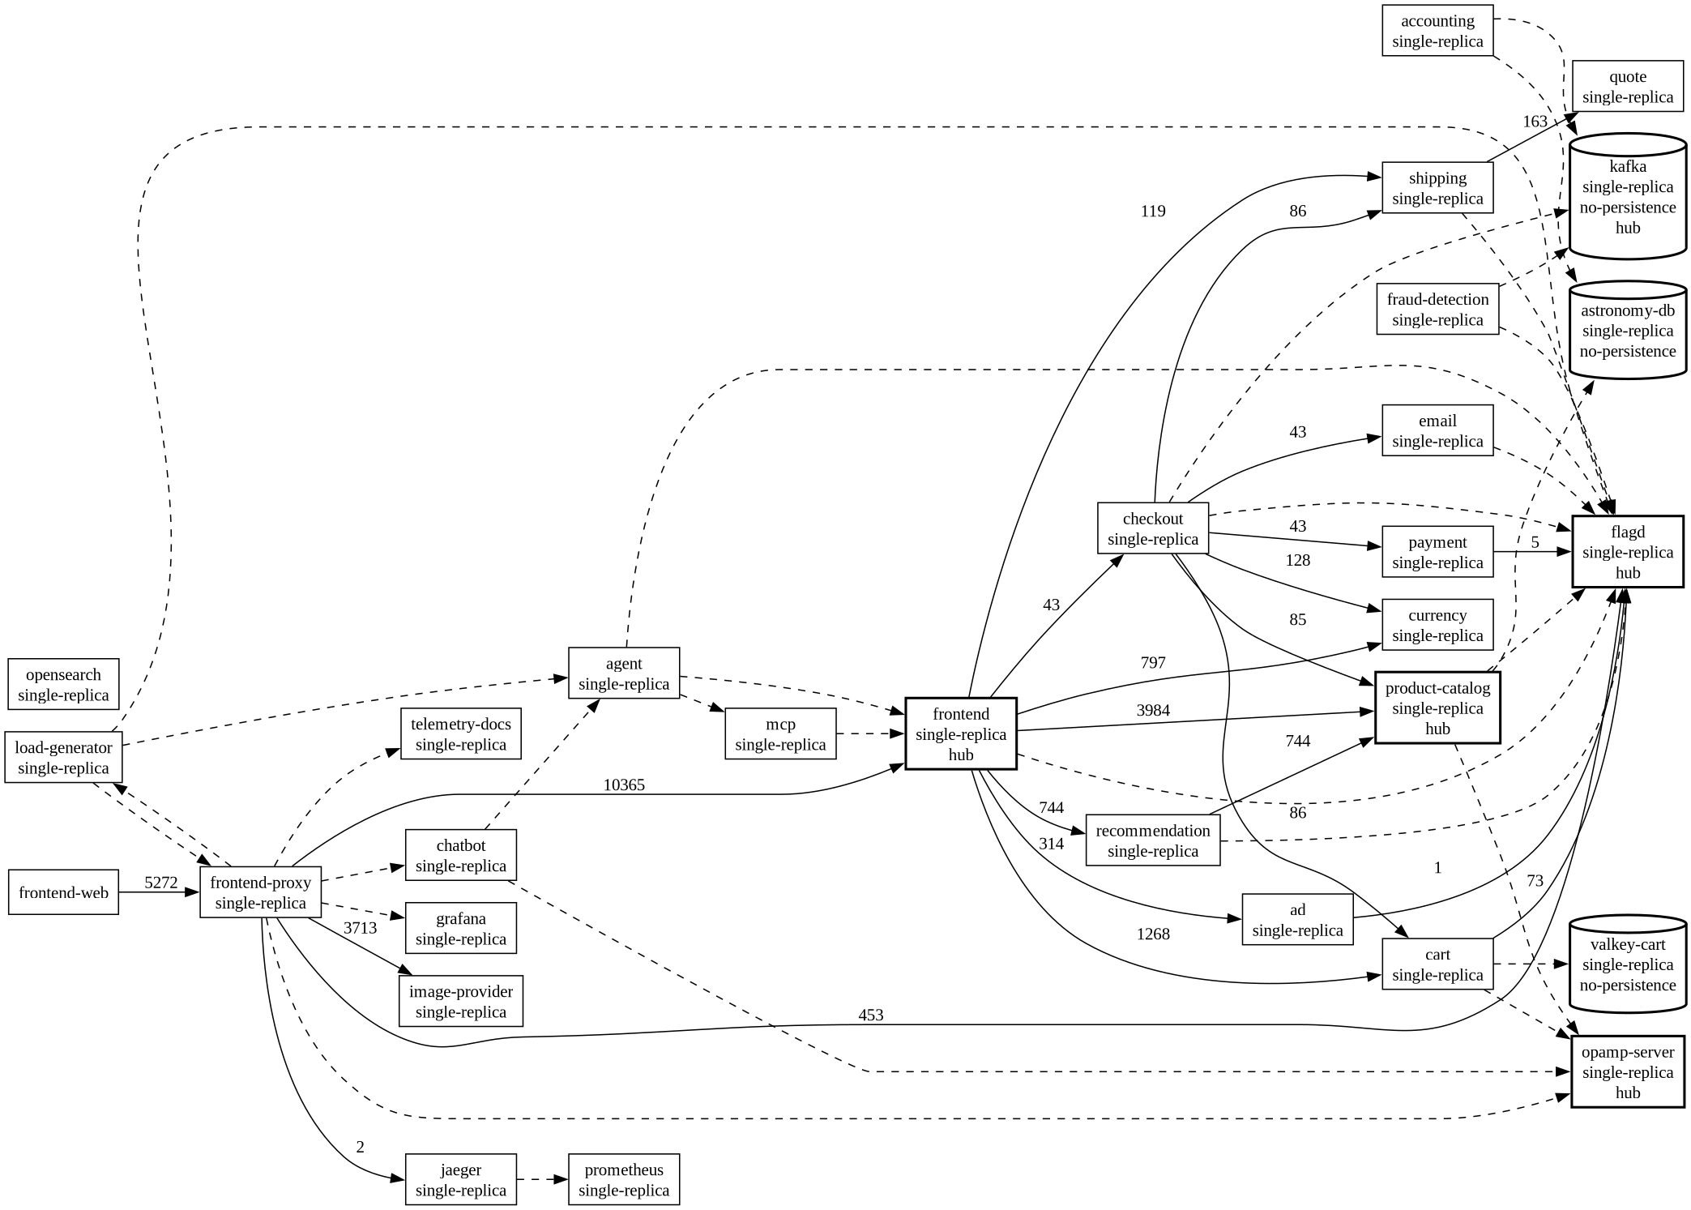
The sample app: OpenTelemetry Astronomy Shop
A real microservice shop, Apache-2.0, installed with Helm on a 3-node kind cluster on one laptop.
What it is
About 20 services: frontend, checkout, cart, product catalog, payment, shipping, quote, currency, recommendation, ad, email, plus Kafka, Postgres and Valkey. github.com/open-telemetry/opentelemetry-demo
Where it runs
kind: a control plane, a “blast” node with the backends (node faults land here) and a “steady” node with the frontend, flagd, load generator, Jaeger and Prometheus.
The flow that matters
Checkout: prepare (cart, catalog, currency, quote) → charge the card → ship → empty the cart → email → Kafka.
Mapped from its own traces
35 of 36 official links found, plus 10 the official diagram misses. flagd has 13 dependents; carts, orders and the catalog DB have no volume.
depmap.py: who calls whom (Jaeger), links to data stores (kubectl), risk flags
Notes:
We picked the OpenTelemetry demo because it's a realistic shop with about 20 services, and it already emits traces and metrics, so we could map it and measure it without adding our own tracing. The map on the right is built by depmap.py from those traces.

Slide 7
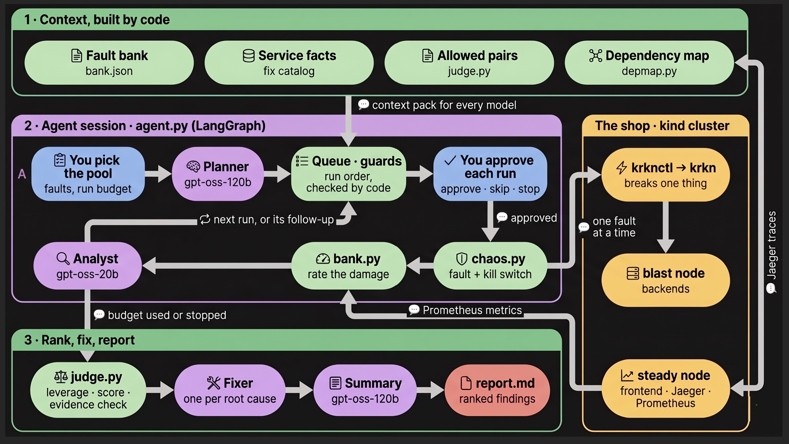
Solution architecture
Code builds the context, the agent runs one approved fault at a time on the cluster, then code ranks and models explain.
Colour code
a person
code
a model
the cluster
the output
Two worker nodes give network faults a real network to slow
Monitoring sits on the steady node, so a fault can't blind the kill switch
Models never touch the cluster
Notes:
Read it top to bottom. Box 1: code builds the context pack. Box 2: the agent session, where a person picks the pool, the planner orders it, a person approves each run, chaos.py injects under a kill switch, bank.py rates the damage from Prometheus, and the analyst explains. Box 3: rules rank and score, the fixer proposes, the summary writes report.md.

Slide 8
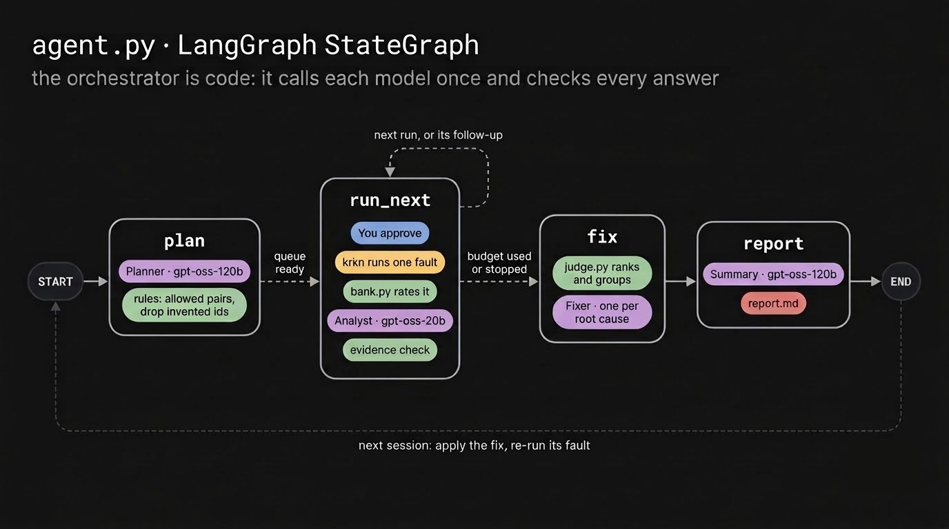
How the agents hand off
The orchestrator is code: agent.py's LangGraph graph calls each model once per task and checks every answer.
Models never call each other
Each answer comes back through rules before anything acts on it.
Loop 1, inside a session
An allowed analyst follow-up joins the queue as the next run: at most 2, never a broad fault, still approved by a person.
Loop 2, across sessions
The fixer names the fault that proves its fix. A person applies the fix and re-runs that fault.
Notes:
We deliberately didn't let models talk to each other. Each node calls one model once, and every answer comes back through rules. There are two feedback loops: inside a session the analyst can queue a follow-up, and across sessions the fixer names the fault that proves its fix.

Slide 9



Right model, right context, nothing wasted
A big model where judgment matters, a small fast one per run. Code builds every context pack; no model sees the cluster.
Role | Model | Reads (built by code) | Code checks
Planner | gpt-oss-120b | pool faults with their strength and map facts (callers, risk flags), code-checked pairs, service facts | invented ids dropped; faults it left out added by rules
Analyst, one per run | gpt-oss-20b | the measured tier (final), broken SLOs, effects, the allowed follow-up list | tier can't change; evidence check; ≤ 2 follow-ups
Fixer, one per root cause | 120b if high, else 20b | findings that share a root cause, the fix catalog | the fault that proves the fix must exist
Summary | gpt-oss-120b | the ranking, fixes and score | every number comes from judge.py
Fallback chain
Groq key 1, then keys 2 and 3, then OpenRouter's nemotron. No keys at all: rules do everything, marked (no AI).
Prompt cache
Each answer is saved under a hash of role and prompt. A replayed session costs zero tokens and gives the same answers.
Every model also reads docs/service-facts.md, written from the shop's source code, so it can explain why: checkout charges the card before it ships.
Short, structured answers
One JSON object, every text field under 25 words. Fits Groq's free tier of 8k tokens a minute.
Notes:
Model allocation: gpt-oss-120b plans, writes the summary and fixes high-severity findings; gpt-oss-20b runs once per experiment. Every prompt is a context pack built by code: the map facts, the measured numbers, the service facts we wrote from the shop's source. Answers are cached by a hash of the prompt, so replaying a session costs nothing.

Slide 10
Two scores, never mixed
Leverage ranks the findings. The resilience score rates the whole system over a pool fixed at session start. Both come from rules.
Leverage = impact ÷ strength
Resilience score
impact: high 3 · medium 2 · low 1
strength: mild 1 · targeted 2 · broad 3 · a pair adds both
krkn's formula: points kept ÷ points possible × 100, over 7 SLOs a customer feels. Critical = 3 points, warning = 1.
3
customers get answers
3
no data lost
3
the shop recovers
3
the shop stays up
1
other services answer
1
customers aren't 2x slower
1
nothing else restarts
Why not krkn's built-in score: it gave 100/100 to a fault that made the shop 66x slower.
Big damage from a small push ranks first. A flood that breaks everything sinks.
Notes:
Leverage is impact divided by how hard we pushed. blast-loss is only 10 percent packet loss but it broke checkout, so it ranks first at 3.0. The cart-wipe plus traffic-spike pair also rated high, but half of it is a flood, so it ranks last. The resilience score is krkn's formula, but over SLOs a customer actually feels.

Slide 11
How far to trust each AI answer
A model's note reads just as fluently when it's wrong. So rules check every note, and the model's own confidence sits under it.
Evidence check, by rules
starts at 100 %, minus:
Model's own estimate, unchecked
Each model returns its own confidence, 0 to 1. It sits under the evidence check on every AI output, as Bosch's code of ethics asks.
It stays labelled unchecked: an early prompt's example said 0.6, and one model copied it into every note.
−40
each claim the data disproves, like “no data loss” when carts emptied
−30
names no service that broke
−20
the error ratio rests on fewer than 20 calls
−10
cites no evidence (only files that exist count)
100 %
blast-latency +
catalog-db-cutoff
80 %
blast-loss
20 %
cart-wipe
Contradicts nothing, names checkout and product-catalog, cites bank.json. Model's own: 85 %.
Grounded, but checkout's error ratio rests on only 9 calls (−20).
Said “no data loss, SLO preserved” while carts went 1 → 0 (−40, −40).
Notes:
The evidence check is what a reviewer would do by hand: does the note contradict the numbers, does it name what broke, is the sample big enough, does it cite anything. The model's own confidence is shown because Bosch asks for confidence next to every AI output, but it's labelled unchecked, because self-reported numbers aren't calibrated.

Slide 12



Tools and technologies
Open source or free tier, all on one laptop. The replay mode runs anywhere, with no cluster and no keys.
Language and frameworks
AI models and APIs
Chaos
Python 3.12 with uv · LangGraph for the agent's StateGraph · a Streamlit console with a drag-and-drop queue · pytest
Groq: gpt-oss-120b and gpt-oss-20b · OpenRouter: nemotron-3.5-lightning as the fallback · one llm() wrapper, so a Bosch-provided model swaps in one place
krkn through krknctl v0.14.2-beta: pod kills, network filters, node network chaos, CPU and memory hogs, service hijacking, HTTP load
Infrastructure
Observability
App and repository
Docker · kind v0.33.0, 3 nodes · Kubernetes 1.37 · Helm 4.3 · kubectl. Tested on Arch Linux, Ryzen 7 6800H, 16 GB RAM
Prometheus: per-service span metrics, CPU and memory · Jaeger traces, which build the dependency map · Grafana
OpenTelemetry Astronomy Shop 3.1.0, Apache-2.0 · Helm chart 0.42.3. Our code on GitHub:
StrikerEureka34/Back-propagandist
Notes:
Everything here is open source or free tier. One design choice worth calling out: every model call goes through one llm() function, so swapping in a model Bosch provides is a one-place change.

Slide 13
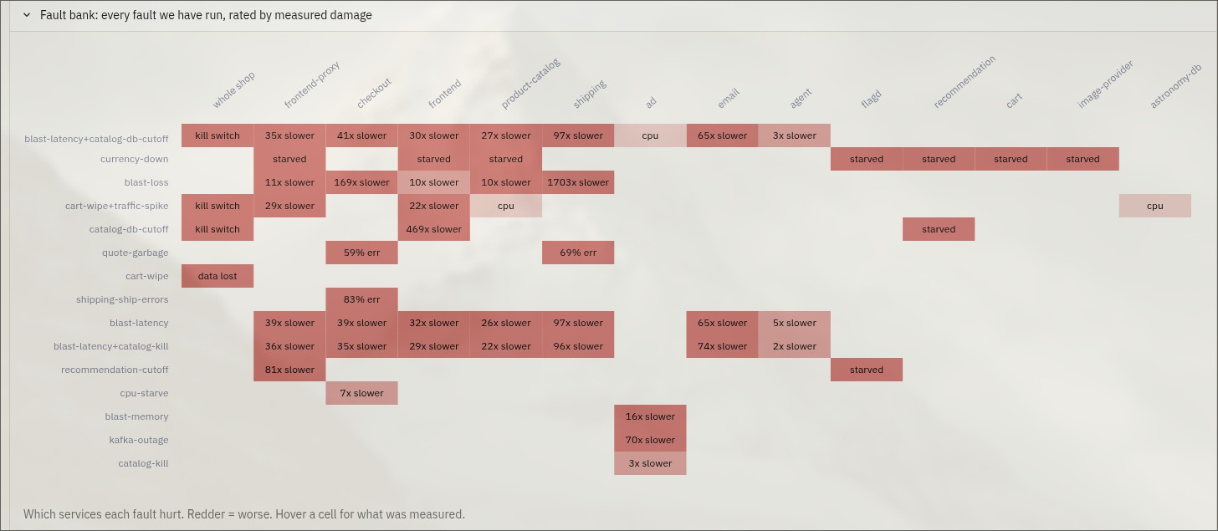
Failure scenarios we chose, and why
13 faults, 3 pairs and 2 known-answer controls, each one run on the cluster and rated by measured damage.
Failure type | Our faults
Service crash | catalog-kill · payment-kill · kafka-outage · cart-wipe
Slow or lossy network | blast-latency (+200 ms) · blast-loss (10 % loss), on the backend node
Failed dependency | catalog-db-cutoff (Postgres cut off) · recommendation-cutoff · currency-down
Wrong answers | quote-garbage (200 OK, wrong body) · shipping-ship-errors (500 after the charge)
Resource pressure | cpu-starve (100 % CPU) · blast-memory (1 GiB)
Traffic spike | traffic-spike (1,000 requests a second), run paired with cart-wipe
Combined | blast-latency + catalog-kill · blast-latency + catalog-db-cutoff · cart-wipe + traffic-spike
The fault bank in the console: which services each fault hurt. Redder is worse.
From outside the app, like real trouble: a pod dies, the network slows, a dependency answers nonsense.
The demo's built-in failure flags were dropped as findings: their outcome is written into the demo. Two stay as controls: paymentFailure must rate high, adHighCpu low.
The planner orders faults by expected leverage, from the map. Code pairs two faults only when they can interact.
Notes:
Every fault comes from outside the app, the way real trouble does. We dropped the demo's own failure flags as findings because their outcome is written into the demo, and kept two as controls to prove our measuring is right. The heatmap is the console's view of the bank: which services each fault hurt.

Slide 14
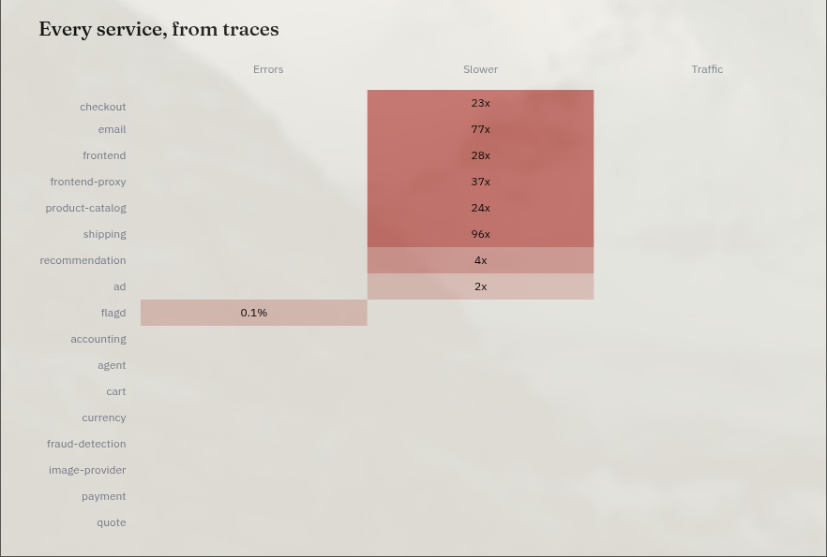
Measured against a clean baseline
A dirty “before” once rated shipping-ship-errors low. Now every fault is compared with a quiet window, service by service.
Before
Wait until the last fault is 5 min in the past, then take the baseline. 5 healthy shop checks in a row before any fault.
During
The shop is probed every second. Per service, from Prometheus: errors, p95, throughput, plus CPU, memory, restarts and cart contents.
After
Checks until 5 in a row are normal, then damage is tracked minute by minute: it often outlasts the fault.
How a fault is rated
high
customers hit errors or lose data, or the shop doesn't recover
medium
another service errors, or customers are 2x slower
Live run page during a fault: six services 23x to 96x slower than usual, the rest clear.
low
anything less
Calibration: both known-answer controls pass, paymentFailure rates high and adHighCpu low.
Notes:
Damage is only as honest as the baseline it's compared with. We wait until the last fault is five minutes in the past, compare every service's errors, p95 and traffic against that window, and keep watching after the fault because damage often outlasts it. The screenshot is the Live run page during a fault.

Slide 15




Safety controls, tested on the cluster
Stop limits live in experiments.toml, one set per fault. The stop path was tested with a real traffic flood.
Kill switch, every second
error rate, p95, blast radius (another pod goes NotReady), time limit
2.6 s
Manual stop
Emergency stop on the Agent page, runs/STOP, Ctrl+C
from the first slow probe to the stop
0.7 s
One fault at a time
a machine-wide run lock; no fault goes into an unhealthy shop
from the stop to krkn killed and cleaned up
1.9 s
Guards
one target per run, nothing on the steady node, never two broad faults, no controls in the pool
until the shop was back to its baseline
Cleanup
krkn containers and helper pods removed, leftover network delay cleared, hijacked services restored
traffic-spike run 2, 1,000 requests a second: the p95 limit tripped. A manual STOP cleaned up in 0.2 s.
Notes:
The kill switch checks every second. On a real flood of 1,000 requests a second, it stopped krkn 2.6 seconds after the first slow probe and had everything cleaned up 0.7 seconds later. The shop was back to its baseline 1.9 seconds after that.

Slide 16
Demo run: 2 faults, 2 high weaknesses
Two targeted faults, both rated high, each a different root cause. Both fixes need the shop's code, so they stay recommendations.
#1
high
targeted
leverage 3 ÷ 2 = 1.5
#2
high
targeted
leverage 3 ÷ 2 = 1.5
The catalog loses its database
Customers charged, then no order
catalog-db-cutoff
shipping-ship-errors
What broke frontend-proxy p95 33 → 2,234 ms; the shop stops answering.
What broke checkout errors 0 % → 91 % (20 of 22 calls), after the card is charged.
Fix In product-catalog: a ~1 s query timeout, a circuit breaker, and the last good catalog served from memory.
Fix Reserve shipping before charging, or refund when shipping fails.
Corrected by a person: the fixer's draft pointed at recommendation calls.
67/100
100 %
2 of 2
1 held back
resilience score, 2026-10-11 03:30 UTC
evidence check on both analyst notes
tiers the planner predicted right
catalog-kill queued, not approved, never ran
Notes:
This is the session in the video, 11 October at 03:30 UTC, sized to fit three minutes. Four faults picked, budget two. The catalog losing its database took the whole shop down, and shipping errors meant customers were charged with no order. A person corrected the fixer's first draft, which pointed at recommendation calls.

Slide 17
Three longer sessions
Same cluster, too long for the 3-minute video. Each one found something the others didn't.
Session 3
2026-10-11 02:59 UTC
73 /100
catalog-db-cutoff
catalog-kill
shipping-ship-errors
blast-loss
10 % packet loss alone made checkout 9 s slow: the top leverage, 2.0. After its fix, catalog-kill rated medium, a tier below its old high.
resilience
Session 2
2026-10-10 21:50 UTC
44 /100
quote-garbage
blast-latency + catalog-db-cutoff
cart-wipe + traffic-spike
A 200 OK with a wrong body broke 59 % of checkouts while the shop looked healthy. The latency + database pair left the shop unhealthy 120 s later; neither fault did that alone.
resilience
Session 1
2026-10-10 20:28 UTC
80 /100
blast-loss
cart-wipe
blast-latency
Carts live in memory only, so one pod restart empties every cart. The planner predicted all 3 tiers right.
resilience
Across all four runs, mild and targeted faults found 3 distinct root causes: checkout breaks · carts are lost · the catalog loses its database.
Session 2's pair leverage predates fix a305be8; corrected, the pairs are 0.6 and 1.0, so quote-garbage ranks first. Session 1's analysts ran on nemotron, since replaced by gpt-oss-20b.
Notes:
These three ran before the demo. Session 2 is the interesting one for combined failures: the latency plus database pair left the shop unhealthy two minutes later, which neither fault did alone. Across all four runs, mild and targeted faults found three distinct root causes. Scores compare a pool before and after a fix, not one session against another.

Slide 18
Fix verified: catalog-kill, high to low
Same fault, re-run after the fix: two tiers lower, 3 runs out of 3. This one needed only config, so we could prove it.
What broke
Killing the only catalog pod left the shop broken for about 2 minutes, though the pod was back in 4 s.
Root cause, from the logs
The frontend reconnected to the dead pod's IP. With no gRPC connect timeout, every catalog request waited out Linux's SYN retries, about 127 s.
The fix, config only
product-catalog: 2 replicas and a 10 s preStop sleep, so callers aren't routed to a dying pod.
What's left
The real fix is a connect timeout in the frontend. This one removes the trigger for planned deletes, not for crashes.
Run | Tier | Shop probes failed | Pod back
Before, 1 replica | high | 3 / 26, kill switch tripped | not healthy 120 s after
After, run 1 | low | 0 / 37 | 3.3 s
After, run 2 | low | 0 / 41 | 6.6 s
After, run 3 | low | 0 / 33 | 2.8 s
4/15 → 15/15
SLO points for catalog-kill, before and after. Any pool that includes it now scores higher.
Still holds on a slow network: blast-latency + catalog-kill rates medium, no worse than the latency alone.
Notes:
Killing the only catalog pod took the shop down for two minutes even though the pod came back in four seconds. The logs showed why: the frontend kept connecting to the dead pod's IP and waited out Linux's SYN retries. Two replicas plus a ten second preStop took it from high to low, three times out of three, and it still holds under a slow network.

Slide 19
What we learned the hard way
Most of the work went into making the measurements trustworthy, not into the AI.
1
A tool's “pass” isn't proof
krkn reported success for network faults that never ran. Now: every result needs positive evidence of the fault; we scan krkn's logs.
Limitations
2
Stopped isn't gone
A +200 ms delay stayed on the node for 8 minutes after a stop. Now: cleanup clears it; we check the shop, not the exit code.
Live faults need Linux; Windows runs the replay and the console
One laptop, one replica per service: not production scale
The model's own confidence isn't calibrated
Two demo fixes need shop code changes, so they aren't verified yet
Recovery time is minute-accurate: Prometheus scrapes once a minute
Groq's free tier rate-limits back-to-back sessions
3
A dirty baseline hides damage
A fault started 3 min after another looked harmless. Now: wait 5 quiet minutes before the baseline.
4
Overlapping faults spoil both
One overlap made a calibration check fail. Now: one fault at a time, machine-wide.
5
Models invent names
Follow-ups named faults that don't exist, so nothing ran. Now: show the allowed list; code drops the rest.
Notes:
Every one of these produced a wrong result at least once before we caught it. The common thread: don't trust an exit code or a tool's pass, check what the shop actually did. On the right, the limits we know about.

Slide 20


Next: a genetic search, scored by leverage
Today a person picks the pool from faults we built by hand. Next, let a search propose new ones, inside the same guards.
1 · Genetic search over faults
2 · Verify the code fixes
Evolve new faults with a genetic algorithm. Its weak spot is the fitness function: reward damage and it drifts toward destruction. Leverage is the fitness it needs: it rewards big damage from a small push and sinks “break everything”.
Rebuild checkout to ship before it charges, or refund. Rebuild product-catalog with a query timeout and a circuit breaker.
Then re-run shipping-ship-errors and catalog-db-cutoff: each should drop a tier, and the pool's resilience score should rise.
The same loop that proved the catalog-kill fix.
the search proposes a fault
›
code checks the guards
›
a person approves
›
bank.py rates the damage
›
leverage is the fitness
The fittest new faults join the bank, and the planner ranks them like any other.
Notes:
A genetic algorithm can evolve new chaos faults for us. Its weak spot is the fitness function: reward damage and it drifts toward destruction. Our leverage score is exactly the fitness it needs. Every candidate still goes through the guards and a person's approval, and the best ones join the bank.

Slide 21
Thank you
Code measures. Models explain. A person decides.
Code and README
github.com/StrikerEureka34/Back-propagandist
Findings report
SUBMIT.md, with raw reports in evidence/agent-live-session-1 to 4 demo
Try it, no cluster needed
uv sync, then uv run python agent.py --replay bank.json
Notes:
Thanks. The repo runs in replay mode on any laptop with no cluster and no keys, and SUBMIT.md has the full findings report with the raw session reports behind it.

