Slide 1
Proposal description
Topic: Aspects related to Startups

Slide 2
Team name: techknights
Members:
Harpreet Singh Lamba
Aryan Das
Vrashabh Paliwal
SSOID: SINGHLAMBA227

Slide 3
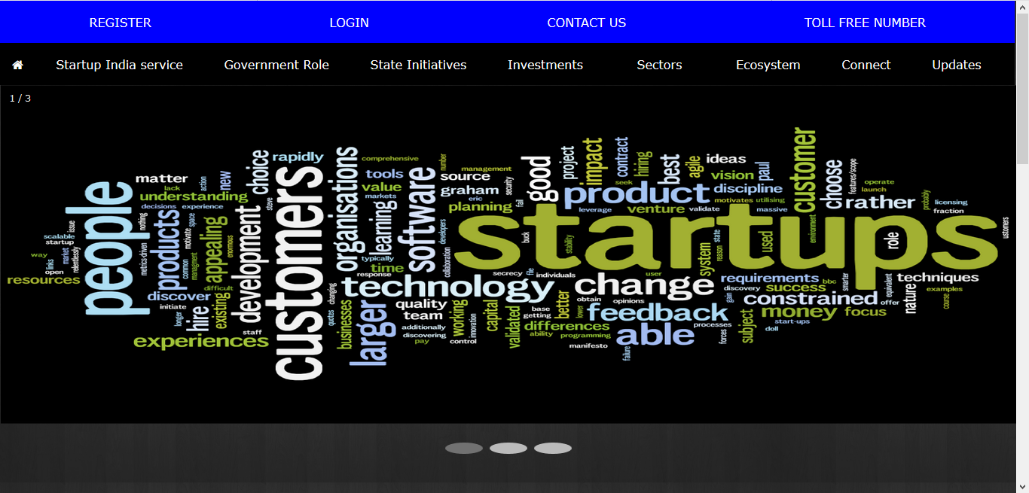
Front PAge

Slide 4
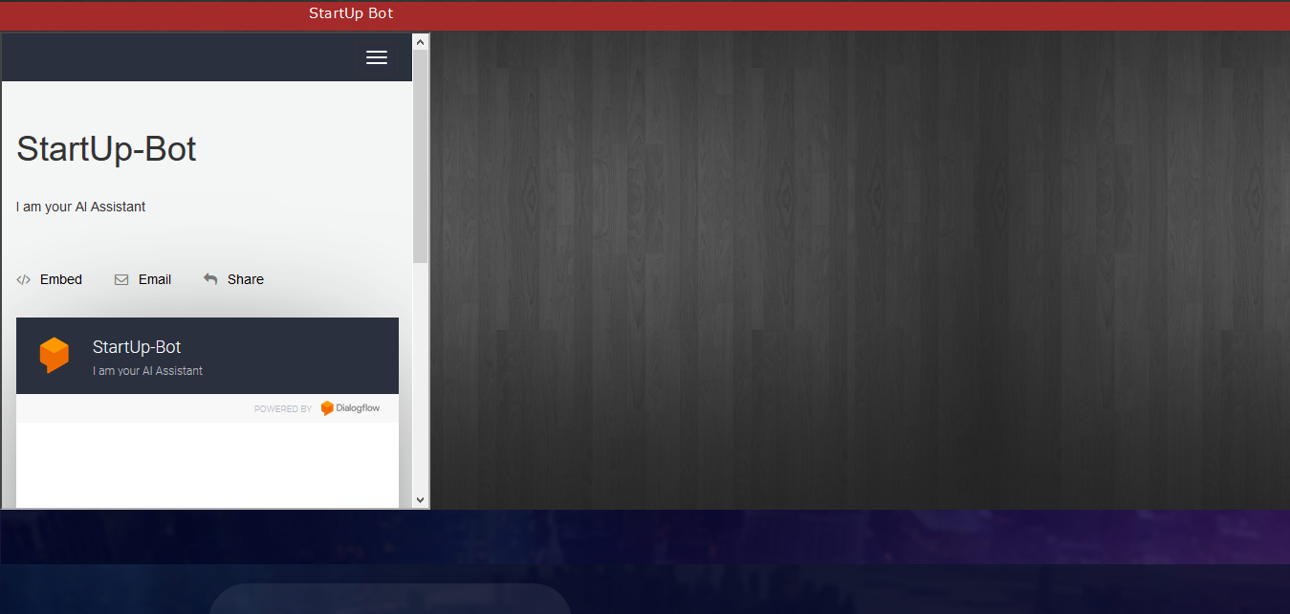
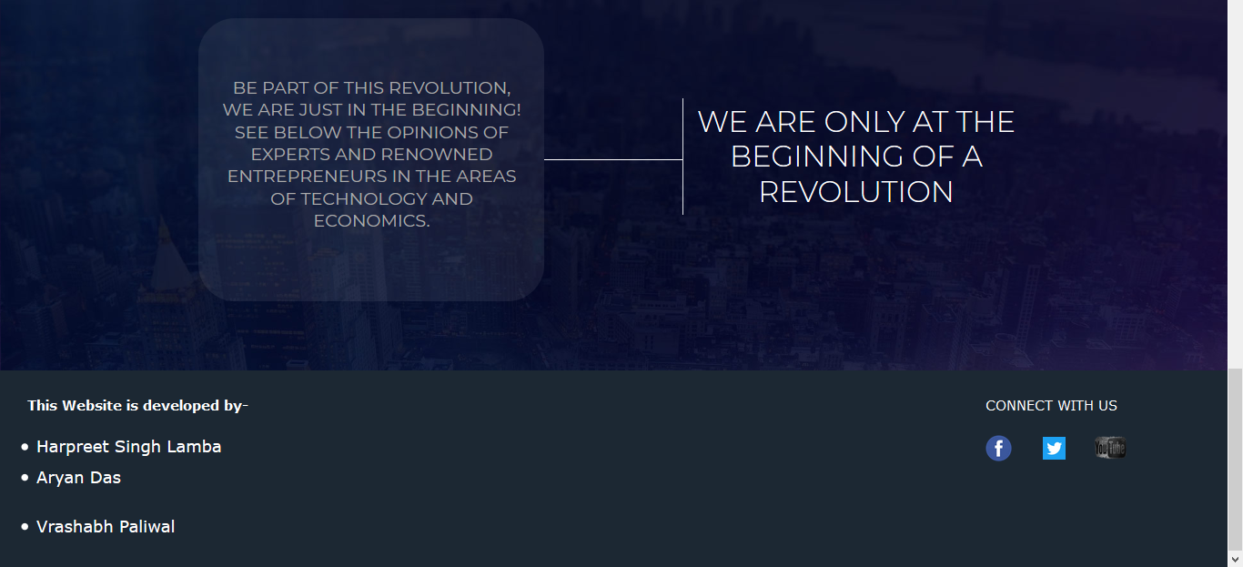

Slide 5
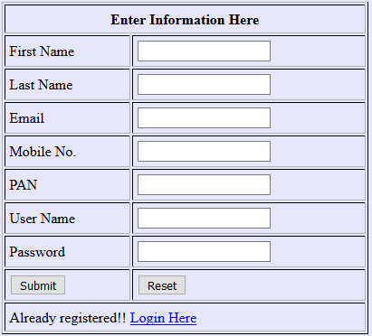
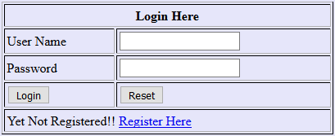
Registration and Login Form using database connectivity

Slide 6
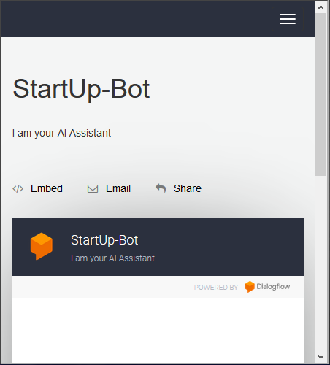
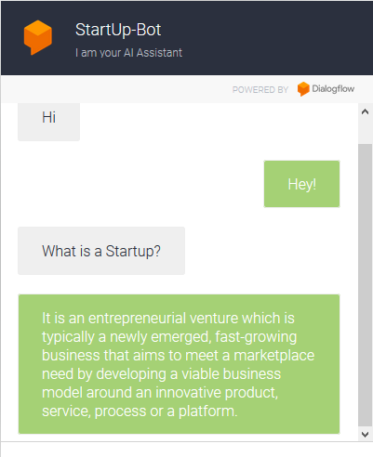
Artificial Intelligence bot

Slide 7
Open Main.html to start the website

Slide 8
Conclusion

